Slide 1
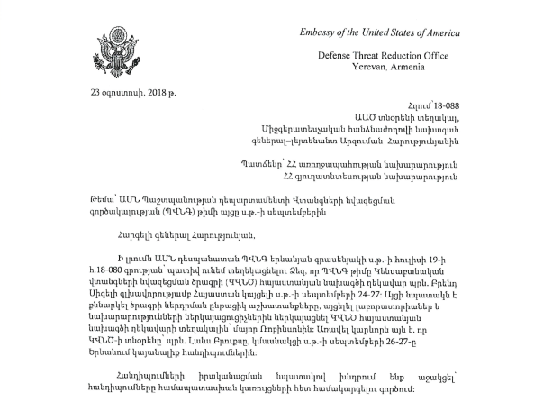
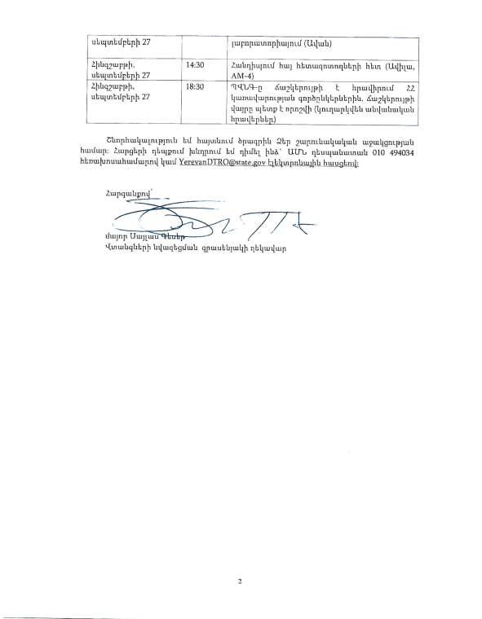
August 23, 2018
To the Deputy of the National Security Service of Armenia
To the Lieutenant General
Arzuman Harutyunyan
A group of U.S. military officers from the U.S. Defense Threat Reduction Agency (DTRA) is scheduled to visit to discuss a joint project to reduce the biological threat in Armenia.
Director of the Permanent Mission of the U.S. Defense Threat Reduction Agency in Armenia, U.S. Air Force Major Silas W. Glassert 2

Slide 2
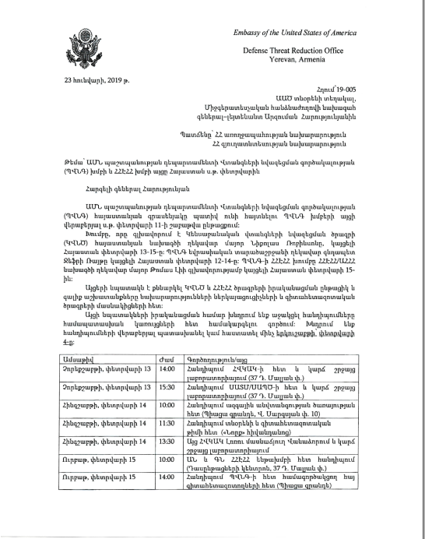
January 23, 2019
To the Deputy of the National Security Service of Armenia
To the Lieutenant General
Arzuman Harutyunyan
A group of U.S. military officers from the Defense Threat Reduction Agency is scheduled to visit to discuss the deployment of an Integrated Electronic Disease Control System.
Schedule of events

Slide 3
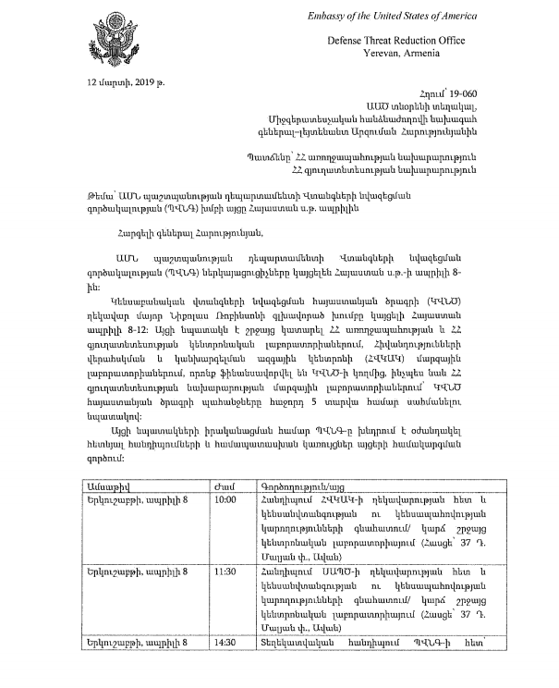
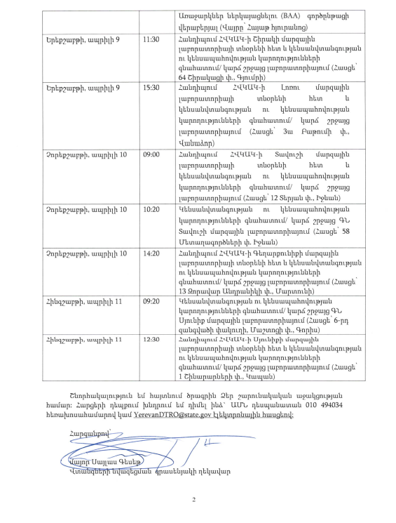
March 12, 2019
To the Deputy of the National Security Service of Armenia
To the Lieutenant General
Arzuman Harutyunyan
Copies to the Minister of Health and the Minister of Agriculture of Armenia
A group of US Armed Forces officers from DTRA is scheduled to visit the laboratory in Marts, funded by the agency. Special attention will be paid to discussing the budget for the next five years.
Schedule of events
Director of the Permanent Mission of the U.S. Defense Threat Reduction Agency in Armenia, U.S. Air Force Major Silas W. Glassert 2

Slide 4
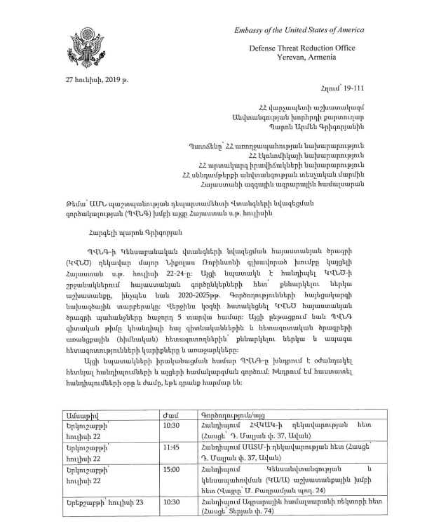
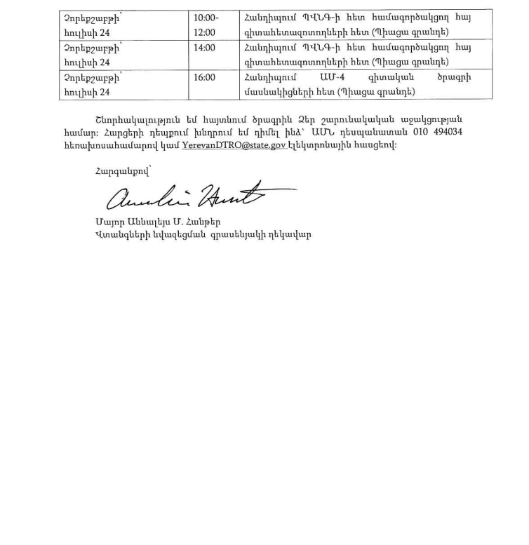
June 27, 2019
Secretary of the Security Council Armen Grigoryan
Copies to the Ministers of Health, Agriculture, Economy, and Emergency Situations of Armenia.
A visit of the DTRA delegation is planned to jointly develop a variant of the Concept of Operations to counter threats of particularly dangerous pathogens in Armenia for 2020-2025.
Schedule of events
Air Force Major A. Hunter, Director of the Permanent Mission of the US Defense Threat Reduction Agency in Armenia

Slide 5
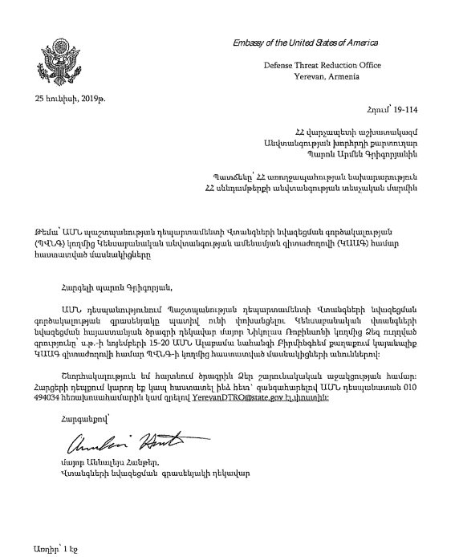
June 25, 2019
To the Secretary of the Security Council
To Armen Grigoryan
Approval is needed for the Armenian side to attend the annual conference under the auspices of the Defense Threat Reduction Agency in Birmingham, Alabama, USA to discuss further steps to implement joint programs.
Air Force Major A. Hunter, Director of the Permanent Mission of the US Defense Threat Reduction Agency in Armenia

Slide 6
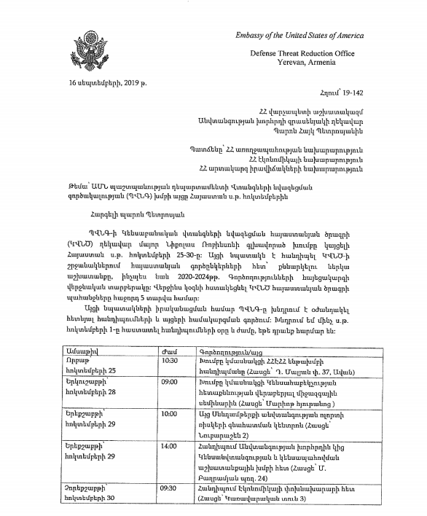
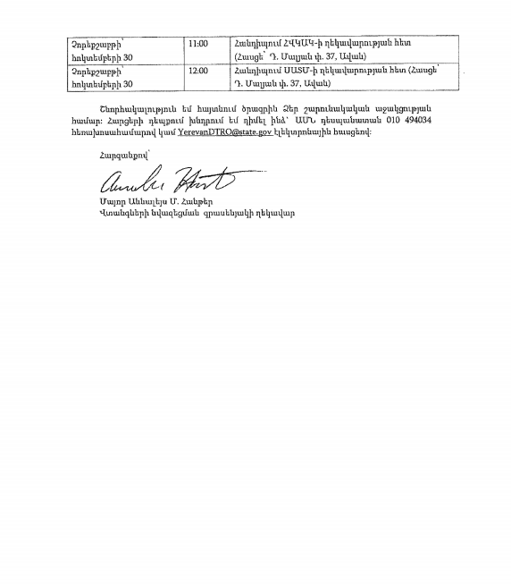
September 16, 2019
Head of the Office of the Security Council H.To Petrosyan
Copies to the Ministers of Health, Agriculture, Economy, and Emergency Situations of Armenia.
A delegation from the US Defense Threat Reduction Agency is scheduled to visit Armenia to approve the final version of the Concept of Operations for Countering the Threats of Particularly Dangerous Pathogens in 2020-2025.
Air Force Major A. Hunter, Director of the Permanent Mission of the US Defense Threat Reduction Agency in Armenia

Slide 7
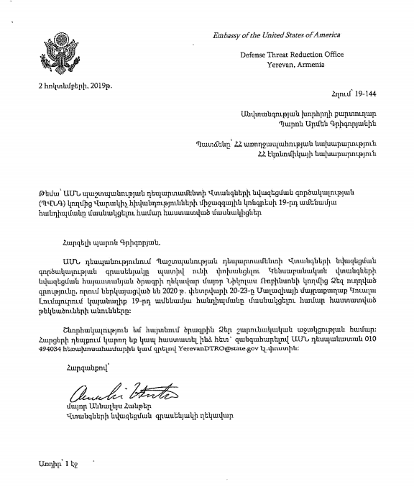
October 2, 2019
To the Secretary of the Security Council
To Armen Grigoryan
Approval is needed for the Armenian side to attend the annual conference under the auspices of the Defense Threat Reduction Agency in Kuala Lumpur, Malaysia in February 2020.
Air Force Major A. Hunter, Director of the Permanent Mission of the US Defense Threat Reduction Agency in Armenia

Slide 8
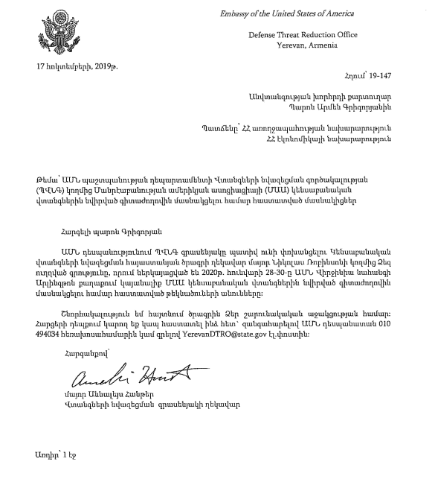
October 17th, 2019
To the Secretary of the Security Council
To Armen Grigoryan
Approval is needed for the Armenian side to attend the conference of the American Association of Microbiologists within the framework of joint projects on training specialists through the US Defense Threat Reduction Agency in Arlington,
Virginia in January 2020.

Slide 9
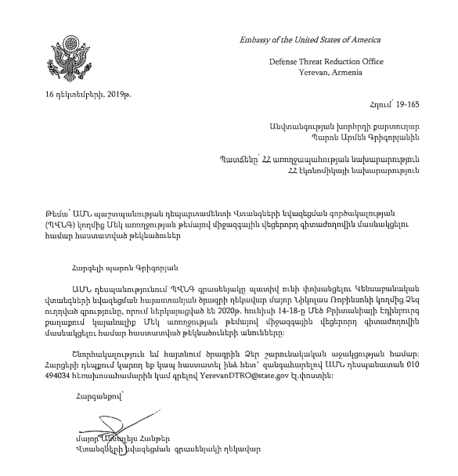
December 16, 2019
To the Secretary of the Security Council
To Armen Grigoryan
I ask you to ensure that candidates from the Armenian side (Appendix) attend the Sixth World Health Congress in Edinburgh, Great Britain in June 2020 as part of the delegation of the US Defense Threat Reduction Agency.
Air Force Major A. Hunter, Director of the Permanent Mission of the US Defense Threat Reduction Agency in Armenia

Slide 10
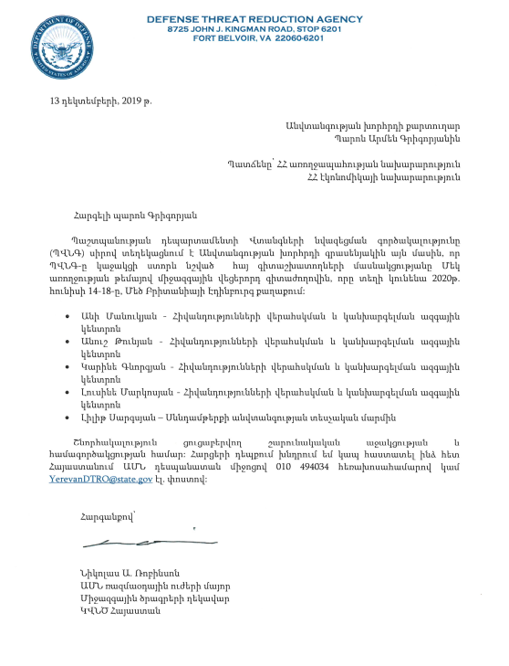
December 13, 2019
To the Secretary of the Security Council
To Armen Grigoryan
Ani Manukyan, Anush Tunyan, Karin Gevorgyan, Luzin Markusyan – National Center for Disease Control of Armenia;
Lilit Sargisyan is the Quality Compliance Inspectorate (an analog of Rospotrebnadzor in Armenia).
International Relations Manager
U.S. Defense Threat Reduction Agency
Air Force Major Nicholas A. Robinson

