Slide 1
HCV Elimination in Georgia: developing an evidence-based Elimination Plan
Juliette Morgan MD
Country Director
CDC South Caucasus
Notes:
Good afternoon all, thanks for coming to hear about this amazing story unfolding in Georgia on Hep C.
I am Juliette Morgan, I am the CDC Country Director of the South Caucasus Office in Tbilisi Georgia

Slide 2
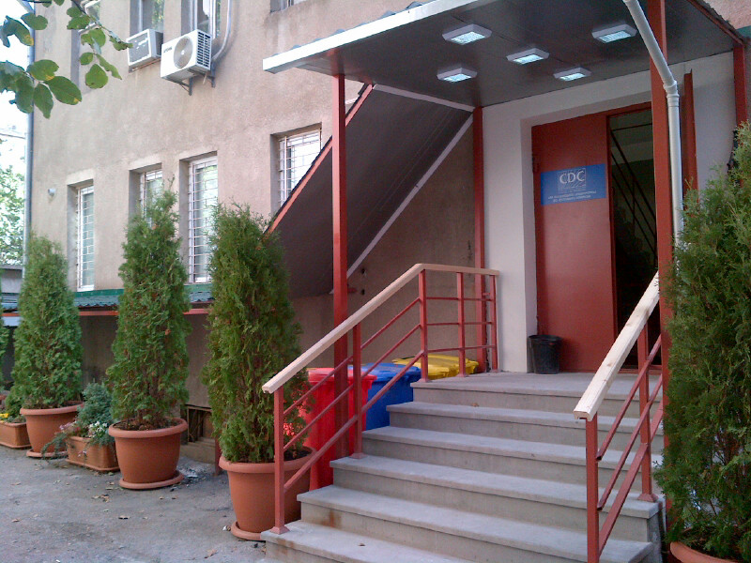
CDC South Caucasus, Tbilisi Georgia
Notes:
It is through my office that a lot of CDC support gets coordinated, we are located in the Georgian NCDC campus and we work closely with NCDC on Hep C and other public health matters. and I have been fortunate to be involved in this elimination project since the very day we dared to mention the “E” word.

Slide 3
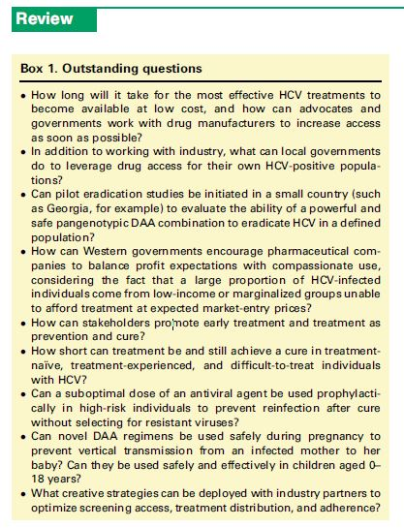
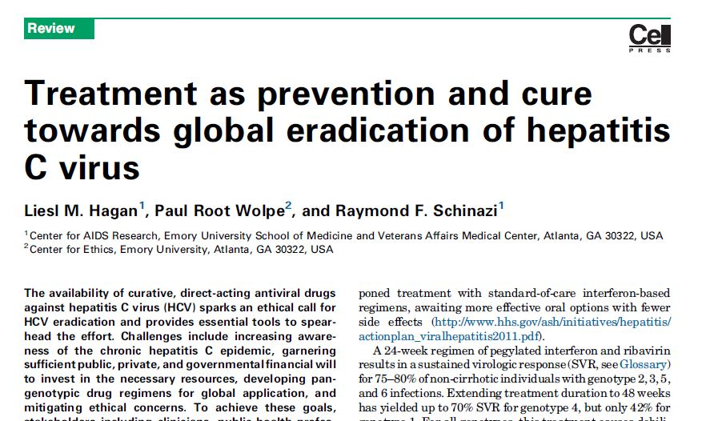
Before WHO Strategy and Glasgow Declaration
Notes:
And speaking of the elimination, when Georgia started using this word and started floating the concept of elimination, there was no Global Strategy for Elimination or Glasgow Declaration encouraging countries to get plans together for elimination Charles Gore and Gottffired Hirnschall this morning. I want to highlight this article by Liesl Hagan and Ray Schinazi, because it inspired CDC and NCDC to dream and to dream big. With this inspiration we worked to first get support within Georgia, the clinicians, the patient advocates, and of course the government and then we went out, specifically to the EASL in London 2014 and pitched it to the pharmaceutical companies who were just starting to launch the DAAs and the rest is history.

Slide 4


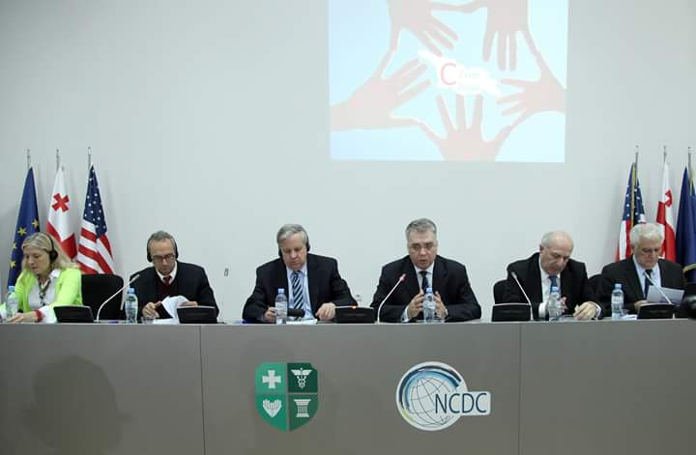
3rd National Hepatitis C Elimination Workshop, Tbilisi Georgia
Notes:
So, my presentation today will present to you today some of the key discussions and outcomes of the third Wokrshop on HCV elimination to generate some good discussion here that will help us finalize an elimination plan that will make Georgia’s ambitious goal achievable. We believe we have all the tools, but also as was mentioned this morning from Charles Gore, this is massive and we don’t have a lot of experience doing this. What we do have however, are the lessons learned from phase 1, we have the results of the sero survey, we have modelling to input into the WHO strategic framwork outline.

Slide 5
Lessons learned: elements necessary for HCV Elimination
Political environment
Policies and plans needed
Finances
Health information systems
Current epidemiologic data (target populations, risk factors for transmission, morbidity, mortality, incidence, prevalence etc.)
Notes:
This doesn’t do justice to all of the presentations given at the workshop but I believe that this is a good list of the areas where we identified challenges that need to be addressed to achieve the elimination goals. I will review these issues in these areas very briefly

Slide 6
Lessons learned: elements necessary for HCV Elimination
Diagnostic/screening capacity
Treatment and care capacity
Prevention capacity (infection control, harm reduction, safe blood)
Communication
Surveillance, monitoring and evaluation
Research

Slide 7
The Elements Necessary for HCV Elimination in Georgia
Political environment
Policies and plans needed
Finances
Current epidemiologic data (target populations, risk factors for transmission, morbidity, mortality, incidence, prevalence etc.)

Slide 8
Political environment
Commitment by Georgian government is unquestionable and commendable
Commitment by service providers and patient advocates
Commitment by partners
Difficult issues that need to be addressed in the political arena in Georgia:
  Drug use decriminalization
  Enforcement of Quality Regulations on private entities
    Laboratories
    Blood banks
    Clinics
Notes:
There is no question in my mind that this elimination program and particularly the rapid implementation of the program would not be possible anywhere in the world but in Georgia. Some of the characteristics of why Georgia is the ideal place to do this were previously listed by Dr. Amiran this morning and while all of them are true, probably the most important factor has been that government is extraordinarily committed to this.
But also, so are the other stakeholders in this endevour and I would like to highlight this as well. Without out the clinicians doing their tremendous work and without the patient advocates pushing on all the issues that are obstacles to them, this wouldn’t be possible either.
The hard questions that the government needs to deal with are hard political questions but they need to be discussed in the context of elimination.

Slide 9
The Elements Necessary for HCV Elimination in Georgia
Political environment
Policies and plans needed
Finances
Current epidemiologic data (target populations, risk factors for transmission, morbidity, mortality, incidence, prevalence etc.)

Slide 10
Policies needed
Drug policies:
  Decriminalization of injection drug use and possession
  Needle exchange/harm reduction
Regulation of “deregulated” private entities
  Quality control of laboratories, clinical services
  Blood safety
  Infection Control in health care and non-health care settings (tattoo, beauty salons, dentist etc)

Slide 11
Plans needed
Elimination Plan
  Global Strategy for Elimination framework + Evidence from sero-survey + Lessons learned from Phase 1 + modelling = Concrete but flexible Plan
    who to treat with ~30,000 treatments/year in each region/city
    Identified by targeted screening (find “transmitters”) and
    while implementing the prevention measures and improving lab quality, expanding provider services, harm reduction, infection etc
Notes:
This is essentially the slide that responds to the title of my presentation. You will see as we move through my presentation that there is overlap in many of the needs.

Slide 12
Combination interventions and targeted treatment on Incidence and Prevalence
INCIDENCE IMPACT
Targeted treatment plus HR increases impact:
  Large benefit targeting PWID and HR
  Crucial for elimination
  Reduce treatments
  needed
Elimination target
Data from Peter Vickerman and Hannah Woodall
Targeted scenario assumes PWID infections have twice chance of treatment as non-PWID
Notes:
This is the most powerful slide from Peter Vickerman’s modelling and I want to highlight it as I think we must take these calculations into account if we want to achieve the goals laid out for 2020 and especially as the implications are very important for directing the elimination plan.
The baseline incidence calculation came from fitting the model to the ‘stable’ HCV prevalence in PWID and non-PWID while accounting for average life expectancy and duration of injecting - the model projected the HCV incidence must be about 0.24 per 100 person years.
it can double the impact achieved as shown by the black arrow, and by 2020 results in much lower incidence than if PWID had not been treated and harm reduction (HR) had not been scaled up. It also results in achieving the elimination target which isn’t achieved otherwise. For prevalence, little added impact is achieved from targeting and adding harm reduction (HR), but if treatment is not maintained after 2020 then prevalence and incidence will stay low if HR had been scaled up and treatments had been targeted to PWID, BUT if HR had not been scaled up and treatment hadn’t reached PWID then prevalence and incidence both start increasing again and quite quickly for incidence.
SO the main message is - scaling up harm reduction and targeting treatment to PWID is crucial for achieving elimination on HCV incidence, and for maintaining this impact in future years after the mass treatment campaign.

Slide 13
Plans needed
Screening guidelines: targeted testing based on results of sero survey and other evidence (demographic groups: i.e men between 30 and 50 years old)
Treatment and monitoring guidelines
  New diagnostic and monitoring approaches (decrease government costs)?
Monitoring and evaluation framework
  To measure impact
  To assess progress and re-orient efforts as needed
Research agenda
Notes:
In addition to the overarching elimination plan, specific plans for screening should be developed.
Such as the screening. This is an area we will touch on again later, but briefly, with targeted screening that focuses on an age group for example and no the specific risk factor, you will probably get more bang for your buck, as Francisco demonstrated in his presentation that showed the outcome of the screening among different populations.

Slide 14
The Elements Necessary for HCV Elimination in Georgia
Political environment
Policies and plans needed
Finances
Health information systems
Current epidemiologic data (target populations, risk factors for transmission, morbidity, mortality, incidence, prevalence etc.)

Slide 15
Finances
Patient out-of-pocket co-payments (can there be standardization)?
Provider administrative expenses: reimburse providers?
Reallocation of government funding by subsidizing less costly laboratory testing?
Notes:
My colleagues from Georgia, particularly the patient advocates can speak better to the financial elements that represent barriers to access to treatment but this area, finances, again represents a hard discussion the government needs to address.
I would suggest that in all of these discussions the cost effectiveness of the eliminating HCV in Georgia be taken into account especially in preventing costly treatments that come along with advanced liver diseases that will be averted by treated all georgians that are infected and thefore avoid later sequelae.

Slide 16
The Elements Necessary for HCV Elimination in Georgia
Political environment
Policies and plans needed
Finances
Health information systems
Current epidemiologic data (target populations, risk factors for transmission, morbidity, mortality, incidence, prevalence etc.)

Slide 17
Health information systems
Phase 1 database and information system not adequate for Phase 2: need “new STOP C”
Stakeholder input is on-going; needs time and resources for system capable of responding to the demand of meticulously documenting this program
New STOP C needs to
  capture data necessary to calculate indicators to measure process, outputs, outcome and impact
  Link screened persons to care

Slide 18
The Elements Necessary for HCV Elimination in Georgia
Political environment
Policies and plans needed
Finances
Health information systems
Current epidemiologic data (target populations, risk factors for transmission, morbidity, mortality, incidence, prevalence etc.)

Slide 19
Current epidemiologic data
Sero-survey results to guide
  Screening and linking to care
  Allocation of yearly treatments available in Georgia
    based on burden of disease (geographically)
    based on “transmitter” potential (from risk factor information)
    Disease stage (need more info on this) to impact mortality
  Prevention interventions
    Harm reduction
    Blood safety
    Infection Control

Slide 20
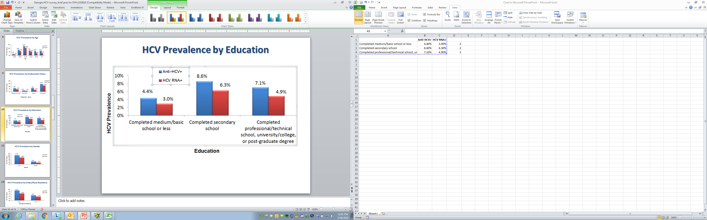

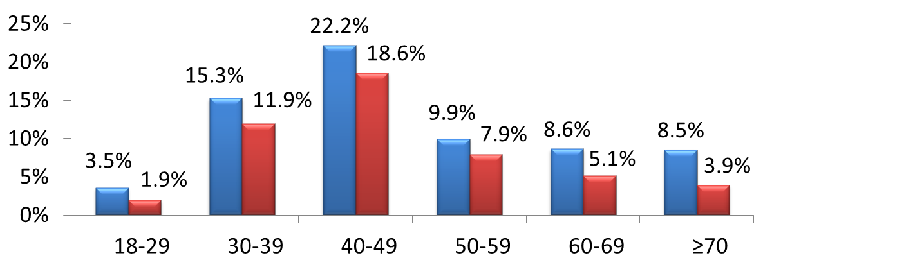
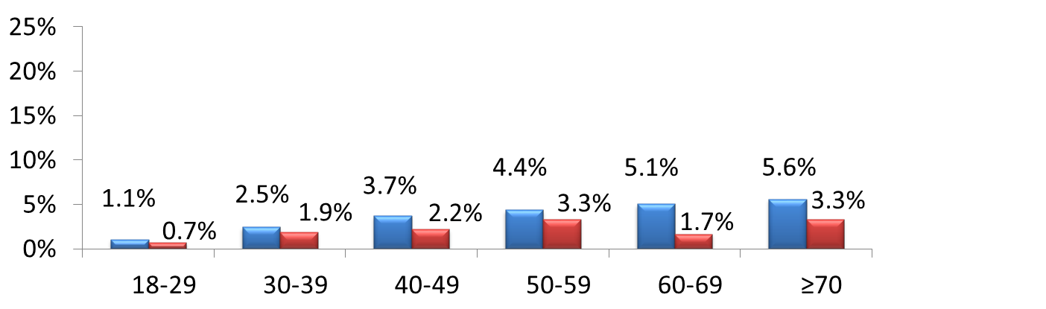
HCV Prevalence by Age and Gender
HCV Prevalence
Females
(n=3,662)
Screen men between ages 30 – 50
Males
(n=2,334)
National Center for Disease Control & Public Health
www.ncdc.ge
Notes:
So, this goes back to the screening plans that are needed: based on our results from the sero survey, roughly 1 in 5 adult males in Georgia is infected. By targeting this age group for screening you will pick up the bulk of the infections quickly. Of course they then need to be linked to care,

Slide 21
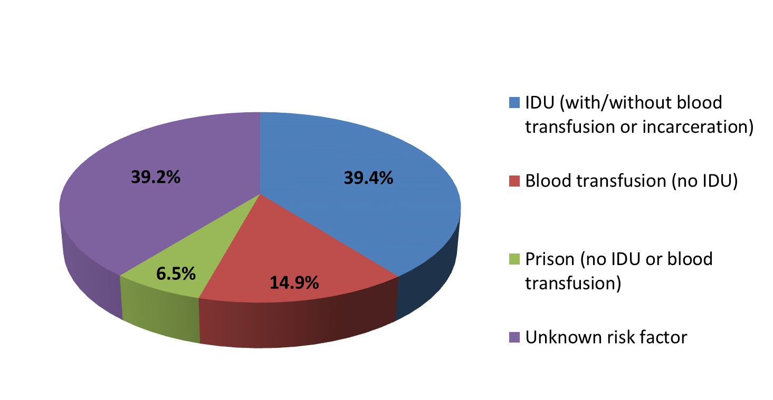
  % Anti-HCV+ with Risk Factors
  Significant in Multivariable Analysis
39.2% of those anti-HCV+ do not report one of the risk factors that were significant in multivariable analysis
Infection control? More research
Blood transfusions are still a problem, low hanging fruit for prevention interventions
National Center for Disease Control & Public Health
www.ncdc.ge

Slide 22
The Elements Necessary for HCV Elimination in Georgia
Diagnostic/screening capacity
Treatment and care capacity
Prevention capacity (infection control, harm reduction, safe blood)
Communication
Surveillance, monitoring and evaluation
Research

Slide 23
Diagnostic/screening capacity
Go beyond risk factor (i.e. IVDU) to broad target (men between 30 – 50) for screening
Screen at NSP and OST sites
LINK TO CARE
Screening and confirmatory testing with novel approach (Core Atg)
  Introduce dried blood spots
  Centralize confirmatory testing while decentralizing specimen collection
Notes:
So we just saw how the sero survey results give us direction for screening, you talked about this example

Slide 24
The Elements Necessary for HCV Elimination in Georgia
Diagnostic/screening capacity
Treatment and care capacity
Prevention capacity (infection control, harm reduction, safe blood)
Communication (with public and stakeholders)
Surveillance, monitoring and evaluation
Research

Slide 25
Treatment and care capacity
  Expand pool of providers to improve access
    Train more of >600 service providers (ID or GI Drs)
    Train primary care Drs?
    Treatment at NSP/OST centers?
Notes:
We know the number of current health care providers in Georgia that are “allowed” to treat HCV infected patients in Georgia but in phase 1 we saw only about a sixth of those involved in the care of the 7000 patients. We could estimate how many providers are needed to be able to treat 30000 patients a year necessary to achieve the target of elimination by 2020 with ~30 000 treatments a year.
And then train them.
In other countries, care is decentralized from the highly specialized physician to primary care doctors and nurses. And if this were possible then diagnosis and treatment could potentially be done in settings like NSP and OST centers.
This is something that also may need to be discussed i

Slide 26
The Elements Necessary for HCV Elimination in Georgia
Diagnostic/screening capacity
Treatment and care capacity
Prevention capacity (infection control, harm reduction, safe blood)
Communication
Surveillance, monitoring and evaluation
Research

Slide 27
Prevention capacity (infection control, harm reduction, safe blood)
Infection Control:
  Weak
  Needs policies and plans (on going)
  More research to better understand
Harm reduction:
  Can not underestimate importance
  Policies
  Partnerships
Notes:
The infection control issues are great, would require a presentation on its own but mostly I think here we need better understanding of what is going on, how much of the 39% of the risk factor pie comes from this for example.
The same for HR, we heard from our colleague Margaret Hellard when she presented in Tbilisi on her program in Australia and

Slide 28


Slide 29
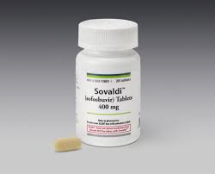
You have to treat people who inject drugs !!!

Slide 30
Safe Blood
Problems:
  70% blood donation centers are for profit
  Most blood donors are paid
  Limited regulatory oversight for quality
What needs to get done is know, overcoming the challenges is the issue

Slide 31
The Elements Necessary for HCV Elimination in Georgia
Diagnostic/screening capacity
Treatment and care capacity
Prevention capacity (infection control, harm reduction, safe blood)
Communication
Surveillance, monitoring and evaluation
Research

Slide 32
Communication
With public:
  Awareness
  De-stigmatization
With Stakeholders
  Internal
  Partnerships

Slide 33
The Elements Necessary for HCV Elimination in Georgia
Diagnostic/screening capacity
Treatment and care capacity
Prevention capacity (infection control, harm reduction, safe blood)
Communication
Surveillance, monitoring and evaluation
Research

Slide 34
Surveillance, monitoring and evaluation
Intersectoral working group coordinated by NCDC
Financial estimations
Surveillance
Laboratory
Infection control
Safe Blood
Communi-cation
Harm reduction
HCV screening, treatment and care
Monitoring and Evaluation
What to measure, how to measure, why to measure
Notes:
I took Dr. Amiran’s graph that demonstrates the areas included in the elimination plan draft and for the workshop we essentially broke into working groups and asked the groups to take a step back and think what were the questions for which the answers would provide whether or not the activities being done in each of these areas where successful and if they weren’t, why not? So, to prove and improve
The M&E plan is being developed still but the input from the workshop was excellent. Also, this is the process that is needed to develop the information system that is needed (the requirements needed for the information system).

Slide 35
The Elements Necessary for HCV Elimination in Georgia
Diagnostic/screening capacity
Treatment and care capacity
Prevention capacity (infection control, harm reduction, safe blood)
Communication
Surveillance, monitoring and evaluation
Research

Slide 36
Research
Need a body that coordinates internally and advocates for partnerships
Tremendous opportunities
  Operational
  Diagnostic
  Clinical

Slide 37
Summary
We have the tools
We have the commitment
We have the evidence
  Global Strategy for Elimination framework + Evidence from sero-survey + Lessons learned from Phase 1 + modelling = Plan

Slide 38
Didi Madlova!

Slide 39
Main Directions
Establish a lead agency responsible for supervision of blood transfusion practice;
Legislation for licensing requirements for modern standards and for effective suspension or/and revocation of blood production practice license;
Ensure transition from profit based management of blood establishments to nonprofit legal status;
Establish centralized TTI capacities;
Introduce pooled Nucleic Acid Testing (NAT) or other sensitive tests for centralized TTI testing;

Slide 40
Main Directions
Develop guidelines for donor selection and blood testing;
Develop QMS based on GMP and ISO principles;
Regulation for mandatory participation of all blood banks in National Blood Registry;
Mobile units and voluntary donor recruitment
Intensive educational and awareness raising campaigns.

Slide 41
HR and targeting PWID VERY important for maintaining impact
HCV incidence
HCV prevalence
Mass treatment stops
Mass treatment stops
Elimination target
-Rebound if no HR scale up and no targeting PWID
-Impact maintained if HR scaled up and PWID targeted

