Slide 1

Georgia HCV Elimination 1st Scientific Committee Meeting 31 August 2016
Muazzam Nasrullah, MD, MPH, PhD
Francisco Averhoff, MD, MPH
Division of Viral Hepatitis (DVH)
Centers for Disease Control and Prevention
National Center for HIV/AIDS, Viral Hepatitis, STD, and TB Prevention
Division of Viral Hepatitis

Slide 2
Documenting HCV Elimination in Georgia is a Program Priority
Why? Worlds first HCV elimination program, serves as a model for the world
Answer critical questions
Document lessons learned
What worked well
What presented challenges
Document Success: was the elimination achieved?

Slide 3
Documenting HCV Elimination
Monitoring &
Evaluation
Surveillance
Research

Slide 4
Opportunities for Documentation (data already available)
STOP-C, Elimination-C (observational)
Population Seroprevalence Survey
Other?

Slide 5
Need for Coordination
Why?
Critical to document worlds’ first elimination program accurately
Avoid duplication and wasted efforts; resources limited
Ensure that only high quality information/findings are disseminated/published
Ensure access to quality data for stakeholders
Coordinate research activities
Transparency; ensure scientific integrity

Slide 6
How do we coordinate efforts?
Establish Transparent Governance Structure
Example: Scientific Committee for Research, Surveillance and Evaluation (GOG & CDC)
Engage/recruit stakeholders
Academic institutions/researchers
Clinicians
NGOs
Develop and prioritize (research) agenda
Obtain resources for conducting priority activities

Slide 7
Scientific Committee

Slide 8
Objectives
Coordination of scientific agenda between stakeholders in Georgia HCV elimination program
Assist stakeholders, conduct analysis and dissemination of research

Slide 9
Stakeholders (proposed)
MoLHSA
NCDC
Infectious Diseases, AIDS and Clinical Immunology Research Center
Clinic “Hepa”
Clinic “Neolab”
Mrcheveli
CDC
Others?

Slide 10
Benefits of Scientific Committee
Maintain clean and up-to-date databases
Treatment database (STOP-C, Elimination-C)
2015 Serosurvey
Screening database (proposed)
Others
Maintain protocols, data dictionary, questionnaire etc.
Review and approve study proposals
Support of approved proposals
Study implementation and data collection
Data analysis
Manuscript writing

Slide 11
Members (proposed)
Co-chairs
CDC: Francisco Averhoff*
NCDC: Amiran Gamkrelidze
Members
MoLHSA: Irina Tskhomelidze
NCDC: Paata Imndaze, Maia Tsereteli, Davit Baliashvili
Infectious Diseases, AIDS and Clinical Immunology Research Center: Nikoloz Chkhartishvili
Clinic “Hepa”: Tengiz Tsertsvadze
Clinic “Neolab”: Giorgi Kamkamidze
Mrcheveli: Jaba Zarkua
CDC: Muazzam Nasrullah, Lia Gvinjilia, Juliette Morgan*
Special presenters for research proposal: Invited by one of the members of committee
* Will share co-chair responsibilities for CDC, depending on availability

Slide 12
Staffing (proposed)
Scientific research coordinator: either from CDC or NCDC
Data cleaning and programmer: one each from CDC and MoLHSA / NCDC
Data analyst/Epidemiologist one each from CDC and MoLHSA / NCDC
Statistician: CDC, Atlanta

Slide 13
FLOW DIAGRAM of protocol for submitting a research proposal (for STOP-C/Serosurvey/Special studies)
Research proposal concept sheet
Scientific committee
Approval / Rejection
Writing group formation
Analysis discussion
Table shells
Manuscript writing
Finalize tables
Data analyst
Finalize table shells
Writing group re-discussion

Slide 14
FLOW DIAGRAM of protocol for submitting a research proposal (for STOP-C/Serosurvey/Special studies)
Research proposal concept sheet
Members of Scientific Committee or outside investigators as approved by the Scientific Committee may submit proposals

Slide 15
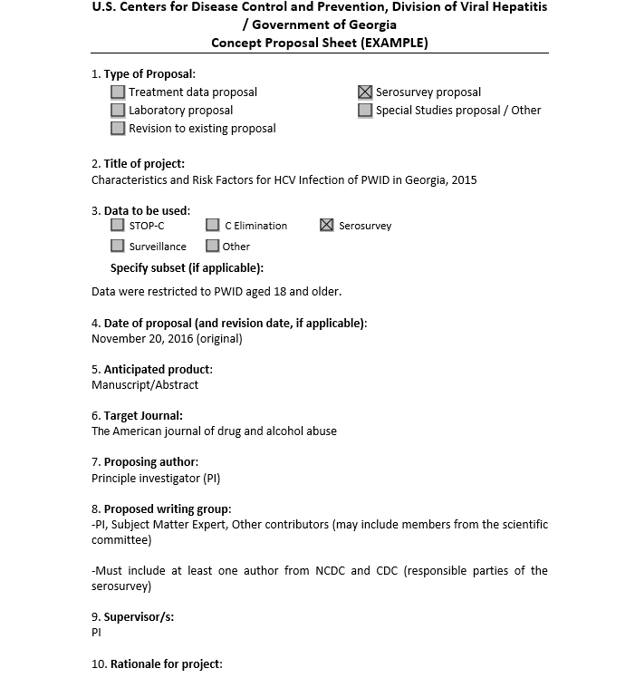

Slide 25
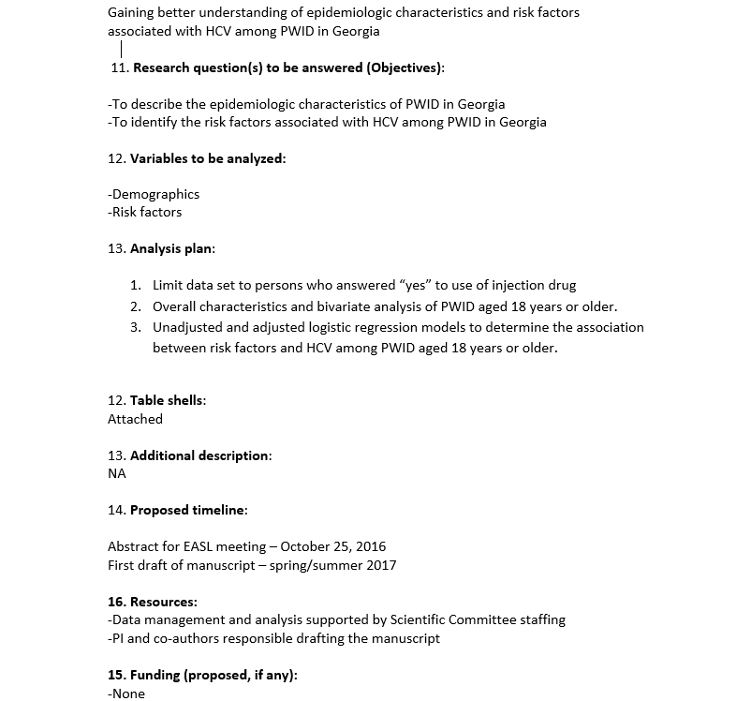

Slide 32
FLOW DIAGRAM of protocol for submitting a research proposal (for STOP-C/Serosurvey/Special studies)
Scientific Committee
Approval / Reject

Slide 33
FLOW DIAGRAM of protocol for submitting a research proposal (for STOP-C/Serosurvey/Special studies)
Writing group formation
Analysis discussion
Table shells

Slide 34
FLOW DIAGRAM of protocol for submitting a research proposal (for STOP-C/Serosurvey/Special studies)
Table shells
Finalize table shells
Writing group re-discussion

Slide 35
FLOW DIAGRAM of protocol for submitting a research proposal (for STOP-C/Serosurvey/Special studies)
Scientific committee
Manuscript writing
Finalize tables
Data analyst

Slide 36
Procedures
All studies that use the treatment database (i.e. STOP C and Elimination C) should include at least one author from each of 4 clinical sites (Infectious Diseases, AIDS and Clinical Immunology Research Center, Clinic “Hepa”, Clinic “Neolab”, Mrcheveli)
Individual clinics may use their own data for research studies, analysis and dissemination without involvement / authorization of the Scientific Committee
May include outside investigators as approved by the scientific committee

Slide 37
Questions in HCV Elimination
Examples
Impact of HCV treatment on morbidity and mortality?
Is HCV incidence increasing or decreasing?
Economic impact of HCV treatment on Georgia?
Effectiveness of screening and linkage to care strategies?
Importance of intra-familial and community transmission in the HCV epidemic? Does HCV transmission cluster in villages? Why?
Effectiveness of treatment strategies targeting high risk populations on transmission and prevalence?
Effectiveness of primary care providers to deliver care and treatment for HCV (vs. specialists)
Can monitoring of patients on treatment be simplified? Newer treatments (SOF/VEL)
Effectiveness ( and Cost-Effectiveness) of HCV Core-Ag (vs. Anti-HCV + PCR)?

Slide 38
Discussion / Issues
Agreement on Scientific Committee
Submission of proposals
Frequency of scientific meeting
Next meeting
Funding
Other

