Slide 1
HEALTH SYSTEM ACHIEVEMENTS AND CHALLENGES GEORGIA

Slide 2





Demographic and Socio-Economic Situation, 2016
Population – 3 719 300
Birth rate (per thousand population) – 15.2
Mortality rate (per thousand population) – 13.7
Life expectancy at birth – 72.7
Maternal Mortality (per 100000 live birth) – 22.9
Infant mortality (per 1000 live birth) – 9.0
Under 5 mortality rate (per 1000 live birth) – 10.7
GDP per capita (at current prices), (2016) – 3852 $US
GDP real growth – 2.7%
Government expenditure on health per capita – 104 $US
Government expenditure on health as % of GDP – 2.8%
Government expenditure on health as % of State Budget – 8%
Government expenditure on health as % of GDP – 3%
General Government expenditure on health per capita (USD) – 116

Slide 3
Universal Health Care – Socially Oriented Political Platform
Reforms have moved Georgia closer to universal health coverage
Unprecedented Expansion of State Budget for Health care
365 mill GEL in 2012 → 1017 Mill Gel in 2016
Launch of Universal Health Care Program in February 2013
Better access to care
Better user experience
Better financial protection

Slide 4
Health sector expenditures
Out-of-Pocket Payment as % of Total Health Expenditure, Georgia
Public Health Expenditure, Georgia
Source: Georgia NHA 2010-2016 (MoLHSA, 2017)

Slide 5

Better user experience
80.3% beneficiaries satisfied with the outpatient service and 96.4% expressed satisfaction with hospital level emergency care
Over 77% of the population notes increased financial access to outpatient and inpatient services

Slide 6
Coverage of Healthcare services
Services utilization
Hospitalization per 100 population
UHC Program has led to a major expansion in population entitlement to publicly financed health services (HUES)
Ambulatory care visits per person per years

Slide 7
Expanding benefits
I Phase - 28 February 2013 (minimum package)
- Planned ambulatory care
- Urgent outpatient and inpatient care
II Phase - July 1, 2013 (basic package)
- Planned ambulatory care
- Urgent outpatient services
- Urgent inpatient and critical are
- Elective surgical care
- Chemo-, hormone- and radiotherapy
- Maternity services
- Basic drugs for target groups
III Phase - May 1, 2017 - Service stratification according to revenue groups using “social justice approach”
- Outpatient drugs benefit for chronic conditions

Slide 8
Challenges ...
▪ Still very low public spending on health
▪ Still very high out-of-pocket payments
▪ Expenses on outpatient medications are high
▪ Service delivery model is biased towards
hospital/emergency services, and less primary care
centered
▪ Purchasing strategies are low effective at ensuring quality
and containing costs

Slide 9
Strategies adopted by Government
Georgian Healthcare System State Concept 2014-2020
Georgia Maternal & Newborn and Reproductive Health Strategy 2017-2030 and Action Plan 2017-2019
Noncommunicable diseases prevention and Control Strategy 2016-2020
Tobacco Control Strategy and Action Plan 2013-2018
Hepatitis C Elimination Strategy 2016-2020
HIV/AIDS prevention and Control Strategy 2016-2020
TB Control Strategy 2016-2018
Strategy for Containment of Antimicrobial Resistance 2016-2020
Active Ageing strategy 2017-2018

Slide 10
priority directions for the development of the healthcare sect
Health in all policies – general state multi-sectoral approach.
Development of the healthcare sector governance.
Improvement of healthcare financing system .
Development of quality medical services.
Development of human resources in the healthcare sector.
Development of health management information systems.
Support of maternal and child health.
Improvement of prevention and management of priority communicable diseases.
Improvement of prevention and control of priority non-communicable diseases.
Development of public health system

Slide 11
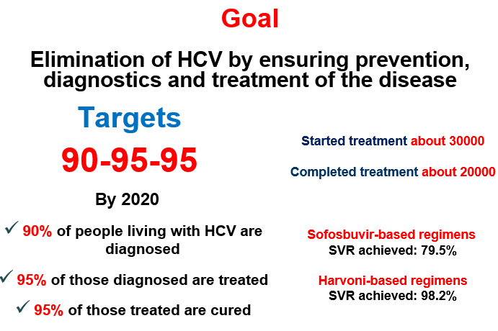
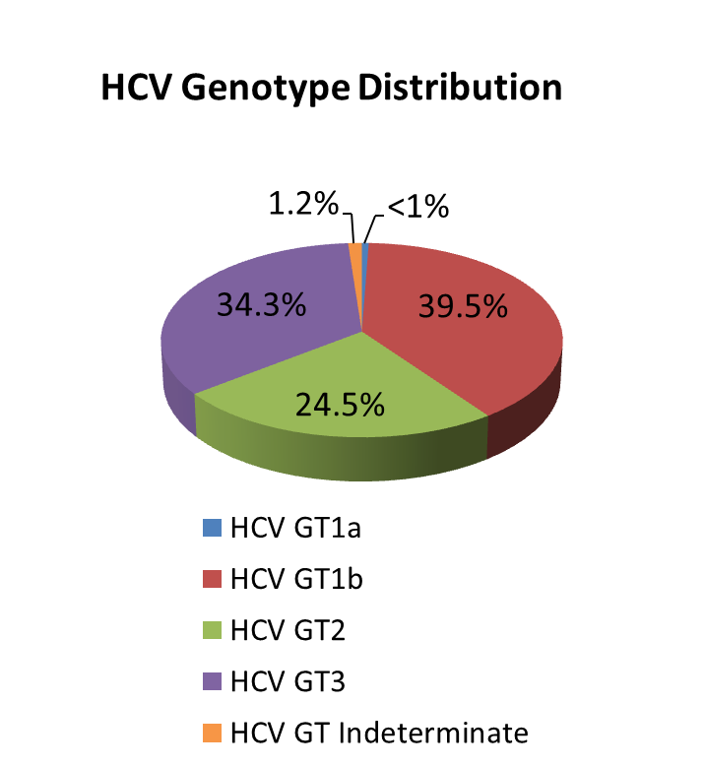
National Hepatitis C Elimination Strategy
Nationalwide survey, 2015
Anti-HCV+ | 7.7%
HCV RNA+ | 5.4%
Screened - 1,600,00
Started Treatment - 46000
Completed treatment - 41000
Sofosbuvir-based regimens
SVR achieved: 82%
Harvoni-based regimens
SVR achieved: 98%

Slide 12
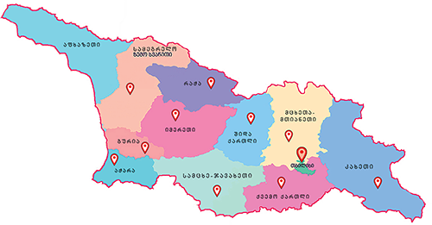
Maternal and Child Health
Georgia Maternal & Newborn and Reproductive Health Strategy 2017-2030 and Action Plan 2017-2019
Perinatal Care Regionalization - “gold” model of maternal and new born service organization
Congenital syphilis and mother-to-child transmission (MTCT) of HIV elimination plan
Universal newborn hearing screening program
Essential Nutrition Action Plan - folic acid and iron supplements for all pregnant women, breastfeeding promotion, multiple micronutrient supplementation for 6-23 months children
Under UHC program selective contracting for childbirth & C-section and neonatal intensive care services

Slide 13

Health management Information system
▪ Electronic system and regulatory mechanisms for vital events registration (since 2011)
▪ Electronic case-based reporting systems for in- and outpatients in health-care institutions (since 2014)
▪ Population-based cancer registry (since 2015)
▪ Birth registry - new electronic registration for antenatal and obstetric services and the surveillance of maternal and child health (since 2016)
▪ E-prescription (2017)
▪ Electronic health records (2017)

Slide 14
Human Resources
▪ HRH regulation and accreditation
- Medical specialties and sub-specialties aligned with EU
- Medical residency programs updated/prepared in 56
medical specialties
▪ Certification exam system revised
- New instrument for accreditation of continuous medical education
program developed
▪ Labor market analyses initiated
▪ Medical residency programs in several specialties funded by the
government

Slide 15
Future Plan
Working on:
Health system development strategy
PHC system development strategy
Mental Health system development action plan
Strategic Purchasing implementation action plan
DRG system implementation action plan

Slide 16
Thank you for your Attention!

