Slide 1
Options for a Quality Management Entity for the Republic of Georgia
Presentation to Ministry of Labor,
Health & Social Affairs
Dr. Ben Chan MD MPH MPA Consultant, World Bank
Tbilisi, Georgia, 6 March 2014

Slide 2
Quality Dimensions & Common Problems
Dimension | Major Quality Problems
Effective | Poor chronic disease management Suboptimal cancer screening, TB management
Safe | Healthcare-acquired infections, procedural complications, drug errors, injuries/falls
Accessible | Access to basic primary care
Pt-Centred | Poor communication, engagement in decisions
Efficient | Wasted resources, staff time Overuse (e.g. certain medications)
Equitable | Gaps in outcomes between rich & poor, urban/rural

Slide 3
Many “Evidence Bundles” Exist…
Diabetes – regular eye test, foot checks, labwork (A1C, cholesterol); keep BP<130/80, LDL < 2, A1C < 7; lifestyle modification / counselling / self-management
Coronary artery disease – ASA, beta-blockers, statins, ACE inhibitor, keep LDL<2, BP<140/90
Cancer screening – Pap, fecal occult blood testing, mammography
TB management – DOT protocols

Slide 4

The Evidence Gap
The lag between publication of landmark clinical trials and application in practice (to 50% use) is unnecessarily long, in the range of about 15 to 20 years.
Balas and Boren, 2000
Notes:
You can see the need for a complimentary science, that of Quality Improvement. Both are necessary, but on their own, neither is sufficient for timely implementation of best practice.

Slide 5
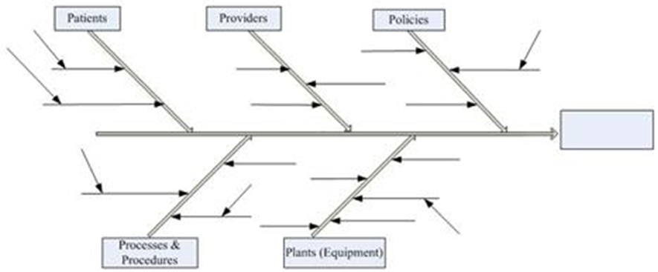
Why Are Best Practices Not Adopted? Understand Root Causes

Slide 6
Why Are Best Practices Not Adopted?
Root Cause | Changes
Providers unaware of how poor performance actually is | Measurement and feedback systems
Easy to forget, busy, too complicated, unaware of best practice | Reminder systems, clinical decision supports
Poor processes, non-standardized | Redesigned processes
Lack of skill to perform best practice, or deterioration over time | Training AND skills verification, “on-boarding”, specialized staff or team
Wrong, or lack of resources | Targeted investments
Patients unaware of their role or options, not engaged | Patient engagement – education, involvement in design
No incentive or motivation to change | Recognition, rewards, inspiring leadership, accountability, performance comp

Slide 7
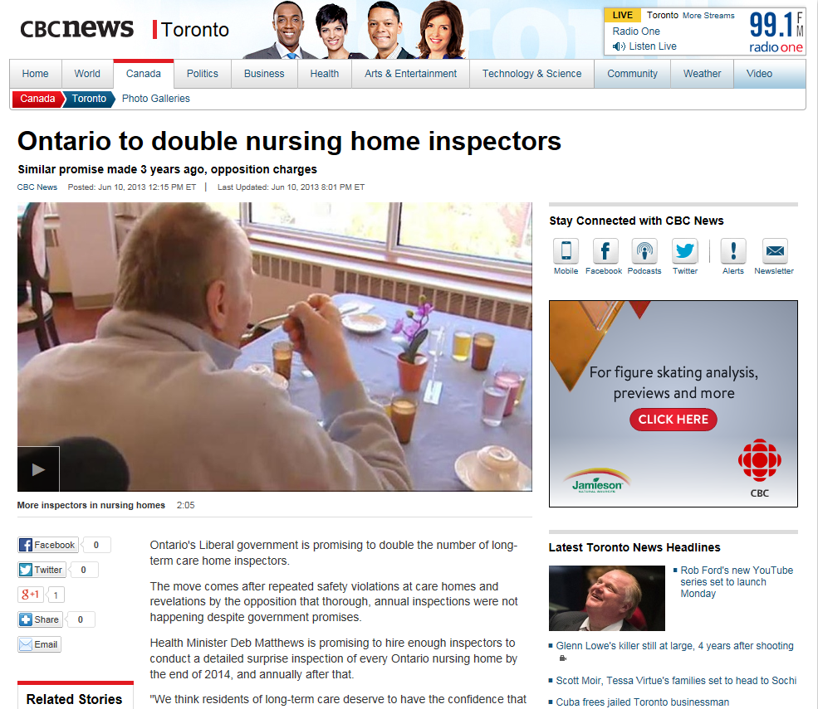
How to Improve Quality?

Slide 8
Quality Assurance
A program for the systematic monitoring and evaluation of the various aspects of a project, service, or facility to ensure that standards of quality are being met.

Slide 9
Quality Improvement
“The combined and unceasing efforts of everyone—healthcare professionals, patients and their families, researchers, payers, planners and educators—to make the changes that will lead to better patient outcomes (health), better system performance (care) and better professional development.”
Paul Batalden. What is “quality improvement” and how can it transform healthcare? Qual Saf Health Care 2007;16:2-3.

Slide 10
Different World Views
Quality Assurance | Quality Improvement
Inspect Quality | Measure, Understand Quality
Weed Out Bad Apples | Improve Everyone’s Performance
People Are Problem | Systems Are the Problem
Punish Mistakes | Motivate & Empower People to Change

Slide 11
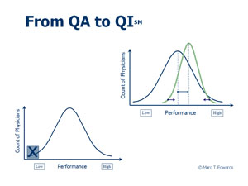
QA vs QI

Slide 12
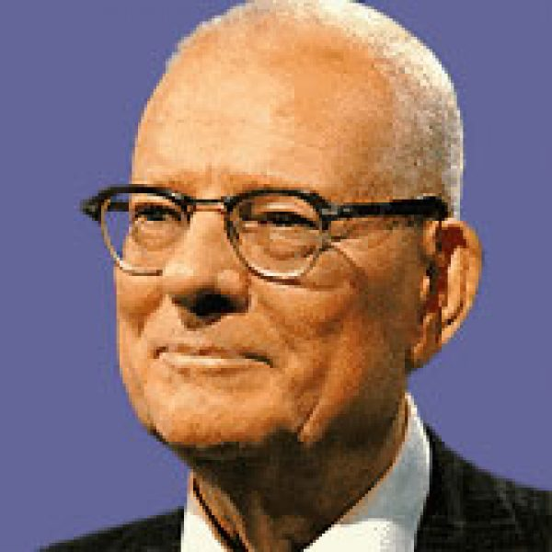
Quality Improvement Theory
Dr. W. Edwards Deming’s “System of Profound Knowledge”
Appreciation of a system
Knowledge of variation
Theory of knowledge
Knowledge of psychology

Slide 13
System of Profound Knowledge
Appreciation of a system:
understand processes & how poor handoffs, miscommunication, inconsistencies occur
Knowledge of variation:
Understand natural variations in quality, distinguish it from special causes which change quality
Theory of knowledge:
Develop theories of why quality is poor; test theories, act on the knowledge you’ve gained
Knowledge of psychology:
understand human nature – why is it hard to change behavior, & what can we do about it?

Slide 14
Understanding Processes
Steps 2010 Survey: 34% of adults with hypertension, 61% of patients with HBP not on appropriate treatment
Patient Makes Appointment
Arrives at Doc’s office
Has BP taken and is high
Doctor notes high BP, adds / changes drugs
Patient told to return to clinic in 3 months
Patient fills prescriptions
What could go wrong?

Slide 15
Understanding Processes
MD unaware of guidelines, forgets to order Rx
Pt forgets to fill Rx, mis-understands directions
Pt forgets to make apptmt
Pt can’t make it, no-show
Staff forget to take BP
Pt forgets apptmt
Patient Makes Appointment
Arrives at Doc’s office
Has BP taken and is high
Doctor notes high BP, adds / changes drugs
Patient told to return to clinic in 3 months
Patient fills prescriptions
What could go wrong?

Slide 16
Patient recall system
Flowsheet
Treatment algorithm
Logbook for patient
MD unaware of guidelines, forgets to order Rx
Pt forgets to fill Rx, mis-understands directions
Pt forgets to make apptmt
Pt can’t make it, no-show
Staff forget to take BP
Pt forgets apptmt
Patient Makes Appointment
Arrives at Doc’s office
Has BP taken and is high
Doctor notes high BP, adds / changes drugs
Patient told to return to clinic in 3 months
Patient fills prescriptions
Ideas for Improvement

Slide 17
Process Analysis Skills in Workforce
A critical strategy to fundamentally changing how care is delivered
Labor-intensive but essential
systematically map up steps in delivery of care and identify:
Bottlenecks, miscommunication, poor handoffs, non-value-added steps

Slide 18
Key Ingredients to System-Wide Quality Improvement
I - Quality Measurement
selection of key indicators
data collection
data quality assurance
Analysis
Comparisons over time
Comparisons by organization

Slide 19
Key Ingredients to System-Wide Quality Improvement
II - Public Reporting
Report by individual health care organization
If possible, identify benchmarks for performance
Key purpose: motivate managers to improve quality

Slide 20
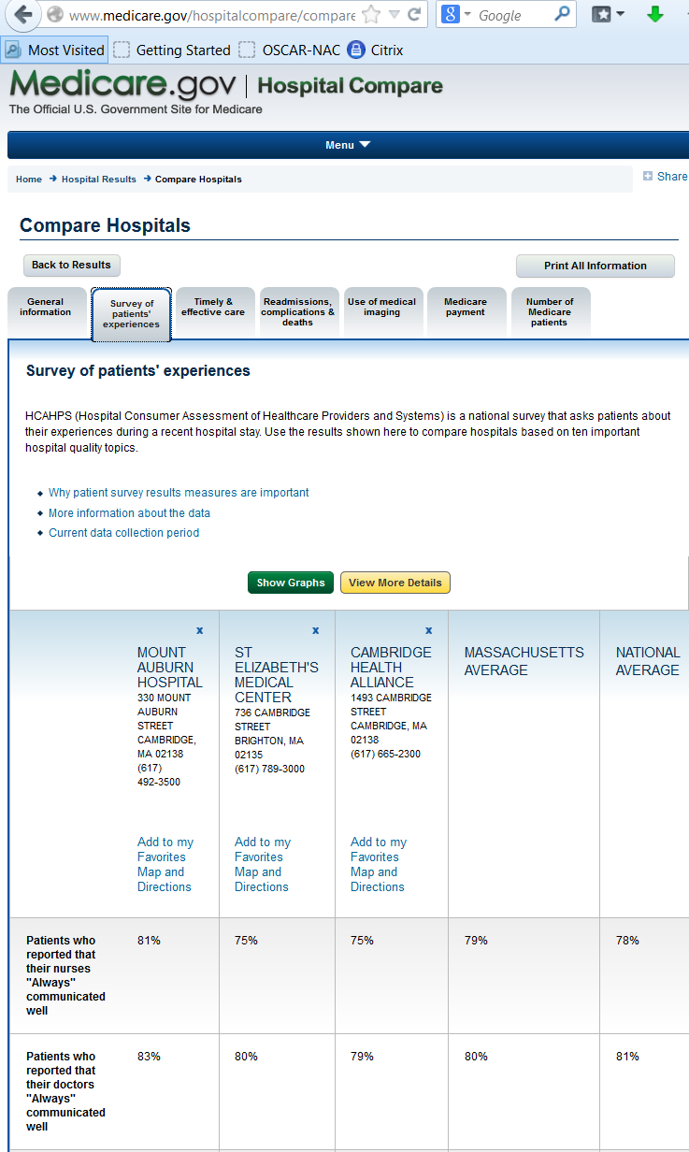
Examples
USA:
Hospital Compare
Nursing Home Compare
Detailed comparisons
of quality measures
by different hospitals

Slide 21
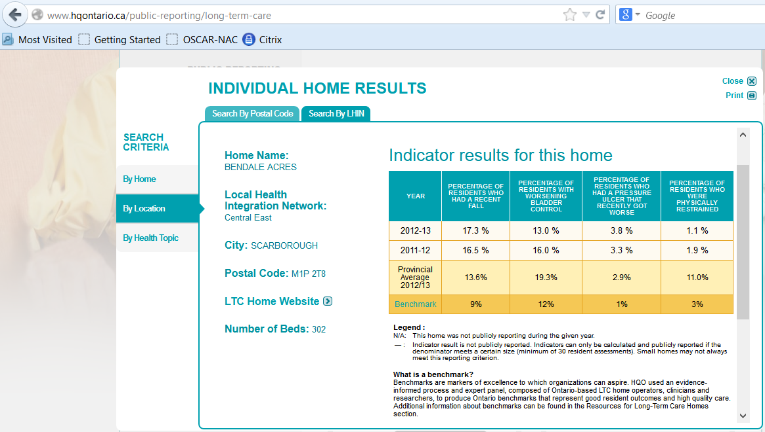
Examples
Health Quality Ontario – Long-term care homes

Slide 22
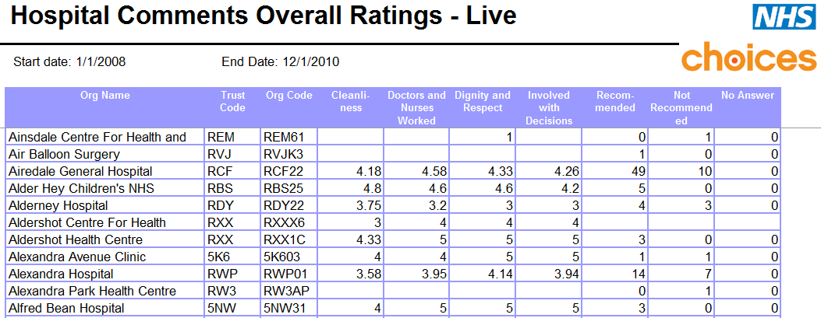
Examples
Public Reporting in UK
http://data.gov.uk/dataset/england-nhs-nhschoices-organisations-hospitals-patient-comments#

Slide 23
Key Ingredients to System-Wide Quality Improvement
III - Quality Improvement Capacity
Deep skills in process improvement within staff of health care organizations
Most organizations grossly under-resourced & overestimate existing capacity to manage change
Develop leadership skills for quality
Moving from culture of blame to culture of improvement

Slide 24

Qulturum Jonkoping, Sweden
Long-term mission (12 yrs) to build QI capacity within Jonkoping
Houses 40 dedicated individuals
46% of health care workers have spent time in institute
Hub for numerous QI initiatives
Jonkoping widely regarded as leading health system with better outcomes, lower costs
www.lj.se/infopage.jsf?nodeId=31736

Slide 25
Health Quality Council, Saskatchewan LEAN Transformation
Saskatchewan – province of 1 million
$30 mil, 5 yr investment in LEAN training
Aims for capacity building:
advanced LEAN skills for all CEOs & senior management
By 2016: 1000 QI projects, 25% of 40,000 staff to receive core LEAN training
www.health.gov.sk.ca/lean-introduction
www.gov.sk.ca/adx/aspx/adxGetMedia.aspx?mediaId=1769&PN=Shared

Slide 26
Key Ingredients to System-Wide Quality Improvement
IV - Decision Supports /IT
Support providers to “remember to do the right thing”
Embed into EMR (electronic medical record) where possible, but EMR not a prerequisite
Includes checklists, standard orders, decision trees, standard pathway, reminders & alerts
Ensure planning for QI embedded into EMR strategy

Slide 27
Examples
Many examples of IT implementation agencies, but incorporation of decision supports to promote QI not always explicit
Agency for Healthcare Research & Quality (USA), Clinical Decision Support Initiative
Developing EMR algorithms to support best practice adoption
http://healthit.ahrq.gov/ahrq-funded-projects/clinical-decision-support-initiative

Slide 28
Key Ingredients to System-Wide Quality Improvement
V - Accountability & Incentives for Quality
Contracts / accountability agreements with organizations
Results-based payment / pay-for-performance
Incentives for participation in QI activities

Slide 29
Key Ingredients to System-Wide Quality Improvement
VI - Quality assurance / inspection/ accreditation / licensure / professional regulation
A role for QA / inspection even within systems with strong QI focus
Small percentage of providers with significant issues regarding competence, abusive / disruptive behaviour, etc.

Slide 30

Examples
UK
Inspects services at hospitals, nursing homes, primary care, home care
Publishes results on website

Slide 31
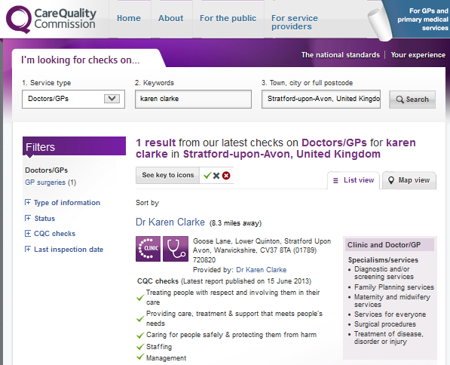
Example: Inspection Reports

Slide 32
Example - Accreditation
Accreditation
A self-assessment and external peer assessment process used by health care organisations to accurately assess their level of performance in relation to established standards and to implement ways to continuously improve.
Still based on inspection but more collegial & constructive than pure QA
Most accrediting bodies non-profit corporations
Accreditation Canada (International)
The Joint Commission (International)
QHA Trent Accreditation (UK)
Australian Council for Healthcare Standards (International)

Slide 33
Key Ingredients to System-Wide Quality Improvement
VII - Patient engagement
Knowledge of choices, participation in decision making, adherence to advice important to QI
Examples:
“It’s Safe to Ask” campaigns on patient safety
“Did I Wash My Hands?” strategy
“Nothing About Me Without Me”, IHI
“Questions to ask” for families of nursing home residents, Health Quality Ontario

Slide 34
Key Ingredients to System-Wide Quality Improvement
VIII - Quality planning
Establishment of key targets & time frames for completion
Assignment of roles, expectations for each health care organization contributing to a national strategy

Slide 35
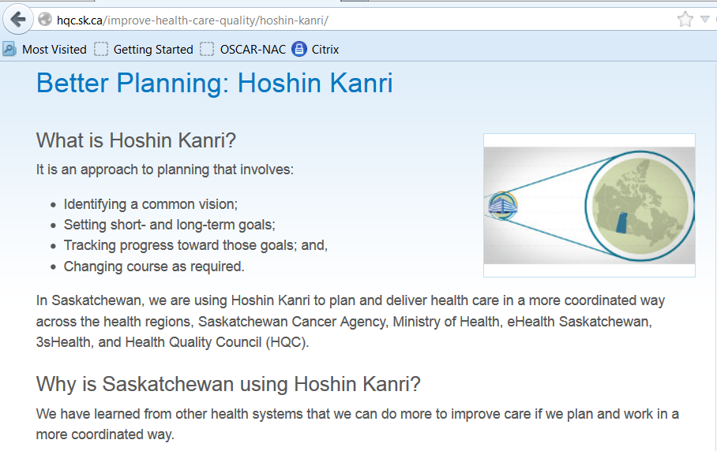
Examples – System-Wide Quality Planning

Slide 36
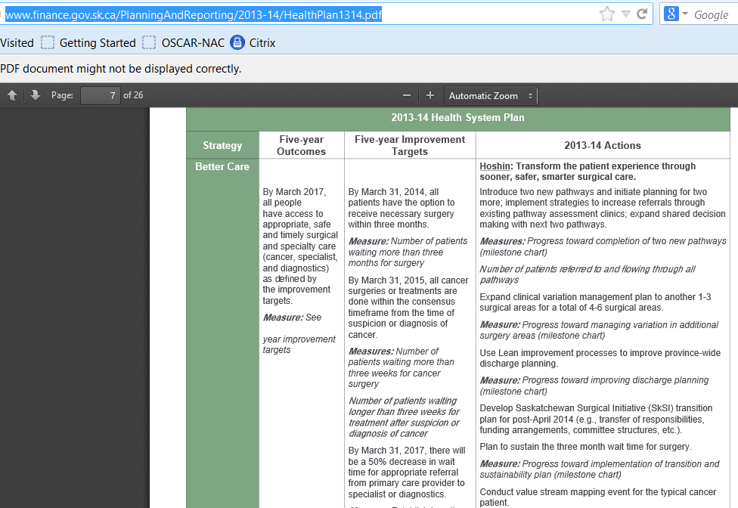
Example – System-wide Quality Planning

Slide 37
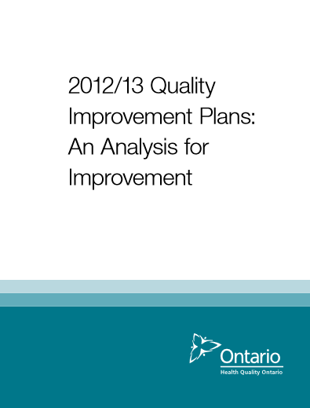
Example – Quality Planning

Slide 38
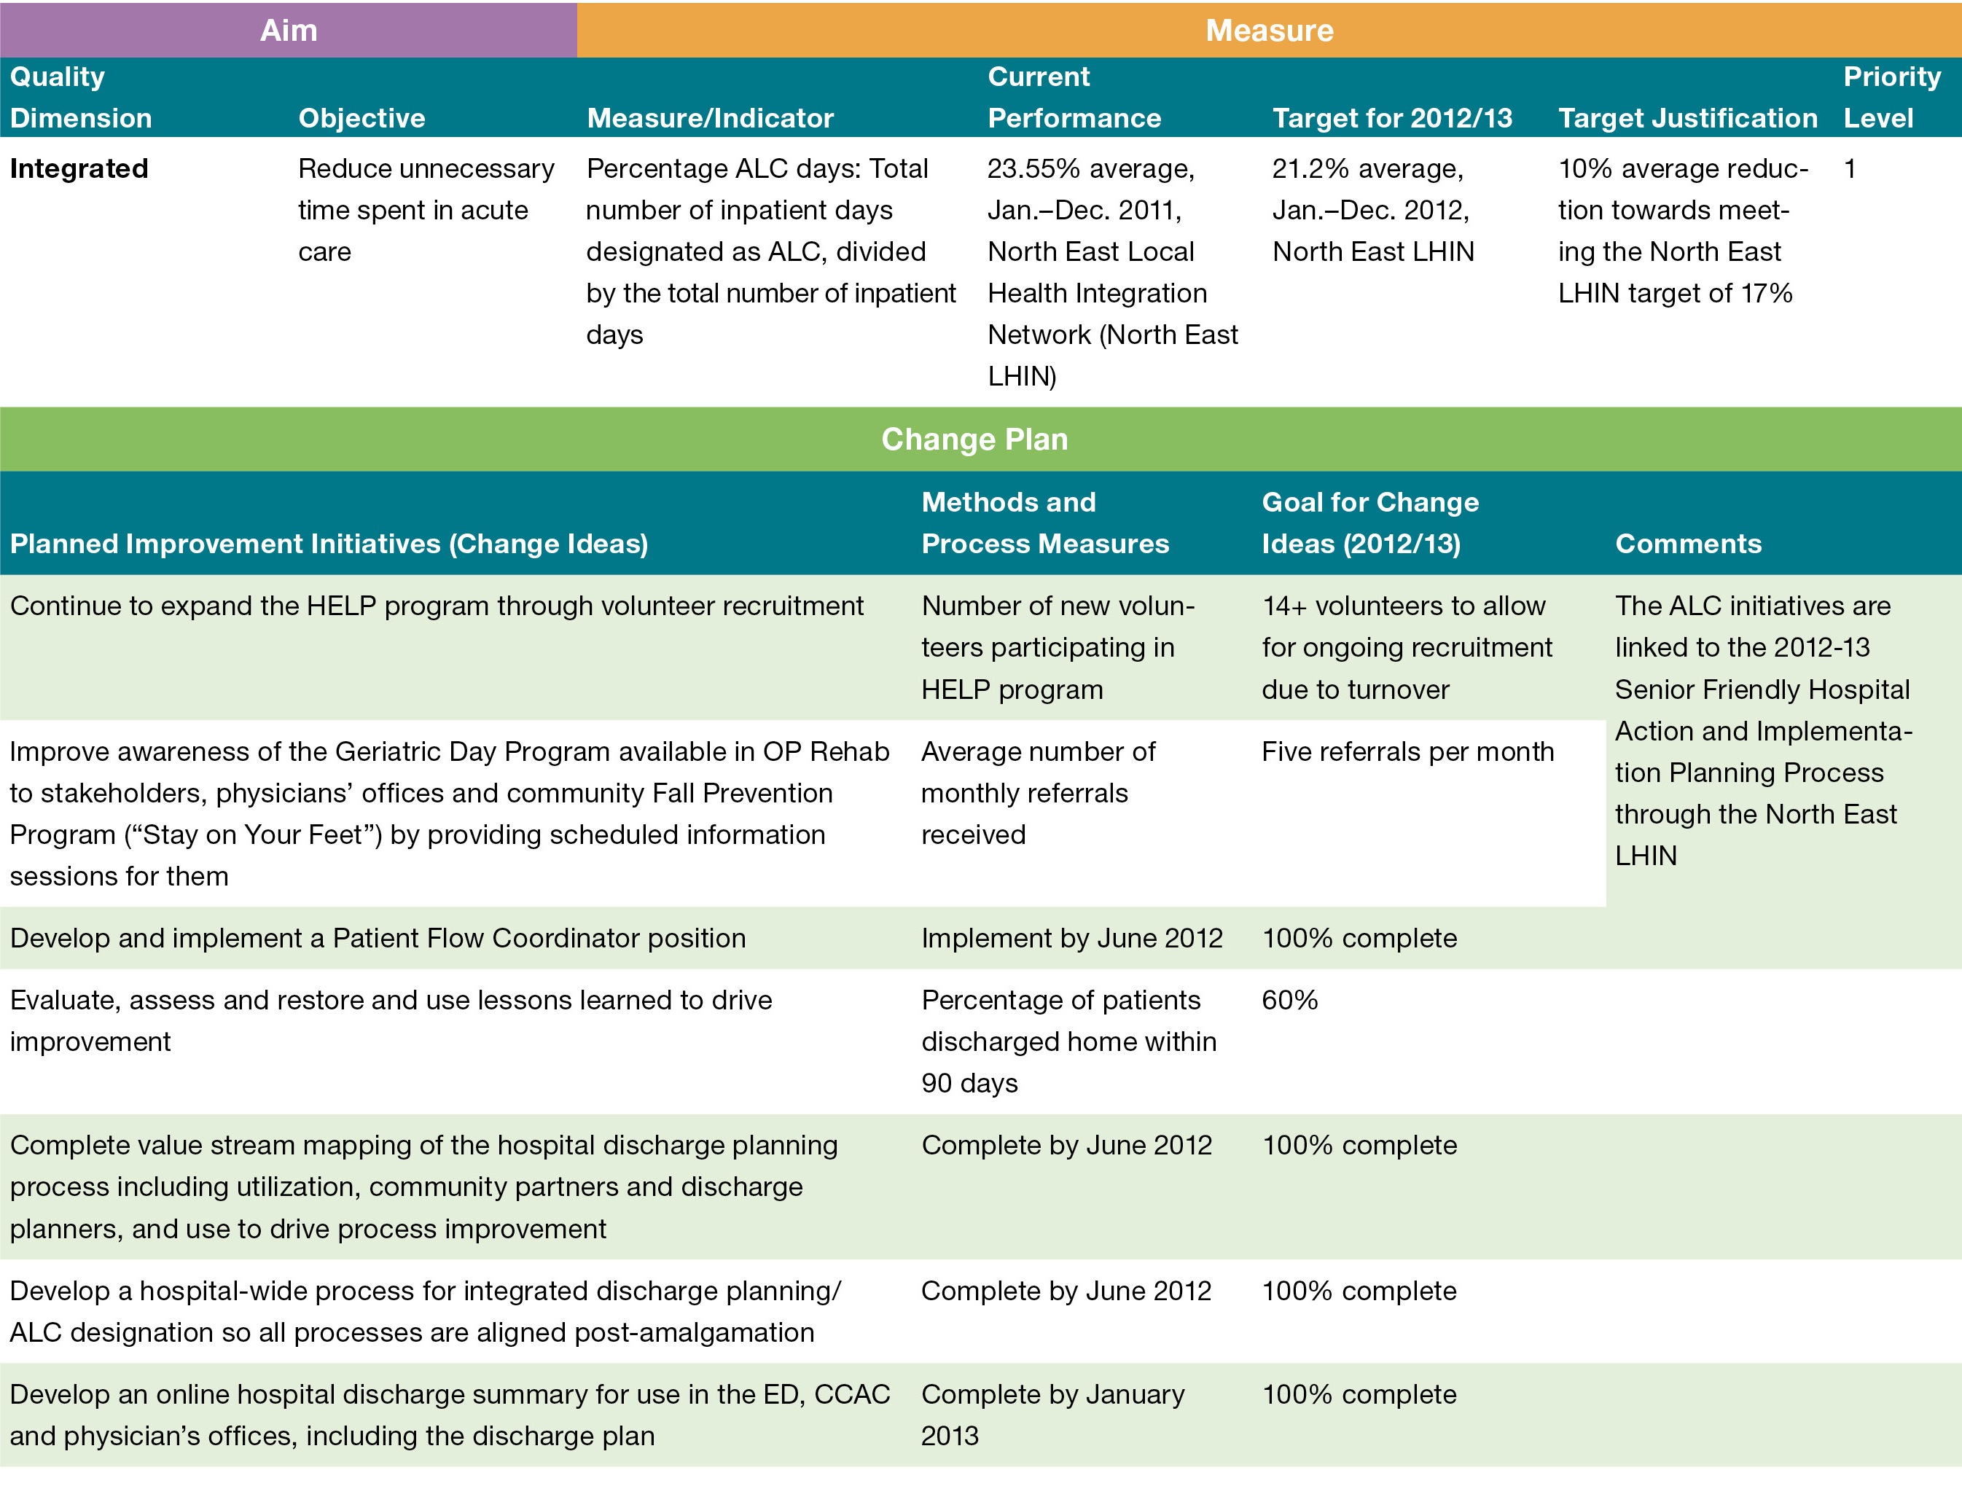
Examples – QI Plans

Slide 39
Ingredients for Quality Strategy
I - Quality measurement
II - Public reporting
III - Quality improvement capacity
IV - Decision supports
V - Accountability / incentives
VI - Patient engagement
VII - Quality assurance / accreditation / regulation
VIII - Quality planning

Slide 40
How to Make Mix Ingredients for Quality Together?

Slide 41
Quality Improvement Entities Worldwide
Organizations sponsored by governments with a mandate to promote health care quality
Different organizations take on different combinations of 8 key functions

Slide 42
Canadian Landscape
Health Quality Councils
BC Patient Safety & Quality Council
Health Quality Council of Alberta
Health Quality Council of Saskatchewan
Health Quality Ontario
New Brunswick Health Council
Health Council of Canada
Canadian Patient Safety Institute

Slide 43
Canadian Lanscape (ctd)
Accreditation Canada
Canadian Institute for Health Information

Slide 44
Matrix of Roles
Org | Q measure-ment | Pub Reporting | QI support | Decision supports | Accredi-tation/ regulation | Accoun-tability / Incentives | Pt Engage-ment | Quality Strategy
BCPSQC |  |  | X
HQCA | (x) | (x) |  |  | X
HQC(sk) | (x) | X | X |  |  |  |  | (x)
HQO |  | X | X |  |  | (x) | (x) | (x)
NBHC | (x) | X |  |  |  |  | X
Accred Can |  |  |  |  | X
CPSI |  |  | X
CIHI | X | X
Govern-ments | (x) | (x) |  | (x) |  | X |  | X
(x) = limited role e.g. supportive or partial

Slide 45
American Landscape
Quality Improvement Organizations
One QIO per state / territory
Independent, not-for-profit organizations on contract with Centres for Medicare & Medicaid Services (CMS)
Assorted roles including:
QI capacity building, support adoption of best practices
Public reporting
Assistance with complaints process

Slide 46
American Landscape
Joint Commission
Health Human Resources (Ministry equivalent) and agencies:
CMS
Agency for Healthcare Research & Quality (AHRQ)

Slide 47
Matrix of Roles
Org | Q measure-ment | Pub Reporting | QI support | Decision supports | Accredi-tation/ regulation | Accoun-tability / Incentives | Pt Engage-ment | Quality Strategy
CMS | X | X |  |  |  | X |  | X
QIOs |  | x | X |  |  |  | (x)
TJC |  |  |  |  | X
AHRQ | X |  | (x) | (x)

Slide 48
UK Landscape
Continuous reorganization of quality organizations within NHS
Examples:
NHS Improving Quality
Formerly NHS Institute for Innovation & Improvement
Care Quality Commission
formerly Health Care Commission
UK Primary Care Development Trust*
* defunct

Slide 49
Key Questions for MOLHSA
Of the 8 functions to be enhanced, what is the priority assigned to each?
For each function, what is the preference:
within Ministry
Quasi-governmental agency
Independent organization (contracted)?
Which functions can be combined? Which are separate?

Slide 50
Options for Org Structure
A - Within government Ministry
May be branch, division, unit
reporting to senior official (e.g. ADM, DM)
B - Within arms-length agency
Often explicitly created by legislation
Governed by Board of Directors
Board members may be govt appointees
C - Within independent organization
fully funded by & contracted to government

Slide 51
Examples
A - within government
Centers for Medicare & Medicaid Services
Agency for Health Research & Quality
B– arms-length agency
Provincial health quality councils
NHS Institute for Innovation & Improvement
C – non-profit corporations on contract
QIOs (USA)
Most accrediting bodies

Slide 52
Variations in Canada on Choice of Model
Organization | Govt Funded Non-Profit | Govt Agency, Indep Board | Within Ministry
BC Centre for Patient Safety & Quality |  | X
HQC Alberta |  | X
HQC Saskatchewan |  | X
Manitoba Institute for Patient Safety | X
Health Quality Ontario |  | X
New Brunswick Health Council |  | X
Nova Scotia Quality Unit |  |  | X

Slide 53
Within Government or Arms Length to Government?
Within Government – advantages | Arms Length to Government – advantages
Direct accountability to government & ability set the quality agenda Can leverage ability to mandate change – “push strategy” | Opportunity to set organizational culture different from government “due process” in government vs “innovation – keep improving processes all the time” Public reporting perceived as more objective if from an arms-length agency; some protection against manipulation / suppression of data Useful for voluntary change activities which support true culture change – “pull strategy”

Slide 54
Mixing of Functions?
Quality improvement & quality assurance generally kept separate
Historically, accreditation bodies tend to be stand-alone organizations
Jurisdiction | Quality Improvement | Quality Assurance
UK | NHS Institute for Innovation & Improvement | Care Quality Commission
Ontario | Health Quality Ontario | Performance Improvement & Compliance Branch, Ministry

Slide 55
Public Reporting
Public reporting role can be combined in many different ways
Often multiple groups report on quality
Examples:
Organization | Functions
Canadian Institute for Health Information | Quality measurement & public reporting
Health Care Commission, UK (now defunct) | Quality assurance & public reporting
Most Health Quality Councils in Canada | Quality improvement & public reporting

Slide 56
Mixing of Functions
QI capacity building tends to be outside of government
Arms-length agency or contracted not-for-profit
Likely driven by need for innovative culture

Slide 57
Question 1 - For each of the 8 areas:
What existing capacity do we have in Georgia to leverage?
What additional activities do we need?
What are the barriers to overcome?
What are solutions to these barriers?

Slide 58
Question # 2
If a quality management entity is set up, what will be the highest priority topics for improvement?
Primary care access?
Chronic disease management (DM, HBP)?
Cancer screening?
Maternal / child health?
Hospital care issues – safety, access?

Slide 59
Question # 3
Of the 8 functions to be enhanced, what is the priority assigned to each?
For each function, what is the preference:
within Ministry
Quasi-governmental agency
Independent organization (contracted)?
Which functions can be combined? Which are separate?

Slide 60
Master Design Table
Function | Priority? | Govt? | Agency? | Non-Profit?
Quality measurement
Public reporting
QI Capacity building
Decision supports
Accountability / incentives
Patient engagement
Quality assurance / accreditation / regulation
Quality Strategy

Slide 61
Contact: drben.chan@utoronto.ca

