Slide 1
HEALTH SYSTEM ACHIEVEMENTS AND CHALLENGES
GEORGIA
Dr. David Sergeenko
Minister of Labor, Health and Social Affairs
24 January, 2018
Notes:
Since 2013 the Government of Georgia has undertaken an important reforms to expand health care coverage to the entire population and improve health care services.

Slide 2

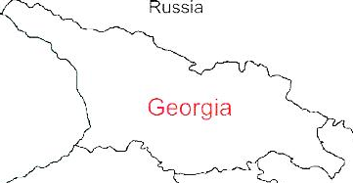



Demographic and Socio-Economic Situation, 2017
Population – 3 728 300
Birth rate (per thousand population) – 14.3
Mortality rate (per thousand population) – 12.8
Life expectancy at birth – 73.5
Maternal Mortality (per 100000 live birth) – 13.1
Infant mortality (per 1000 live birth) – 9.6
Under 5 mortality rate (per 1000 live birth) – 11.1
GDP per capita (at current prices) – 4067 $US
GDP real growth – 5.0%
Government expenditure on health per capita – 104 $US
Government expenditure on health as % of GDP – 2.8%
Government expenditure on health as % of State Budget – 8%
Government expenditure on health as % of GDP – 3.1%
General Government expenditure on health per capita (USD) – 117
Notes:
The population of Georgia has declined during the last 25 years, largely due to the outmigration and according to the census conducted in 2014, it is 3,7 mln.
Georgia has made a good progress in improving health outcomes. Life expectancy has increased by about 5 years over the few decades and currently is at 73.5 years.
Significantly has declined under-five mortality and infant mortality
In 2015 Georgia met MDGs 4th Goal: decrease under-5 mortality rate

Slide 3
25 years: Collapse, Stabilization, Acceleration, Development …
Civil war
Notes:
Georgia went through turbulent past 25 years that are characterized by collapse, stabilization, acceleration, crisis and rebound… During these 25 years the country went through two wars - civil war, conflicts in Abkhazia and South Ossetia resulting in a large number of internally displaced persons, and in 2008 war between Georgia and Russia.
important landmarks: in 2012: Peaceful transfer of power (Georgia Dream Party), signing of the Association Agreement with the EU in 2014 and in 2017, visa free travel to the EU.
During these years Georgia’s health care system has undergone several reforms, in late 1990s moving strongly away from Semashko model and decentralization of the health care system, extensive privatization introduced by the reforms in 2007-2012 which were also characterized by deregulation and trust in market mechanisms. At that time most government spending on health was channeled through private health insurance. Following the extensive privatization, most providers are independent of government in terms of ownership and management.

Slide 4
Economic Growth
3.5 %
Average GDP growth during 2014-2016, when most of Georgia’s neighbors were in or close to recession.
4.5%
Average economic growth in 2017
4.9 %
Average real GDP growth projection in 2018-2022, according to IMF
Notes:
Average GDP growth during 2014-2016, when most of Georgia’s neighbors were in or close to recession. GDP per capita is 3852 US$.
After 2012 doubled foreign direct investment in the county and significant increase as % of GDP from 6% to 12%

Slide 5
Unemployment and Poverty Indicators
2017
annual unemployment rate reached its lowest point in 13.9 years
2009-2017
Decreasing trend of unemployment rate

Slide 6
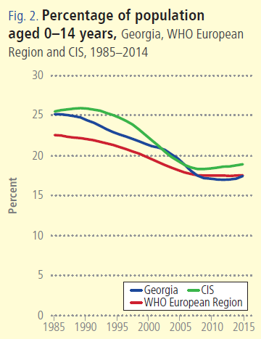
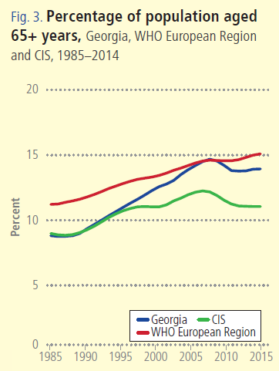
Notes:
Georgia, as many countries in the WHO European Region is facing a similar demographic challenges – ageing population and a declining birth rates.

Slide 7
Non-communicable diseases are the primary driver of overall disease burden
Cause of Burden of Disease (DALYs)
Injuries
Communicable
diseases
1990
2005
Non-communicable
diseases
2015
Notes:
If we look at the diseases burden, non-communicable diseases are the primary driver of overall diseases burden and it has been for a long time. The major causes of death in Georgia are related to non-communicable diseases, including cardiovascular diseases, cancer, diabetes and respiratory diseases, which together with injures make 94% of deaths.
The large share of premature deaths from NCDs are influenced by the health-related behaviors and risk-factors. STEPs survey results, population-based survey, which was conducted in Georgia second time to evaluate the trends in health related behaviors and risk-factors showed low physical activity, unhealthy diets, smoking and heavy alcohol consumption among the population.
An important breakthrough in this direction is an adoption of tobacco control law in May 2017, the law that is fully aligned with the WHO Framework Convention on Tobacco Control and is one of the strongest tobacco control laws in the European region. Large –scale antitobacco campaign and health promotion national programme with a strong tobacco control component will be implemented to strengthen tobacco control measures.
The primary concern of Georgia’s health system’s is the alleviation of the burden of NCDs and strengthening NCD control activities, including better management of chronic diseases at the primary health care level, improving health promotion and preventive measures is a priority.

Slide 8
Incidence of TB, Georgia, WHO European Region, CIS, 1990-2016
Incidence of HIV, Georgia, WHO European Region, CIS, 1990-2017
* Data for 2017 are preliminary
Notes:
The infant mortality rate and under five mortality rates have declined during the past several years, however, it is still higher than the Region’s average.
Maternal mortality has significantly fluctuated during the last decade. In 2016 we have seen a steep decline. Reproductive age mortality studies conducted to evaluate maternal mortality and completeness of the registration system revealed significant improvements in the deaths registration of women of reproductive age, determined at 98%.

Slide 9
Maternal Mortality ratio per 100000 live birth, Georgia, WHO European Region, EU, 2000-2017
Infant Mortality ratio per 1000 live birth, Georgia, WHO European Region, EU, 2000-2017
* Data for 2017 are preliminary
Notes:
The infant mortality rate and under five mortality rates have declined during the past several years, however, it is still higher than the Region’s average.
Maternal mortality has significantly fluctuated during the last decade. In 2016 we have seen a steep decline. Reproductive age mortality studies conducted to evaluate maternal mortality and completeness of the registration system revealed significant improvements in the deaths registration of women of reproductive age, determined at 98%.

Slide 10
Universal Health Care – Socially Oriented Political Platform
Reforms have moved Georgia closer to universal health coverage
Unprecedented Expansion of State Budget for Health care
365 mill GEL in 2012 → 1017 Mill Gel in 2016
Launch of Universal Health Care Program in February 2013
Better access to care
Better user experience
Better financial protection
Notes:
The main goal of the elected government in 2012 and re-elected in 2016, is the poverty reduction and socially oriented political platform. The strong political will pledged in the election platform was translated into an unprecedented, in 2013 almost 2-fold expansion of budgetary allocation for health.
The second major step towards securing enjoyment of health rights in the country was the launch of a Universal Health Care Program in February 2013. Georgia now has a foundation of universal entitlements within its health system, representing a major step towards improving access to health services for the entire population.
Although the health impact of the UHC program remained to be seen and will be apparent in the medium to long-term, very important achievements and results are already visible, specifically with respect to the financing scheme and greater equity in the health system.
The survey carried out by the World Bank, the World Health Organization and the US Agency for International Development showed the main achievements of the Universal Healthcare Program: increased access to medical services, increased utilization of medical services, reduced financial barriers and enhanced coverage
Under the UHC program, patients have almost unlimited choice of provider. In terms of the package of benefits, benefits have been gradually increasing.
From May 2017, the highest earners are excluded from the UHC programme and expected to purchase health insurance. This reduction in coverage is counterbalanced by an expansion in the benefits package for those living below the poverty line to cover the essential outpatient pharmaceuticals for four chronic conditions.

Slide 11
Health sector expenditures
Out-of-Pocket Payment as % of Total Health Expenditure, Georgia
Public Health Expenditure, Georgia
Source: Georgia NHA 2010-2016 (MoLHSA, 2017)
Notes:
The UHC program was accompanied with a substantial increase in the governments budget allocations. From 2012 to 2016, the health budget more than doubled, as a percentage of GDP it increased from 1.7 percent to 3% in 2016.
The share of the out-of-pocket payments in total health expenditures has significantly decreased from 73% (in 2012) to 56% (in 2016), mainly due to the lower cost of hospitalization, which is a direct consequence of the universal healthcare program.

Slide 12
Coverage of Healthcare services
Services utilization
Hospitalization per 100 population
  UHC Program has led to a major expansion in population entitlement to publicly financed health services (HUES)
Ambulatory care visits per person per years
Notes:
The coverage of population improved as demonstrated by the series of health care utilization and expenditures surveys. Over half of the population were covered first time. We have seen a surge in utilization of the health care services. Utilization of outpatient and inpatient care has almost doubled since the introduction of the UHC program.
. In Georgia, during last 2 decades, this indicator did not exceed 2.2. In the frame of the UHC programme the numbers of out- and in-patient encounters continued to grow due to increased accessibility of healthcare services. In 2016, the number of contacts with out-patient facilities per capita reached 4.0.

Slide 13
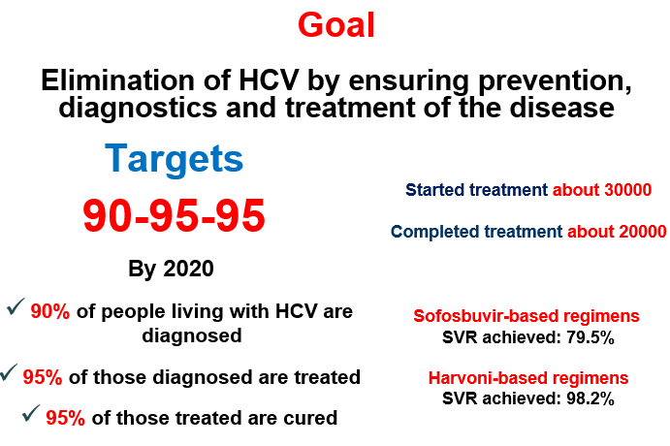
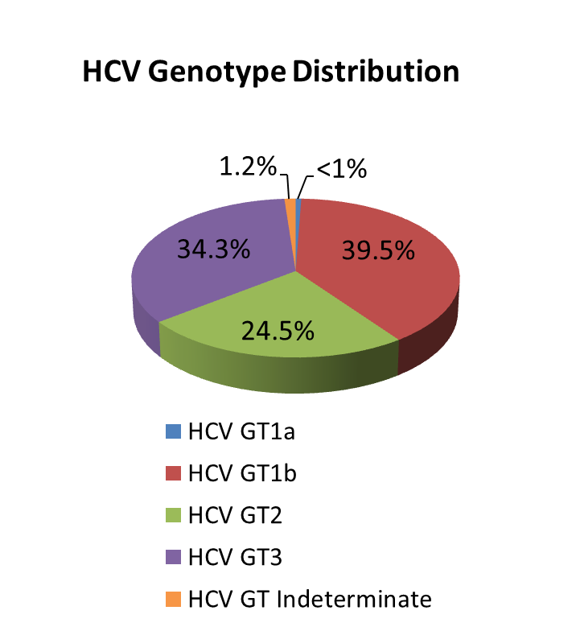
National Hepatitis C Elimination Program
Nationalwide survey, 2015
Anti-HCV+ | 7.7%
HCV RNA+ | 5.4%
Screened - 1 800 000
Started Treatment – 45 600
Completed treatment – 41 500
Sofosbuvir-based regimens
SVR achieved: 82%
Harvoni-based regimens
SVR achieved: 98.2%
Notes:
Based on available data, Georgia is among the countries with high hepatitis C (HCV) Prevalence. 2015 National survey conducted by NCDC and CDC revealed that ~150 thousand people are infected with active HCV infection and need to be treated. The survey estimated that 7.7% of population are anti-HCV positive and 5.4% are HCV RNA positive. The most prevalent genotype nationwide is genotype 1 (appx. 40%) followed by genotype 3 and 2.
Memorandum of Understanding between the Government of Georgia and US pharmaceutical company Gilead was prepared and officially signed on April 21, 2015.
Long-term elimination strategy for 2016-2020 was developed together with CDC based on WHO guidelines. Goal: Elimination of HCV by ensuring prevention, diagnosis and treatment of the disease

Slide 14

Public health Emergency Preparedness and Responsible Capacity
The revision of Epidemics, Pandemics and Biological Incidents Response Plan
Updating/Developing disease specific plans:
    Influenza Response Plan
    Ebola virus
    Zika Virus
    Crimean-Congo Hemorrhagic fever
    Polio
    Dengue
Emergency Preparedness
WHO IHR was fully implemented in 2012;
NCDC was designated as the national IHR Focal Point;
24/7 Duty Officer System is established;
Georgia, together with other countries is actively involved in support of the 11 Action Package objectives:
  Real-Time Surveillance - as a leading country
  National Laboratory System – as the contributing country
  Zoonotic Diseases – as the contributing country
GHSA
IHR
Notes:
The revision of Epidemics, Pandemics and Biological Incidents Response Plan
Georgia reached the full compliance with the core IHR requirements by the June 2012 deadline set by the World Health Organization (WHO).
GHSA has become a new vision for Georgia since it’s launch, when first external assessment of baseline GHSA capabilities was conducted and since Georgia took a path to contribute to Zoonotic Disease and National Laboratory System Action Packages and lead an Action Package of Real-Time Surveillance. The National Center for Disease Control and Public Health (NCDC) is designated as the National Focal Point (NFP).

Slide 15
Main Challenges and future plans…
▪ Still very low public spending on health
  Government annually is increase public investment in health care
▪ Expenses on outpatient medications are high
  Already started and is continuing expand access to outpatient drugs
▪ Purchasing strategies need improvement for ensuring quality and containing costs
  Implement of active purchasing, selective contracting and performance based financing
Notes:
High OOP Payments are a Risk Factor for Impoverishment
Population ageing + weak management of NCDs + inefficient service delivery structure ➔ are the mix of cost drivers
40% of total health spending on pharmaceuticals and most of this is paid for out-of-pocket
We are not just looking at finding additional resources but also trying to understand constraints, and employ efficiency savings: get better value for money from existing resources.
SSA is a single purchaser and needs to fully exploit its purchasing power. Need to move away from passive purchasing: selective contracting, performance monitoring, make better use of information and health information systems broadly
Extend coverage of cost-effective outpatient medicines for better health, wealth and value

Slide 16
Thank you for your Attention!

