Slide 1
Diagnosis Related Groups: training of trainers
WHO UHC Partnership in Georgia
15-16 May, 2018

Slide 2
Objective
Build the capacity of key people related to the DRG implementation in Georgia
Prepare a team of trainers in MOLHSA, SSA and NCDC

Slide 3
Agenda: Today
9:30 – 11:30 Basics of casemix systems worldwide, incl. history, development, main building blocks of casemix systems
11:30 – 12:00 Coffee break
12:00 – 13:30 Using DRG for hospital’s performance monitoring (Part 1)
13:30 – 14:30 Lunch break
14:30 – 15:30 Using DRG for hospital’s performance monitoring (Part 2)
15:30 – 16:00 Coffee break
16:00 – 17:30 DRG cost weights and pricing

Slide 4
Agenda: Tomorrow
9:00 – 9.30 Registration
9:30 – 11:00 Primary classifications and DRG grouping logic (Part 1)
11.00 – 11.30 Coffee break
11:30 – 13:00 Primary classifications and DRG grouping logic (Part 2)
13:00 – 14:00 Lunch break
14:00 – 15:30 NordDRG grouping logic, “reading” the definition tables

Slide 5
Basics of casemix systems worldwide
Triin Habicht
15.05.2018

Slide 6
Let’s get terminology right
CASEMIX: The relative complexity and intensity of services required to treat patients in a hospital due to diagnosis, disease severity, and personal characteristics such as age
CASE GROUP: A group of hospital cases defined for a case-based hospital payment system to include cases with similar clinical characteristics and resources required to diagnose and treat the cases, or to complete a phase of case management
DIAGNOSIS RELATED GROUP: A classification of hospital case types into groups that are clinically similar and are expected to have similar hospital resource use. The groupings are based on diagnoses, and may also be based on procedures, age, sex, and the presence of complications or comorbidities
Source: http://siteresources.worldbank.org/HEALTHNUTRITIONANDPOPULATION/Resources/Peer-Reviewed-Publications/ProviderPaymentHowTo.pdf

Slide 7
Rationale of using different payment mechanisms
The relationship between purchaser and provider is compound
    information asymmetry
    conflicting interests
    outcome uncertainty
Incentives aim to alter providers behaviour in towards desired objectives to promote improvements in quality, access, efficiency and to ensure cost containment
    Incentives could be financial and nonfinancial
    Impact of the incentives depends on their size, design and delivery

Slide 8
Do financial incentives always deliver what is desired?
Difficult to design financial incentives that motivate better performance for complex tasks
Usually easier to incentivize to increase the “output” e.g. diagnostic tests
Shift towards incentivized activities and away from others that could have important benefit for health
Financial incentives might overplay clinicians intrinsic motivation

Slide 9
Design of the payment incentives has to fit with the expectations to the service delivery system:
What is the most appropriate care setting for the delivery of particular services?
How to ensure that care is coordinated and continuous across care settings?
Prevention
Primary health care
Outpatient specialist care
Acute hospital care
Rehabilita-tion
Long term care

Slide 10
Revenue and Expenditure:
2 sides of the UHC Coin
REVENUE
Resources available to expand and sustain effective coverage
EXPENDITURE
Benefits package
Payment to providers
Source: Adapted from Cheryl Cashin, 2013

Slide 11
Most common payment methods to cover base cost (full payment)
Method | Description | Usual Setting | Degree of bundling
Fee for service | Activity based billing of individual services and patient contacts and bed days | Predominantly used for GPs and for outpatient specialist services
Payment per case | Activity based payment per patient, patient classified by similar clinical condition and/or activities | Predominantly for hospital inpatient care
Capitation | Lump-sum payment per enrolled patient covering a range of services | Predominantly used for GPs
Global budget | Lump-sum payment covering a range of services independent of actual volume of care | Payment for public hospitals in a number of countries
Unbundeled
Bundeled
Source: Adapted from https://www.oecd.org/els/health-systems/Better-ways-to-pay-for-health-care-FOCUS.pdf

Slide 12
Case based payment: How it works
Payment depends on the patient and/or clinical characteristics
Providers are paid a fixed amount per admission or discharge

Slide 13
Case based payment: Provider incentives
Increase admissions
Reduce inputs per case, which may improve the efficiency of the input mix
Reduce length of hospital stays, may improve quality
Shift pre- and after care to the outpatient setting

Slide 14
Case based payment: When to use
Rather high management capacity of the purchaser and providers
Excess hospital capacity and improving efficiency is a priority
Need to monitor providers performance, provides standardized classification
Increase hospital management autonomy, reorientation from input based budgets to paying for outputs
Cost control is not a main concern

Slide 15
Case based payment: Risks
Over-hospitalization of low-cost patients
Under-treatment of high-cost patients
Up-coding: DRG-creep
Volume (cost) may escalate if other cost control mechanisms not used

Slide 16
Usual expectations to DRG system
Increase efficiency in the provision of hospital services
Achieve better planning and resource allocation in order to meet population demands for improved access to hospital care
Provide incentives for more efficient service delivery
Improve health service outcomes
Achieve greater equity in financing, in the sense that every provider receives the same payment for equal services delivered
NB! Expectations depend on what payment method was in place before DRG: fee-for-service or line-item budget or global budget

Slide 17
Building blocks of DRG systems
Data collection
2
  Demographic data
  Clinical data
  Cost data
  Sample size, regularity
Price setting
3
Actual reimbursement
4
Patient
classification
system
  Volume limits
  Outliers
  High cost cases
  Quality
  Innovations
  Negotiations
1
  Cost weights
  Base rate(s)
  Prices/ tariffs
  Average vs “best”
  Diagnoses
  Procedures
  Severity
  Frequency of revisions
Source: Adapted from Busse, EURO-DRG project, 2012

Slide 18
Key principles to shape a classification system (Fetter 1991)
Patient
classification
system
1
  Diagnoses
  Procedures
  Severity
  Frequency of revisions
The definition of groups is to be based on information routinely collected in computerized hospital abstracts
There is to be a “manageable” number of groups
Each group is to contain cases with similar patterns of resource use (“resource homogeneous”)
Each group is to contain cases that are similar from a clinical perspective (“clinically meaningful”)

Slide 19
Patient grouping
medical and management decision variables
patient variables
gender, age,
main diagnosis, other diagnoses, severity
mix and intensity of procedures, length of stay
Group of clinically similar patients with homogenous resource use
= DRG
Notes:
Objective: To provide fair reimbursement of hospital costs (not too much but not too little)

Slide 20
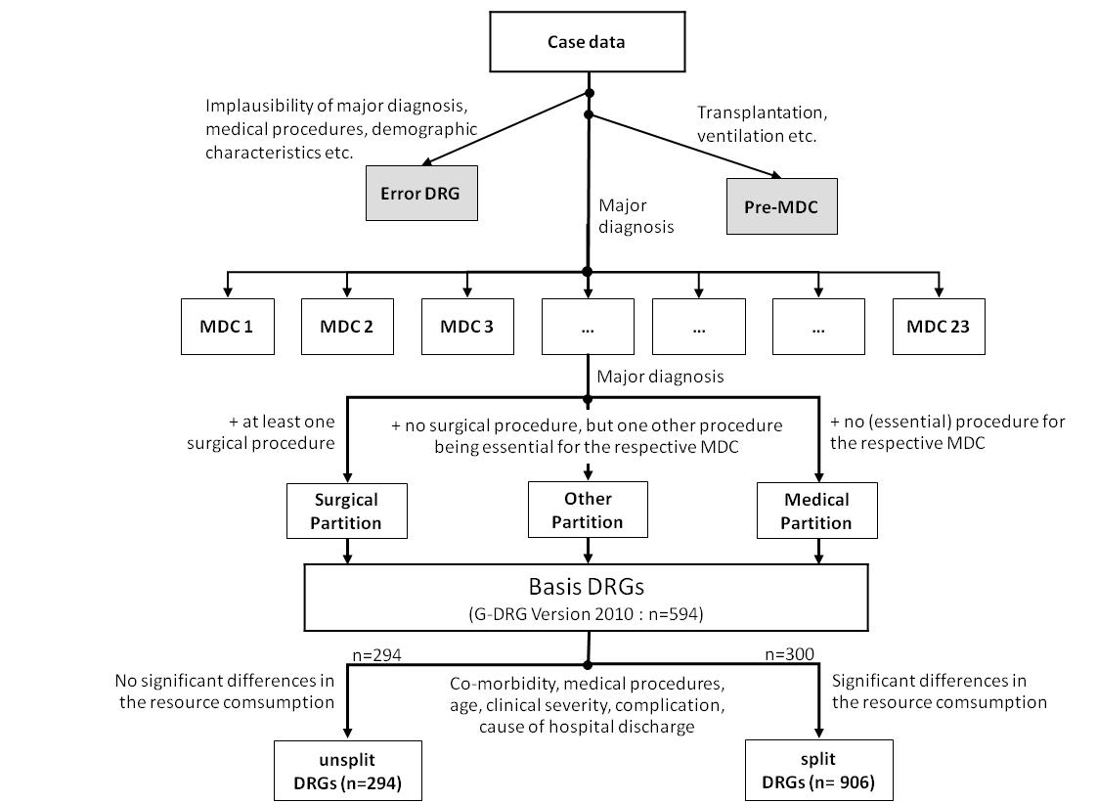
German DRG example
NordDRG manual http://www.norddrg.net/norddrgmanual/NordDRG_2012_NC/index.htm

Slide 21
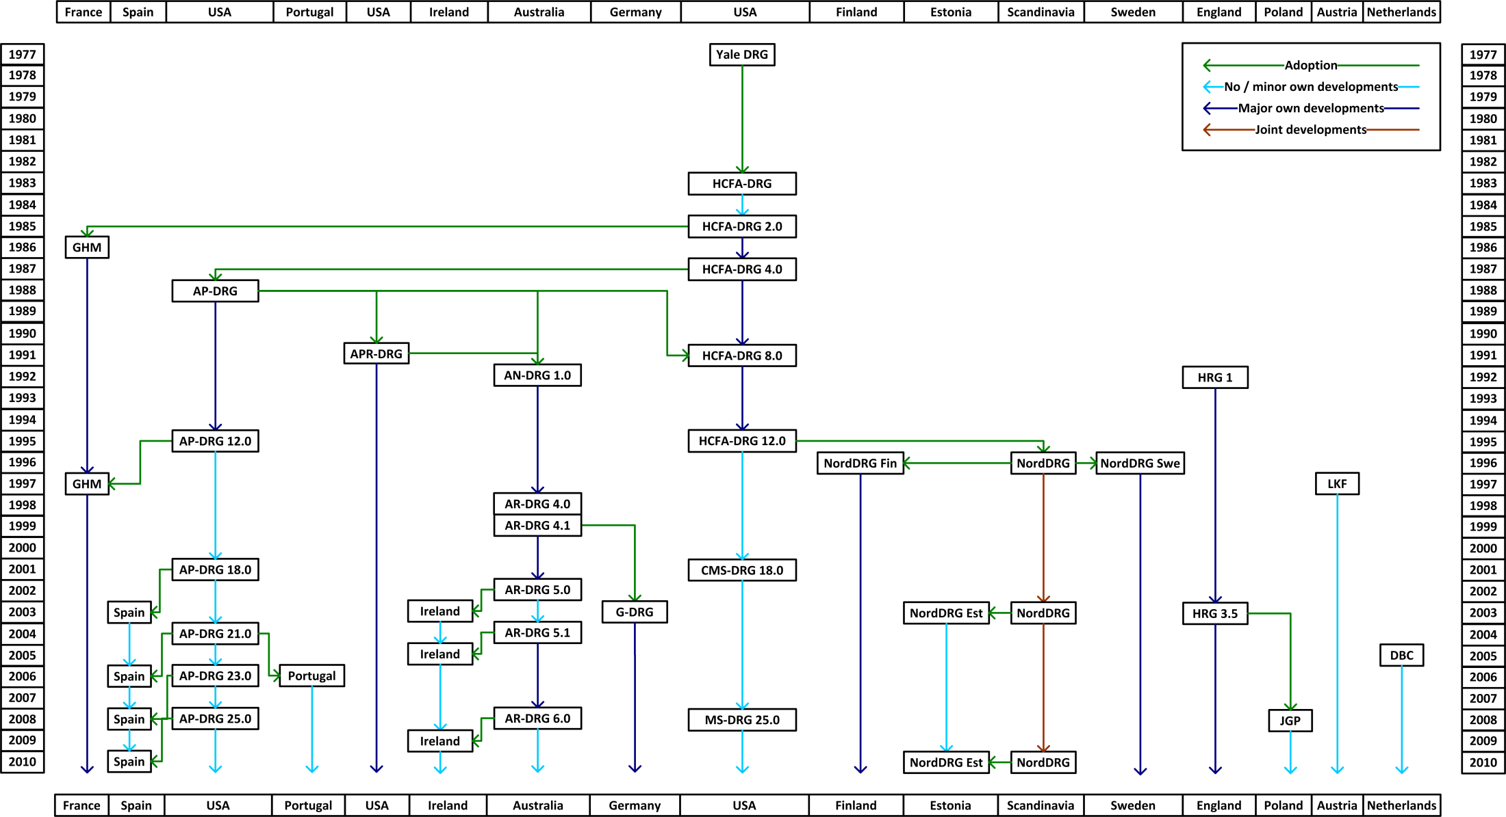
Choosing patient classification system
Patient
classification
system
1
  Diagnoses
  Procedures
  Severity
  Frequency of revisions
Find more: http://perspectives.ahima.org/disease-groupings-what-are-they/

Slide 22
Data requirements to define case groups and prices
Patient
classification
system
1
  Diagnoses
  Procedures
  Severity
  Frequency of revisions
Type | Input Data
No grouping | Average cost per hospital case
Department/specialty level grouping | Department level activity data: number of cases, cost, length of stay
Diagnosis-based grouping | Provider/department and individual level activity data: number of cases, cost, length of stay, diagnosis, age, sex, surgical procedure etc

Slide 23






6 versions of Thai DRG
2018
2012
2007
2003
1,543
2001
2,450
1999
1,920
1,283
511
511

Slide 24
Data requirements to define case groups and tariffs
Data collection
2
  Demographic data
  Clinical data
  Cost data
  Sample size, regularity
High quality clinical data on diagnoses and (surgical) procedures
Cost data to define relative weights of DRG groups and to set a base rate
    Option to import cost data but difficult to contextualize
    Good cost data requires standardized cost accounting – easier to define a sample of hospitals
    Decision what costs (recurrent/capital) costs are included
Cost does not have to be equal to the tariff/price
    Actual vs best practice
    Price incentives
Price setting
3
  Cost weights
  Base rate(s)
  Prices/ tariffs
  Average vs “best”

Slide 25
DRG’s for actual reimbursement
Actual reimbursement
4
  Volume limits
  Outliers
  High cost cases
  Quality
  Innovations
  Negotiations
Short and long stay adjustments
Exemptions based on clinical characteristics e.g. psychiatric care
Additional payments e.g. high cost drugs, ICU, dialysis
Quality adjustments e.g. no extra payment for readmissions, quality deductions or bonuses
Volume ceilings

Slide 26
Estonian case

Slide 27
Situation before introducing DRGs (2000/2001)
The average cost per case increased rapidly and volume inflation growth was fast
  increase by more than 30% between Jan.2000 and Sept.2002
Inefficient use of bed-days
  high ALOS (9,9 days in 1999)
Difficult access to care
  long queues and waiting times
FFS and per diem rates were the main payment methods for in-patient care
  perverse incentives for providers
Still an extensive over-capacity in hospital sector
DRGs were seen as a tool to:
  decrease the volume inflation
  increase further transparency of hospital output
  gain the efficiency and contain cost in terms of fixed budget of EHIF
Need for additional incentives for rising efficiency

Slide 28
Selection of the DRG model
Three alternative was considered
    Australian DRG
    NordDRG
    Build Estonia’s own case-based system
Various criteria were used to evaluate the available systems in line with other clinical classifications in use, e.g.
    Use of primary classifications
    Technical solutions (location of the grouper, invoicing system)
    Availability of technical support
    Cost of the system
    Maintenance and development of the system
    Comparison of clinical practice and hospital production
    Finally, the NordDRG system was selected

Slide 29
Stakeholder involvement
Advisory board including representatives of stakeholders
Clinical panel
    translation of terminology
    mapping of new and old procedure classification
    validation of grouping rules etc)

Slide 30
DRG cost-weights development
Critical discussion topic during DRG implementation
    EHIF developed different scenarios for advisory board of stakeholders to make the decision
Two discussion objects:
    Same or different DRG rates for different level hospitals, e.g. equal weights but different base rates?
    which cost weights to implement - Estonian own? HCFA?
  Final decision: “homemade” mix of Estonia’s own data (based on FFS billing information) and HCFA cost weights

Slide 31
Gradual implementation
2001 – decision to implement case-mix system by EHIF was made. Preparatory work included e.g.:
    Implementation of new procedure classification
    Grouping simulation to forecast the impact of DRG implementation
2003 – DRGs were used as a grouping tool
2004 – DRGs started to use as a financing tool....
.... but, DRGs were/are used in combination with the FFS and per diem rates, i.e. only a proportion of each case is reimbursed on the basis of DRG price
2004 10%
2005 50%
2009 70%

Slide 32
Before introducing DRGs (2000/2001) FFS and per diem rates were the main payment methods for in-patient care
Source: Estonian Health Insurance Fund

Slide 33
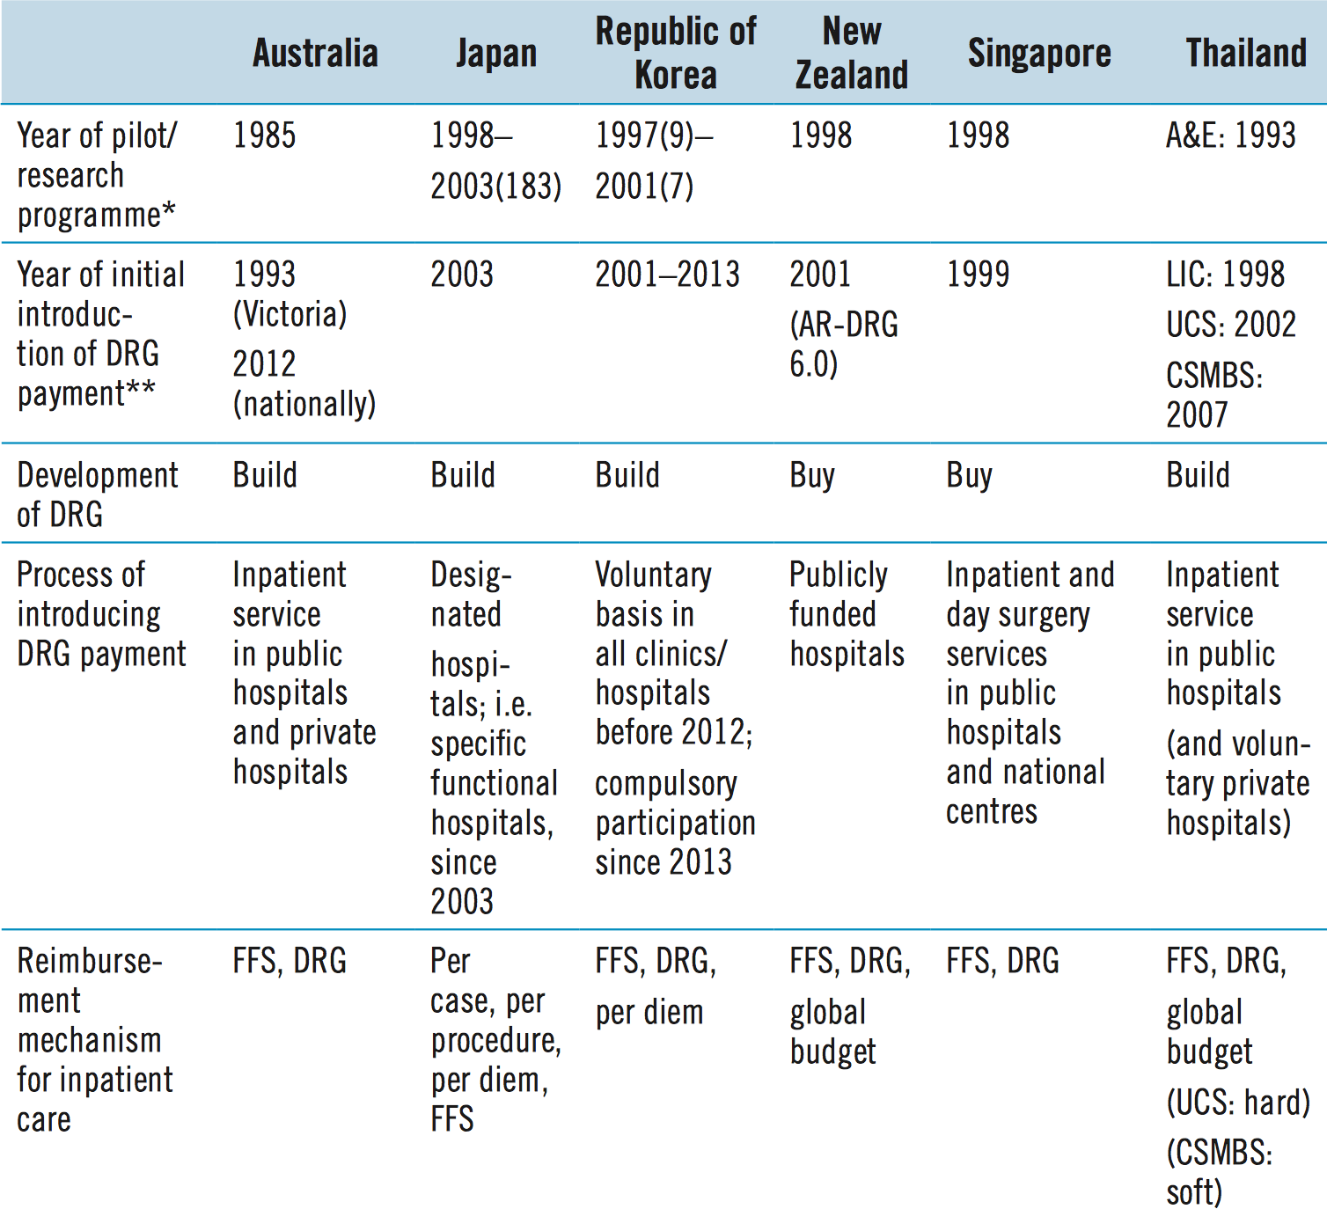
Experiences with DRG’s in Pacific Asia
Source: http://www.wpro.who.int/asia_pacific_observatory/country_comparative_studies/who_apo_drg.pdf

Slide 34
Features of DRG systems: evidence from 29 low and middle income countries
In many countries, DRG-based payments applied to both public and private sector providers
Hospitals need a certain degree of autonomy in management and spending
All countries for which information was available had a budget ceiling in place
Most of the countries used 500–800 DRG case groups (which is consistent with OECD countries)
The base rate value was ultimately a reflection of the overall amount of funding available
Most countries had adjusted cost weights in some way to their country context
The lack of standardized data generation and coding procedures had slowed down the introduction of DRGs
Source: Bull World Health Organ 2013;91:746–756A | doi: http://dx.doi.org/10.2471/BLT.12.115931

Slide 35
Impact of DRG: summarizing global evidence
Length of stay tends to decrease, in particular during the initial period following the introduction of a DRG system
Volume of hospitalizations tends to increase in countries that use DRGs to set hospital budgets, while it tends to decrease in countries that shifted from a cost-based reimbursement system to a DRG-based payment
Evidence regarding technical efficiency (cost per admission) is mixed
DRGs may also impact in an indirect way upon the non-hospital sector, as cost-shifting from inpatient to outpatient and patient-shifting to long-term or home care may take place
Evidence regarding the impact on quality is very limited but no associated detrimental impact on quality of care was observed
Source: http://www.wpro.who.int/asia_pacific_observatory/country_comparative_studies/who_apo_drg.pdf

Slide 36
Implementation: Options to phase in DRG system
Phasing of the proportion of inpatient activity covered, e.g. phasing of the number of DRGs subject to case-based payment or those with long wait times
Phasing of the proportion of the average price to be paid under new, standardized arrangements, and what proportion to be paid based on a hospital’s own, historic level of funding
Phasing the nature of costs covered by case-based payments, e.g. non-salary costs might be covered but salary costs might be paid as input-based subsidies
  “Shadow funding” arrangements can also be used, whereby hospitals are advised of what they would have received if the new funding method were implemented;
Phasing of the number of participating hospitals, e.g. voluntary participation (e.g. Republic of Korea)
Phasing the proportion of patients covered by the scheme, e.g. separation by funders
Source: http://www.wpro.who.int/asia_pacific_observatory/country_comparative_studies/who_apo_drg.pdf

Slide 37
Phase in of DRGs in Germany
2000-2002
2003 - 2004
2005 - 2009
2010 - 2014
1) Phase of preparation
2) Budget-neutral phase
3) Phase of convergence
to state-wide base rates
4) Further developments
Historical Budget (2003)
Transformation
DRG-Budget
(2004)
Nationwide base rate
Dual Financing or Monistic
Introduction of DRG-like reimbursement for psychiatric hospitals
Selective or uniform negotiations
Quality Assurance (adjustments)
Hospital specific base rate
15 %
20%
20%
20%
Statewide
base rate
25%
25%
20%
20%
20%
15 %
Hospital specific base rate

Slide 38
Key contextual factors of DRG implementation
The purpose and objective for introducing DRGs and their place in health-care financing reform need to be clear
The design and strength of hospital information systems must be adequate to describe, track and monitor changes in the volume and type of services provided
The degree of hospital autonomy in decisions regarding resource allocation and management in relation to financial incentives
The availability of DRG cost estimates is not a prerequisite for the introduction of a DRG-based payment system - several countries have adjusted to the local context DRG weights imported from other countries to set prices when phasing in the system
To be effective, DRG-based payment systems should be supplemented by regulatory mechanisms, such as activity ceilings, marginal pricing, data audit, monitoring of the care process, and measurement of patient satisfaction and health outcomes
The political and economic environment is important
Source: http://www.wpro.who.int/asia_pacific_observatory/country_comparative_studies/who_apo_drg.pdf

