Slide 1




Chiara Pelino
Institution Building, TAIEX, Twinning
DG Neighbourhood and Enlargement Negotiations

Slide 2



PRESENTATION SUMMARY
Institution Building Unit
1 HOW DOES TAIEX WORK?
2 STATISTICS
3 VIDEO

Slide 3




1/
MISSION STATEMENT
TAIEX SUPPORTS BENEFICIARY COUNTRIES IN:
● UNDERSTANDING
● DRAFTING
● IMPLEMENTING & ENFORCING
EU POLICIES , LEGISLATION, RULES – THE ACQUIS

Slide 4
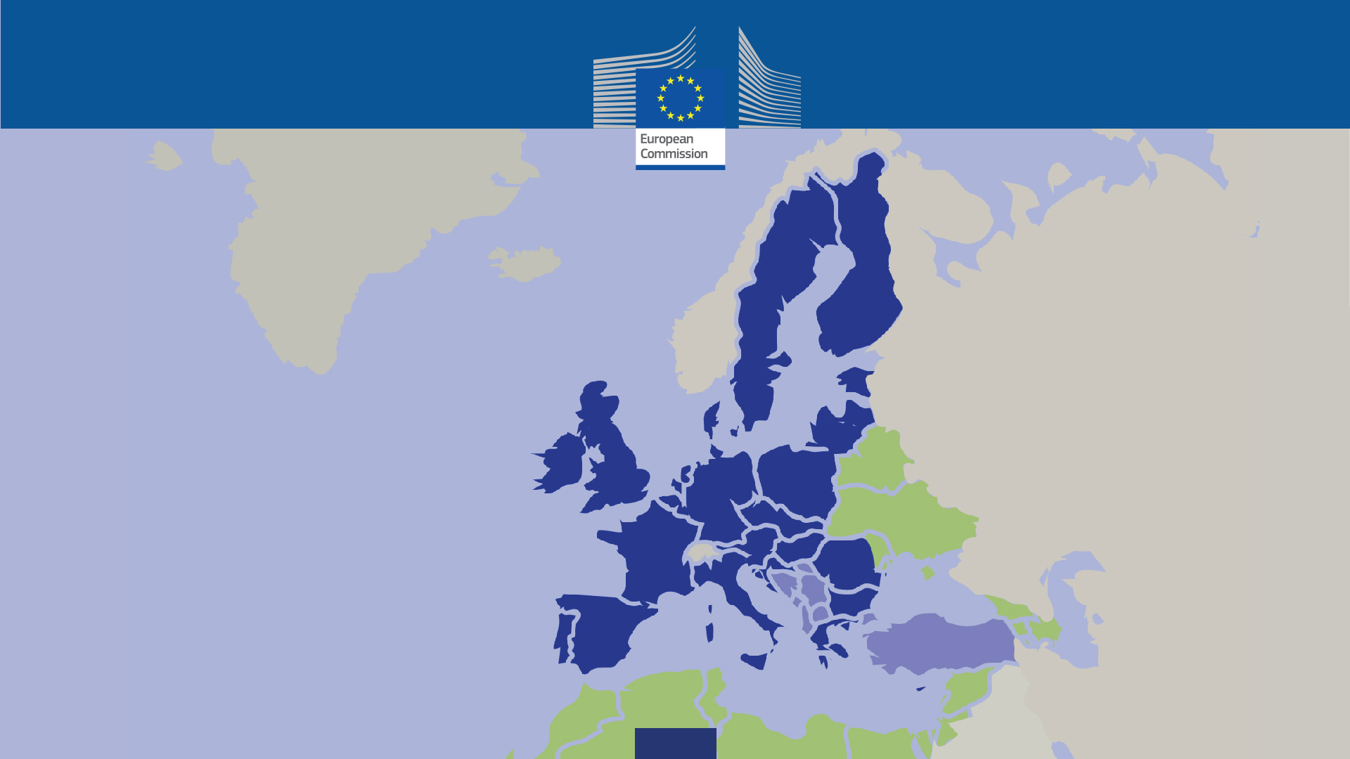
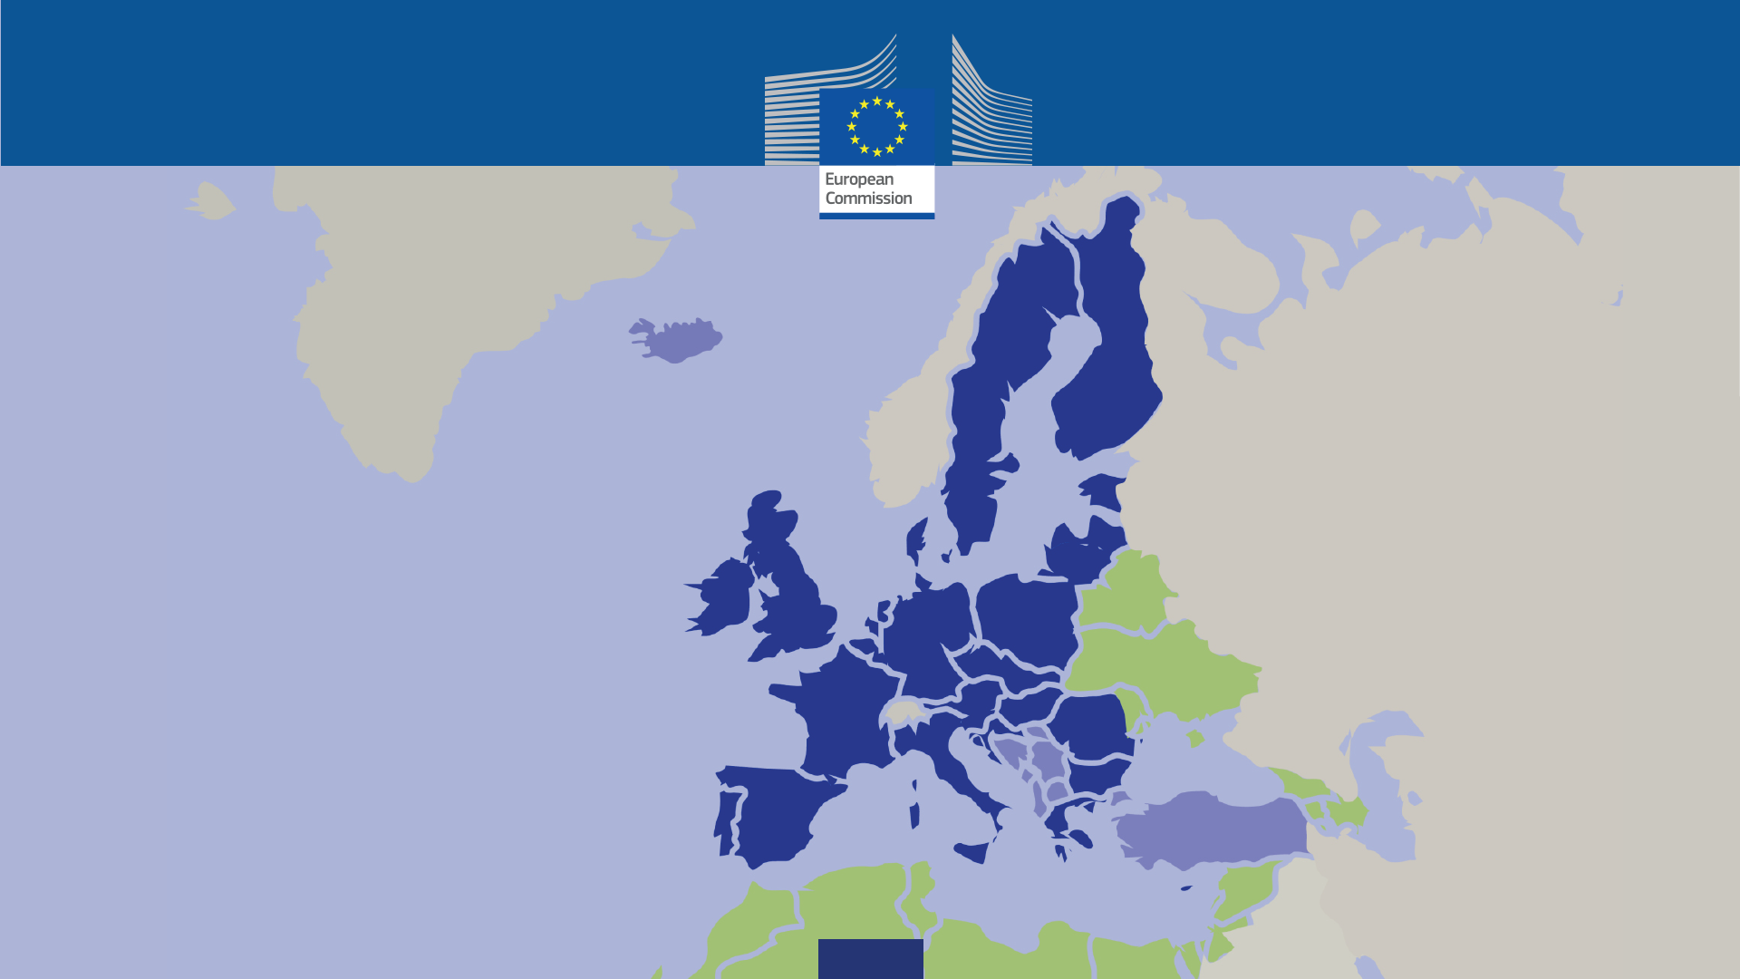
2/
BENEFICIARIES

Slide 5





3/
FORMS OF ASSISTANCE
CLASSIC TAIEX ASSISTANCE
DELIVERED THROUGH:
Strategic TAIEX
New feature – closer alignment assistance and policy priorities
Possibility for EU Delegations and European Commission services to request
TAIEX events to push forward reforms on agreed common priorities
:
WORKSHOPS
EXPERT MISSIONS
STUDY VISITS
SINGLE OR MULTI-BENEFICIARY

Slide 6















4/
MAIN AREAS COVERED
JUSTICE
HOME AFFAIRS
INTERNAL MARKET
CUSTOMS
EMPLOYMENT
SOCIAL POLICY
AGRICULTURE
FOOD SAFETY
ENVIRONMENT
ENERGY
TRANSPORT
TELECOMMUNICATIONS

Slide 7




5/
"PEER TO PEER" EXPERTISE
MOBILISED EXPERTS ARE ALMOST EXCLUSIVELY
EU MEMBER STATES’ PUBLIC-SECTOR OFFICIALS
● Every year 5.000 EU
Member State public experts
reach (exchange expertise with)
30.000 counterparts
in beneficiaries' administrations
● such expertise is not available
in the private sector
TAIEX Expert Database
Any public official of a Member State
familiar with EU legislation
is encouraged to register online

Slide 8





6/
TAIEX: A SUCCESS STORY
● DEMAND DRIVEN
ADAPTED TO YOUR NEEDS
● PEER-TO-PEER
NETWORKING
BETWEEN MEMBER STATES
AND BENEFICIARY OFFICIALS
● GAP-FILLING
TARGETED AND COMPLEMENTARY
TO OTHER EU ASSISTANCE
● SHORT TERM ASSISTANCE,
LONG TERM EFFECT
● QUICK
STRAIGHTFORWARD APPLICATION
AND FAST DELIVERY

Slide 9








7/
TAIEX CYCLE
1
SUBMISSION
REQUEST
2
CONSULTATION
PROCESS
3
APPROVAL
6
EVALUATION
5
IMPLEMENTATION
4
PLANNING, EXPERT
IDENTIFICATION

Slide 10

8/
STATISTICS

Slide 11
2016 IN NUMBERS
Participants
Activities
Experts
3 368
1 424
25 447

Slide 12
NUMBER OF ACTIVITIES ORGANISED PER SECTOR IN 2016

Slide 13
EVENTS BREAKDOWN - IPA BENEFICIARIES IN 2016

Slide 14
EVENTS BREAKDOWN - ENI EAST BENEFICIARIES IN 2016

Slide 15
EVENTS BREAKDOWN - ENI SOUTH BENEFICIARIES IN 2016

Slide 19
9/
FEEDBACK AND IMPACT EVALUATION

Slide 20
FEEDBACK OF THE BENEFICIARIES ON THE QUALITY OF THE EXPERTS

Slide 21
IMPACT EVALUATION OF TAIEX ASSISTANCE AFTER 6 MONTHS SINCE January 2015

Slide 22

Key elements for a successful request:
Clear, complete and detailed information
English proof reading

Slide 23

Key elements for a successful request:
References, whenever possible, to previous TAIEX and TWINNIG assistance (or other types of assistance) in the same area;
Proposal of MS Experts/Host Institutions in the request
Nomination of a competent* Local Co-Organizer

Slide 24
Key elements for a successful request:
* Also Known As:
"Contact person for administrative questions and practical matters related to this event"
[TAIEX Request Form]

Slide 25
Tips for a successful implementation and follow up of events:
the role of the LCO
Inform and liaise with the participants, monitor and ensure their presence and active participation, moderate/chair meetings, participate in evaluations.
Pro-active
Good command of English/French
Able to follow-up and meet deadlines

Slide 26
Tips for a successful implementation and follow up of events:
the role of the LCO as for EXPERT MISSION
Drafting a meaningful agenda
Indicate if interpretation is needed or not
Include the name of the institution and the address of the venue (on the cover)
On-time submission of agenda and participant list

Slide 27

Tips for a successful implementation and follow up of events:
the role of the LCO as for EXPERT MISSION
Ensure the participation and the meetings are conducted according the agenda
Request the mission evaluation report from the NCP after the completion of the mission

Slide 28
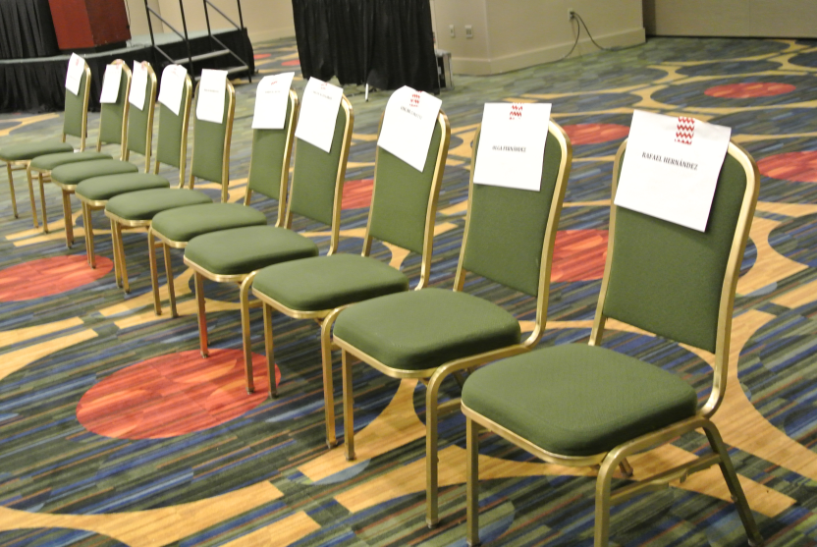
Tips for a successful implementation and follow up of events:
the role of the LCO as for WORKSHOP
Drafting a meaningful agenda; Propose experts;
Confirm participation of each participant before submitting the list.
participation comes with a cost for TAIEX. Absences should not be tolerated (except in rare and well justified cases).

Slide 29

Tips for a successful implementation and follow up of events:
the role of the LCO as for WORKSHOP
On-time submission of agenda and participant list;
After the deadline, replacement or addition of participants poses big logistical problems, therefore it is not allowed.
Inform the participants in advance about:
the rules governing their attendance: the Guide for Participants.
The link to TAIEX library, where they can find all presentations

Slide 30

Tips for a successful implementation and follow up of events:
the role of the LCO as for WORKSHOP
Chair and moderate the workshop
Give and encourage feedback (through evaluation)

Slide 31



Tips for a successful implementation and follow up of events:
the role of the LCO as for STUDY VISIT
Explain clearly what are the objectives of the visit, what kind of information and/or experience is sought;
On-time submission of agenda and participant forms;
Insure the relevant staff is selected for participation, based on their actual responsibilities and language skills;
Inform TAIEX about visa obligations (if any).

Slide 32

Tips for a successful implementation and follow up of events:
the role of the LCO as for STUDY VISIT
Inform the participants in advance about the rules governing their attendance: the Guide for Participants
Invite the participants to share their experience with the colleagues with the organization of internal meetings.
Follow-up actions
Sharing the information and expertise with the colleagues
Recommendations

Slide 33
NOVELTY IN E-APPLICATION
YOU CAN ASK FOR SERIES OF ACTIVITIES (up to 5) with one application: there is an additional tab allowing you to request
The validity of the application is up to 2 years.

Slide 34
QUESTIONS?

Slide 35
Thank you for your attention!
Stay connected with us
E-mail: chiara.pelino@ec.europa.eu
NEAR-taiex@ec.europa.eu
Twitter: #EUTaiex
Web site: http://ec.europa.eu/taiex

