Slide 1


Status of Georgian translation
3rd Working Group Meeting
May 18, 2017

Slide 2
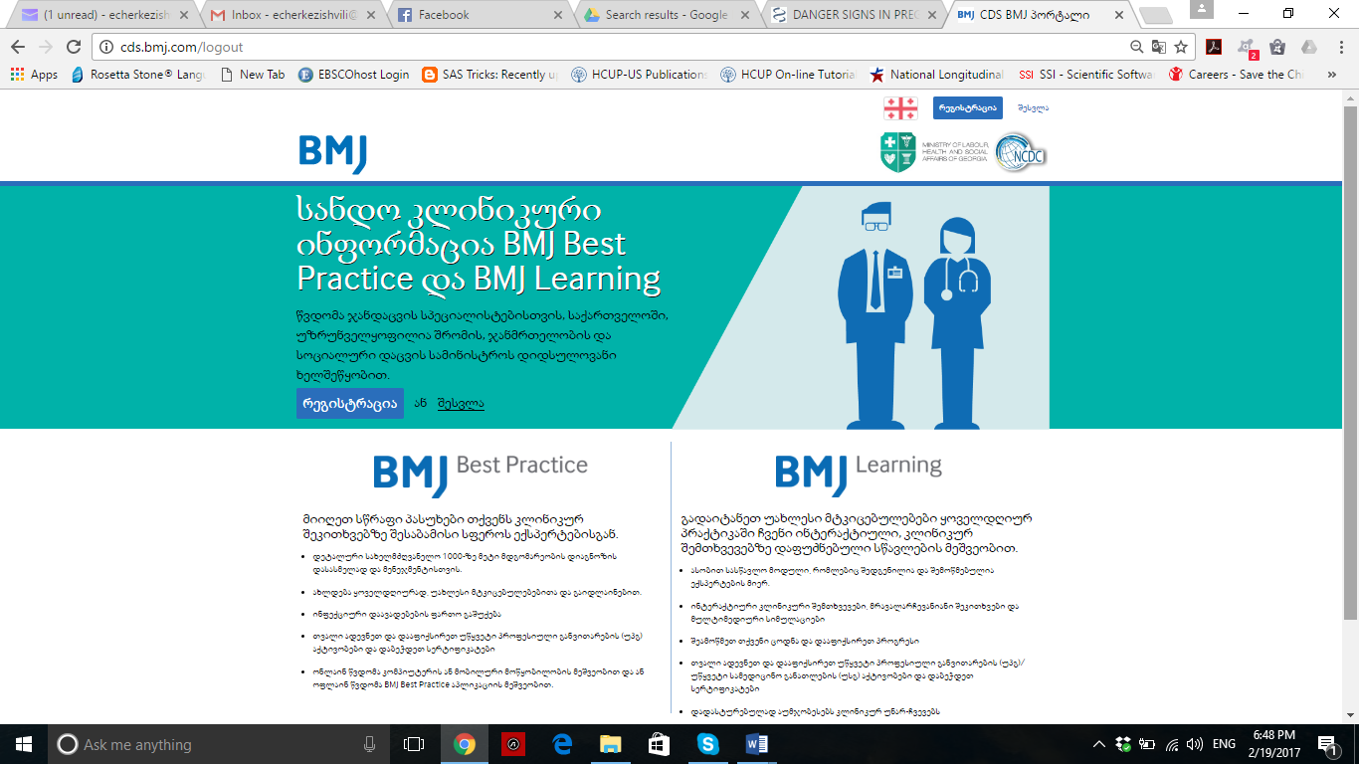

Slide 3
Translated Best Practice Modules
Atypical Pneumonia
Chronic Kidney Disease
Acute Bronchitis
Henipaviruses
Malaria
Hospital acquired pneumonia
Rheumatoid arthritis
Pulmonary Tuberculosis
Lymphadenopathy
Yersinia infection
Fever of unknown origin
Tickborne encephalitis
Venezuelan equine encephalitis
Ehrlichiosis
Assessment of Dysphagia Overview of Pneumonia
Overview of Seizure Disorder
Overview of Diabetes
Anthrax
Herpes B
Lupus
Melioidosis
Translated Learning Modules
Sore throat: diagnostic picture tests
Delirium

Slide 4
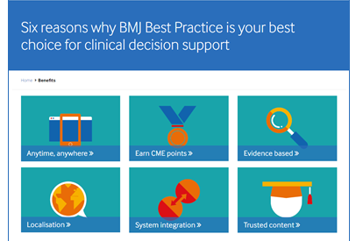

Slide 5
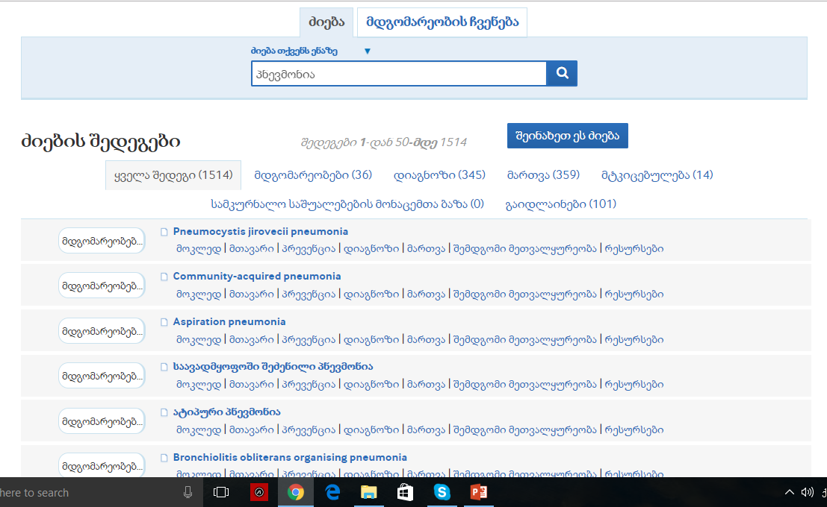
Fully functional Search in Georgia

Slide 6
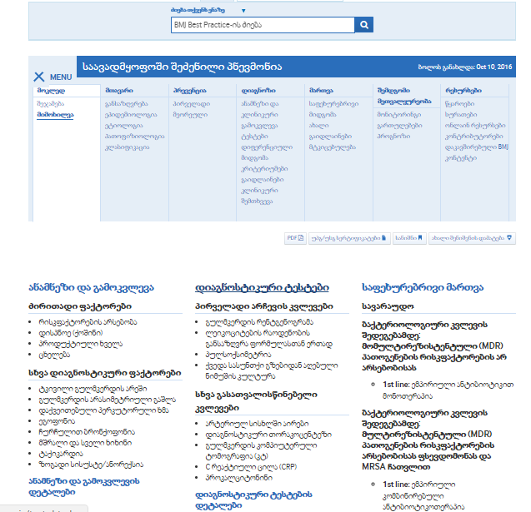
Example of Condition Monograph

Slide 7
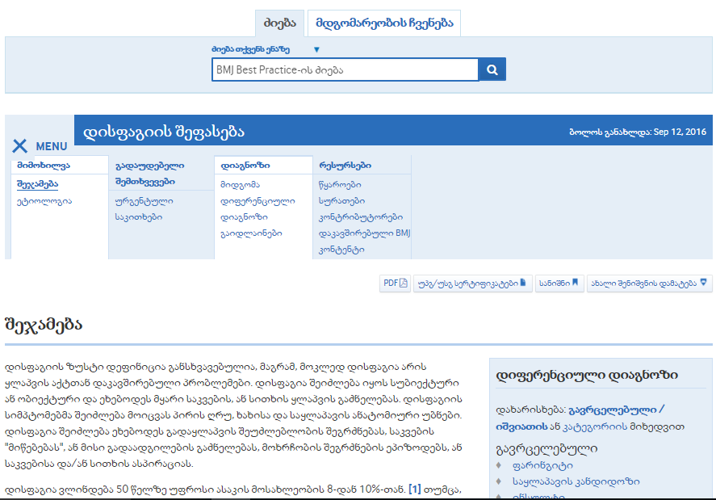
Example of Assessment Monograph

Slide 8
Example of Assessment Monograph

Slide 9
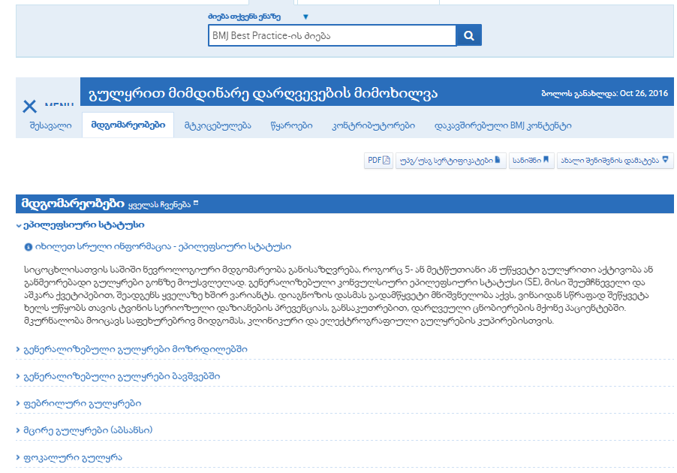
Example of Overview Monograph

Slide 10
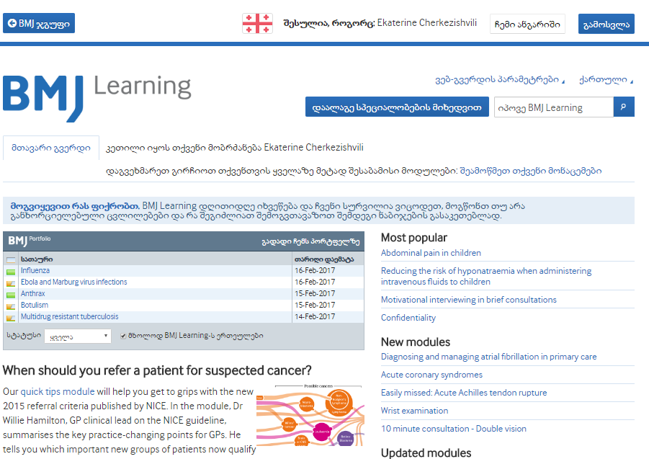

Slide 11
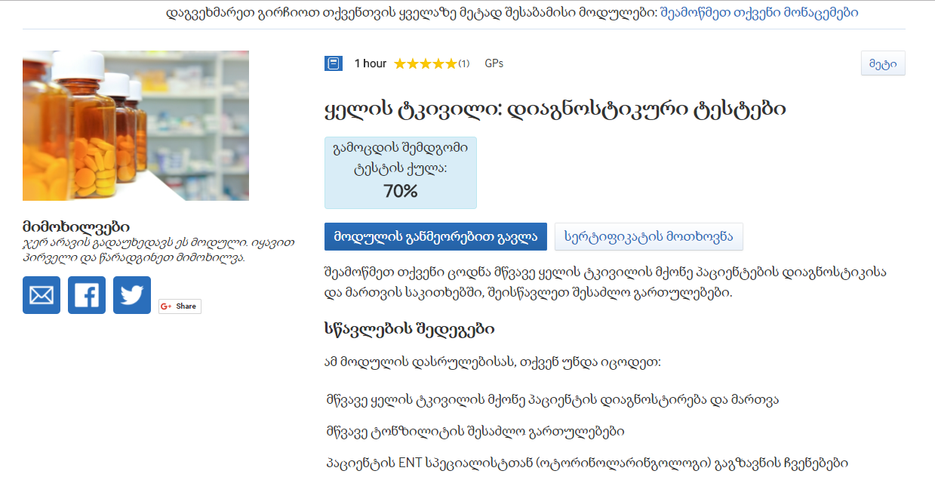
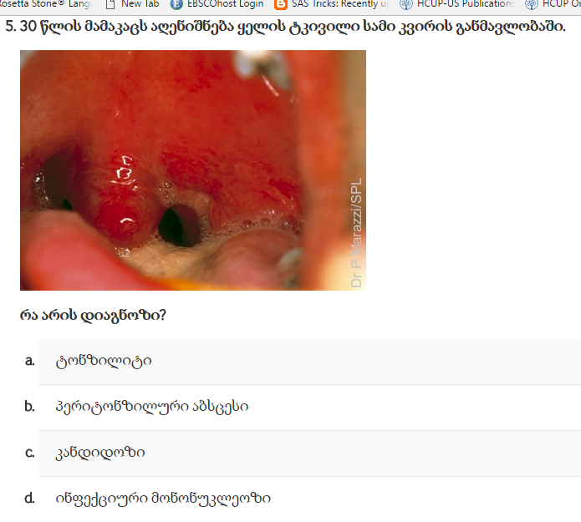
Learning Module

Slide 12
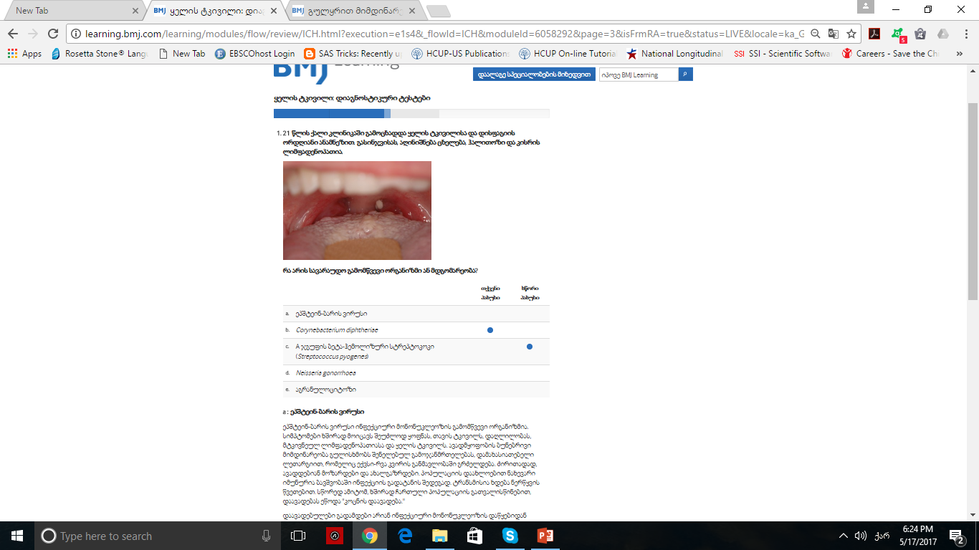

Slide 13
How we create Georgian Portal
Separate Translation and Quality Assurance team
Multiple stages before signing of topics
Regular bi-weekly meetings
Regularly updated shared glossary

Slide 14
Thank You
Questions?

