Slide 1

State Public Health Programs
Eteri Kipiani, MD
Department of State Programs
9 May, 2017
დაავადებათა კონტროლისა და საზოგადოებრივი ჯანმრთელობის ეროვნული ცენტი
www.ncdc.ge
National Center for Disease Control & Public Health
www.ncdc.ge
Notes:
1

Slide 2
State Public Health Programs
State public health programs are adopted by the Resolution №638 of the GoG, dated on 30 December, 2016 on “Approval of the 2017 State Healthcare Programs” and include:
State Public Health Programs | Other vertical programs
Disease Early Detection and screening | Mental Health
Immunization | Management of Diabetes
Epidemiological Surveillance | Child Onco-hematology
Safe Blood | Dialysis and Kidney Transplantation
Prevention of Occupational Diseases | Palliative Care of Incurable Patients
Management of Tuberculosis | Treatment of Rare Diseases
Management of HIV/AIDS | Ambulance and Emergency Care
Mather and Child Health | Rural Doctor
Health Promotion | Medical Screening for Army Recruits
Management of Hepatitis | Referral Service
 | Treatment of Drug Users
დაავადებათა კონტროლისა და საზოგადოებრივი ჯანმრთელობის ეროვნული ცენტრი
www.ncdc.ge
National Center for Disease Control & Public Health
www.ncdc.ge
Notes:
2

Slide 3
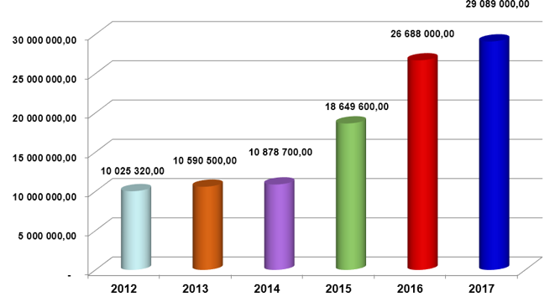
Budget of the State programs administered
by NCDC
www.ncdc.ge
National Center for Disease Control & Public Health
www.ncdc.ge
www.ncdc.ge
www.ncdc.ge
Notes:
3

Slide 4
Early Disease Detection and Screening
The main goal of the program is the early detection and prevention of the spread of diseases. The program includes the following components:
Cancer Screening Component provides:
Screening of breast, cervical, colorectal and prostate cancer in consideration of specific age range, in particular:
Mammography and ultrasound examination for women aged from 40 to 70 years old every 2 years
Screening for cervical cancer in women age 25 to 60 years with cytology (Pap smear) and colposcopy every 3 years
Fecal occult blood testing and colonoscopy in adults beginning at age 50 years and continuing until age 70 years every 2 years
Prostate cancer antigen testing for men between the age of 50-70 once in the year in case of physician’s referral
Program services are provided by contractor organization - Evex Medical Corporation through its regional branches and mobile units.
დაავადებათა კონტროლისა და საზოგადოებრივი ჯანმრთელობის ეროვნული ცენტრი
www.ncdc.ge
National Center for Disease Control & Public Health
www.ncdc.ge

Slide 5
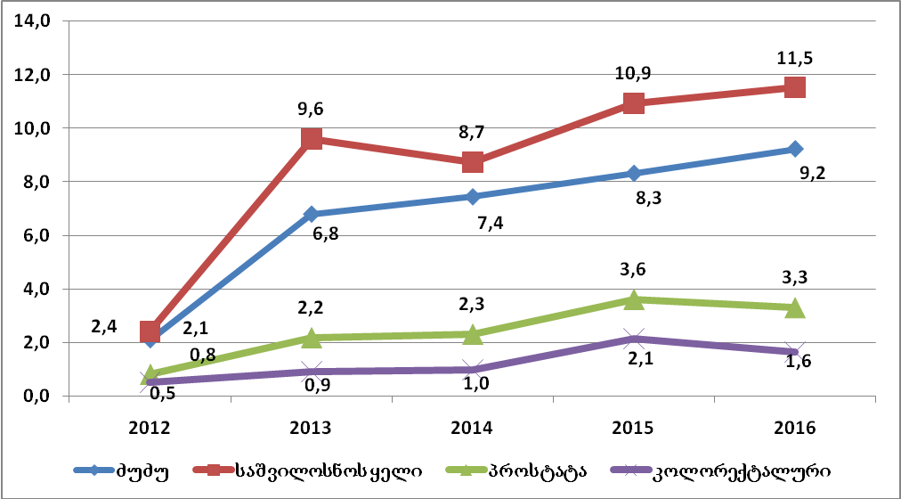
Dynamic of screening coverage for different cancer localizations in 2012-2016
Breast
cancer
Cervical cancer
Prostate cancer
Colorectal cancer
დაავადებათა კონტროლისა და საზოგადოებრივი ჯანმრთელობის ეროვნული ცენტრი
www.ncdc.ge
National Center for Disease Control & Public Health
www.ncdc.ge

Slide 6

Early Disease Detection and Screening
Organized cervical cancer screening component
Results are sent back to the rural doctor
Rural doctor consults women between age 25-60 and either refers them to the service provider clinic or collects Pap smears and sends them to the service provider for cytological examination once in a week;
Rural doctor informs the patient about testing outcome and in case of abnormal results refers the patients to the service provider clinic for further colposcopy and/or biopsy
A pilot of organized screening has been launched in Gurjaani Municipality in 2014.
Service provider is non-profit organization Kakheti-Ioni
In 2015, equipment for cervical cancer screening was purchased by the funds allocated from the state budget.
In 2015-2016, in close collaboration with UNFPA training courses have been conducted for rural doctors in Pap smear collection technique
Since 2016, rural doctors are given the opportunity to take over the Pap testing and make referral to service provider clinic.
In 2016, total number of target population was 11 791 persons, annual target was 3930 and the coverage rate reached 28.5% (1122 persons).
Results are sent back to the rural doctor
Treatment results and history are sent back to the rural doctor.
Rural doctor informs patients about testing results and in case of precancerous disease refers them to the specialized clinic and those with cancer are referred to the secondary level hospital.
National Center for Disease Control & Public Health
www.ncdc.ge
www.ncdc.ge

Slide 7
Early Disease Detection and Screening
Other program components include:
Prevention of mild and moderate mental disorders in children aged 1 to 6 years
Early diagnosis and surveillance of epilepsy
Newborn screening for Retinopathy of prematurity (ROP)
National Center for Disease Control & Public Health
www.ncdc.ge
www.ncdc.ge

Slide 8
Early Disease Detection and Screening Budget
№ | Component | Budget GEL
1 | Cancer screening | 1 200 000
2 | Organized cervical cancer screening | 40 000
3 | Prevention of mild and moderate mental disorders in children aged 1 to 6 years | 170 000
4 | Early diagnosis and surveillance of epilepsy | 400 000
5 | Newborn screening for Retinopathy of prematurity (ROP) | 90 000
Total |  | 1 900 000
დაავადებათა კონტროლისა და საზოგადოებრივი ჯანმრთელობის ეროვნული ცენტრი
www.ncdc.ge
National Center for Disease Control & Public Health
www.ncdc.ge

Slide 9
State Immunization Program
The goal of the program is to protect the population from vaccine-preventable diseases, to ensure provision of rabies vaccine and immunoglobulin and to create strategic stockpiles of specific serums and vaccines.
Program activities include:
Procurement of vaccines and vaccination materials (syringes and safe boxes) for vaccination of children up to 15 years old
Procurement of vaccines against hepatitis B for patients with the diagnosis of HIV/AIDS and hepatitis C
Procurement of specific serums (against botulism, diphtheria, tetanus, snake venom antiserum) and yellow fever vaccine strategic supply
Procurement of rabies vaccine and immunoglobulin for treatment purposes
Procurement of influenza vaccines
Storage and distribution of vaccines, serumsand vaccination materials in compliance with the Cold Chain principles, from the central level through the administrative units
Vaccination of persons up to 30 years old with incomplete or no measles vaccination.
National Center for Disease Control & Public Health
www.ncdc.ge
Notes:
9

Slide 10
State Immunization Program
State Immunization Program has a separate budget line within the Law of Georgia “On State Budget of Georgia” which allocates funds for vaccine procurement.
The Program has fully undertaken the financial obligation of purchasing of new vaccines (such as PCV, Rotavirus, Pentavalent) from Gavi Alliance.
For vaccine procurement both the UNICEF mechanism and an electronic tender platform are applied by the program.
State program purchases vaccines that are WHO prequalified, safe and effective despite the country of origin and are fully covered by the program budget.
Immunization services for children are completely free of charge and are covered by the Universal Health Program and Rural Doctor State Program.
Geographical access to immunization services are fully ensured by the program.
National Center for Disease Control & Public Health
www.ncdc.ge
Notes:
10

Slide 11
State Immunization Program
Immunization services are provided by 307 medical facilities and 2617 rural doctors that have registered children up to 15 years old, have necessary conditions for vaccine storage and logistics in accordance with the Ministers decree №01-57/N, are registered by appropriate public health centers as service providers and ensure free of charge vaccination service for program beneficiaries.
Center renders vaccines and vaccination materials to municipal public health centers that distribute them to service providers throughout the country.
During the last several years no interruption in vaccine supply was observed.
Since 2015, no single case of rabies disease was registered.
In 2014-2015 upgrading of Cold Chain infrastructure was performed at central and regional levels within the program limits.
The program budget provided an effective response measures to cope with the measles outbreak in 2013-2015
National Center for Disease Control & Public Health
www.ncdc.ge
Notes:
11

Slide 12
State Immunization Program
Program budget:
№ | Component | Budget GEL
1 | Procurement of vaccine and vaccination materials | 11 573 000
2 | Procurement of specific serums and vaccines | 40 000
3 | Procurement of rabies vaccine and immunoglobulin | 4 300 000
4 | Procurement of influenza vaccine | 300 000
5 | Reimbursement for vaccination and physician consultation | 40 000
Total |  | 16 253 000
დაავადებათა კონტროლისა და საზოგადოებრივი ჯანმრთელობის ეროვნული ცენტრი
www.ncdc.ge
National Center for Disease Control & Public Health
www.ncdc.ge

Slide 13
Epidemiological Surveillance State Program
The goal of the program is to provide control over communicable and non-communicable diseases, ensure disease detection, adequate response and prevention measures through the epidemiological surveillance and laboratory-based system. Within the vertical program funding:
The Center contracts 59 municipal public health centers that:
coordinate the immunization activities, ensure the quality of statistical reporting and provide epidemiological surveillance in respective municipalities.
provide the surveillance over the malaria including the laboratory diagnostics of diseases with specific symptoms and the bonification measures against malaria vectors.
Program provides funding for control and surveillance over the hospital infections, influenza and diarrhea through sentinel surveillance sites.
დაავადებათა კონტროლისა და საზოგადოებრივი ჯანმრთელობის ეროვნული ცენტრი
www.ncdc.ge
National Center for Disease Control & Public Health
www.ncdc.ge

Slide 14
Epidemiological Surveillance State Program
Component | Budget (GEL)
Provision of surveillance, immunization and medical statistics system at regional and municipal level by local public health centers | 548 000
Prevention and control of malaria and other transmissible diseases | 831 000
Hospital infection Surveillance | 21 000
Diagnostic of viral diarrhea | 77 000
Influenza surveillance network sustainability and seasonal/pandemic influenza response measures through sentinel stations | 302 000
Total | 1 779 000
დაავადებათა კონტროლისა და საზოგადოებრივი ჯანმრთელობის ეროვნული ცენტრი
დაავადებათ კონტროლისა და საზოგადოებრივი ჯანმრთელობის ეროვნული ცენტრი
www.ncdc.ge
National Center for Disease Control & Public Health
www.ncdc.ge
www.ncdc.ge

Slide 15
Safe Blood
Since 1997, a State Safe Blood Program operates in the country which aims at preventing the spread of transfusion transmissible infections.
Program ensures:
Screening of 100% of blood donations for Hepatitis B and C, HIV by means of EIA method and Syphilis (using TPHA method) as well as blood group and rhesus determination
Provision of external quality control by Lugar Center of NCDC and Internationally accredited Reference laboratory
Upgrading and administration of Blood Donor Database
Popularization of regular unpaid blood donations
Currently, there are 12 blood establishments enrolled in the program, approximately 70 000 donations are performed per year and percentage of non-paid donations reached 30% of the total donations in 2016.
National Center for Disease Control & Public Health
www.ncdc.ge

Slide 16
Statistical Data
Number and percentage of non-paid donations have been increased and reached 30% of the total donation in 2016
National Center for Disease Control & Public Health
www.ncdc.ge

Slide 17
Statistical Data
Share of screening positive transfusion transmissible infections among all donations performed in 2016
0.1%
0.5%
1%
0.8%
National Center for Disease Control & Public Health
www.ncdc.ge
Notes:
This slide shows that the portion of HCV screening positive donations is higher in comparison with other transfusion transmissible infections and reaches 1 % among all donations performed in 2016.

Slide 18
Safe Blood
Component | Budget
Screening of 100% of blood donations for Hepatitis B and C, HIV by means of EIA method and Syphilis (using TPHA method) as well as blood group and rhesus determination | 1,530.0
- Provision of external quality control by Lugar Center of NCDC and Internationally accredited Reference laboratory - Upgrading and administration of Blood Donor Database | 115.0
Popularization of regular unpaid blood donations | 55.0
Total | 1 700 000
National Center for Disease Control & Public Health
www.ncdc.ge
Notes:
Since 1997, a State Safe Blood Program operates in the country which is carried out by National Center for Disease Control and Public Health since 2011. The goal of the program is to prevent the spread of transfusion transmissible infections. Program provides the following activities:
- Screening of blood donors for Hepatitis B and C, HIV and Syphilis (using TPHA method) as well as blood group and rhesus determination.
- Provision of external quality control by Lugar Center of NCDC and Internationally accredited Reference laboratory. There are two mechanisms for external quality control. First is that state program requires from participating blood banks
to keep blood portions (aliquots) from each donation for two years and 5% of them are randomly selected and sent to Lugar Center for their retesting. Another option is that state program also requires from blood banks to contract internationally accredited reference laboratories and conduct proficiency testing.
- Popularization of regular unpaid blood donations and supporting campaigns including activities related to the World Blood Donor Day.
There are 12 blood establishments involved in the state program.
Since 2005, an electronic Donor Database has been launched which incorporates information on donors and donations from 16 blood banks.

Slide 19
Prevention of Occupational Diseases
The goal of the program is protection of the health of employed population through the prevention of diseases caused by occupation and support to a safe working environment, as well as the investigation of employee’s health, assessment of occupational health risks and provision of appropriate recommendations
Currently , service provider organization conducts investigation at three industrial companies which includes:
Examination and monitoring of employees health status
Identification and assessment of occupational risk factors
Elaboration of recommendations regarding the reduction of harmful exposition for certain organization
Conducting training courses for administration staff and employees on the subject of risk assessment, control and disease prevention
Creation of epidemiological map of occupational risks factors and operation of database
Program budget is 270 000 GEL
National Center for Disease Control & Public Health
www.ncdc.ge
Notes:
19

Slide 20
Mother and Child Health
Program component implemented by the Center:
Provides the tests (hepatitis B and C, HIV/AIDS and syphilis) and consumables for screening of pregnant women enrolled in the antenatal component
Ensues confirmatory diagnostic of screening positive cases of hepatitis B and syphilis
Provides hepatitis B immunoglobulin for infants born to a mother with hepatitis B infection.
The program also provides newborn hearing screening at all existing maternity homes throughout Tbilisi that primarily aims to identify congenital hearing problems in children in order to prevent further complication of diseases.
Program budget – 474 000 GEL
National Center for Disease Control & Public Health
www.ncdc.ge
Notes:
20

Slide 21
Mother and Child Health
Currently, there are 325 antenatal service providers
45 400 pregnant women have been screened in 2016 and among them:
5 cases of confirmed HIV
820 cases of confirmed Hepatitis B
49 cases of confirmed syphilis
194 Hepatitis C screening positive cases.
NCDC coordinates state, municipal (Ajara) and donor (Imereti, Samegrelo, Guria regions) newborn hearing screening.
Overall, there were 31 838 newborns screened by all parallel programs in 2016 and among them - 23 090 within the state program limits.
13 cases of deafness were revealed.
National Center for Disease Control & Public Health
www.ncdc.ge
Notes:
21

Slide 22
Health Promotion
The program aims to raise the awareness and education of the Georgian population on health and to create an environment supporting population health. The program includes the following priority directions:
Strengthening tobacco control
Education on healthy diet
Raising the awareness about alcohol abuse
Promotion of physical activity
Prevention of hepatitis C and promotion of public education
Promotion of mental health and prevention of drug abuse
Health promotion popularization and strengthening.
National Center for Disease Control & Public Health
www.ncdc.ge
Notes:
22

Slide 23
Thank you!
National Center for Disease Control & Public Health
www.ncdc.ge

