Slide 1
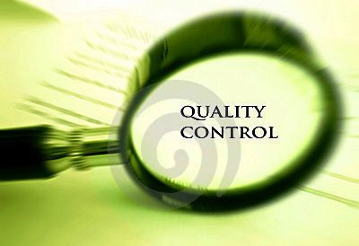
Quality Control National Strategy of Healthcare Services

Slide 2
Increasing Importance of Healthcare Quality Control for MoLHSA
Assessing the quality of care has become increasingly important for MoLHSA after becoming the primary purchaser of healthcare services by implementing Universal Health care program.
MoLHSA has begun to focus on transparency and the cost-effectiveness of health care system in producing of health outcomes.
By implementing Universal Health care program , accessibility of healthcare services has been assured national wide. Now, Patients need information about the quality of care in order to make informed choices.

Slide 3

Quality Control Strategy of Health care Services
The aim of Quality Control Strategy is to secure mutual grounding and methods for documentation, and development of the quality of health care services national wide, for benefits of the patients:
  Improve prevention, diagnostics, treatment, and rehabilitation;
  Provide documentation for setting priorities
  Create an information resources for Patients and Service purchasers
For assessment of healthcare service quality MoHLSA would implement Quality Control Core National indicators

Slide 4

Development of Core National Quality Indicators
Health care domains
Effectiveness. Relates to providing care processes and achieving outcomes as supported by scientific evidence.
Efficiency. Relates to maximizing the quality of a comparable unit of health care delivered or unit of health benefit achieved for a given unit of health care resources used.
Equity. Relates to providing health care of equal quality to those who may differ in personal characteristics other than their clinical condition or preferences for care.
Patient centeredness. Relates to meeting patients' needs and preferences and providing education and support.
Safety. Relates to actual or potential bodily harm.
Timeliness. Relates to obtaining needed care while minimizing delays.
Mattke, S., et al. Health Care Quality Indicators Project Initial Indicators Report. 2006. OECD Health Working Papers. No. 22. Available at: http://www.oecd.org/dataoecd/1/34/36262514.pdf, last accessed September 2006.

Slide 5

Development of Core National Quality Indicators
Selection of indicators would be based on:
importance
• Impact on health.
• Policy importance.
• Susceptibility
scientific soundness
• Face validity
• Content validity
• Reliability.
Feasibility
Data availability
Comparability issues
Overall Assessment
If there is no scientific evidence available and the clinical problem is relation to the disease is very important, indicators are determined by consensus among experts group and MoHLSA.
Mattke, S., et al. Health Care Quality Indicators Project Initial Indicators Report. 2006. OECD Health Working Papers. No. 22. Available at: http://www.oecd.org/dataoecd/1/34/36262514.pdf, last accessed September 2006.

Slide 6

Quality Control Process
There are eight steps involved in implementing QC cycle:
Step 1→ Choose Core national indicators and benchmarks
Step 2→ Identify the Importance, Scientific Soundness, and Feasibility of indicators.
Step 3→ Determine ways to collect the information.
Step 4→ Approve Core national indicators and benchmarks
Step 5→ Compare collected information with the established Benchmarks.
Step 6→ analyze quality of Health care services.
Step 7→ Provide information and if necessary, take corrective action regarding finding to appropriate source.
Step 8→ Determine when there is a need for re-evaluation

Slide 7
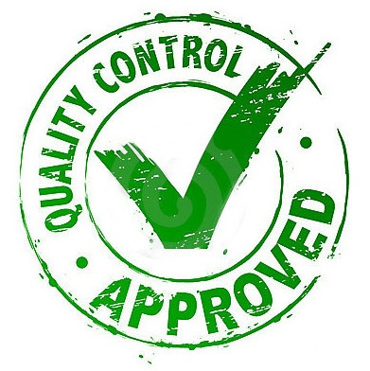
Quality Control Process Cycle
Department of Strategic development
Working Group
Department of Strategic development
Hospitals
NCDC
HMIS
RAMA
Data Collection and reporting
Data provision
Data monitoring
Provide valid data based on introducing indicators
Analyze data in accordance to National Core Quality Indicators
Approve National Core Quality Indicators and Benchmarks
Revise and improve indicators and benchmarks
Working Group
Choose National Core Indicators,
Set Benchmarks

Slide 8

Benefits for Stakeholders From Quality Control Strategy Implementation
MoLHSA / Strategic development Department – Ongoing monitoring of quality of care provides an opportunity to improve quality by looking at results continually over time on hospital level., following the effects of structural changes, changes in resources, etc.
National Center for Disease Control and Public Health (NCDC) – collaboration of reliable data collection tools. Reporting on hospital level.
LEPL State Regulation Agency for Medical Activities (RAMA) – effective schemes for quality monitoring of medical services in hospitals.
Hospitals – opportunity to see a validate comparison of the quality of care over time.
Beneficiaries – increased awareness about quality of health care services on hospital level and opportunity to make informed choices.

Slide 9

THANK YOU

