Slide 1

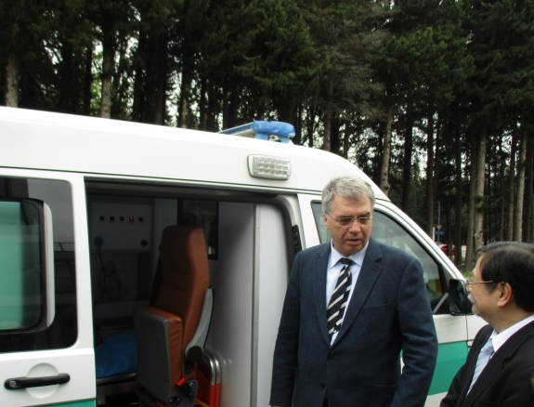
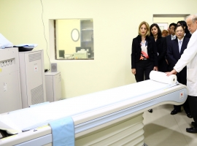
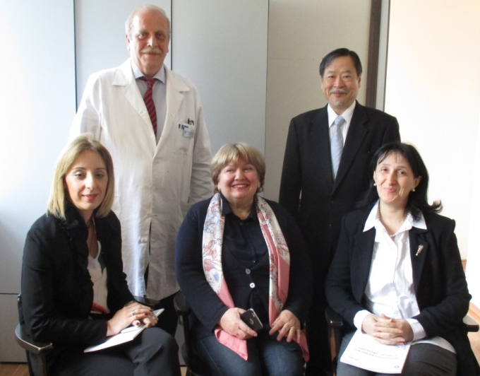
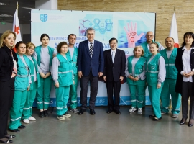
Handover Ceremony of the Japan’s
non-project grant aid for provision of Japanese
Medical Equipment for Georgia
On Friday, April 28, 2017 the handover ceremony of the Japan’s non-project grant aid for provision of Japanese Advanced Medical Equipment for Georgia was held at the National Training Center.
The ceremony was attended by Minister of Labour, Health and Social Affairs of Georgia H.E. Mr. David Sergeenko, Ambassador Extraordinary and Plenipotentiary of Japan to Georgia, H.E. Mr. Toshio Kaitani and others. Earlier on this day the Ambassador visited Universal Medical Center to inspect the provided equipment.
Under this project, Japanese advanced medical equipment has been installed in JSC Universal Medical Center, LLC Batumi Clinical Republican Hospital and LEPL Emergency Medical Assistance Service. Equipment includes Computer Tomography, Radiography system (Digital type) with X-ray film illuminator and defibrillators etc.
The Ambassador met Ms. Marina, who found early stage of lung cancer and recovered thanks to the granted CT. The Minister Sergeenko expressed gratitude telling that the granted defibrillators raised the chance to save the lives of patients by 70%. Total amount of Grant Aid equals five hundred million Japanese Yen.
Minister and Ambassador inspecting defibrillators
Ambassador inspecting CT
Ms. Marina (center) has cured lung cancer thanks to early finding by CT
Minister and Ambassador with emergency medical staff

