Slide 1
Making the World Safer from Biological Weapons
The CH2M HILL Way
Dr. Mark Morris
Senior Vice President
Environmental Services Business Group

Slide 2
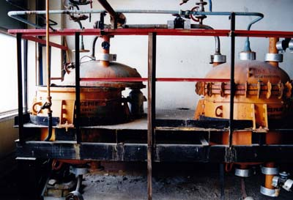
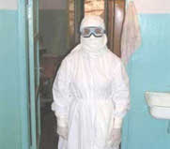
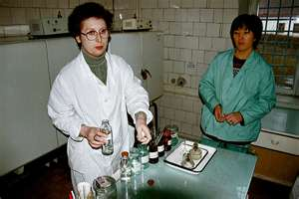
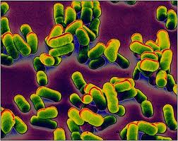

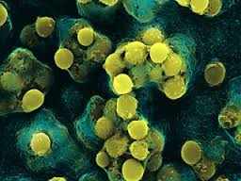
Biological Threat Reduction Integrating Contract
Cold War Legacy….
During the Cold War, the Soviet Union was a biological warfare (BW) superpower
Industrial scale BW facilities built to win the germ war arms race.
With the collapse of the Soviet Union, world faced with challenge of deadly pathogens at sites left unprotected and vulnerable
The Nunn-Lugar Cooperative Biological Engagement Program implemented to dismantle this massive biological WMD program and refocus it to peaceful purposes
Soviet BW
Production Facilities
Some of the estimated 60,000 people engaged in BW
Smallpox Anthrax Plague
Page 1

Slide 3
Biological Threat Reduction Integrating Contract
Growing a New Practice…
$4B Biological Threat Reduction Integrating Contracts Awarded by DTRA
(2008)
CH2M HILL Wins Armenia, Tanzania
(2012)
CH2M HILL Wins Vietnam, Cambodia and Laos
(2013)
CH2M HILL wins Georgia and transitions program from Bechtel
(2010)
CH2M HILL Wins Iraq and Afghanistan
(2013)
Program
Integration
Laboratory
A/E/C
Biological and Environmental Science
Page 2
Notes:
CH2M HILL is one of 5 contract holders of the Defense Threat Reduction Agency’s (DTRA) Biological Threat Reduction Program Integrating Contract (BTRIC), a 5-year base contract with a 5-year option period and an overall ordering capacity of up to $4 billion shared among all contract holders. Other contract holders include Bechtel, AECOM, URS and Black & Veatch.
CH2M HILL was awarded our first BTRIC task order in the Republic of Georgia and began work in the summer of 2010. We are supporting DTRA and the Government of Georgia in completing the biological threat reduction program in the country, including the operational commissioning of a BSL-3 research laboratory, training of scientists, handling equipment and logistics, and various other sustainment activities. We currently have a team in Georgia that recently completed a gap analysis, setting the stage for our next phase of work.
NOTE:
DTRA’s Biological Threat Reduction Program (BTRP) has three objectives:
1. Prevent the theft, sale, diversion, or release of pathogens by strengthening biosafety and biosecurity measures at BW-capable facilities.
2. Strengthen and enhance recipient state’s existing surveillance systems
3. Prevent proliferation of dual-use biological weapons expertise to rogue states and terrorists.

Slide 4
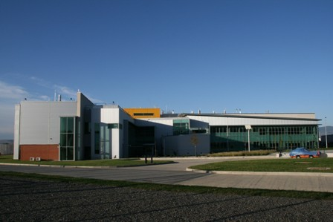


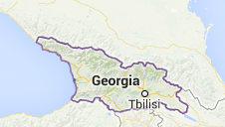
Biological Threat Reduction Integrating Contract
Achieving Sustainable Disease Response Capability - Georgia
$150MTask Order covers entire country of Georgia
CH2M HILL Role: Integrating Contractor
Team: Battelle Memorial Institute
Project Achievements:
Securing biological agents
Fixing and commissioning DTRA’s “Crown Jewel” Biosafety Level 3 Laboratory
Conducting research and re-employing former biowarfare scientists
Training over 2,500 scientists to ensure best practices
Improve response to disease outbreaks – making the world safer !
The Richard C. Lugar Center for Public Health Research, Tbilisi, Georgia
Page 3
Notes:
CH2M HILL is one of 5 contract holders of the Defense Threat Reduction Agency’s (DTRA) Biological Threat Reduction Program Integrating Contract (BTRIC), a 5-year base contract with a 5-year option period and an overall ordering capacity of up to $4 billion shared among all contract holders. Other contract holders include Bechtel, AECOM, URS and Black & Veatch.
CH2M HILL was awarded our first BTRIC task order in the Republic of Georgia and began work in the summer of 2010. We are supporting DTRA and the Government of Georgia in completing the biological threat reduction program in the country, including the operational commissioning of a BSL-3 research laboratory, training of scientists, handling equipment and logistics, and various other sustainment activities. We currently have a team in Georgia that recently completed a gap analysis, setting the stage for our next phase of work.
NOTE:
DTRA’s Biological Threat Reduction Program (BTRP) has three objectives:
1. Prevent the theft, sale, diversion, or release of pathogens by strengthening biosafety and biosecurity measures at BW-capable facilities.
2. Strengthen and enhance recipient state’s existing surveillance systems
3. Prevent proliferation of dual-use biological weapons expertise to rogue states and terrorists.

Slide 5








Biological Threat Reduction Integrating Contract
The CH2M HILL BTRIC Team
Working the CH2M HILL Way…Every Day!
Scott Smith, Project Manager
Ray Tyler
BTRIC Program Manager
Kathy Hanna
Deputy Program Manager
Elena Aroustamova Georgia Country Manager
Peter Cook,
Lead HVAC Engineer
Dave Vander Els,
Construction Manager
Scott Newman.
Commissioning
Rick Farnsworth, PhD
Battelle Science Lead
Page 4
Notes:
CH2M HILL is one of 5 contract holders of the Defense Threat Reduction Agency’s (DTRA) Biological Threat Reduction Program Integrating Contract (BTRIC), a 5-year base contract with a 5-year option period and an overall ordering capacity of up to $4 billion shared among all contract holders. Other contract holders include Bechtel, AECOM, URS and Black & Veatch.
CH2M HILL was awarded our first BTRIC task order in the Republic of Georgia and began work in the summer of 2010. We are supporting DTRA and the Government of Georgia in completing the biological threat reduction program in the country, including the operational commissioning of a BSL-3 research laboratory, training of scientists, handling equipment and logistics, and various other sustainment activities. We currently have a team in Georgia that recently completed a gap analysis, setting the stage for our next phase of work.
NOTE:
DTRA’s Biological Threat Reduction Program (BTRP) has three objectives:
1. Prevent the theft, sale, diversion, or release of pathogens by strengthening biosafety and biosecurity measures at BW-capable facilities.
2. Strengthen and enhance recipient state’s existing surveillance systems
3. Prevent proliferation of dual-use biological weapons expertise to rogue states and terrorists.

Slide 6
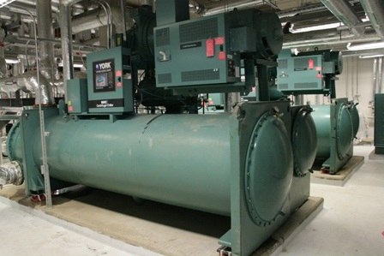
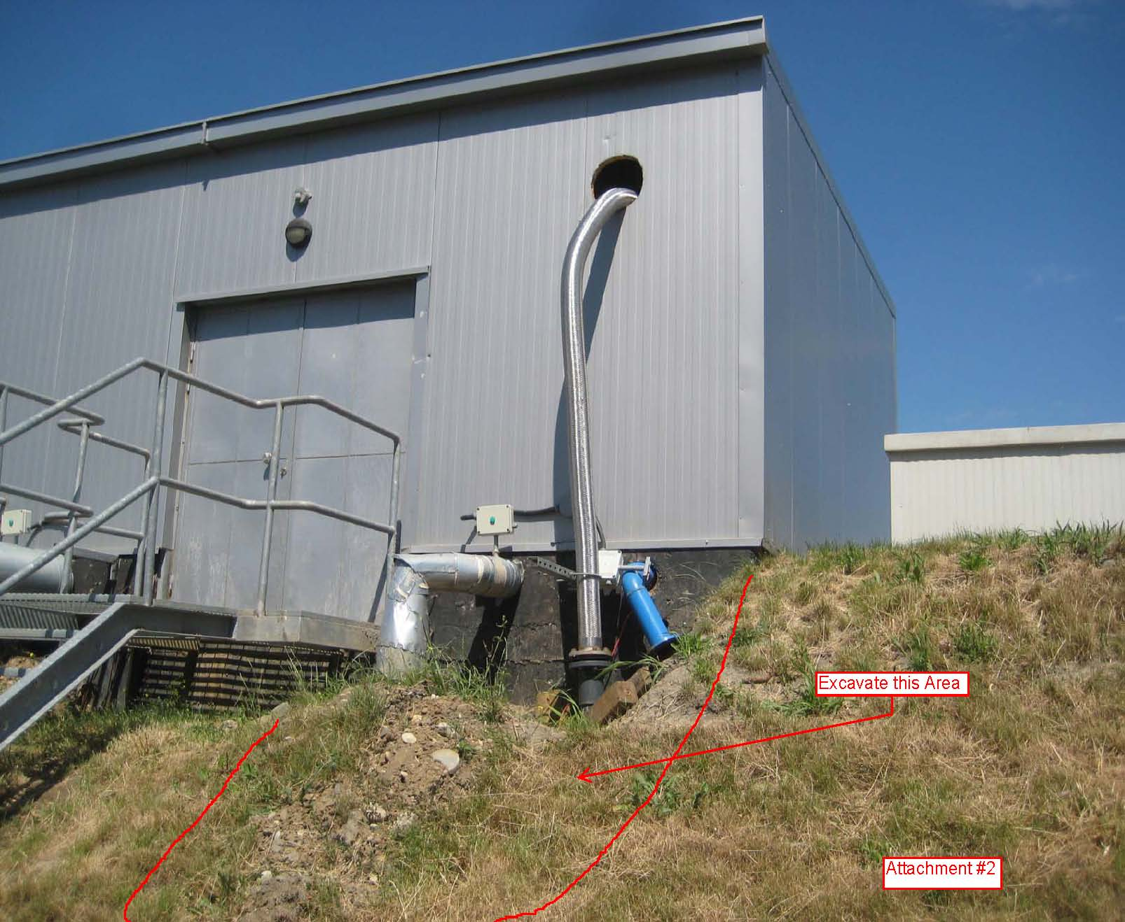
Biological Threat Reduction Integrating Contract
Solving the Puzzle
Fixing and Commissioning A Complex Biosafety Level 3 Facility while Executing the Program
Problem: CH2M HILL “inherits” $130M design/construction…was not capable of “Biosafety Level 3” work!
  High visibility international program – US Credibility on the line…
  Lots of issues – HVAC, Equipment installed incorrectly, poor construction quality, gaps in floors, etc.
How we did it
Detailed “gap analysis”
Sat with DTRA to develop approach
Put the right team on the job
Integrated the client into the process
Focus, focus, focus!
Page 5
Notes:
CH2M HILL is one of 5 contract holders of the Defense Threat Reduction Agency’s (DTRA) Biological Threat Reduction Program Integrating Contract (BTRIC), a 5-year base contract with a 5-year option period and an overall ordering capacity of up to $4 billion shared among all contract holders. Other contract holders include Bechtel, AECOM, URS and Black & Veatch.
CH2M HILL was awarded our first BTRIC task order in the Republic of Georgia and began work in the summer of 2010. We are supporting DTRA and the Government of Georgia in completing the biological threat reduction program in the country, including the operational commissioning of a BSL-3 research laboratory, training of scientists, handling equipment and logistics, and various other sustainment activities. We currently have a team in Georgia that recently completed a gap analysis, setting the stage for our next phase of work.
NOTE:
DTRA’s Biological Threat Reduction Program (BTRP) has three objectives:
1. Prevent the theft, sale, diversion, or release of pathogens by strengthening biosafety and biosecurity measures at BW-capable facilities.
2. Strengthen and enhance recipient state’s existing surveillance systems
3. Prevent proliferation of dual-use biological weapons expertise to rogue states and terrorists.

Slide 7
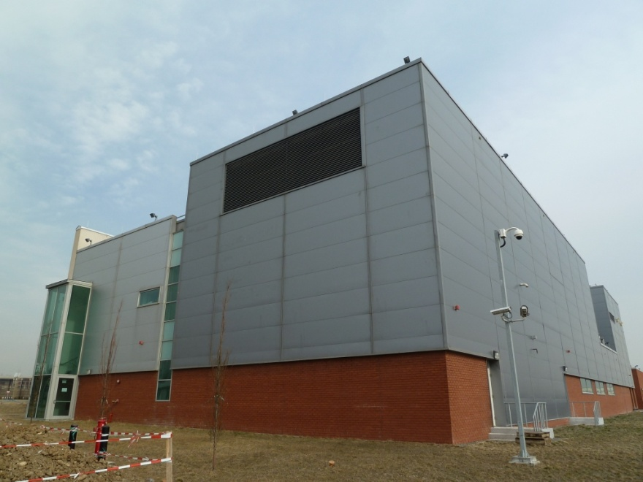
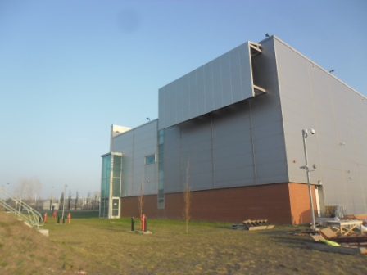
Biological Threat Reduction Integrating Contract
Key Airflow Issue Finally Resolved!
How the heck…
Simple...a “wind defender”
Constant Wind – Unanticipated Effect on HVAC Balance
CH2M HILL’s Peter Cook focused on unprotected vent and found a solution
The Result –
Perfect Balance!
Page 6

Slide 8
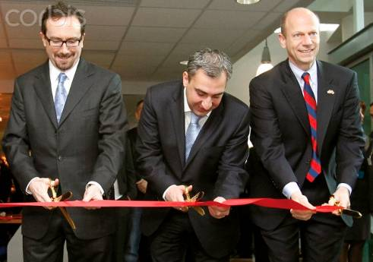
Biological Threat Reduction Integrating Contract
A Delighted Client!
The remediation of the CPHRL [sic] was a daunting task and was--at times--difficult. Yet, positive attitude and hard work prevailed, and the commissioning and endurance run is a testament to the professionalism of the CPHRL [sic] team.
Eric Graham, U.S. Army Corps of Engineers
From Left to Right – US Ambassador in Georgia - John R. Bass
The Prime Minister of Georgia – Nikoloz Gilauri
Assistant Secretary of Defense for Nuclear, Chemical, and Biological Defense Programs - Andrew C. Weber
Page 7
Notes:
CH2M HILL is one of 5 contract holders of the Defense Threat Reduction Agency’s (DTRA) Biological Threat Reduction Program Integrating Contract (BTRIC), a 5-year base contract with a 5-year option period and an overall ordering capacity of up to $4 billion shared among all contract holders. Other contract holders include Bechtel, AECOM, URS and Black & Veatch.
CH2M HILL was awarded our first BTRIC task order in the Republic of Georgia and began work in the summer of 2010. We are supporting DTRA and the Government of Georgia in completing the biological threat reduction program in the country, including the operational commissioning of a BSL-3 research laboratory, training of scientists, handling equipment and logistics, and various other sustainment activities. We currently have a team in Georgia that recently completed a gap analysis, setting the stage for our next phase of work.
NOTE:
DTRA’s Biological Threat Reduction Program (BTRP) has three objectives:
1. Prevent the theft, sale, diversion, or release of pathogens by strengthening biosafety and biosecurity measures at BW-capable facilities.
2. Strengthen and enhance recipient state’s existing surveillance systems
3. Prevent proliferation of dual-use biological weapons expertise to rogue states and terrorists.

Slide 9
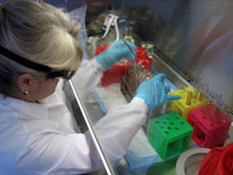
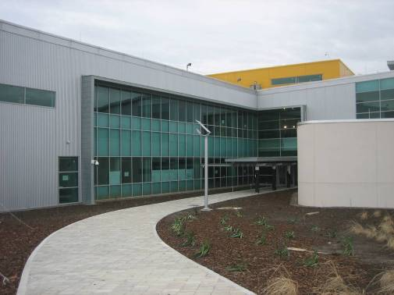
Biological Threat Reduction Integrating Contract
Contributing to the DTRA Mission
Thousands of disease samples now secured in new facility – preventing unauthorized distribution
CH2M HILL “solved the puzzle” and commissioned the extraordinarily complex Richard C. Lugar Center for Public Health Research – delighting the client and setting the standard for the entire program
Focusing the efforts of thousands of Georgian scientists towards peaceful purposes and fighting dangerous diseases
Established meaningful research capability to carry the project into the future
Page 8
Notes:
CH2M HILL is one of 5 contract holders of the Defense Threat Reduction Agency’s (DTRA) Biological Threat Reduction Program Integrating Contract (BTRIC), a 5-year base contract with a 5-year option period and an overall ordering capacity of up to $4 billion shared among all contract holders. Other contract holders include Bechtel, AECOM, URS and Black & Veatch.
CH2M HILL was awarded our first BTRIC task order in the Republic of Georgia and began work in the summer of 2010. We are supporting DTRA and the Government of Georgia in completing the biological threat reduction program in the country, including the operational commissioning of a BSL-3 research laboratory, training of scientists, handling equipment and logistics, and various other sustainment activities. We currently have a team in Georgia that recently completed a gap analysis, setting the stage for our next phase of work.
NOTE:
DTRA’s Biological Threat Reduction Program (BTRP) has three objectives:
1. Prevent the theft, sale, diversion, or release of pathogens by strengthening biosafety and biosecurity measures at BW-capable facilities.
2. Strengthen and enhance recipient state’s existing surveillance systems
3. Prevent proliferation of dual-use biological weapons expertise to rogue states and terrorists.

Slide 10
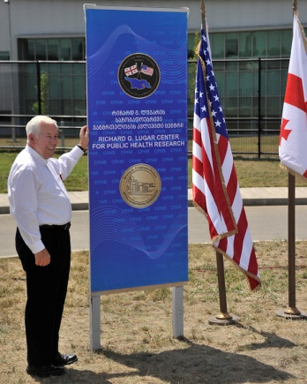
Biological Threat Reduction Integrating Contract
Questions?
Page 9

