Slide 1


Drug Safety & Public Health
Safety Information Reporting for Vendors Commissioned for Gilead Sponsored Programs
Version 8.0, April 2017
Course: RC-ILC-000343
Notes:
Welcome to this training on “Safety Information Reporting for Vendors Commissioned for Gilead Sponsored Programs”. This course is aimed at anyone who is conducting sponsored programs or projects commissioned by Gilead.
Gilead solicited programs, such as patient support and assistance programs, may require you to be in contact with either patients or prescribers about a Gilead product, during the course of these conversations you may learn of safety information related to our product. This training provides instruction on how to identify and report safety information related to a Gilead product.
This training also applies to those vendors who have been commissioned for social listening projects as well as those whose scope of activities include the review of email communications from Gilead sponsored digital media.

Slide 2
Course Overview
Learning Objectives
Types of safety information
Safety information reporting
Follow-up and Reconciliation
Training requirement
v8.0 April 2017
Notes:
This course will cover the learning objectives, types of safety information to be reported and how to report the safety information to Gilead. We will also cover when follow-up on a report may be needed as well as the reconciliation process. We will end this course by speaking about when and for whom this training is applicable.

Slide 3
Learning Objectives
By the end of this session you will know:
The legal obligation to report safety information
How to Identify safety information to be reported to Gilead
How, when and where to report safety information to Gilead
v8.0 April 2017
Notes:
As a pharmaceutical company, Gilead has the legal obligation to report safety information generated from all areas of the company’s activities including solicited programs, social listening projects and digital media.
By the end of this course, you will understand how Safety Information is defined, how to identify it, and when and where to report it to Gilead.
Let’s get started.

Slide 4
Types of Safety Information
Types of Safety Information
v8.0 April 2017
Notes:
Next, you will learn about the different types of safety information that require reporting.

Slide 5
Safety Information to be Reported
Safety Information
Adverse Events
Special Situation Reports
Other Safety Information
… any untoward medical occurrence (signs or symptoms) in a person taking a Gilead product whether or not it is thought to be caused by the treatment.
Reports which provide additional information about the safety of products
v8.0 April 2017
v8.0 April 2017
Notes:
When we talk about “Safety Information” we are including Adverse Events, Special Situation and other types of Reports.
The term Adverse Event has a very specific regulatory definition: … any untoward medical occurrence (signs or symptoms) in a person taking a Gilead product whether or not it is thought to be caused by the treatment. Events can be non-serious or serious according to the criteria that are met.
Special situations and other types of reports give us information about the safety of our products.
DSPH collects any safety information, and there are many possible scenarios – do not worry too much about what it is called, just inform drug safety and/or your local safety contact/PRP.

Slide 6
All Safety Information Must Be Reported
Even if the adverse event or special situation report is already known and included in the product’s package insert.
Even if the respondent has said they have already sent it to Gilead or a regulatory authority
Even if the patient recovered from the adverse event or special situation report
If in doubt, report to Gilead
v8.0 April 2017
Notes:
Please remember, you must report all safety information to Gilead even if the adverse event or special situation is already known to occur, or even if the respondent tells you they have sent it to the company or regulatory authority, and even if the patient has recovered from the adverse event or special situation.
If ever you are in doubt about whether to report, or not; please, always report to Gilead.

Slide 7

Drug Safety Reporting & You
<<Please customize this slide with the project name, description>>
<<Example Provided Below>>
Gilead’s Cayston® Access Program
is a counselling and support program that assists patients with reimbursement and access to Cayston® through Specialty Pharmacies
v8.0 April 2017
Notes:
Trainer Notes:
Slide to be used when training a Cayston® vendor only:
This slide is to be used for description of the project. It is also a good opportunity to pause while presenting and ask the audience to give a summary of the project (if appropriate) such that you can confirm the understanding of the project and agree potential places that safety information may surface, for you to focus on later. This slide is an opportunity to confirm our understanding of how this vendor works, which will help inform the specifics regarding the rest of the presentation.
The example given here is for a call centre and is just for you to understand how to use this slide. Please change this slide so it is applicable to the vendor you are training. (This slide doesn’t have to be included).
For this particular example you could explain as follows:
********************************************************************************************************************************************************************************
The program you are involved in is a call centre for HBV, as patients have the possibility to call this number for support on management of their disease or if you maybe need to remind the patient to take their medication, you are in direct contact with the patient and therefore there is a possibility that the patient might mention safety information to you.
As an example, a patient might not adhere to their treatment because of adverse events.

Slide 8

Drug Safety Reporting & You
<<Please customize this slide with the description of the Digital Media for example forum monitoring as shown below or a ‘Contact Us’ page on slide 9>>
Facebook Unbranded Page (HCV)
Monitoring social media comments on the Facebook page has the potential to include safety information about a Gilead product, which would need to be reported to Gilead.
v8.0 April 2017
Notes:
Trainer Notes:
This slide is to be used for all programs other than Cayston®
This slide is to be used for description of the project. It is also a good opportunity to pause while presenting and ask the audience to give a summary of the project (if appropriate) such that you can confirm the understanding of the project and agree potential places that safety information may surface, for you to focus on later. This slide is an opportunity to confirm our understanding of how this vendor works, which will help inform the specifics regarding the rest of the presentation.
The example given here is for a call centre and is just for you to understand how to use this slide. Please change this slide so it is applicable to the vendor you are training. (This slide doesn’t have to be included).
For this particular example you could explain as follows
**********************************************************************************************************************************************************************************
The program you are involved in is a call centre for HBV, as patients have the possibility to call this number for support on management of their disease or if you maybe need to remind the patient to take their medication, you are in direct contact with the patient and therefore there is a possibility that the patient might mention safety information to you.
As an example, a patient might not adhere to their treatment because of adverse events.

Slide 9
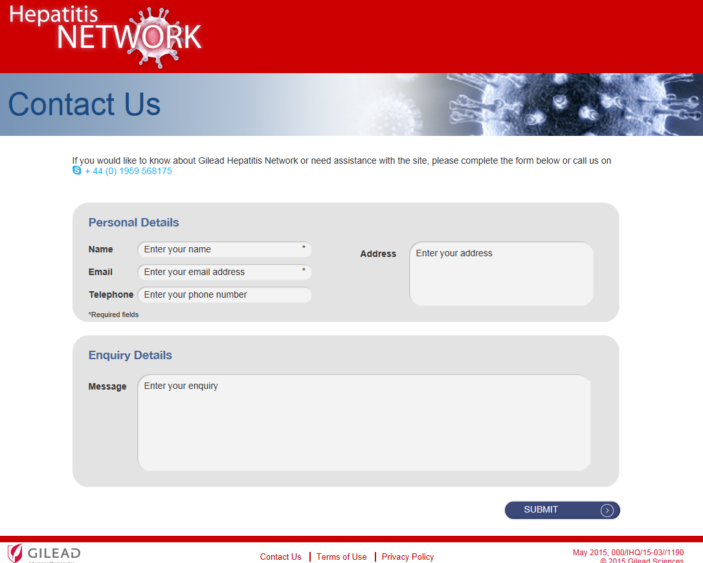
‘Contact Me’ Page
<<Please include the ‘Contact Us’ page of a Digital Media if applicable>>
<<Example Provided Below>>
During your review of the ‘Contact Us’ page, you may read about safety information.
v8.0 April 2017
Notes:
This is an example of a contact page – as you can see it is not related to reporting safety data, but there is a possibility of an AE report arising and hence for the PSMF this should be marked “yes” in the column asking whether it is possible to make contact through the website.
Also the vendor behind this hotline should be trained on Gilead's AE reporting process

Slide 10
Adverse Events
Examples of adverse events to be reported to Gilead.
Headache
Hospitalization
Rash
Death
Stomach pain
Heart attack
Allergic reaction
v8.0 April 2017
Notes:
Here are some examples of adverse events. These can be serious adverse events such as resulting in death and hospitalisation but also less serious such as a rash or headache. Regardless of the severity, all adverse events are to be reported to Gilead.
An adverse event is an untoward medical occurrence in a person taking a Gilead product, whether or not it is thought to be caused by the treatment.
All of these would be reportable to Gilead if you learned of them during your conversations with patients or prescribers even though they may not be related to our product.
For those vendors working on a social listening project, if you saw these examples written in a blog or patient forum and they also mention a Gilead product, it would be reportable to us.

Slide 11
Special Situation Reports (SSRs)
Other safety information can sometimes be called a Special Situation Report (SSR), here are examples of SSRs collected only when associated with an Adverse Event.
Occupational exposure with Adverse Event
Adverse Event following exposure via breastfeeding
Product complaint with Adverse Event
v8.0 April 2017
Notes:
Now we will move on to Special Situation Reports. Special Situations are not always associated with an adverse event; however, they are important safety information that must be reported to Gilead. These reports are useful for Gilead to learn about the effect of our drugs where typically we would not conduct clinical trials; such as in pregnant women. Others of these reports are required by regulatory authorities.
Special situation reports are grouped into 2 categories – those that must be reported only when associated with an AE and those that must always be reported whether or not there is an associated AE.
Let’s go through these in detail.
Here are the 3 Special Situation Reports, or SSRs, that you will report only when there is an associated Adverse Event.
Adverse events that occurred as a result of someone being exposed to a Gilead product through their job, fall into the category of occupational exposure. For example, a nurse who is administering an injection accidentally pricks her finger and experiences some swelling.
Also report any adverse event in an infant being breastfed by a mother who is or has been treated with a Gilead product as it may be unknown whether the product can be transferred in breastmilk.
Finally, if you hear about Gilead product complaints, for example, broken tablets or tablets of a different colour than usual, and the patient has an adverse event after taking the broken or discoloured tablets; this also needs to be reported.

Slide 12


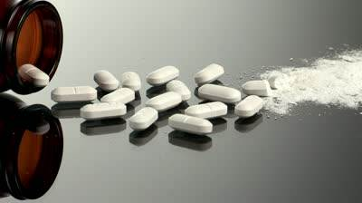
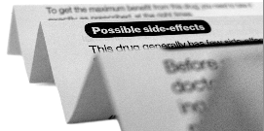

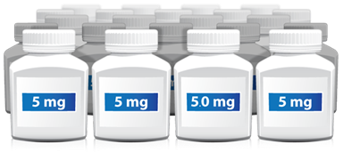
Special Situation Reports
Examples of Special Situation Reports collected regardless if they have an associated adverse event or not.
Pregnancy
Overdose
Abuse or misuse
Off-label use
Lack of effect
Medication errors
v8.0 April 2017
Notes:
These are the Special Situation Reports which you must report regardless if there is an associated adverse event or not.
Pregnancy- if you become aware of someone being pregnant while on a Gilead product you must report the pregnancy to Gilead. You also must report pregnancies following paternal exposure to a Gilead product – Meaning if the man is being treated with a Gilead product and his partner becomes pregnant; then this must be reported, as the medicinal product could be transferred through semen.
Overdose is when someone has accidently or intentionally taken too much of a drug – more than the prescribed dose.
Drug abuse is the excessive use of a medical product accompanied by harmful physical or psychological effect.
Misuse is also something you must report. Misuse is the inappropriate intentional use of a product other than as prescribed by the doctor; such as when a patient deliberately takes the tablet with food when the instructions are to take on an empty stomach; or breaks the tablets when they are meant to be swallowed whole.
Off-label use-is when a product is intentionally prescribed and used for a medical purpose not in accordance with the authorised product label; such as the product being used for a different indication, or administered by a different route, at a different dose or in a different patient population. For instance, if a product is being prescribed to a child or elderly adult when the product is not licenced for this use.
Lack of effect- is when a patient or healthcare provider tells you that the patient did not have the intended effect of the Gilead product. This includes situations where the patient reports no effect at all; “it didn’t work” or a reduced effect of the medicine. Also, report any explicit reference to our product not working such as switching from one Gilead product to another or stating “Drug X did not work”. This could be a reason for treatment failure or breakthrough of viral loads. Please, only report the exact words used by the reporter. Gilead will make any determination of whether there was truly a lack of effect.
Medication errors – are any unintentional error in the storage, prescribing, dispensing, preparation for administration, or administration of a medicinal product while in the control of the healthcare professional, patient or consumer. Note: Medication errors are reported with or without an associated AE; even if the error was prevented, the potential error must be reported.
There are many possible scenarios for special situation reports. Do not worry too much about what category to call it. Rather, please ensure to report the information to Gilead and we will ensure appropriate classification.

Slide 13
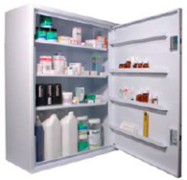





Medication Error
Medication Errors could occur at any stage in the drug treatment process:
Storing
Prescribing
Dispensing
Preparing for administration
Administering
Missed Dose
It is important to determine the root cause of any Medication Error where possible by asking: Why did it happen?
v8.0 April 2017
Notes:
A Medication Error can occur in any of the following stages of the drug treatment process. Some examples where a medication error might arise are:
There may be storage errors that can occur when a product is stored outside the instructions on the product information, for example, a diluent ampule of Cayston® stored outside the refrigerator for more than 28 days.
A Drug Prescription error: such as, the wrong dosage of a product according to a patient’s weight being prescribed by the HCP.
Errors occurring due to dispensing of the product: For example, a patient prescribed Atripla® finds Eviplera® tablets in their prescription bottle.
Errors occurring due to preparation for administration: For example, Harvoni® tablets were crushed to aid in swallowing.
Errors occurring during Administration: For example, Cayston® treatment was not administered in accordance with the nebulizer manufacturer instructions.
Gilead also requests that missed doses be reported along with the reason why the dose was missed. For example a patient has missed taking their medication, there will be a reason behind this, perhaps they did not read the label instruction correctly and missed a day or they forgot to take the medicine according to the prescription information.
Finding the root cause of the Medication Error is important. Ask for the reason it occurred so we can classify it appropriately, this is of particular importance for reports of missed dose. If the reason why is not provided, please make a note of this in your report as the Drug Safety Operations team is obligated to follow-up and request the reason if not provided.

Slide 14
The following scenarios provide examples of safety information that is reportable to Gilead.
v8.0 April 2017
Notes:
The following examples depict real life adverse events and special situation reports from Gilead sponsored market research. In each example we will discuss identification of the event as well as the required reporting action.
Safety information at Gilead includes but is not limited to adverse events, serious adverse events and special situation reports.
We will go over each of these in more depth on the following slides.

Slide 15
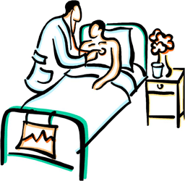

Hospitalization
I am being treated with a Gilead product. Last week my blood pressure increased and I had to be hospitalized for one night.
My blood pressure is back to normal now.
Report all hospitalizations to Gilead. Ask for the reason or diagnosis that caused the hospitalization, if not provided.
v8.0 April 2017
Notes:
Here we have patient who was hospitalized for an increase in his blood pressure.
This event would be reportable to Gilead because at the time of his hospitalization he was being treated with a Gilead product.
When completing the report form for this event, you would include all the details provided in the example. We will go through how to complete the form on a later slide.
Please remember to always ask why or what led to the patient’s hospitalization, having this information is very helpful to Gilead during our analysis of the event and in determining if our product contributed to the hospitalization.

Slide 16
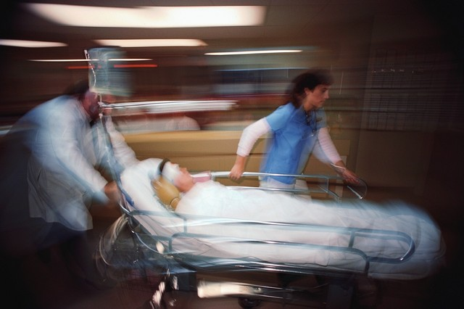
Hospitalization
<<Please include this slide for all vendors working on Cayston® solicited programs>>
Involves an Event
Routine visits for standard of care, i.e. bronchial washouts, are not required to be reported.
v8.0 April 2017
Notes:
Slide to be used when training a Cayston® vendor only:
Here we have patient who was hospitalized for an increase in his blood pressure.
This event would be reportable to Gilead because, at the time of his hospitalization, he was being treated with a Gilead product.
When completing the report form for this event, you would include all the details provided in the example. We will go through how to complete the form on a later slide.
Please remember to always ask why or what led to the patient’s hospitalization. Having this information is very helpful to Gilead during our analysis of the event and in determining if our product contributed to the hospitalization.

Slide 17


Death
Hi, this is Mrs. Thompson’s daughter.
I just wanted to inform you that you no longer have to deliver the Gilead product to my father as he passed away this morning.
Report events of death to Gilead. Ask for the diagnosis or cause of death, if not provided.
v8.0 April 2017
Notes:
Here we have an example of a patient’s daughter calling our specialty pharmacy vendor to discontinue delivery of a Gilead product because the patient passed away. The specialty pharmacy agent taking the call would be required to report the death to Gilead.
As with hospitalizations, it is very important for Gilead to know the cause of death or the reason why a patient was taking our product. Having this information assists Gilead in the event analysis, and in determining whether our product could have contributed to the death. Please take care in requesting the cause of death from patient’s relatives, keeping in mind this is perhaps a sensitive time for the family and they may not want to discuss details of the death with you. If you are unable to obtain additional information about the death, please include that on the report form.
If you learn of a patient’s death from a prescriber, then requesting additional information about the cause or diagnosis at the time of death is appropriate.
Now that you understand the importance of reporting details about a patient’s hospitalization or death, let’s take a look at discontinuations of a Gilead product and the details that are needed when reporting these types of events.

Slide 18
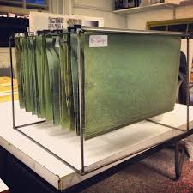
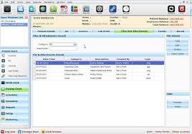
Discontinuation Due to AE
Note: Stopping treatment or discontinuation is only reported when there is an associated AE.
Beware: Are you an organization that closes patient discontinuation files with a notation of “death” or “hospitalized”.
ALERT – you must assure a safety report was submitted for every occurrence of death or hospitalization.
v8.0 April 2017
Notes:
We just covered one of the ways a vendor can learn of a patient discontinuing from a Gilead product, death.
A patient discontinuing from our product is not an event, and not reportable to Gilead.
In order for a discontinuation to be reportable to Gilead it must be associated with an adverse event, for example, discontinuing our product due to diarrhea, or nausea or vomiting. There needs to be an event associated with the discontinuation in order for it to be reportable.
The same is true when you learn of a patient who has missed a dose of our product. A missed dose in and of itself is not considered an adverse event and, therefore, not reportable to Gilead. However, if the patient misses or skips a dose due to say nausea or vomiting, then this would be reportable to Gilead.
So in the previous slides we discussed the importance of reporting the events of death and hospitalization should you learn of them in your conversations with patients or prescribers, but your organization may also use the codes of death or hospitalization for administrative purposes, such as to close out a patient’s account. Please be sure that these reports of death and hospitalization are also reported to Gilead. We understand that the call center and administrative division of an organization may be separate, and that reports of death or hospitalization learned of on the administrative side of the organization may not be reported to Gilead. Please be sure your organization has a process in place to ensure that these reports are submitted to Gilead.
Now let’s take a look at a scenario a call center agent may experience and how best to manage it.

Slide 19

“But the doctor already knows about the adverse event”: Do I need to report to Gilead?
YES!
If you become aware of any safety information, you should report it to Gilead REGARDLESS of whether that safety information has already been reported to the patient’s Doctor.
OR, regardless of whether the safety information has already been reported to a regulatory authority.
Take away message: Always ensure you forward safety information to Gilead.
I have an AE that I need to
report to Gilead.
v8.0 April 2017
Notes:
What would you do in the following scenario? A patient currently being treated with a Gilead product states she has been having diarrhea since beginning the medication, and her physician knows and is treating her, would you still report this to Gilead?
If you answered yes, good job you are correct.
Gilead would need to receive the report even though the patient’s physician is aware of it and treating it. The same hold true if a patient tells you that she already reported the event directly to a regulatory authority such as the FDA. You would still report the event to Gilead.
If your organization uses a warm-transfer process for reporting adverse events, please ensure your call center staff understand to whom in your organization they should transfer the calls so that the events are reported to Gilead.
Next we will look at Special Situation Reports, which you are also required to submit to Gilead.

Slide 20

Overdose
Accidently or intentionally taking more of the medicinal product than you should.
Last week I took two tablets on the same day instead of one. I felt ok afterwards.
Although the patient felt okay afterwards, this must be reported to Gilead.
v8.0 April 2017
Notes:
An overdose is defined as taking more of our product than you were prescribed to take, this can be either accidental or intentional.
The example listed here is of someone who took two tablets in one day instead of just one. Although he felt okay afterwards, this would still be reportable to Gilead. And the information in the word cloud is exactly what you would include on the report form.

Slide 21


Missed Dose
Yesterday I saw a patient who missed their Genvoya® medication on three separate occasions. She said she felt fine.
Although the patient said she felt fine, this must be reported to Gilead.
Remember to ask Why the doses were missed and include this in your report.
v8.0 April 2017
Notes:
In the example on this slide, you can see that a physician mentions that they have a patient who has missed their Genvoya® medication on three separate occasions; she had no adverse events.
This is an example of a missed dose which is a medication error. In this case there was no associated adverse event. As with the other examples, even though there was no adverse event, this is another example of a reportable incident to Gilead.
It is also necessary to ask for the reason Why the doses were missed and record this on your reporting form.

Slide 22

Off-label Use
Gilead product is not indicated for use in 3 year old child, however I have been prescribing it for a child and they are doing well with no adverse events
If a product is prescribed outside of the authorized product information with respect to indication, dose, route of administration or patient population.
v8.0 April 2017
Notes:
Here we have the definition and example of a Off-label use.
Gilead defines off-label use as a product that is prescribed outside of the authorized product information with respect to the following:
Indication: Being prescribed our product for a medical condition that is not listed on the package insert for the product.
Dose: Being prescribe a dose which is higher than what is listed on the package insert. We are not interested in dosages that are lower than what is listed in the label, only those higher than.
Route of Administration: Being prescribed to take our product in a way that is not listed on the package insert.
Patient Population: Prescribing our medication to a patient who falls outside of the patient population listed on the package insert.
In the example on this slide, you can see that a physician prescribed one of our products for a 3 year old child, which would be considered off-label, as the child falls outside of the patient population listed on the package insert.
Let’s move onto the last Special Situation report.

Slide 23

Lack of Effect
I have been on the Gilead product for 3 weeks now but with no effect from the drug.
A report of a situation where the patient hasn’t had the intended effect of the product.
v8.0 April 2017
Notes:
Here we have an example of a lack of effect which is a situation where the patient has not had the intended effect of the product.
In the example, the patient has been on the Gilead product for three weeks, but has not noticed any effect of the drug.
Lack of effect can also be seen in patients who have been taking a Gilead product and having the intended effect, but then notice a reduced effect of the medication, or no effect at all.

Slide 24
How to report to Gilead
How to report to Gilead
v8.0 April 2017
Notes:
Now that you know what safety information you must report, we will tell you how to report the safety information to Gilead.

Slide 25
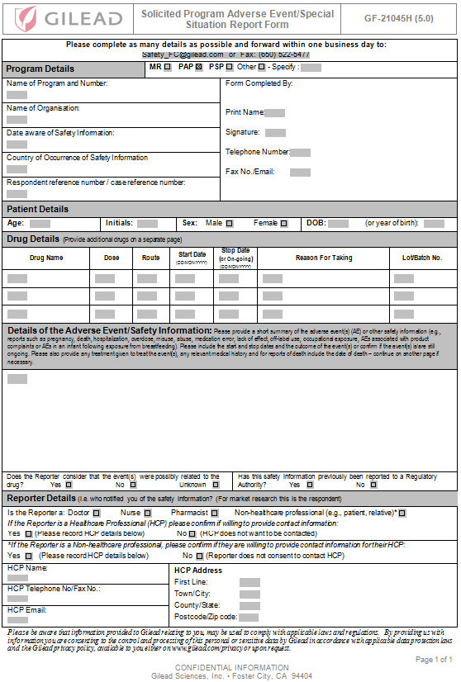
Safety Information Reporting
Gilead’s Safety information reporting form is:
Provided with this training
Used to report all safety information to Gilead
Completed electronically or print and write in
If you wish to use your own form, please get agreement from Gilead
v8.0 April 2017
Notes:
This is our safety information reporting form.
You will complete this for each patient who experiences an adverse event or special situation report while taking a Gilead product. If a patient experiences more than one event, say nausea and vomiting, you would record both on the same report form.
We will now go through how to complete each section.

Slide 26
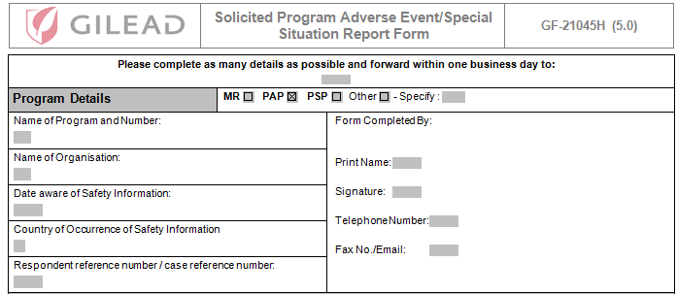
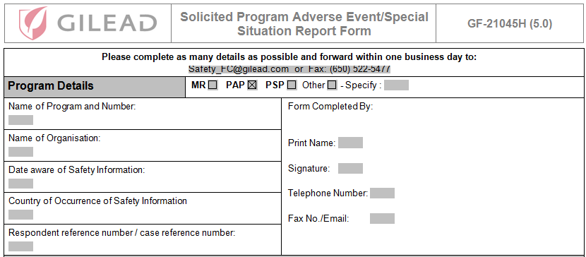
Safety Information Reporting
Example Date Format: 02-Aug-2015
v8.0 April 2017
Notes:
The first section of the form captures the program details and contact information of the person completing the form.
The checkboxes to the right of the Program Details refer to the type of program the vendor has been commissioned for; MR refers to Market Research projects; PAP refers to Patient Assistance Programs; PSP refers to Patient Support Programs; Other refers to research projects/programs not considered MR, PAP or PSPs. This section will be pre-populated for you.
Beginning on the left side of the form, let’s take a look at each of the rows:
Name of Program & Number: The name of the project/program will be pre-populated for you. If your project/program has a number associated with it, then please ensure you add that here when completing the report form.
Name of Organization: The name of your organization will be pre-populated for you.
Date aware of Safety Information: This date is very important as it is the date that you or your organization first became aware of the safety information. In the case of a death or hospitalization, this date begins the regulatory reporting clock for Gilead as we have 7 to 15 days from this date to report the death or hospitalization to regulatory authorities. Always be sure to include this date when reporting safety information to Gilead.
Country of Occurrence of Safety Information: Please provide the country in which the patient was located in at the time of the event.
Respondent reference number/case reference number: If your organization assigns references numbers to the safety reports submitted to Gilead, then please enter that number here.
Moving to the right side of the form, this captures the contact details of the person completing the report – your information. We will reach out to you in the event there is missing information or further clarification of information provided on the form is needed. Please provide your name and signature and a telephone or email address by which we can reach you. If you are faxing reports to Gilead, please be sure to include a centralized email address on the report form so that we may send you the acknowledgment of receipt. If your organization does not have a centralized email address, then please include the email address of the person who will be responsible for submitting the reconciliation report to Gilead. Later, we will discuss why an email address is needed.
<Click to bring up the Date format>: Please be sure to write out the month for all dates included on the form.

Slide 27
Safety Information Reporting
Only collect anonymized patient information.
Do not collect personal details such as the patient’s name or hospital medical record number.
v8.0 April 2017
Notes:
It is important to collect as much information as possible about the patient as we will use it to contact their physician to obtain additional information about the event if necessary.
We realize privacy requirements will limit the information you will be able to provide. For example, you should not put the patient’s full name or hospital medical record number, but we will request you obtain the following:
The patient’s age, if you don’t know the age, then the patient’s age group; infant, child, adult or elderly patient is also acceptable.
Their initials
Their gender
Their full date of birth, if only the year is known, then please provide that information; as much information as possible in order for us to follow up with the patient’s physician.

Slide 28
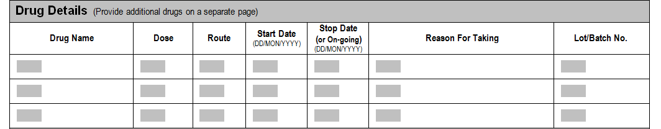
Safety Information Reporting
Please provide as much information as you can about the drug that the patient was taking at the time of the event.
v8.0 April 2017
Notes:
It is important to collect as much information as you can about the Gilead drug that the patient was taking or still taking when they experienced the adverse event you are reporting.
Beginning on the left side of the screen, let’s look at the details we ask you collect about the Gilead product:
Drug Name: The name of the Gilead product is listed here.
Dose: The dose or how much of the Gilead product, the patient was taking at the time of the event is captured here. If the patient is unable to provide the dose in milligrams, then the number of tablets they were taking is acceptable.
Route : The route, or how the patient was taking the medication is listed here. For example, orally or inhalation.
Start Date: This is the date the patient began the taking the medication; as a reminder, please note the format we ask you to use. If the patient is unable to provide the exact date, then we will accept approximations, such as “I think I started the medication 3 weeks ago”.
Stop Date: This is the date the patient stopped the medication, as with the Start date, if the patient is unable to provide the exact dates, we will accept an approximation. If the patient is still taking the medication, then simply write ‘Ongoing’.
Reason For Taking: This is the reason why the physician prescribed our product for the patient. The reason for taking is also referred to as the indication for the medication, and if the physician prescribed the medication for an indication that is not listed on the package insert, then it would be considered off-label use and reportable to Gilead. We will discuss off-label use on a later slide.
Lot/Batch No: This is a number which is located on either the box the bottle of medication is delivered in, or on the bottle of medication itself. If the patient is able to locate this number then please collect this information. The lot/batch number is helpful in determining whether there could be a quality issue with one of our products if we identified an increase in the number of a particular adverse event such as nausea within a particular lot/batch number.
NOTE: If the patient was taking other medications in addition to the Gilead product as the time of the event, then please list those here and provide as much detail as possible.

Slide 29
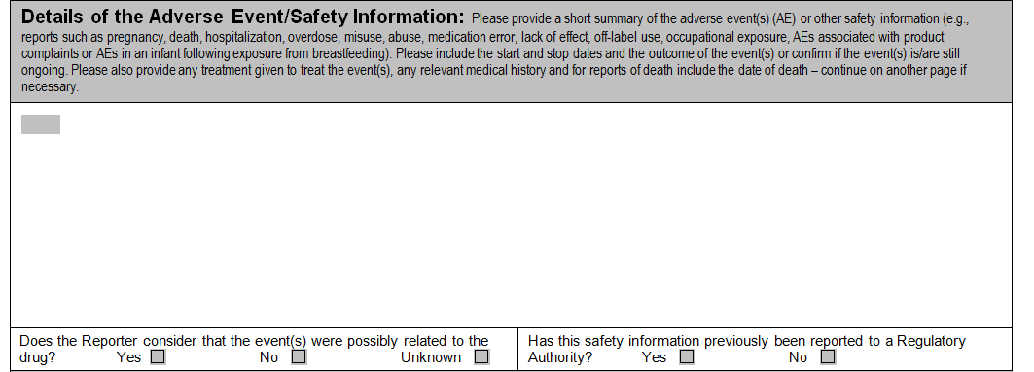
Safety Information Reporting
Please write in the information provided and indicate whether the reporter considers the event to be related to the drug.
Do not fill in your own assessment of relatedness.
v8.0 April 2017
Notes:
This next section is where you record the details of the safety information the patient or physician is telling you about.
The grey box provide a summary of the safety information that Gilead collects, and it also provides guidance on the characteristics of the event can be recorded in the white space, such as the start date of the event, treatment given, and whether the event has stopped or is ongoing. Other information that can be collected and is very helpful in our assessment of the event is other medications the patient was taking at the time of the event as well as other medical conditions the patient has, like diabetes or high blood pressure.
An example of what can be recorded in this section is a patient who reports to you the following: “I was hospitalized for two weeks because I had pneumonia, I got antibiotics and was released. I feel much better now and was happy that I was able to stay on my Sovaldi while in the hospital. I had pneumonia last year too but didn’t need to go to the hospital”. Collecting this level of detail about the pneumonia helps our safety physicians when reviewing the case to determine if the Gilead product contributed to the event in anyway.
If you need more space, please add another sheet.
If the safety information you receive is in written format, you are welcome to write ‘see attached’ and send the written statement with the reporting form.
To complete this section, be sure to answer the two questions below the narrative box. The question on the left asks, “Does the person you are speaking with think that the event might have been caused by the Gilead drug?” If the patient or physician has an opinion about whether the Gilead product caused the event then please complete the appropriate box. If they are unsure or don’t know please leave that question unanswered.
The second question on the right asks if the patient or physician has already reported this safety information to a regulatory authority, such as the FDA – please mark the appropriate checkbox or leave blank if they do not know.

Slide 30
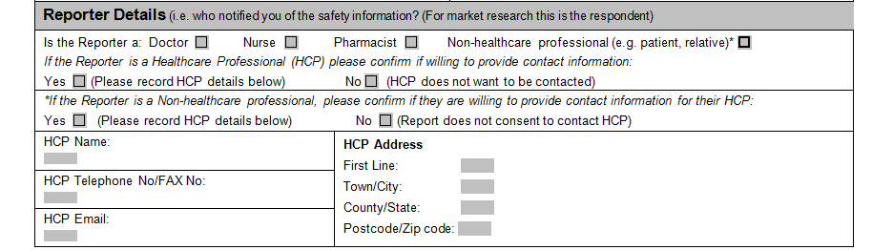
Safety Information Reporting
Please provide Gilead with the contact details of the patient's treating doctor (HCP), if available. If the reporter is a patient ask them to provide the details of their healthcare professional.
v8.0 April 2017
Notes:
We’ve reached the last section of the report form, the Reporter Details, which collects information on the reporter, the person who is providing you with all of this information.
The first question describes the person to who you are speaking as either a healthcare professional, Doctor, Nurse or Pharmacist, or Non-healthcare professional, a patient or patient’s relative; please check the box which best describes them. Remember you can always use the Details of the Adverse Event/Safety Information section of the report to include additional information about the reporter which may not be included here, such as the reporter being a friend or care giver of the patient.
The next question is directed to those who are healthcare professionals and asks if they would provide their name and contact information so that Gilead can follow up with them should additional medical information about the event be needed. Please check the appropriate box. If they give permission, then please record their name and contact information in the HCP details section. If they refuse, which is their right, please make a note in the Details of the Adverse Event/Safety Information section, or we may contact you to confirm this information.
The next question is directed to those reporters who are Non-healthcare professionals, like the patient or their relative, and asks if Gilead can contact their physician to obtain more information about the event. Please check the appropriate box. If they give permission, then please record the name and contact details of the healthcare professional in the section right below this question. If they refuse, which is their right, please make a note in the Details of the Adverse Event/Safety Information section, or we may contact you to confirm this information.
Every report we receive is closely analyzed against the current and respective product safety profile as we want to ensure our patients are taking our products in the safest way as possible. The patient’s healthcare professional team, particularly their physician, is in the unique position to provide us with the information we need in order for our analysis of the event to be complete, as the physician has an understanding of the patient’s experience while on our product.
The report is now complete and is ready for submission to Gilead drug safety. The report can be submitted using either email or fax, which we will cover on the next slide. For each report you submit, Gilead will send back to you an acknowledgement of receipt. On this acknowledgment will be a unique case identifier called the Gilead reference number or MCN. The Gilead reference number is very important as it will be used on the reconciliation report form, so make sure to save. If you do not receive the acknowledgment of receipt in 3 business days then please send us a follow up email requesting the acknowledgement.
That completes the reporting form.

Slide 31

When to Report to Gilead
Report to Gilead within 24 hours* of first becoming aware of the safety information
Prompt reporting is critical as Gilead has strict reporting timelines to Regulatory Authorities
*Please report within 24 hours if possible, but no later than one business day.
v8.0 April 2017
Notes:
Now that you have completed the reporting form it is ready to be sent to Gilead. You will find the details of where to report at the top of the form. You may choose to report by email or fax.
Gilead is obliged to report safety information to the regulatory authorities within certain time lines, especially for those cases of hospitalization and death. This could be either within 7 or 15 calendar days.
Our clock start date for reporting safety information to regulatory authorities begins the date you receive the information. This is why it is so important that you report the information to us within 24 hours, if possible, but no later than one business day.

Slide 32
<<<<Trainer instructions>>>
If training in the US keep slide 33, which has US details for reporting safety information and delete slide 34.
If you are a PRP or training outside of the US, then delete slide 33 and edit slide 34 with applicable contact information, remove any red text.
<Remove this instruction once you have read and understood >

Slide 33
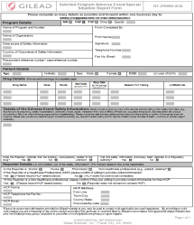

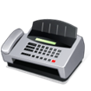


Reporting Safety Information
Complete the form and send it to Gilead within 24 hours
<<<<Trainer notes: use this slide if training to vendors in the US, remove red text after reading >>>>
Safety_FC@gilead.com
Fax: +1 650-522-5477
Medical Information +1 800-GILEAD-5
QualityComplaints@gilead.com
v8.0 April 2017
Notes:
The expectation is that you will complete the report form and send it to Gilead within 24 hours of becoming aware of the safety information, or 24 hours from the ‘Date Aware of Safety Information’ on the report form.
For the US, the report form can be faxed or emailed to Gilead Drug Safety in Foster City, please note, the email address has an “underscore” between ‘safety’ and ‘FC’, for Foster City.
If for any reason you miss the 24 hour reporting requirement, please send the report as quickly as possible but no later than one business day. Please be sure to include the reason for the delay on either the fax coversheet or within your email as this will be included within the case.
If a patient or prescriber has a question about a Gilead product, please provide them with the Medical Information number at Gilead. Our Medical Information staff are trained to answer questions about all Gilead products.
If you learn of a quality or product complaint, then please send the information to the Quality group at Gilead at qualitycomplaints@gilead.com. Within your communication, please provide as much information as possible about the complaint and be sure to include your contact information should additional information be needed.

Slide 34
Reporting Safety Information
Complete the form and send it to Gilead within 24 hours
Global Safety Contact information
Safety_FC@gilead.com
<<<Trainer notes: please enter local safety reporting details here and remove red text after reading >>>>
v8.0 April 2017
Notes:
The expectation is that you will complete the report form and send it to Gilead within 24 hours of becoming aware of the safety information, or 24 hours from the ‘Date Aware of Safety Information’ on the report form.
Here are the contact details for reporting safety information in <<add country>>
If for any reason you miss the 24 hour reporting requirement, please send the report as quickly as possible but no later than one business day. Please be sure to include the reason for the delay on either the fax coversheet or within your email as this will be included within the case.

Slide 35
Safety Information Reporting Acknowledgments
You should receive an acknowledgement from Gilead for each report you send
All acknowledgements will include a Gilead reference number
Enter your Gilead reference number on the Reconciliation report form….
v8.0 April 2017
Notes:
After you have reported the safety information to Gilead you should receive an acknowledgement from Gilead with a Gilead reference number.
The case reference number assures you that your form has been received by Gilead. Please save this reference number as you will use the number later when completing the reconciliation form; which we will cover shortly. A ‘best practice’ is to add the reference number to your reconciliation report as acknowledgements arrive, which makes it much simpler to submit the reconciliation report on time as it will already be complete.
If you don’t receive an acknowledgement from Gilead within 3 business days from submitting the form you can let us know by sending a reminder.

Slide 36
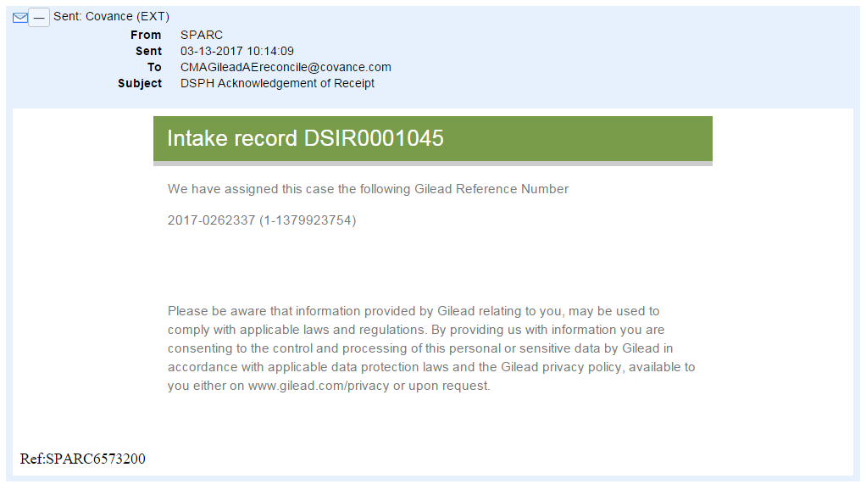
SPARC Acknowledgement of Receipt
The Acknowledgement of Receipt (AOR) for the safety reports you submit to <<Safety_FC@gilead.com>> change this address based on region will come from SPARC@gilead.com.
The SPARC AOR will contain the Gilead Reference Number (MCN), and every safety report you submit to Gilead will be assigned a separate (MCN).
To be sure you can match the Gilead MCN to the correct report, please include a tracking number for the report on the AE report form.
The Gilead MCN will be listed beside the tracking number you provided.
Retain the Gilead MCN as you will need to include it on the reconciliation report form.
Note: For vendors who fax safety reports to Gilead, please include a centralized email address on the AE report form to which the SPARC AOR can be sent
CentalPVteam@vendor.com
Vendor case tracking number
Gilead Case Reference Number (MCN)
Gilead Case Reference Number (MCN)
v8.0 April 2017
Notes:
Although you will send your safety reports to Safety_FC@gilead.com you will receive the acknowledgments of receipt from SPARC@gilead.com.
Within the SPARC email you will see the Gilead Reference Number or MCN for each case you submit to Gilead. In order to be able to match the Gilead MCN to the safety report you submitted to Gilead, please include a tracking number for the report on the AE report form in the respondent/case reference number at the top portion of the form before sending to Gilead. This will ensure you are able to match the Gilead MCN to the correct report.
Be sure to retain the Gilead MCN as you will need to use it on the reconciliation report form.
For those vendors who fax safety reports to Gilead, please include a centralized email address on the AE report form to which the SPARC email can be sent, if your organization doesn’t have a centralized address, then please provide the email address of the person responsible for completing and submitting the reconciliation report to Gilead.

Slide 37

Follow-Up
Gilead may sometimes need additional information to perform medical assessments of safety reports.
All follow-up requests will be sent from SPARC. On receipt of follow-up requests for information we request all reasonable assistance in providing the information.
In situations where follow-up is not possible (e.g. when consent is refused by respondent), please include this information on the form to avoid us asking unnecessary questions.
v8.0 April 2017
Notes:
Gilead may sometimes need additional information to perform medical assessments of safety reports. It is our preference to obtain this information from the patient’s healthcare professional, however, if Gilead was not given consent to follow up with them, then we will reach out to you as the reporter to obtain that information. We will contact you via SPARC to ask for this “follow-up information”.
Per internal procedures, Gilead staff are required to query reporters for missing or additional information 3 times. If we contact you, please provide us with all reasonable assistance in obtaining the information.
In situations where follow-up is not possible, please make a note in the Safety Information Details section of the report form stating “no additional information available” and Gilead will not attempt to contact you for additional information.

Slide 38


Reconciliation
Reconciliation is a process to ensure all cases have been received by Gilead
We use the Gilead reference number (MCN) to reconcile with you
Reconciliation may be monthly, at an agreed interval based on the project size, or at the end of the project
There is a specific form to be completed….
v8.0 April 2017
Notes:
Reconciliation is a periodic check to assure that all safety reports that you send have been received by Gilead, and is the primary tool by which we can demonstrate safety oversight of our solicited programs. We usually begin with a monthly reporting schedule, and reassess based on the volume of reports submitted over time. If the volume is low, then the reconciliation schedule can be on a quarterly basis. Anytime the reconciliation schedule is changed, we will send you an email with confirmation of the change and ask that you keep a copy for your records.
Let’s review the report form and the information that is required to complete it.

Slide 39
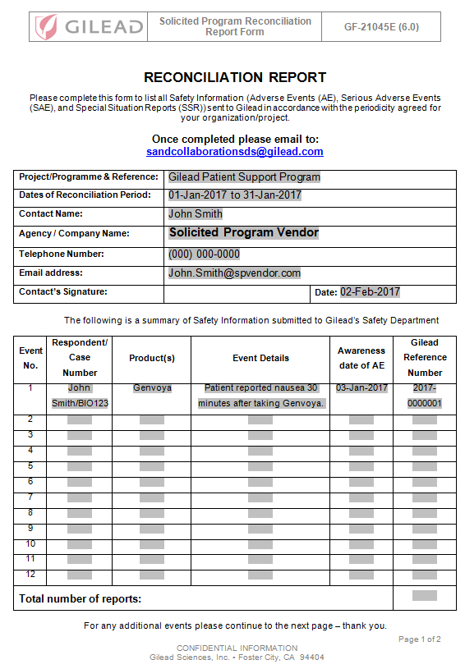
Reconciliation
v8.0 April 2017
Notes:
This is an example of a complete reconciliation report form. Beginning at the top, let’s look at each section and how to complete it.
The first part of the form captures the program and vendor details including:
Project/Program & Reference: The name of the Gilead project or program is listed here.
Dates of Reconciliation Period: The dates covered by the reconciliation report. As mentioned before this is generally monthly, but can also be on a quarterly or bi-annual basis. As on the report form, please spell out the month when writing out the dates.
Contact Name: The name of the person completing the reconciliation report is captured here.
Agency/Company name: The name of your organization is captured here.
Telephone number: The telephone number of the person completing the report form is listed here.
Email address: The email address of the person completing the report form is captured here.
Contact Signature & date: Please be sure to sign and date the report. Electronic signatures are acceptable.
Prior to sending your organization the form, we will pre-populate the Project/Program & Reference and Agency/Company name fields.
The second section of the form is where you enter key information about the safety information report that you submitted to us during the time period. Let’s look at each of the fields, please note that all of the information for each row needs to be completed.
Respondent/Case Number: If your organization uses a case number to track the reports submitted to Gilead, you can include that number here.
Product(s): List the Gilead products the patient was taking at the time of the event.
Event Details: This is where the safety information you learned about will be captured. An easy way to complete this field is to copy the narrative you wrote in the ‘Details of the Adverse Event/Safety Information’ section on the AE report form and paste it here.
Awareness date of AE: Again, you can copy the date directly from the ‘Date aware of safety information’ field on the AE report form and paste it here.
Gilead Reference Number: This is the unique case identifier which is generated when Gilead registers a report of safety information into our safety database. Gilead will email you an acknowledgement of receipt for every report of safety information your organization submits. Within the acknowledgement of receipt is the Gilead Reference Number for the case. Please be sure to always include this number for each event you list on the report form.
If a case on the report form is missing the Gilead reference number, we will investigate to confirm receipt of the case. If we are unable to find it within our safety database, we will request the source documentation for the case. Compliance with regulatory reporting timelines is very important to Gilead, therefore for late cases, a vendor submits to Gilead, the reason for delay will be requested as well as the corrective action implemented to prevent or minimize future recurrences. We can work with a vendor to ensure their compliance with Gilead safety reporting requirements, please speak with us about customizing the process to meet your business needs. For example, many organizations use an excel spreadsheet in lieu of the reconciliation report as it can easily be generated from their databases. If this is something of interest, please let us know and we will work with you in designing the form to ensure key fields of the reconciliation report are included on your spreadsheet.
Once the reconciliation report is complete, you will send it to sandcollaborationsds@gilead.com, which is noted on the report form. Note that this is a different address from where you send the report form.
This ends the training on Gilead’s safety information reporting requirements. We will now look who needs to complete this training.

Slide 40
Training Requirements
Ensure all staff involved in the program complete this training
Staff must be trained prior to working on a Gilead project
Annual refresher training is required
v8.0 April 2017
Notes:
It is essential that all staff involved in any Gilead project receive this training prior to starting on the project. If you have new staff that join during a project, please ensure they have received the training prior to participating in the project.
In addition, please note that this training must be completed at least once a year by everyone involved in a Gilead market research project.

Slide 41


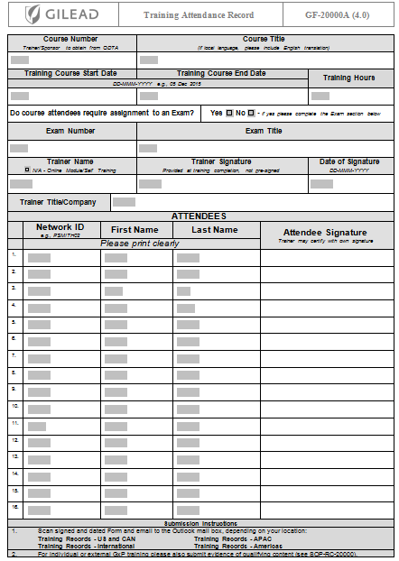
Training Documentation
Complete the appropriate training documentation:
  Training certificate
    Include the attendee name, signature, and date of course completion.
  Training attendance record or equivalent
File locally so it is available to Gilead upon request or for audit and inspection purposes
v8.0 April 2017
Notes:
Be sure your training files are complete with confirmation that those staff who are assigned to a Gilead project have completed Gilead’s safety information training.
Confirmation of training completion can be documented in several ways depending on the size and sophistication of your learning management system.
Individual certificates of completion, pictured here, can be filled out by your staff who have completed the training.
Another option is to use an internal training roster. If your organization does not have one, then Gilead can provide one for you. It is pictured here in the corner of the screen.
Lastly, if you have a learning management system into which this training will be uploaded and completed by your staff, then a system generated report is also acceptable. Regardless of how you document your training completion, the following must be included: course name, version number (this is located at the bottom left of the slide), attendee name and signature and the date of course completion.
You are required to retain confirmation of training completion for all staff assigned to a Gilead project in accordance with your organization record retention policy, but for a period of at least three years.

Slide 42
Quiz
v8.0 April 2017
Notes:
Please don’t be concerned about a “test” this is a summary with the use of scenarios for you to respond to
We use this training for all of our organizations, so you may see Gilead drugs that you do not actually work with. The reporting requirements are the same for all of our Gilead products/drugs.

Slide 43


What to report?
Except for the headache I get when I take my Sovaldi® tablet, the treatment is working really well. I remember my friend telling me people usually get kidney problems with Sovaldi®.
v8.0 April 2017
Notes:
Narrator will read the question and pause to allow for student to guess the answer, and then say….
If you said headache you are correct. Kidney problems is a generalization and therefore not reportable.
Remember to complete all the questions on the report form, and collect as much information as possible about the headache, such as onset date, treatment, stop date, or if the event is ongoing.

Slide 44

Reportable?
My 3-year old daughter has been treated with Cayston® for a week now with no adverse event at all. We are really happy the treatment is working well.
v8.0 April 2017
Notes:
Narrator will Read the question and pause to allow the student to guess the answer, and then say…..
If you said this is reportable, then you are correct, good job. Please progress to the next slide to see the answers.

Slide 45
Answers
Answers
Off-label use
Cayston® is approved for patients 7 years and older
Needs to be reported to Gilead
v8.0 April 2017
Notes:
Cayston is a Gilead product which is approved for children 7 years and older, therefore, prescribing it for a child of three qualifies as off-label use, and would need to be reported to Gilead.

Slide 46
What would you report?
I have just started with my new treatment Harvoni®, I have been having nausea for two weeks now.
Oh that is nothing, when I started my treatment 2 years ago I was hospitalized.
v8.0 April 2017
Notes:
Narrator will read the question and pause to allow the student to answer, and then say….
If you answered both nausea and hospitalization you are correct, good job.
Please progress to the next slide to see an explanation of the answers.

Slide 47
Answers
Two patients
One adverse event and one serious adverse event
Remember to report situations even if the patient has recovered from the event
v8.0 April 2017
Notes:
The conversation was between two patients taking Zydelig.
One experienced an adverse event while the other experienced a serious adverse event, remember it is not important for you to be able to classify the events, we just want you to be able to identify that these would need to be reported to Gilead.
Although the patient who was hospitalized recovered, it would still be reportable to Gilead as the patient was taking a Gilead product, Zydelig, when she was hospitalized.

Slide 48

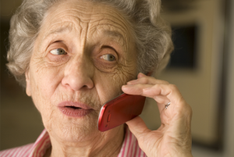
What should you do?
Hello Mrs. Smith, I'm calling to schedule your next shipment of Harvoni®. When would you like it delivered?
Oh don’t bother, I have been having diarrhea for three days. I told my doctor and my doctor’s treating me. I hope I feel better soon.
v8.0 April 2017
Notes:
Narrator will read the question and allow for the student to respond, and then say….
If you said that you would report this to Gilead, you are correct, good job.
Please progress to the next slide for an explanation.

Slide 49
Answers
You would report the diarrhea even though the patient confirmed she informed her doctor of the event and is currently being treated.
v8.0 April 2017
Notes:
All adverse events associated with a Gilead product are reportable to Gilead, even if the patient tells you that her doctor is aware and treating the event.

Slide 50
Examples of Discontinuation
We were informed today not to deliver Harvoni® to Mr. Thompson as he passed away last week.
One of my patients has completed his Sovaldi® treatment of 24 weeks.
Lisa was experiencing tiredness so she had to discontinue her Sovaldi® treatment.
v8.0 April 2017
Notes:
These are examples of discontinuations. I will read each one to you and pause to allow you to answer the question: Is this reportable to Gilead?
We were informed today not to deliver Harvoni to Mr. Thompson as he passed away last week. <Pause> If you answered yes, then you are correct. If you learn of a death of a patient taking a Gilead product, then you would report that death to Gilead.
One of my patients has completed his Sovaldi treatment of 24 weeks. <Pause> If you answered no, then you are correct. There is no adverse event in this example, therefore, this is not reportable to Gilead. As a note, treatment of Sovaldi for 24 weeks is one of the treatment durations listed in the package insert. Let’s move onto to the last scenario.
Lisa was experiencing tiredness so she had to discontinue her Sovaldi treatment. <Pause> If you answered yes, then you are correct. You would report Lisa’s tiredness to Gilead.

Slide 51
Closing Summary
Ensure all staff assigned to the Gilead research project complete this training prior to project start
Know the types of safety information you will need to report:
  adverse events (AE) and special situation reports (SSR)
  If in doubt, report
Complete the safety information report form with as much information as possible
Send the safety information report within 24 hours (Please report within 24 hours if possible, but no later than one business day).
Send the reconciliation form at the project end or agreed time period
For safety reporting questions contact your local drug safety contact or Gilead’s Drug Safety department at standardsandcollaborationsds@gilead.com
v8.0 April 2017
Notes:
To summarise this training: ensure that all staff involved in the project have completed this training prior to project start.
You need to know what safety information to report and forward all safety information associated with a Gilead product within 24 hours of becoming aware of the event.
Complete the Safety Information reporting form with as much information as possible.
Send the safety information report within 24 hours.
Complete and submit the reconciliation form for the agreed time period.
If ever in doubt about whether or not to report – please forward the information and allow us to decide.
For any questions or concerns related to this training, please do not hesitate to contact Gilead Drug Safety at standardsandcollaborationsds@gilead.com

Slide 52

Thank you for your attention!
v8.0 April 2017
Notes:
Thank you for taking the time to complete the training. If you have any questions about your internal process for reporting safety information to Gilead be sure to check with your manager.

