Slide 1
What Can a Small Eurasian Country Teach the World About HCV Elimination? Lessons from Georgia
Francisco Averhoff, MD, MPH
Division of Viral Hepatitis
Centers for Disease Control and Prevention
Atlanta, USA

Slide 2
Disclosures
I have no relevant financial relationships and the views expressed in this presentation reflect those of the author and not official policy of the Centers for Disease Control and Prevention

Slide 3
Georgia HCV Elimination
“It’s what you learn after you know it all that counts.” ~Harry S Truman

Slide 4
HCV Elimination: Why Georgia? 2013-14
Small country, < 4 million population
Large HCV burden (HCV-Ab prevalence ≈ 7% adults)
High demand for action from the public
Many families affected
Active community advocacy
Motivated government and civil society
Negotiated price reductions for Peg/Riba, but few can afford
Began HCV treatment program in prison system
Global Fund supported HCV treatment (HIV/HCV coinfected)
Treatment capacity to provide/scale-up existed

Slide 5
Georgia: Road to Elimination 2013-2015
2013
Initial consultation with CDC Division of Viral Hepatitis (DVH)
Coordinated/requested by CDC Country Office
Define burden/epidemiology as critical first step (serosurvey)
2014
1st National Workshop: Georgia stakeholders (government, providers, NGOs); academic partners (Emory, Bristol); CDC
Topics: burden/epidemiology, treatment capacity/access, feasibility of elimination
Dissemination at EASL & AASLD (side meetings)
Elimination conceptualized, serosurvey planned
Partnership established (Gilead Sciences)
2015
Gilead Sciences agree to donation of drug for demonstration project
Study tour to Egypt (model program)
MOH/GS/CDC plan for April Launch

Slide 6
“The best way to get something done is to begin” ~author unknown
Treatment was catalyst for elimination program
Wildly popular: “every family affected”
Most with severe liver disease and could not afford treatment
Launch April 2015 planned prior to:
Elimination Goals established/vetted
HCV burden and epidemiology defined
Elimination Plan drafted
Resources identified

Slide 7
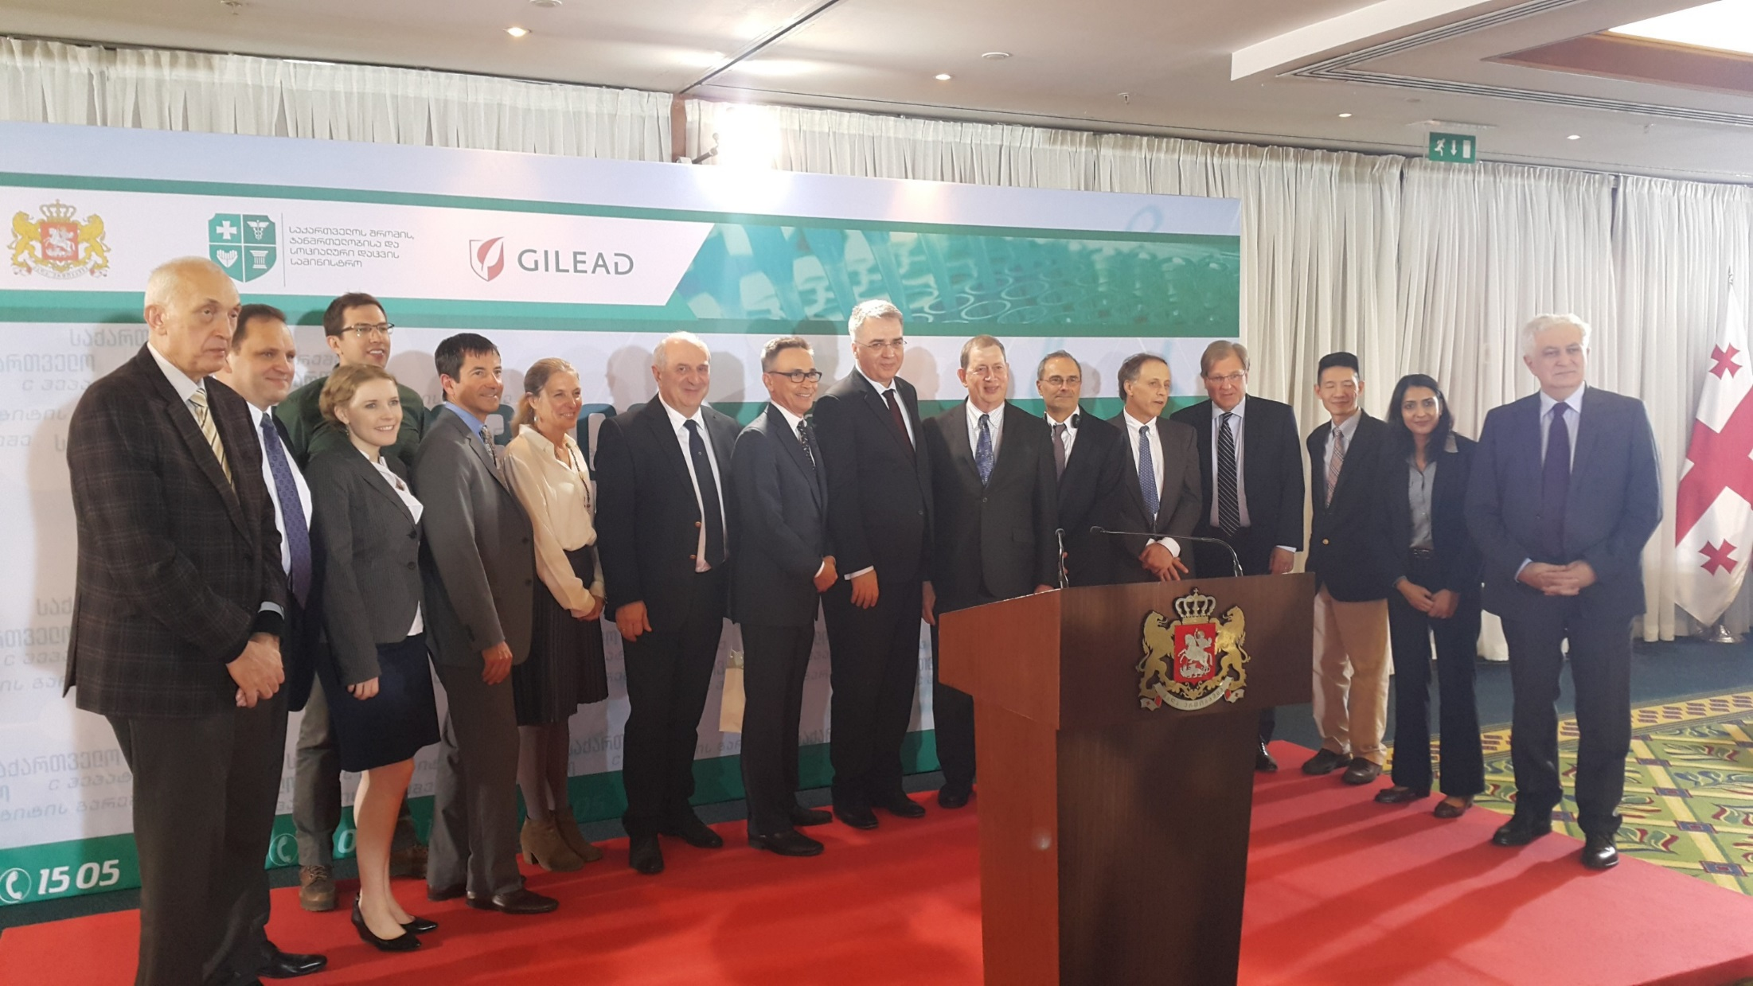
Tbilisi, 21 April 2015
Georgia Hepatitis C Elimination Program Launched!

Slide 8
Priority Activities 2015 - 2016
Ensure treatment and laboratory capacity and quality prior
Treatment database (STOP-C)
National seroprevalence survey
Burden (national/local), identify risk factors/groups,
Develop 5 year Elimination Plan
Establishment of Monitoring and Evaluation
Establish external Technical Advisory Group (TAG)

Slide 9
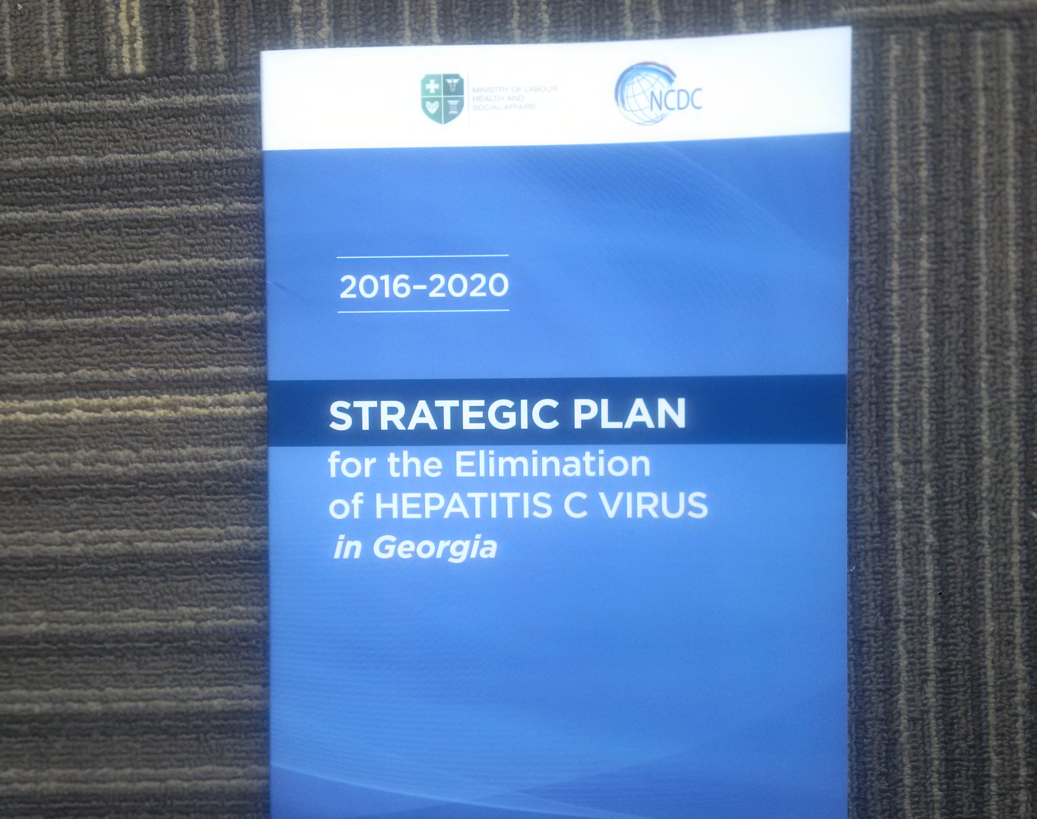
Elimination Plan Strategies*
Going Beyond Treatment….
Advocacy, awareness, partnerships
Prevention
Harm reduction
Infection control
Blood safety
Identify infected
Laboratory diagnostics
Care and Treatment
Surveillance
Research
* Tailored to country-specific needs & priorities

Slide 10
Public Health Benefits: HCV Elimination & Beyond
Laboratory/Diagnostics
Lugar as National (Regional?) Reference Laboratory
Quality Assurance Program
Blood Safety
Serosurvey identified as important independent risk
Only 30% of donations non-paid/voluntary
25% of blood banks unregulated
Now a government priority
Harm Reduction
De-stigmatization, increase harm reduction access (50,000 people!)

Slide 11
Continuous Learning, Feedback, & Exchange
National HCV Elimination Workshop (Annually, in Spring)
2014: HCV Elimination conceived
2015 Preparation for Launch
2016 Elimination Plan and M&E
2017 Implementing TAG Recommendations
Technical Advisory Group (TAG)
International Experts; at least one from each strategic focus
Meet annually in the Fall; 3rd TAG meeting 30 Nov 2017
EASL (+/- AASLD) annual meetings since 2014

Slide 12
Treatment Program 2015 - present
Phased implementation
Cirrhotics at greatest risk of death/complications were itinially prioritized(>90%, year one)
Capacity & training expanded over time
Eligibility for treatment expanded as provider capacity increased
Treatment regimens expanded (SOF/LED) & continuously reviewed, revised, simplified
Technical assistance supported expansion/quality (ECHO & LIFER)
2017 access is prority with treatment expanding to harm reduction and primary care

Slide 13
Screening & Linkage to Care A Key Challenge….

Slide 14
Cumulative number of HCV RNA+ persons enrolled, treatment program, Georgia, Apr 2015 - Dec 2016
Eligibility criteria relaxed
Data source: STOP-C and Elimination C systems

Slide 15
Number of HCV RNA+ persons enrolled in treatment program by month, Georgia, Apr 2015-Dec 2016
Data source: STOP-C and Elimination C systems

Slide 16
Patients Registered by Month and Cirrhosis, Georgia HCV Elimination Program, Georgia, Apr 2015 - Dec 2016
Data source: STOP-C and Elimination C systems

Slide 17
Hospital inpatient HCV screening program (Nov – Dec 2016)**, compared to serosurvey (2015), by age group, Georgia
Male
Female
** Screening rate: 51,438 / 80,547 = 63.9%
* Children < 18 months may have false positive HCV-Ab from maternal antibody.

Slide 18
“I Rob Banks Because That’s Where the Money Is.” ~Willie Sutton
Identifying HCV infected who do not know their status is priority for 2017 and beyond
Only 20% of estimated 150,000 HCV infected enrolled
Most of remaining 80% likely with mild/asyptomatic disease; not aware/enrolled
Screening & linkage to care programs need to be “targeted”; we know who is infected, and where they are (2015 serosurvey)
Screening is widespread: linkage to care effectiveness unknown (PWID & others)

Slide 19
Georgia HCV Elimination Scientific Committee
Established in August, 2016
Research agenda development
Transparency
Coordination
Communication
Initial focus treatment program; now expanding to epidemiologic and other areas of interest
Notes:
The SC serves as an umbrella group to provide coordination and communication among engaged academic institutions/researchers, clinics/clinicians and Non-governmental Organizations (NGOs)

Slide 20
HCV Elimination Scientific Committee
Membership
MoLHSA, NCDC, IDACIRC, Clinic “Hepa”, Clinic “Neolab”, Clinic “Mrcheveli” USCDC
Open to non-member (eg NGOs, Universities, other)
Requires member sponsorship
Bristol U, FIND, MDM, Abbott, Boston U, LIFER/ECHO
Received 24 proposals Aug 2016 - Apr 2017
22 reviewed,17 approved (with or w/o conditions/stipulations)

Slide 21
Research & Innovation Priorities for HCV Elimination in Georgia
Can Elimination Goal (90% reduction in prevalence) be reached by 2020?
Real world effectiveness of treatment regimens (special populations)?
Impact of HCV treatment on morbidity and mortality?
Impact of program on HCV incidence (Treatment as Prevention)?
Understanding/mapping transmission networks and how to interrupt?
Effectiveness (cost effectiveness) of HCV treatment/diagnostics in Gerogia?
Effectiveness of screening and linkage to care strategies?
Effectiveness of screening/linkage/treatment strategies targeting high risk populations on transmission and prevalence?
Effectiveness of HCV treatment/care delivery in alternative sites (harm reduction, primary care)?
Modeling impact of interventions?
Can monitoring of patients on

Slide 22
“It Takes a Village”: The Key Role of Partners
Prior to Launch
Since Launch
Government (MOH, NCDC)
Clinicians
Community/Advocacy/NGOs (Soros Foundation, Georgia Harm Reduction Network, other)
Academia (Emory, Bristol)
Industry (Gilead Sciences)
CDC Country Office + DVH
t
Technical Advisory Group (TAG)
WHO
Liver Inst. For Edu & Res (LIFER)
ECHO (New Mexico/S Arora)
FIND
MdM (Med du Monde)
Global Fund for AIDS, TB and Malaria
Industry (Abbott, Becton-Dickinson)

Slide 23
CDC Role in Georgia HCV Elimination Initiative Focused on Technical Assistance
Largest CDC Viral Hepatitis Engagement outside of USA; key support from CDC Foundation
Notes:
CDC provides TA in several areas including surveillance, laboratory capacity-building, implementing/strengthening data systems, and enhancing screening and linkage to care practices. CDC is also the principal TA provider and implementer for M&E and has some key responsibilities for assisting MOH in coordinating research efforts (see Scientific Committee). CDC is committed to document and apply lesson learned from Georgia to inform other national plans. A TAG with external experts was formed in late 2015 to review the Elimination Plan, make recommendations, and help to monitor progress on an ongoing basis, meeting annually in Tbilisi.

Slide 24
Summary and Conclusions

Slide 25
What Can a Small Eurasian Country Teach the World About HCV Elimination? Lessons from Georgia
Model Program
Why This Country??
Major burden/impact
Every family affected in some way
Active Civil Society
Early efforts pre-date elimination program
Prison program, Global Fund program, reduced price (Peg/Riba)
Georgian HCV Epidemic
Complex epidemiology/transmission
Injection drug use; Infection control; & blood safety
“age cohort effect”
Variety of genotypes

Slide 26
What Can a Small Eurasian Country Teach the World about HCV Elimination? Lessons from Georgia
Think Big! First National HCV Elimination Program
Government Leadership and Ownership
Ambitious Goals (90% reduction prevalence by 2020)
Civil Society remains actively engaged
Don’t recreate the wheel: Study Tour to Egypt, Lessons USA
Jump in! Launch of treatment program preceded secured funding and 5 year comprehensive plan
Be willing to learn while you go; Georgia is writing the roadmap
Major challenge for 2017 and beyond: 80% of HCV positive not identified and linked to care

Slide 27
What Can a Small Eurasian Country Teach the World about HCV Elimination? Lessons from Georgia
Comprehensive Elimination Plan & Program
Public Health approach
Treatment is “tip of the spear”, but…
Investments in strategic information, lab quality, advocacy & civil engagement, prevention (HR, Blood), screening and linkage to care, monitoring and evaluation, research
Spillover Benefits to other programs
Technical Advisory Group (TAG) meets annually/advises
Annual National Workshop for planning activities

Slide 28
Research, Innovation, & Documentation: Lessons from Georgia
Scientific Committee Critical Role
MMWRs published annually summarizing progress: 2015, 2016, 2017
M&E indicators and First Annual Report under development
Manuscript, recently published, under peer review and/or in development
Key research studies funded, protocols under development

Slide 29
Critical role of Partnerships: Lessons from Georgia
CDC key early partner (Country office and DVH)
Providing technical assistance and resources
Serosurvey to understand burden was “job one”
US Embassy engaged/supportive
Gilead Sciences saw need and opportunity
Additional partners playing key roles
Laboratory strengthening
Provider education
Prevention of transmission
Advocacy and education
Research & documentation

Slide 30
HCV Elimination “If it can’t be done in Georgia, it can’t be done” - Author unknown
Thank You
Contact: faverhoff@cdc.gov

Slide 31
Acknowledgements
Georgia NCDC & MOHLSA
Georgia Clinicians & NGO Partners
CDC
CDC Foundation
Bristol University
Industry Partners

