Slide 1
The Georgia Experience:
Lessons for Viral Hepatitis Elimination
John W Ward, MD
Senior Scientist, CDC
Program Director, Viral Hepatitis Elimination
April 15, 2018

Slide 2
Infection and Disease
Control, Elimination and Eradication
Control
Elimination
Eradication
Below acceptable levels
( e.g., flu)
Zero cases in an area (e.g., measles)
Below a certain rate ( e.g., TB)
A proportional decrease (e.g. malaria)
As a public health threat (LF, Chagas)
Zero cases globally
e.g., smallpox
Prevention Interventions
Ongoing
Ongoing
Cease

Slide 3

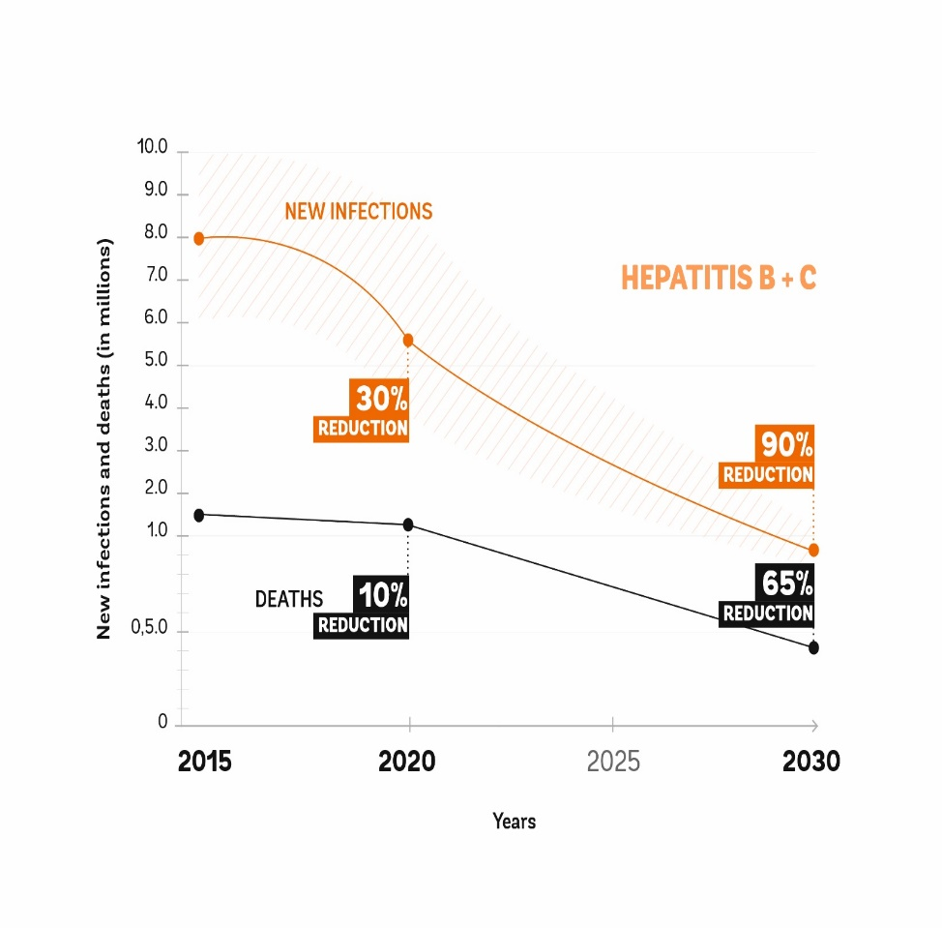
Global Goals for HBV and HCV Elimination by 2030–
Global reductions- WHO
Endorsement
World Health Assembly
International Task Force for Disease Eradication
Countries encouraged to develop national goals
http://www.who.int/hepatitis/strategy2016-2021/ghss-hep/en/ http://nationalacademies.org/hmd/Reports/2017.aspx
Notes:
In 2016, WHO released a global HBV and HCV prevention framework. After several years of deliberations, WHO took the approach of framing elimination in the context of the reducing transmission and mortality to a level where concerted public health actions are no longer required. The WHO goals were defined as a 90% reduction in transmission and 65% reduction in mortality by 2030. The goals were endorsed by the World Health Assembly.
These goals vary from the classic definition of disease elimination with no cases in a specific area after deliberate efforts. The viral hepatitis elimination goals are most similar to one where there is a proportional decrease in burden or a reduction to a level below a certain rate of disease/infection e.g. trachoma.
** May be better to use two slides –one for global goals and one for US with specific talking points for the US graph. Recommend deleting reference on the slide to countries encouraged to develop national goals and simply add this to your talking points in notes.

Slide 4
Goals of Disease Elimination /Eradication Programs
Achievement of time limited goal for improvement in health
Strengthening of existing health systems
Hinman A NY State J of Med 1984; Dowdle W, Bull WHO 1998; Dowdle W, Cochi S, Vaccine 2011

Slide 5
Key Attributes of Successful
Disease /Elimination Programs
Political will/ community support (advocacy)
Agreement on time limited goals and action plan
Adequate public health/ clinical infrastructure
Implementation of feasible, cost effective interventions
Data for monitoring progress and program improvement
Hinman A NY State J of Med 1984; Dowdle W, Bull WHO 1998;

Slide 6
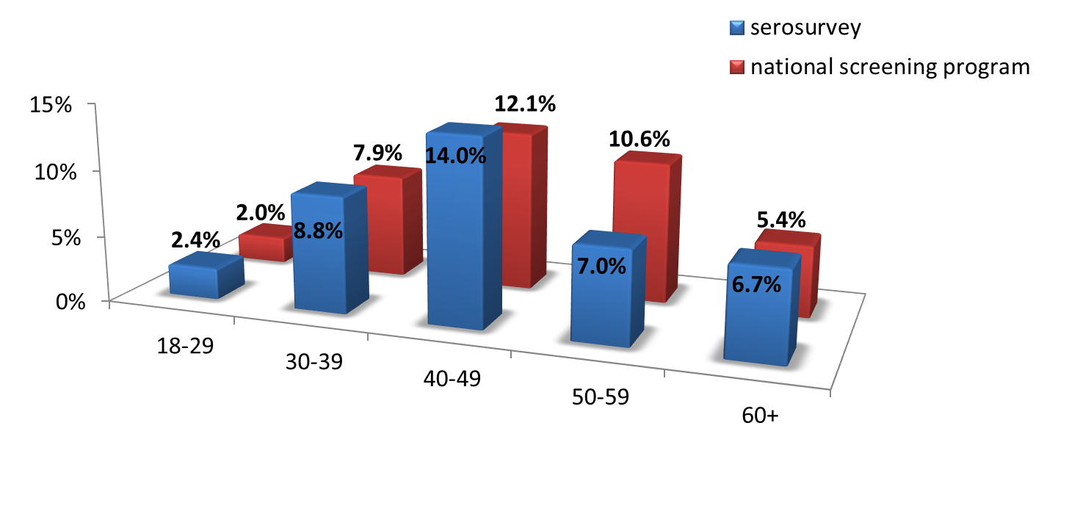
Strategic Date
Benchmark for HCV Prevalence in Georgia
National serologic survey -86% response rate
  Anti-HCV+ 7.7% ( 215,000)
  HCV RNA+ 5.4 % (150,000)
Risk characteristics
  IDU
  Incarceration
  Blood transfusion
46% with no reported risks
HCV prevalence by age

Slide 7
Targets in Georgia
Benefits of Time Limited Targets
Signal Urgency
Demand good performance and accountability
Build consensus on partner roles
Attract donor and community interest
Focus on the end goal – health equity
90-95-95
By 2020
90% of people living with HCV are diagnosed
95% of those diagnosed are treated
95% of those treated are cured
90% Reduction = 135,000 fewer persons with
HCV infection

Slide 8

Georgia
Public-health Based HCV Elimination Plan
Promote advocacy, awareness, education and partnerships
Prevent HCV transmission : Harm reduction for persons
who inject drugs; Infection control in healthcare settings
Identify persons infected with HCV: Expand screening and testing
Improve HCV laboratory diagnostics- Improve laboratory detection
Provide HCV care and treatment: Promote universal access to care and treatment
Improve HCV Surveillance: Assess disease burden, risks for HCV transmission and monitor program effectiveness.
Approved on August 18, 2016

Slide 9
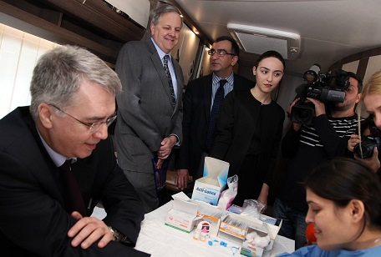
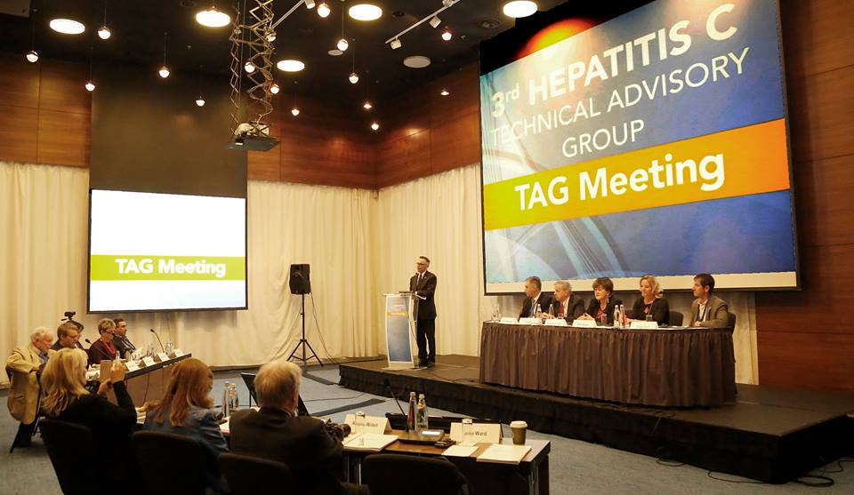
Georgia HCV Elimination Program
Political Commitment
Government participation in social mobilization
Government financial support of program
Changes in laws /regulations
  Blood banking
  Infection control
  Surveillance
Partnership development- financial, technical
Flexibility and open to change
Political /community mobilization is as important
as technical proficiency
Hinman A NY State J of Med 1984; Dowdle W, Bull WHO 1998; Dowdle W, Cochi S, Vaccine 2011

Slide 10







Georgia HCV Elimination Program Partners -2018
Ministry of Labour, Health and Social Affairs
US Centers for Disease Control and Prevention (CDC)
Gilead Sciences, Inc.- drug donation
Abbott Laboratories, BD International
WHO HQ, regions, country offices
ECHO
World Hepatitis Alliance
NOhep movement
National Center for Disease Control and Public Health

Slide 11
HCV Elimination Program Management
Ministry of Labour, Health and Social Affairs of Georgia
Need dedicated focal point
State Committee
Clinical Committee
Scientific Committee
National Center for Disease Control and Public Health
Social Service Agency
Screening providers - 602
Hepatitis Managament Center - Tbilisi
Hepatitis Managament Center - Zugdidi
Healthcare providers - 32
Dowdle, W, Vaccine 2011

Slide 12
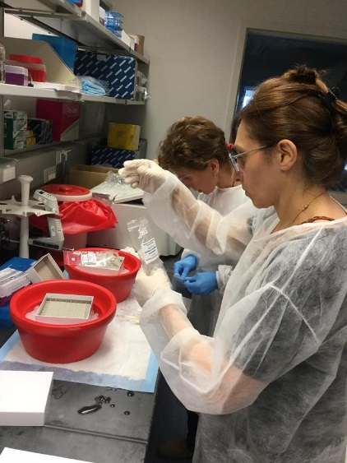

Improvements in Clinical Care System
Clinical training – Project ECHO
Referral networks
Diagnostic laboratory quality assurance program
Blood donor recruitment and screening
Infection control action plan
  Provider guidelines and training - e.g., dentistry
  Facility-based program development and assessment

Slide 13
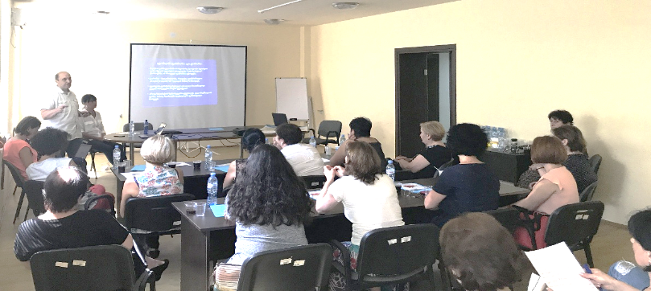
Improvements in Public Health System
Staff training for HCV prevention
and elimination
Enhance HCV surveillance and infrastructure
Improvements in information technology
Electronic Integrated Disease Surveillance System
Hepatitis C Elimination database
STOP C -
HCV Screening database

Slide 14
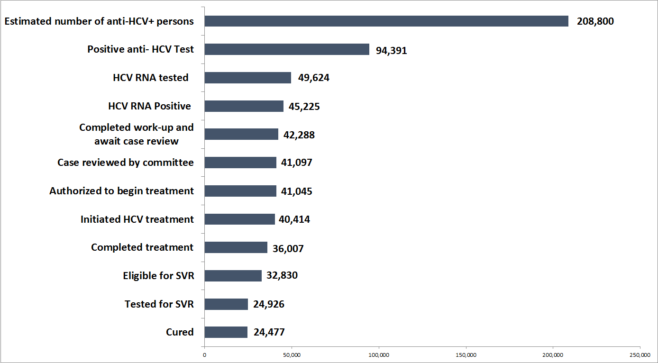
Georgia Hepatitis C Elimination Program Care Cascade
April 28, 2015 – October 31, 2017
Source: Georgia’s HCV Elimination Program Treatment Database

Slide 15
Elimination Demands A Focus on the Work
Yet to be Done
Estimated Number of HCV Infected Persons*
, Georgia, April 2015 – April 2026
40,000 treated
treated
* Assumes no new infections

Slide 16
Data to Track Key Indicators
Patients Initiating Treatment per Month,
April 2015 – October 2017
Averhoff

Slide 17
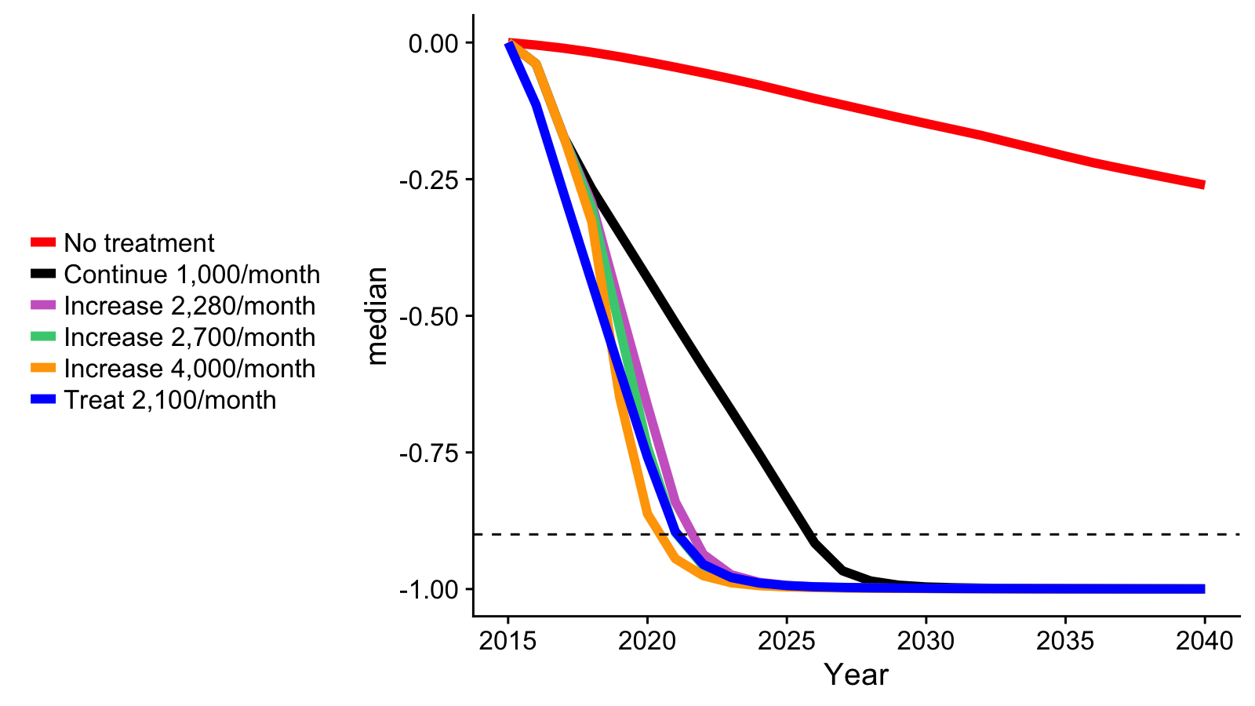
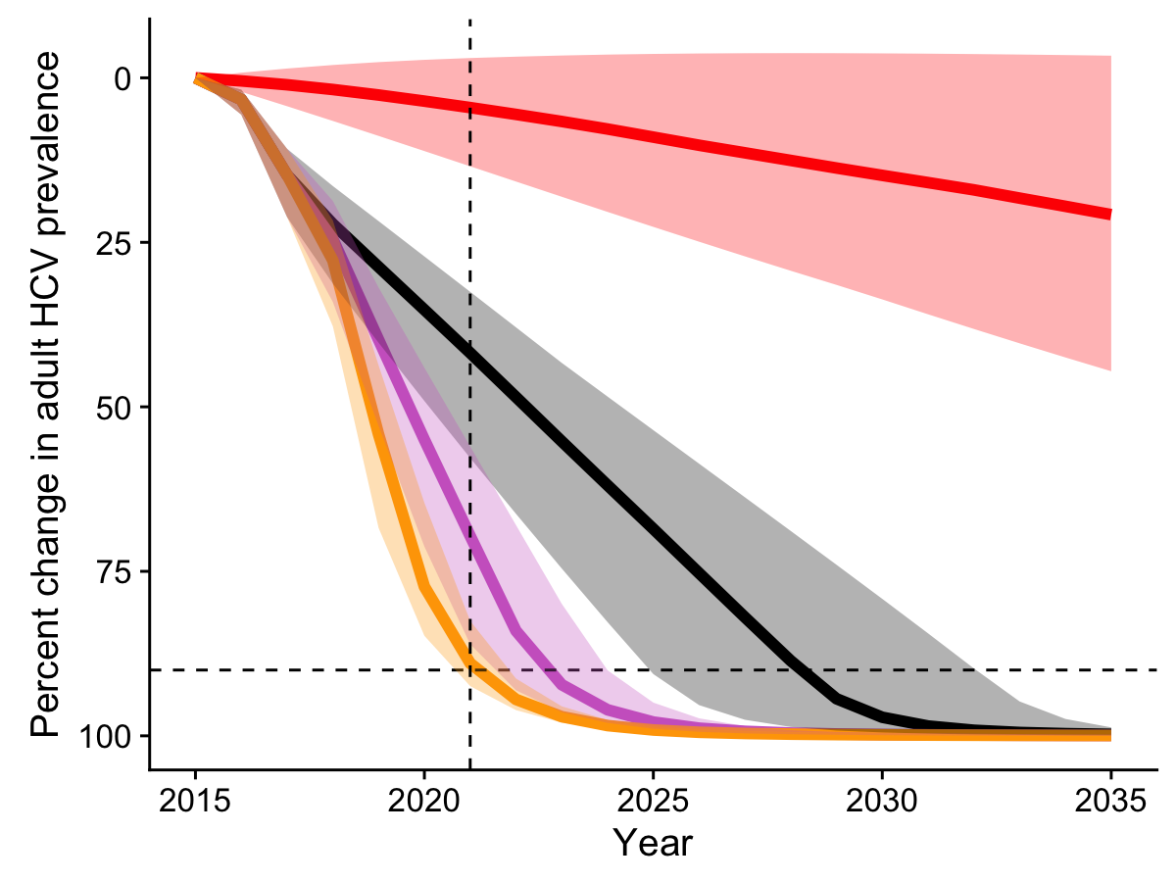
Modelling Data to Monitor Progress Toward Elimination Goal
Number currently treated (~40,000) has
reduced prevalence by 21% to 4.0%
By 2020, at current treatment rate of 1000/month
HCV prevalence will decline by 50%
To meet 90-95-95 goal, increase treatment from
1000 to 2280/month; decrease prevalence by 70%
Increase rate to 4000/month to decrease
prevalence by 90%
Programs change goals and time lines (e.g. polio)
Anticipate plan revisions and communication
with stakeholders

Slide 18
Operational Research Agenda
Model of integrated screening for HCV, TB and HIV in primary care
Studies of HCV treatment for persons who inject drugs
Introduction of innovative technologies for HCV diagnosis and monitoring
Assessment of barriers to screening, care, and treatment

Slide 19
Potential Legacies of HCV Elimination in Georgia Health System
Direct: Elimination of HCV as public health threat
Consequential
  Safer health system- infection control, blood safety
  Improved clinical care- training, referral networks, laboratory quality
  Stronger public health capacity- management, training, and information and
  Demonstrate benefits of prevention – e.g. preventive services for PWID
  Community mobilization – multiple sectors working together

Slide 20

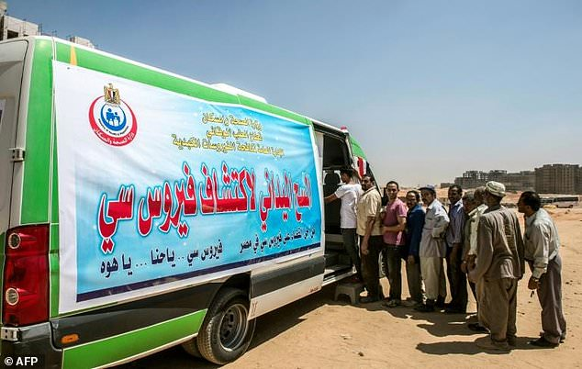
Lessons Are Available from Other
HCV Elimination Programs
Iceland – 1200 infected; 0.3 % HCV prevalence
National plan- 80% reduction in incidence by 2025
Multidisciplinary public health model focus on PWID
Social mobilization – e.g. letters to all households
50-70% of persons diagnosed treated for HCV
Concern- Sustainability
Egypt - 6 M infected; 6.4% prevalence
Goal- 1% prevalence by 2030
Political support and national planning- infection control and HCV treatment
HCV care/treatment system
Affordable HCV treatments
Concerns- Access to testing, treatment in primary care
Olafsson S J Int Med March 2018; El Kassos M. Exp Rev infect Ther March 2018

Slide 21
Georgia HCV Elimination Program
Lessons Learned
Demonstrate essential elements of an effective elimination program
  Time limited goals
  Public health plan
  Political commitment
  Feasible, appropriate interventions
  Data for monitoring and evaluation
Benefits in both eliminating HCV and improving health systems
Current issue - Increase testing and linkage to treatment to reach 2020 goal
Emerging issue – Stakeholder commitment and program sustainability
Opportunity- Improve partner networks to facilitate sharing of elimination strategies and practices among prospective and current elimination programs

Slide 22
Acknowledgements
Georgia
  Amiran Gamkrelidze
  Tengiz Tsertsvadze
  Maia Alkhazashvili
  Maia Tsereteli
  Marina Darakhvelidze
  David Metreveli
  Alexander Turdziladze
US CDC
Beth Skaggs
Francisco Averhoff
Maussam Nasrullah

Slide 23


