Slide 1
HEALTH SYSTEM ACHIEVEMENTS AND CHALLENGES GEORGIA
Dr. David Sergeenko
Minister of Labor, Health and Social Affairs
24 January, 2018
Notes:
Since 2013 the Government of Georgia has undertaken an important reforms to expand health care coverage to the entire population and improve health care services.

Slide 2
25 years: Collapse, Stabilization, Acceleration, Development …
Civil war
Notes:
Georgia went through turbulent past 25 years that are characterized by collapse, stabilization, acceleration, crisis and rebound… During these 25 years the country went through two wars - civil war, conflicts in in Abkhazia and South Ossetia resulting in a large number of internally displaced persons, and in 2008 war between Georgia and Russia.
important landmarks: in 2012: Peaceful transfer of power (Georgia Dream Party), signing of the Association Agreement with the EU in 2014 and in 2017, visa free travel to the EU.
During these years Georgia’s health care system has undergone several reforms, in late 1990s moving strongly away from Semashko model and decentralization of the health care system, extensive privatization introduced by the reforms in 2007-2012 which were also characterized by deregulation and trust in market mechanisms. At that time most government spending on health was channeled through private health insurance. Following the extensive privatization, most providers are independent of government in terms of ownership and management.

Slide 3

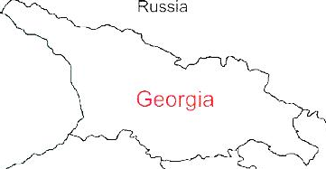



Demographic and Socio-Economic Situation, 2016
Population – 3 719 300
Birth rate (per thousand population) – 15.2
Mortality rate (per thousand population) – 13.7
Life expectancy at birth – 72.7
Maternal Mortality (per 100000 live birth) – 22.9
Infant mortality (per 1000 live birth) – 9.0
Under 5 mortality rate (per 1000 live birth) – 10.7
GDP per capita (at current prices), (2016) – 3852 $US
GDP real growth – 2.7%
Government expenditure on health per capita – 104 $US
Government expenditure on health as % of GDP – 2.8%
Government expenditure on health as % of State Budget – 8%
Government expenditure on health as % of GDP – 3%
General Government expenditure on health per capita (USD) – 116
Notes:
The population of Georgia has declined during the last 25 years, largely due to the outmigration and according to the census conducted in 2014, it is 3,7 mln.
Georgia has made a good progress in improving health outcomes. Life expectancy has increased by about 4 years over the few decades and currently is at 72.7 years.
Significant declines in under-five mortality and infant mortality
On-track for MCH-related MDGs

Slide 4
Economic Growth
3.5 %
Average GDP growth during 2014-2016, when most of Georgia’s neighbors were in or close to recession.
4.8 %
Average economic growth in 11 months of 2017
4.9 %
Average real GDP growth projection in 2018-2022, according to IMF

Slide 5
Unemployment and Poverty Indicators
2016
annual unemployment rate reached its lowest point in 13 years
2009-2016
Decreasing trend of unemployment rate

Slide 6
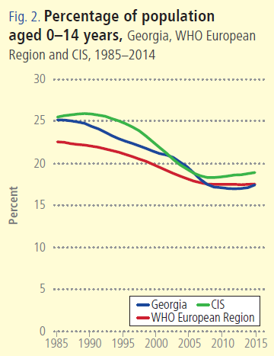
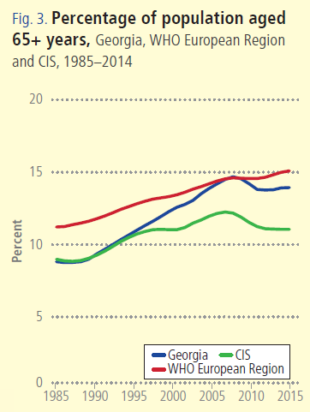
Notes:
Georgia, as many countries in the WHO European Region is facing a similar demographic challenges – ageing population and a declining birth rates.

Slide 7
Non-communicable diseases are the primary driver of overall disease burden
Cause of Burden of Disease (DALYs)
Injuries
Communicable
diseases
1990
2005
Non-communicable
diseases
2015
Notes:
If we look at the diseases burden, non-communicable diseases are the primary driver of overall diseases burden and it has been for a long time. The major causes of death in Georgia are related to non-communicable diseases, including cardiovascular diseases, cancer, diabetes and respiratory diseases, which together with injures make 94% of deaths.
The large share of premature deaths from NCDs are influenced by the health-related behaviors and risk-factors. STEPs survey results, population-based survey, which was conducted in Georgia second time to evaluate the trends in health related behaviors and risk-factors showed low physical activity, unhealthy diets, smoking and heavy alcohol consumption among the population.
An important breakthrough in this direction is an adoption of tobacco control law in May 2017, the law that is fully aligned with the WHO Framework Convention on Tobacco Control and is one of the strongest tobacco control laws in the European region. Large –scale antitobacco campaign and health promotion national programme with a strong tobacco control component will be implemented to strengthen tobacco control measures.
The primary concern of Georgia’s health system’s is the alleviation of the burden of NCDs and strengthening NCD control activities, including better management of chronic diseases at the primary health care level, improving health promotion and preventive measures is a priority.

Slide 8
Incidence of TB, Georgia, WHO European Region, CIS, 1990-2016
Incidence of HIV, Georgia, WHO European Region, CIS, 1990-2017
* Data for 2017 are preliminary
Notes:
The infant mortality rate and under five mortality rates have declined during the past several years, however, it is still higher than the Region’s average.
Maternal mortality has significantly fluctuated during the last decade. In 2016 we have seen a steep decline. Reproductive age mortality studies conducted to evaluate maternal mortality and completeness of the registration system revealed significant improvements in the deaths registration of women of reproductive age, determined at 98%.

Slide 9
Maternal Mortality ratio per 100000 live birth, Georgia, WHO European Region, EU, 2000-2017
Infant Mortality ratio per 1000 live birth, Georgia, WHO European Region, EU, 2000-2017
* Data for 2017 are preliminary
Notes:
The infant mortality rate and under five mortality rates have declined during the past several years, however, it is still higher than the Region’s average.
Maternal mortality has significantly fluctuated during the last decade. In 2016 we have seen a steep decline. Reproductive age mortality studies conducted to evaluate maternal mortality and completeness of the registration system revealed significant improvements in the deaths registration of women of reproductive age, determined at 98%.

Slide 10
Universal Health Care – Socially Oriented Political Platform
Reforms have moved Georgia closer to universal health coverage
Unprecedented Expansion of State Budget for Health care
365 mill GEL in 2012 → 1017 Mill Gel in 2016
Launch of Universal Health Care Program in February 2013
Better access to care
Better user experience
Better financial protection

Slide 11
Health sector expenditures
Out-of-Pocket Payment as % of Total Health Expenditure, Georgia
Public Health Expenditure, Georgia
Source: Georgia NHA 2010-2016 (MoLHSA, 2017)
Notes:
The UHC program was accompanied with a substantial increase in the governments budget allocations. From 2012 to 2016, the health budget more than doubled, as a percentage of GDP it increased from 1.7 percent to 3% in 2016.
The total level of health spending in Georgia at 8.5% of GDP is high compared with countries of similar level of income, however, despite recent increases, public health spending as a share of GDP remains lower than in many comparable countries in the European region.
Total Health expenditure (%) of GDP are relatively low in Georgia at 7.4% (2014). The WHO European Region average is at 8.2%. Average for CIS is at 6.6%.

Slide 12
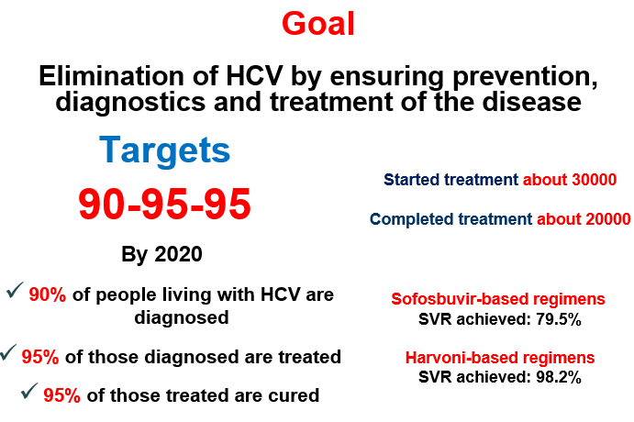
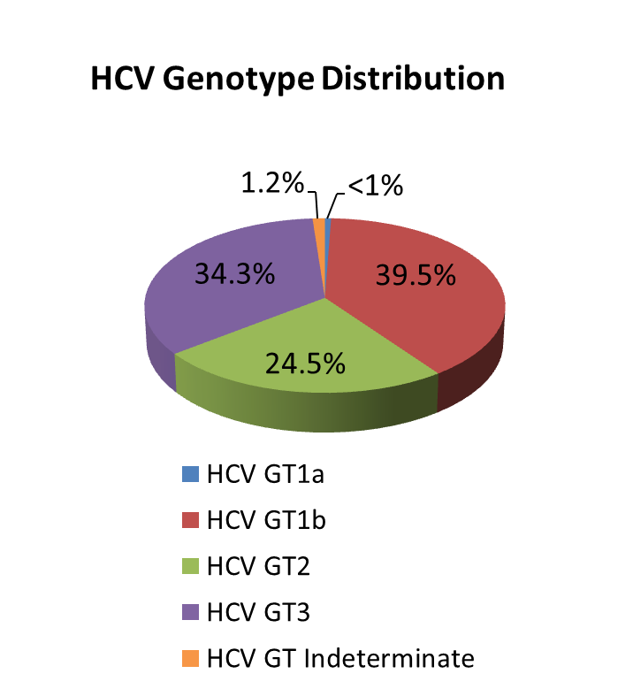
National Hepatitis C Elimination Program
Nationalwide survey, 2015
Anti-HCV+ | 7.7%
HCV RNA+ | 5.4%
Screened - 1,200,00
Started Treatment - 43000
Completed treatment - 37000
Sofosbuvir-based regimens
SVR achieved: 82%
Harvoni-based regimens
SVR achieved: 98.2%
Notes:
2015 National survey conducted by NCDC and CDC revealed that ~150 thousand people are infected with active HCV infection and need to be treated. The most prevalent genotype nationwide is genotype 1 (appx. 40%) followed by genotype 3 and 2.

Slide 13
Strategies adopted by Government
Georgian Healthcare System State Concept 2014-2020
Georgia Maternal & Newborn and Reproductive Health Strategy 2017-2030 and Action Plan 2017-2019
Noncommunicable diseases prevention and Control Strategy 2016-2020
Tobacco Control Strategy and Action Plan 2013-2018
Hepatitis C Elimination Strategy 2016-2020
HIV/AIDS prevention and Control Strategy 2016-2020
TB Control Strategy 2016-2018
Strategy for Containment of Antimicrobial Resistance 2016-2020
Active Ageing strategy 2017-2018

Slide 14
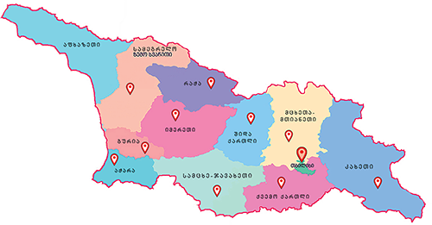
Maternal and Child Health
Georgia Maternal & Newborn and Reproductive Health Strategy 2017-2030 and Action Plan 2017-2019
Perinatal Care Regionalization - “gold” model of maternal and new born service organization
Congenital syphilis and mother-to-child transmission (MTCT) of HIV elimination plan
Universal newborn hearing screening program
Essential Nutrition Action Plan - folic acid and iron supplements for all pregnant women, breastfeeding promotion, multiple micronutrient supplementation for 6-23 months children
Under UHC program selective contracting for childbirth & C-section and neonatal intensive care services
Notes:
Regionalization of maternal and newborn health services – right patient, right place, right time equal access to high-quality of care for every mother and newborn along with other new programs such as, universal newborn hearing screening, EMTCT of HIV/Syphils, Essential Nutrition Action Plan, etc are the major initiatives and programs implemented in MCH area since 2015.
The first comprehensive Maternal and Newborn and RH Strategy and Action Plan was developed and approved by the Cabinet in March 2017.

Slide 15

Health management Information system
▪ Electronic system and regulatory mechanisms for vital events registration (since 2011)
▪ Electronic case-based reporting systems for in- and outpatients in health-care institutions (since 2014)
▪ Population-based cancer registry (since 2015)
▪ Birth registry - new electronic registration for antenatal and obstetric services and the surveillance of maternal and child health (since 2016)
▪ E-prescription (2017)
▪ Electronic health records (2017)

Slide 16
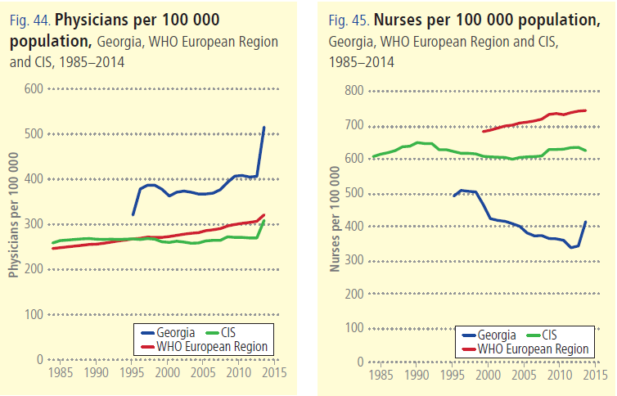

Slide 17
Human Resources
▪ HRH regulation and accreditation
- Medical specialties and sub-specialties aligned with EU
- Medical residency programs updated/prepared in 56
medical specialties
▪ Certification exam system revised
- New instrument for accreditation of continuous medical education
program developed
▪ Labor market analyses initiated
▪ Medical residency programs in several specialties funded by the
government
Notes:
The main goal is to transform professional, technical and vocational education and training and to optimize the performance, quality and impact of HRH through evidence-informed policies, contributing to healthy lives and well-being, effective universal health coverage, and resilient and strengthened health systems at all levels.
Initiated analysis of the labour market in order to develop appropriate policies and strategies; however, developing tools and plans that quantify health workforce needs, demand and supply for projected future scenarios will be needed to address HR needs and planning.
strengthening HRH information systems and other mechanisms for the effective collection, reporting and analysis of reliable HRH data, such as national health workforce registries and national health workforce accounts

Slide 18

Public health Emergency Preparedness and Responsible Capacity
The revision of Epidemics, Pandemics and Biological Incidents Response Plan
Updating/Developing disease specific plans:
Influenza Response Plan
Ebola virus
Zika Virus
Crimean-Congo Hemorrhagic fever
Polio
Dengue
Emergency Preparedness
WHO IHR was fully implemented in 2012;
NCDC was designated as the national IHR Focal Point;
24/7 Duty Officer System is established;
Georgia, together with other countries is actively involved in support of the 11 Action Package objectives:
Real-Time Surveillance - as a leading country
National Laboratory System – as the contributing country
Zoonotic Diseases – as the contributing country
GHSA
IHR

Slide 19
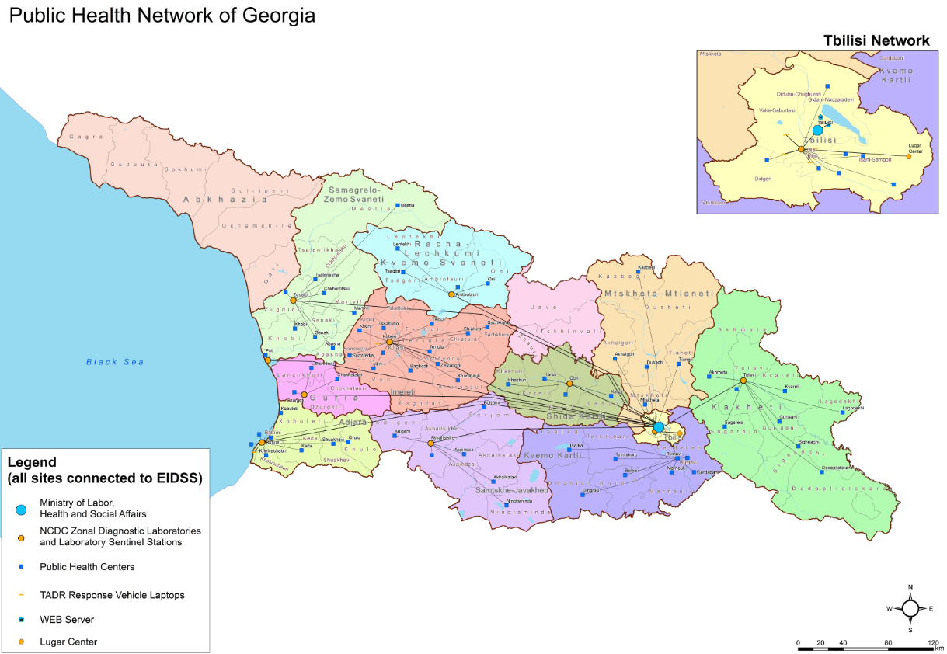
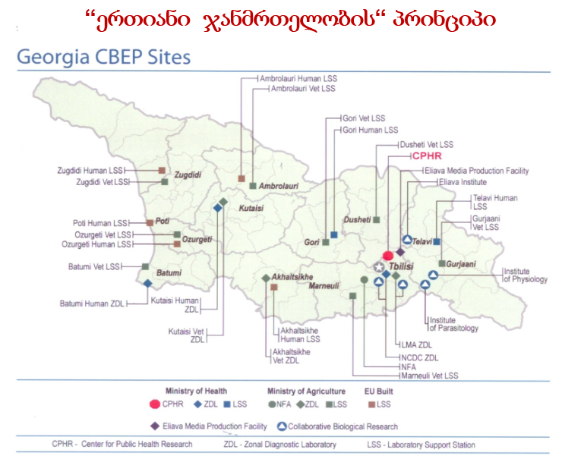

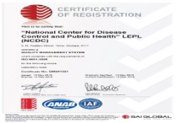
Unified Laboratory Network
One Health
Public Health Network
Electronic Integrated Disease Surveillance System (EIDSS):
72 notifiable diseases
200 entry points
R. Lugar Center for Public Health Research
ISO 15189 accreditation
3 Labs accredited by WHO
Polio
Influenza
Measles/Rubella
Notes:
19

Slide 20
Challenges ...
▪ Still very low public spending on health
▪ Still very high out-of-pocket payments
▪ Expenses on outpatient medications are high
▪ Service delivery model is biased towards
hospital/emergency services, and less primary care
centered
▪ Purchasing strategies are low effective at ensuring quality
and containing costs
Notes:
High OOP Payments are a Risk Factor for Impoverishment
Population ageing + weak management of NCDs + inefficient service delivery structure ➔ are the mix of cost drivers
40% of total health spending on pharmaceuticals and most of this is paid for out-of-pocket
We are not just looking at finding additional resources but also trying to understand constraints, and employ efficiency savings: get better value for money from existing resources.
SSA is a single purchaser and needs to fully exploit its purchasing power. Need to move away from passive purchasing: selective contracting, performance monitoring, make better use of information and health information systems broadly
Extend coverage of cost-effective outpatient medicines for better health, wealth and value

Slide 21
Thank you for your Attention!

