Slide 1


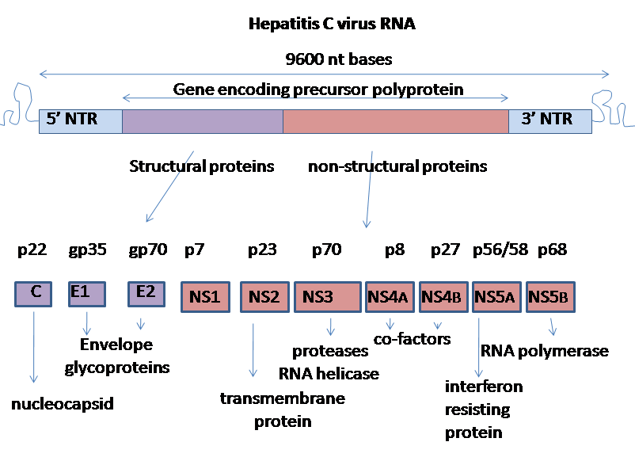
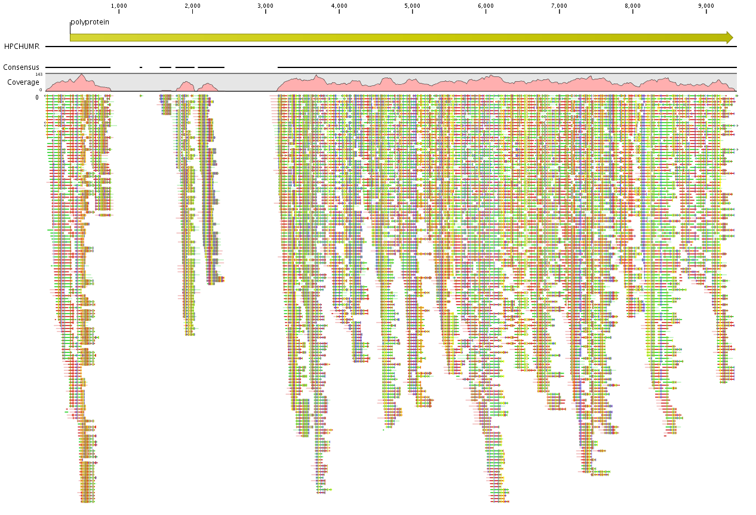
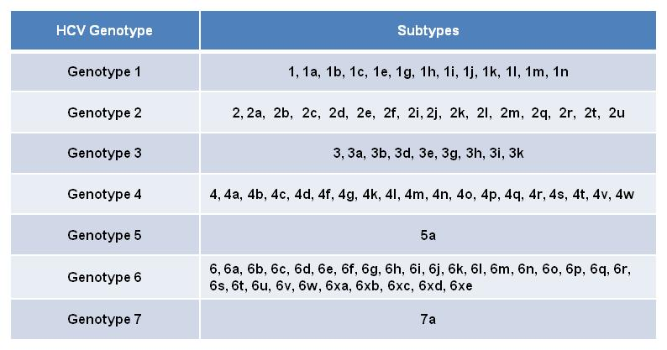
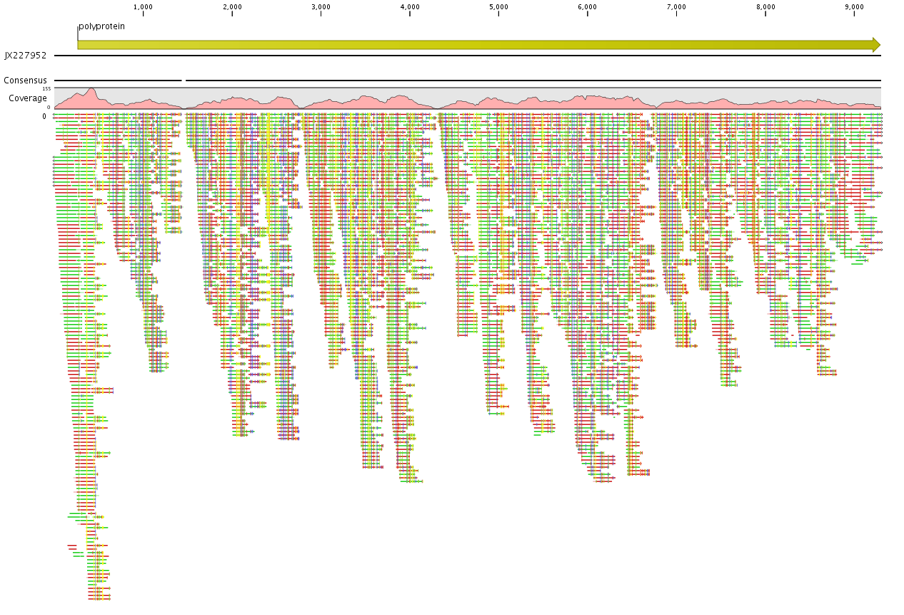
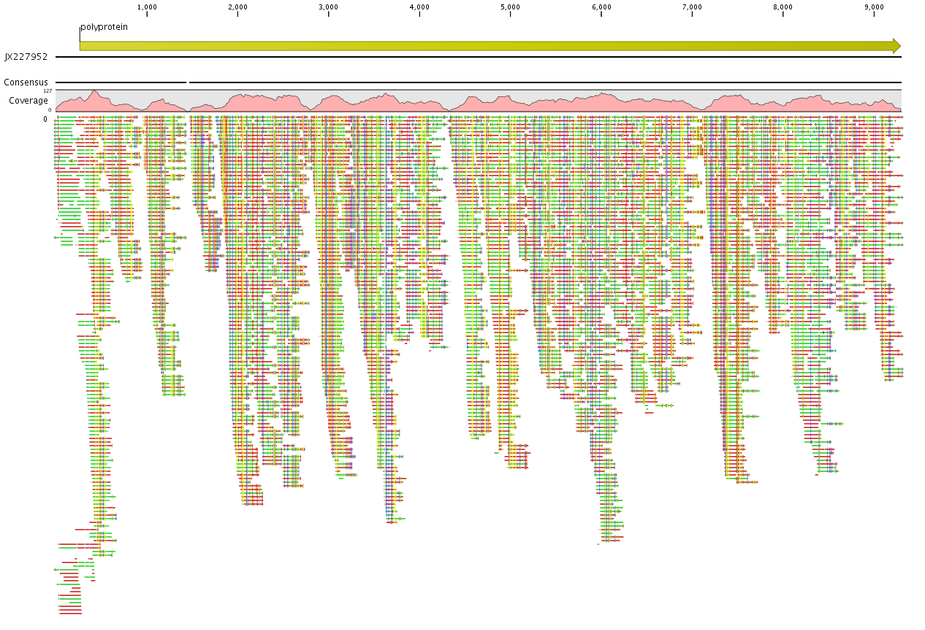
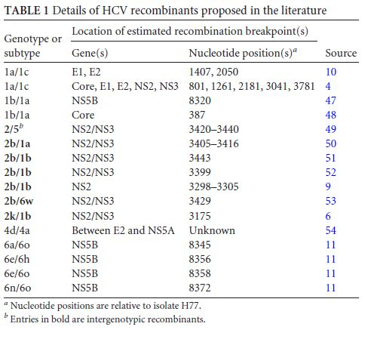
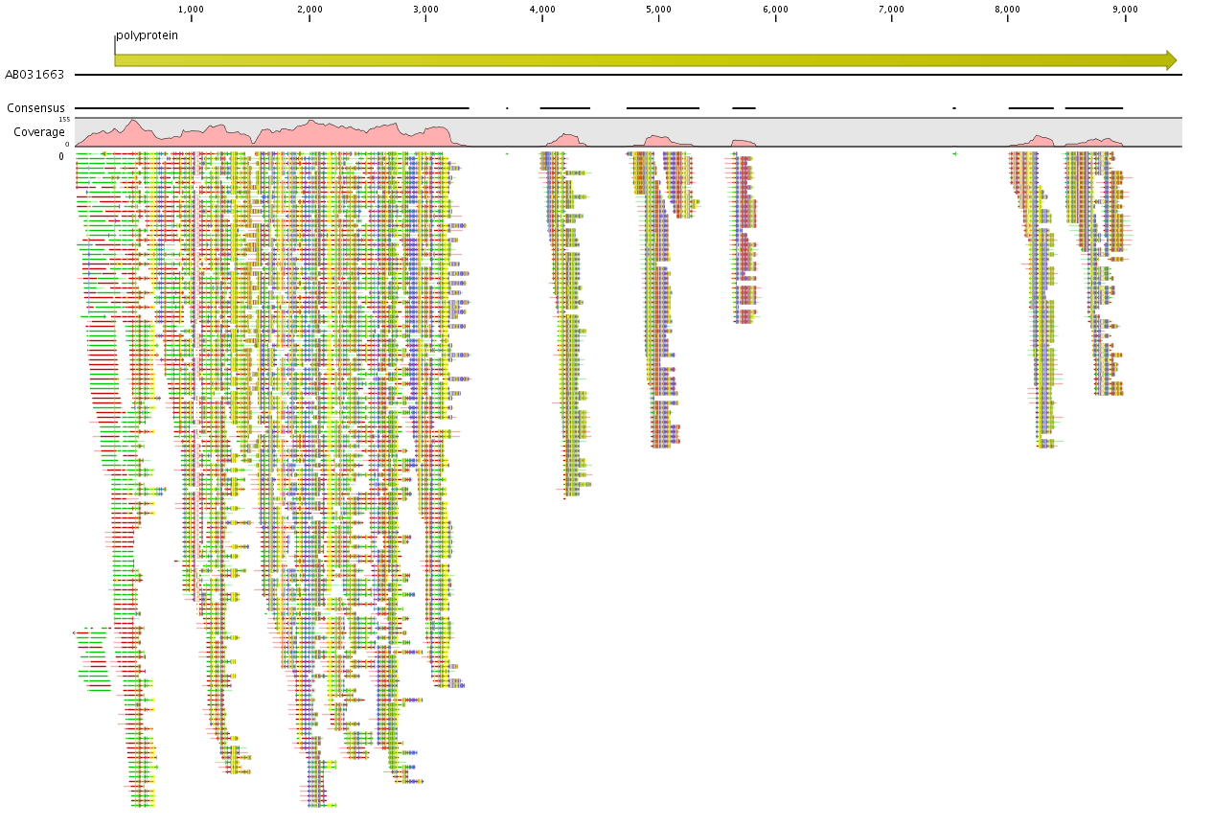
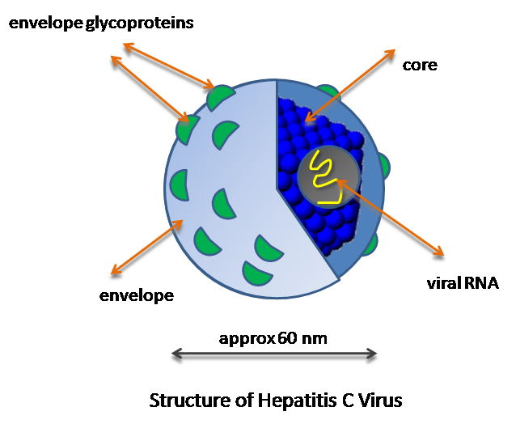
NEXT GENERATION SEQUENCE-BASED CHARACTERIZATION OF HEPATITIS C VIRUS RF1_2k/1b STRAIN IN COUNTRY OF GEORGIA
Adam Kotorashvili¹, Nato Kotaria¹, Maia Zarandia¹, Marika Karchava², Nikoloz Chkhartishvili²,
Tengiz Tsertsvadze², and Paata Imnadze¹
¹Lugar Center for Public Health Research at the National Center for Disease Control and Public Health, Tbilisi, Georgia;
²Infectious Diseases, AIDSs and Clinical Immunology Research Center, Tbilisi, Georgia
INTRODUCTON
MATERIALS AND METHODS
RESULTS
Hepatitis C virus (HCV) is a single-stranded positive-sense RNA virus, belonging to the Flaviviridae family, and exhibits substantial global sequence diversity. Globally, around 140 million people live with chronic HCV infection. The HCV particle consists of a core of genetic material (RNA), surrounded by an icosahedral protective shell of protein, and further encased in a lipid (fatty) envelope of cellular origin. Two viral envelope glycoproteins, E1 and E2, are embedded in the lipid envelope (Figure 1). The structural organization of the ORF genome-encoded protein is as follows: NH2–C–E1–E2–p7–NS2–NS3–NS4A–NS4B–NS5A–NS5B–COOH (Figure 2). This polyprotein yields at least ten different parts through the cleaving activity of host and viral proteases. HCV includes three structural proteins (core, E1, and E2), a small protein (p7), and six non-structural proteins (NS2, NS3, NS4A, NS4B, NS5A, and NS5B). The core protein forms the viral capsid through its RNA-binding capacity. The two envelope glycoproteins (E1 and E2) make viral entry possible. This constitutes a crucial step in its viral life cycle. E2 contains highly variable regions (HVRs) with amino acid sequences differing up to 80% between different isolates.
The C-terminal domain of NS3 has helicase/NTPase activity. Its functions include RNA binding and unwinding of regions of the extensive secondary structure, aside from RNA-stimulated NTPase activity. NS4A acts as a cofactor for NS3 protease activity. The NS3/4A protease activity results in cleavage of the viral nonstructural proteins. Recruitment of other viral non-structural proteins, NS4B forms the replication complex. The role of NS5A is not entirely clear. It is also probably important in viral replication. NS5B being an RNA-dependent RNA polymerase (RdRP) ensures the synthesis of new genomic RNA, and is consequently considered a central component of the HCV replication complex. The high genomic heterogeneity of HCV is the result of the lack of proof-reading activity of this RdRP (Figure 2).
HCV strains isolated in different parts of the world were classified into six major genotypes (i.e., genotypes one to six) and numerous subtypes (Table 1 A & B). Until 2001, HCV was thought to evolve in a clonal manner, with diversity generated through the accumulation of mutations. However, several events of inter- and intra-genotypic homologous recombination have been reported to date from various parts of the world. A 2k/1b recombinant was found in St. Petersburg, Russia, thought to have emerged by homologous recombination during minus-strand synthesis via template switching and seems to be circulating among intravenous drug users in Russia. Isolates of this strain, labeled RF1_2k/1b, have also been found in Ireland, Estonia, Uzbekistan, Western Siberia, and France.
Previous studies showed that RF1_2k/1b strain is common among ethnic Georgian patients previously assumed to be infected by genotype 2. More than 70% of HCV genotype 2 patients are infected with RF1_2k/1b strain based on the discordant results from 5’UTR and 3’UTR amplification based genotyping methods. The purpose of the study was to confirm and characterize the presence of suspected HCV RF1_2k/1b strain among Georgian patients using Next Genome Sequence (NGS) technology. HCV recombinant RF1_2k/1b appears to be widespread in Georgia, highlighting the need for further studies investigating recombination events in epidemiological studies.
RNA isolation, detection, sequencing
Read mapping to HCV subtype 1b reference of HCV2 specimen
In this study HCV genotype 2 clinical samples from chronic HCV patients enrolled in national hepatitis C elimination program at Infectious Diseases, AIDS and Clinical Immunology Research Center of Georgia were analyzed. HCV viral load was done by Cobas Taqman with the detection limit of 25 Iu/ml and initial HCV genotyping by INNO LiPA line probe assay. The NGS of HCV conducted at Genome Center of National Center for Disease Control and Public Health (NCDC)/Lugar Center.
RNA library preparation was conducted using NEBNext Ultra RNA Library Prep Kit for Illumina (New England BioLabs). RNA was reverse transcribed, amplified (12 PCR cycles) using indexed primers, and then purified using appropriate volume Ampure XP beads (Beckman Coulter). Libraries were quantified (Qubit HS DNA assay kit; Invitrogen) and assessed for fragment sizes (Bioanalyzer 2100, High Sensitivity kit; Agilent). Metagenomic (host-pathogen) RNA sequencing libraries were sequenced with 500 cycle sequencing kit on the Illumina MiSeq sequencing system with v3 chemistry.
Low-quality bases were trimmed from demultiplexed sequences using CLC Bio workbench 8.5. Human sequences were excluded by mapping reads to the human reference genomes available at NCBI. HCV-derived paired reads were assembled de novo into contiges; reads were mapped back to the assembly using CLC Bio Workbench 8.5. Genotypes 2k, 1b and recombinant RF 2k/1b available at NCBI were used for analysis as references.
Figure 2. Genome organization of HCV. At the 5' and 3' ends of the RNA are the UTR, that are not translated into proteins, but are important to translation and replication of the viral RNA. The 5' UTR has a ribosome binding site (IRES — Internal ribosome entry site) that starts the translation of a very long protein containing about 3,000 amino acids. The large pre-protein is later cut by cellular and viral proteases into the ten smaller proteins (Wikimedia Commons).
Figure 4. Read mapping analysis of HCV clinical specimen HCV2 for analysis we used 1b (accession number M58335) reference. With 1b reference, most of the reads were aligned with the left part of the genome, suggesting the we have recombination with 1b subtype.
Reference based analysis of HCV3 specimen using HCV RF1_2k/1b and subtypes 2k and 1b references
A
RESULTS
Reference based analysis of HCV2 specimen using HCV RF1_2k/1b and subtype 2k references
A
B
Figure 5. Read mapping analysis of HCV clinical specimen HCV3 for analysis, HCV RF1_2k/1b (accession number JX227952), subtype 2k (accession number AB031663), and subtype 1b (accession number M58335) references were used. With RF1_2k/1b, we got almost 100% coverage.
B
Structure of HCV
SUMMARY
Simplified diagram of the structure of HCV
The recombinant strain designated as RF1_2k/1b was first time reported in Russia. Other groups have also described this genotype among patients in Ireland, Estonia, Uzbekistan, Cyprus, France, Germany, and Israel. This strain was later fully sequenced showing recombination breakpoint positions in NS2-NS3 region of HCV genome. National population-based seroprevalence survey conducted in 2015 reported that HCV genotype 2 is the third most common genotype accounting for 24.5% from all HCV infection in the country. These whole genome sequence-based study shows the occurrence of RF1_2k/1b recombinant strain in ethnic Georgian population suggesting that this strain may be circulating in Georgia.
Table 1. HCV is classified into seven genotypes numbered 1-7 and subtypes by numbers and letters (e.g. 1b). Genotypes 5 and 7 are represented with one subtype 5a and 7a accordingly. (A) HCV intergenotypic recombination tends to occur between the structural and (B) nonstructural genome regions.
Figure 1. Simplified diagram of structure of HCV particle. The HCV particle consists of a core of genetic material (RNA), surrounded by an icosahedral protective shell of protein, and further encased in a lipid (fatty) envelope of cellular origin. Two viral envelope glycoproteins, E1 and E2, are embedded in the lipid envelope (source Wikimedia Commons)
Figure 3. Read mapping analysis of HCV clinical specimen HCV2 for analysis, HCV RF1_2k/1b (accession number JX227952, A), and HCV subtype 2k (accession number AB031663, and B) references were used. With RF1_2k/1b, we got almost 100% coverage, while 2k reference mostly covered the left part of the entire genome, suggesting that we have recombination with 2k subtype.
ACKNOWLEDGMENTS
The work was made possible by the support provided by the CDC (Center for Disease Control and Prevention, Atlanta, GA, USA).

