Slide 1

How to explain temporary labour migration and understand its impacts?
Paweł Kaczmarczyk
Centre of Migration Research
University of Warsaw
Piloting Temporary Labour Migration of Georgian Workers to Poland and Estonia
Workshop on Temporary Labour Migration
Tbilisi, May 30th 2017

Slide 2
Aims
To place discussion on migration in a broader context of development related debate
To discuss peculiarities of temporary/circular migration – with regard to its drivers and outcomes
To provide a background for workshops on temporary migration as a risk/opportunity/challenge

Slide 3
Outline
Context: migration-development nexus
Temporary migration: definitions, understanding, measurement
Temporary migration and its drivers: to what extent specific?
Temporary migration and its impacts – towards identifying developmental potential of migration

Slide 4
Context: migration-development nexus
Migration-development ’pendulum’ (de Haas 2008), between:
migration optimists and migration pessimists
functionalist and structuralist approaches
neo-classical and neo-marxist theories
modernization and disintegration
development and dependency
Main message: heterogeneity of migration development interactions → importance of the structural context

Slide 5
Context: migration-development nexus
„Traditional” approaches: focus on monetary income and economic growth (mostly on the national level), narrow view of development as a process of incorporation into the capitalist system (entailing industrialisation and urbanisation), mainstream migration theory entrenched in a ‘modernist ideology’ → concept of progres, ‘methodological nationalism’ → focus on nation states;
Consequence: Bias towards control of migration and imposing barriers to mobility, believe in the power of migration policies.
Towards a pluralist views on migration and development?
→ structure and agency → migration as a household livelihood strategy (NELM)
→ transnational perspective (’transfers’, diaspora involvement etc.)
→ human capabilities approach (HDR 2009) (development as a ‘process of expanding the substantive freedoms that people enjoy’ - Sen 1999; Mahbub ul Haq (1995): ‘The basic purpose of development is to enlarge people’s choices’)
→ migration as an endogenous variable – ‘integral part of change itself ‘ – de Haas 2008: 47)
→ but also development mantra (Kapur 2004) → dominance of the neo-liberal approach to migration and its outcomes → limited involvement of public policies
Temporary migration as a typical or specific case?

Slide 6
Temporary migration: brief methodological introduction
Basic demographic approach: migrants are the difference between the population sizes in a given period with respect to number of births and deaths → focus on net flows, focus on PERMANENT migration
But demarcation criteria including: place of residence and time
Migration or mobility is a movement involving a change in the place of residence → key factors:
What does really matter? Importance of the social and/or economic setting (institutional environment)
Eisenstadt: migration is „[...] the physical transition of an individual or a group from one society to another. This transition usually involves abandoning one social setting and entering another and different one”
Methodological problems with time criteria → Permanent vs. temporary migration: the duration of migration, i.e. stay in a new place of residence can accurately be determined only a posteriori – after the return to sending community or death of the migrant
Additionally: serious measurement issues…

Slide 7
Temporary migration: brief methodological introduction
What does it mean temporary or circular migration?
Broad literature on temporary migration in the context of urbanisation and development in Africa, Asia and Pacific Islands (Skeldon, Bedford and other)
Process of leaving and returning (sometimes in a cyclical way) (Newland 2009)
A continuing, long-term and fluid movement of people among countries (MPI 2007)
Fluid movement of people between countries which, when it occurs voluntarily and is linked to the labor needs of countries of origin and destination can be beneficial to all involved (GAMM 2007)
A form of migration that is managed in a way allowing some degree of legal mobility back and forth between two countries (EC 2007) → outward circularity (third country nationals settled in the EU) and inward circularity (residents of third countries)
Migration involving continuous engagement in both home and adopted countries (MPI 2008)
Spontanous vs. Regulated temporary/circular migration (Wickramasekara 2011)
Hindered circular migration, embedded circular migration, regulated circular migration (Cassarino 2008)
IMPORTANT ASPECT: distinction between temporary and permanent migration draws a divide between those who have more and those who have less rights (settlement, labour market, social welfare etc.) (Abella 2006) → NON-SETTLEMENT as the main factor...

Slide 8
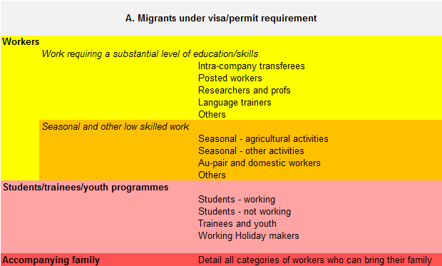
Temporary migration: brief methodological introduction
OECD approach
A temporary migrant is a person who is admitted with a permit or visa which is either not renewable or renewable only on a limited basis

Slide 9
Migration in the 21. century – a global picture
Basic data (HDR 2009):
Number of internal migrants: 740 million
Number of international migrants: 200 million
Number of South – North migrants: < 70 million
Number of South – South / North – North migrants: ~130 million
Number of refugees: 14 million
Number of internally displaced persons: 26 million
Notes:
9

Slide 10
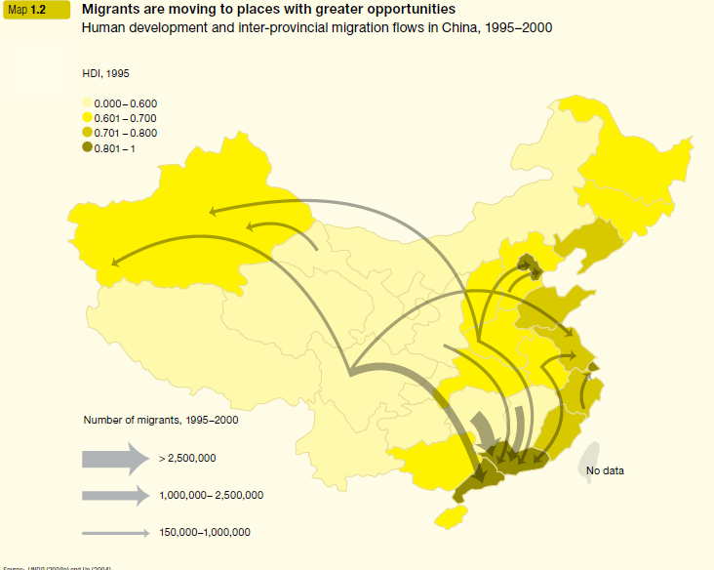
Why do people migrate?
Source: HDR 2009
Notes:
10

Slide 11
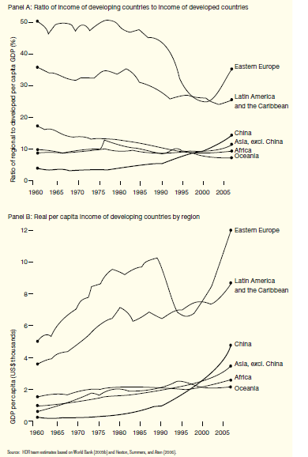
Why do people migrate?
Source: HDR 2009
Notes:
11

Slide 12
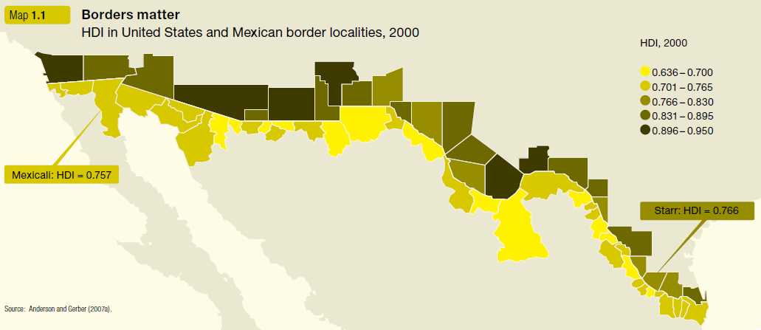
Why do people not migrate?
Source: HDR 2009
Notes:
12

Slide 13
Role of temporary/circular migration
Source: Wickramasekara 2011
Notes:
13

Slide 14
How to explain migration?
Source: Own elaboration based on Massey 1999.

Slide 15
How to explain (temporary) migration?
Permanency assumed (?)
Neoclassical economics (H-O model): → migration is perceived purely instrumentally, as a consequence of wage differential and as a means to equalize inequalities in wages and living conditions on the international level; international trade and capital flows as substitutes to migration flows
Structural approaches → world system theory: mobile populations as an outcome of capitalist penetration; decisive role of structure of power (political/economic) and links within the stratified world order
Human capital approach → migration as an investment decision met with an intention to find maximal pay for a given level of skills → investment which improves the productivity of human capital → BUT: selectivity of migration as an issue!

Slide 16
How to explain (temporary) migration?
Critical importance of temporariness:
Dual labor market theory
NELM
Network theory/theories

Slide 17
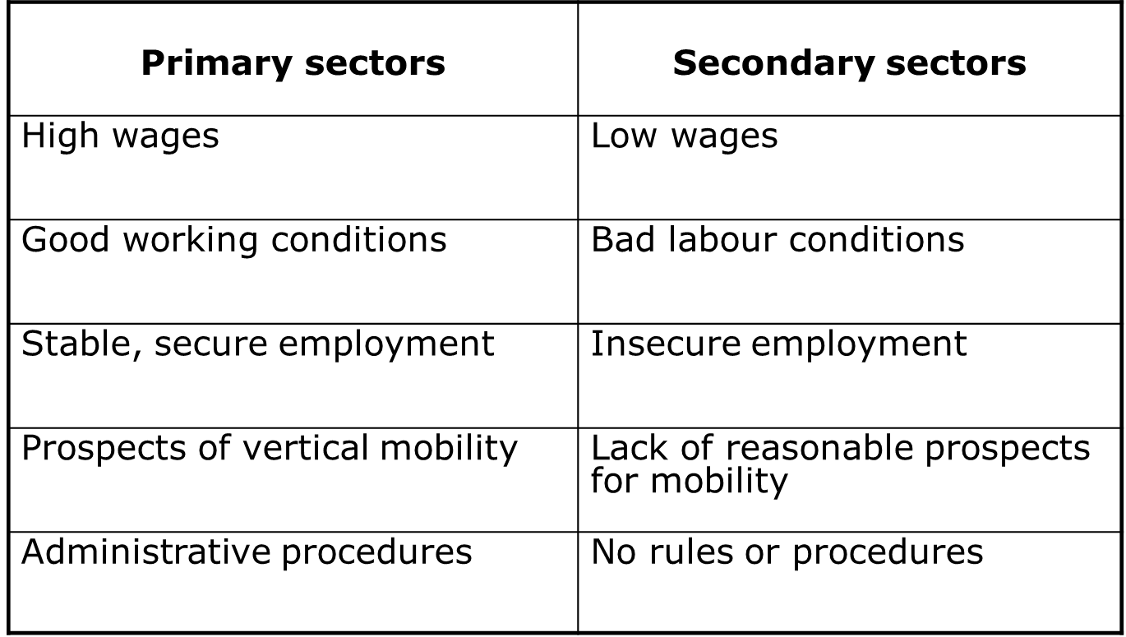
How to explain (temporary) migration?
Dual labor market theory – primary and secondary markets/segments

Slide 18
How to explain (temporary) migration?
Why secondary sectors can be attractive for immigrants?
Immigrants usually perceive their stay in the destination country as temporary. „The temporary character of the migration flow appears to create a sharp distinction between work, on the one hand, and the social identity of the worker, on the other. The individual’s society identity is located in the place of origin, the home community. The migration to the industrial community and the work performed there is purely instrumental: a means to gather income, income that can be taken back to his or her role within that social structure. From the perspective of the migrant, the work is essentially asocial: It is purely a means to an end. In this sense, the migrant is initially a true economic man, probably the closest thing in real life to the Homo economicus of economic theory” (Piore 1979: 54).
PLUS: role of hierachy and hierarchical constraints

Slide 19
How to explain (temporary) migration?
New Economics of Labor Migration
Assumptions:
Labour is a specific factor of production
Individuals are acting in a social context → focus on the family or the household
Migration is to be perceived as a complex social phenomenon - „Migration can be looked upon as a process of innovation, adoption and diffusion” (Stark i Bloom 1985: 176)
Migration does not have to be permanent, in contemporary world temporary mobility is very common.

Slide 20
How to explain (temporary) migration?
New Economics of Labor Migration
Key idea:
migration decisions are not made by isolated individuals but by larger units of related people (families, households, communities)
→ people can act collectively not only to maximize expected income but also to minimize risk and to loosen constraints associated with various kinds of market failures
→ households are able to control risks to their economic well-being by diversifying the allocation of resources (family labour) to different labour markets.

Slide 21
How to explain (temporary) migration?
New Economics of Labor Migration
Key idea:
migration decisions are not made by isolated individuals but by larger units of related people (families, households, communities)
→ people can act collectively not only to maximize expected income but also to minimize risk and to loosen constraints associated with various kinds of market failures
→ households are able to control risks to their economic well-being by diversifying the allocation of resources (family labour) to different labour markets.
CRITICAL ROLE OF MARKET FAILURES AND RISK DIVERSIFICATION ACTIVITIES

Slide 22
How to explain (temporary) migration?
New Economics of Labor Migration
Key market failures and their impact on migration propensity – mechanisms of migration as a social protection strategy:
Absent markets or market imperfections →
→ capitalist penetration →
→ change in socio-economic conditions and in life styles (e.g. consumption behaviour) →
→ high migration propensity → risk diversification strategies

Slide 23
How to explain (temporary) migration?
New Economics of Labor Migration
Evidence:
1) Stark and Lucas (1988) remittances are part of a self-enforcing contractual arrangement between families and migrants → shift from individual independence to mutual interdependence.
2) Stark and Levhari (1982): migration is a means to spread risk rather than a manifestation of risk-taking behavior on the part of migrants.
3) Stark, Rosenzweig and Lucas (1989, 1985): families insure themselves against risk by placing members in labour markets outside their village, where income are not positively correlated with local farm incomes.

Slide 24
How to explain (temporary) migration?
New Economics of Labor Migration
Relative deprivation:
People are acting in a social context → „a person may migrate from one location to another to change his relative position in the same reference group, or to change his reference group” (Stark i Bloom 1985: 173)
People rarely base their decisions on an evaluation of absolute income alone but also take into consideration their relative income
Relative deprivation and temporary migration.

Slide 25
How to explain (temporary) migration?
New Economics of Labor Migration – conclusions:
Not the autonomous individual but families or households are the appropriate units of analysis for migration research.
A wage differential is not a necessary condition for international migration to occur – households may have strong incentives to diversify risk through migration even in the absence of wage differentials.
There is no trade-off between mobility and activities in the country/region of origin. Indeed, there are strong incentives for household to engage in both migration and local activities.
Development in regions need not to reduce the pressures for international migration, in opposite, it may intensify them (change in modes of behaviour, change in income structure).
International labour movement does not necessarily stop when wage differentials have been eliminated between different labour markets. Incentives for migration will continue to exist if other markets (insurance, futures, capital, consumer credit) are absent or imperfect.
The same expected gain in income may not have the same effects on the probability of migration. Income distribution can be crucial factor in determining the scale of migration.

Slide 26
How to explain (temporary) migration?
The perpetuation of migration → social capital theory and network theory
General idea: People gain access to social capital through membership in networks and social institutions and then convert it into other forms of capital to improve or maintain their position in the society.
Fawcett: ‘Migrant networks are sets of interpersonal ties that connect migrants, former migrants, and non-migrants in origin and destination areas through ties of kinship, friendship and shared community origin’.
The meaning of networks:
serving as a channel of information, other resources, and normative structures
influencing the selection of destinations and origin sites
determining, to a degree, who migrates from communities and households
networks make international migration extremely attractive as a strategy for risk diversification or utility maximization
shaping the size and momentum of migration
thanks to migrant networks, migration may become a self-perpetuating process.

Slide 27
How to explain (temporary) migration?
Guilmoto and Sandron (2001) → an institutionalist approach
Transaction costs: cost of acquiring information about employment opportunities, accommodation, legal rules, but also negotiating the contract, sending money home etc.
The lack of efficient markets can be compensated by additional institutions – migrant networks - migrant networks are, in fact, a kind of infrastructure which helps to control the level of risk and reduce the transaction costs associated with mobility.
Process:
Presence of market failures → development of networks as a migration infrastructure → institutionalization of migration → mass process → limits to potential migrants (limited choices, e.g. destinations).

Slide 28
Towards explaining outcomes of migration – sending countries perspective
LABOUR MARKET IMPACTS
loss of labour / ‘export of unemployment’
loss of scarce human capital needed to maintain or increase productivity in the sending country → brain drain
REMITTANCES
remittances → direct and indirect impacts
‘social remittances’
Notes:
28

Slide 29
Labour market impacts
(E)migration as a shock to labour market → loss of labour → labour shortages, pressure on wages
BUT: if there is an oversupply of labour the outflow will have zero opportunity cost
Problem: in the case of high levels of out-migration the loss of emigrant labour reduces the productivity of complementary factors such as land and capital → emigration produces a deadweight welfare loss.
Evidence:
Migration usually does not involve more than 2-3% of labour force
Turkey in 1973 had one million expatriates (6% of labour force), Philipiness about 6% of the labour force abroad → in neither case could the migration solve the problem of structural unemployment
Impact on wages: positive but moderate (Mishra 2007, Hanson 2005, Aydemir and Borjas 2006).

Slide 30
Migration and human capital – brain drain/gain debate
Two distinctive parts of the literature on consequences of highly skilled mobility:
  ‘traditional approach’ - Grubel and Scott (1966), Bhagwati and Hamada (1974): a pessimistic view, emphasis on costs and losses, i.e. fiscal effects, impact on factors’ productivity, money spent on training of emigrants → brain drain;
  ‘modern approach’ - Stark et al. (1997), Mountford (1997), Beine et al. (2001) → new economics of brain drain: migration as a probabilistic event, i.e. the outcome of a lottery where the would‑be migrant has a positive probability p of actually migrating, where p<1 → the decision to invest in education is driven by the expected return to human capital → a positive probability p of migrating increases the expected return to investment in human capital compared to the no‑migration situation → an increase in the optimal level of human capital.
Notes:
30

Slide 31
Migration and human capital – brain drain/gain debate
Additional effects:
  a reduction in educational attainment in the areas characterized by higher emigration rates possible → as a consequence of very low (or even zero) returns to human capital in the destination countries - McKenzie and Rapoport (2008)
  brain waste - Mattoo et al. (2005)
  brain overflow – Kaczmarczyk and Okólski (2008)
  the scope for a beneficial brain drain should be substantially reduced - Egger and Felbermayr (2007), Brücker et al. (2007)
→ A dynamic approach: Beine, Docquier and Rapoport (2001).
Notes:
31

Slide 32
Migration and human capital – brain drain/gain debate
Two distinctive parts of the literature on consequences of highly skilled mobility:
  ‘traditional approach’ - Grubel and Scott (1966), Bhagwati and Hamada (1974): a pessimistic view, emphasis on costs and losses, i.e. fiscal effects, impact on factors’ productivity, money spent on training of emigrants → brain drain;
  ‘modern approach’ - Stark et al. (1997), Mountford (1997), Beine et al. (2001) → new economics of brain drain: migration as a probabilistic event, i.e. the outcome of a lottery where the would‑be migrant has a positive probability p of actually migrating, where p<1 → the decision to invest in education is driven by the expected return to human capital → a positive probability p of migrating increases the expected return to investment in human capital compared to the no‑migration situation → an increase in the optimal level of human capital.
Notes:
32

Slide 33
Statistical brain drain
Percentage of persons with tertiary education in the native and migrant population in the NMS, 2006

Slide 34
Brain drain model with "brain effect" and "drain effect"
Assumptions:
Economic growth is due to the intergenerational transmission of human capital
Human capital is transferable
Higher returns to education abroad
From the theoretical model it follows that:
  Educated are those who migrate (but not all of them!)
  Share of well educated depends on migration prospects
  Economic growth depends on the share of well educated (in a positive way) and migration (negatively) – outcome? (empirical issue)
Important:
  Static effect – drain effect (ex post)
  Dynamic effect – brain effect (ex ante)
  Beneficial Brain Drain (BBD) emerges when the brain effect dominates.
Problem: empirical strategies… (more on that issue later)

Slide 35
What does it mean – remittances?
USUALLY we define remittances as money sent back home by migrants
In banking statistics (World Bank recommendations) remittances are sum of workers’ remittances, currently: personal transfers (transfers of persons staying abroad for over one year), compensation of employees (up to 12 months), and migrant transfers (brought by migrants themselves)
Side note:
Estimates of migrant remittances are based on official banking statistics and do not include in-kind or pocket transfers → according to different estimates they can be even 2 or 3 times higher
But: in the case of Mexico extensive reaearch yielded a range estimates from 2 to 3 billion migradollars annually – figures quite close to official estimates.

Slide 36
Potential impacts - remittances
Scale of the phenomenon:
Registered remittances:
1990 → $31.1 billion
2000 → $76.8 billion
2007 → $240 billion
2013 → $550 billion (6.3% increase as compared to 2012)
2016 (projected) → $700 billion
Registered remittances are close to tripling the value of ODA (Official Development Assistance) (Glytsos 2002)

Slide 37
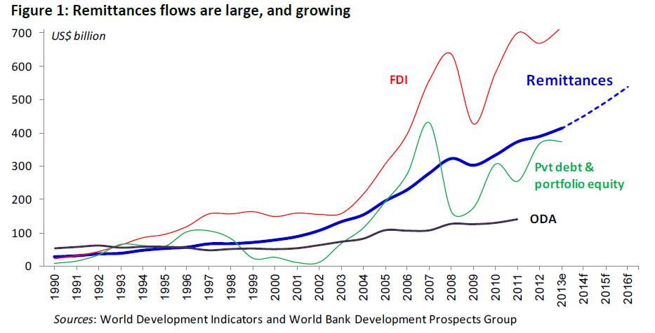
Potential impacts - remittances

Slide 38
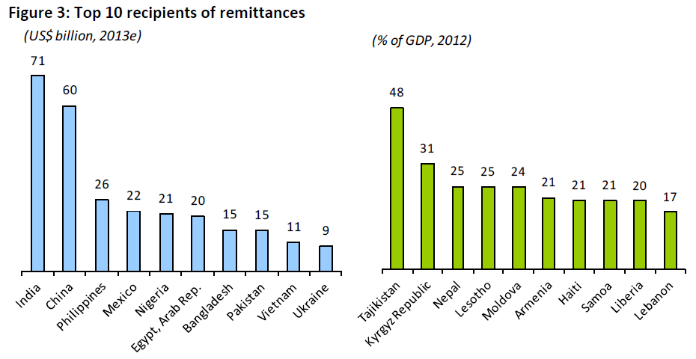
Potential impacts - remittances

Slide 39
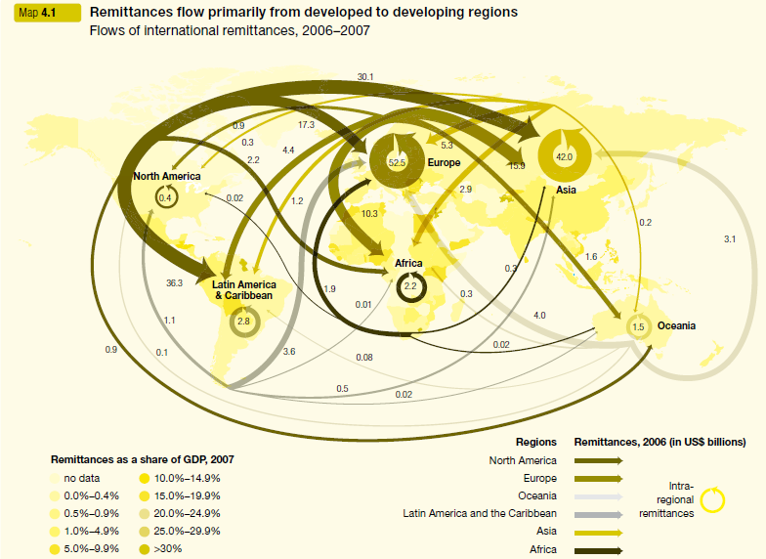

Slide 40
Why do people remit?
Origins:
Lucas and Stark (1985, 1988) → an idea to perceive remittances as a part of intra-family contractual self-enforcing arrangement → derived from the New Economics of Labor Migration (Stark and Bloom 1985):
1) migrants usually originate from less developed countries (or regions) which are highly prone to risk; migration is then one of the avenues to limit or at least diversify the risks resulting from missing markets or market failures → money transfers
2) on the other hand, migration as such can be also risky, particularly in its first phase, and thus the migrant and the family may enter into a “voluntary contractual arrangement”
Lucas and Stark (1985) suggest distinguishing between three main categories of motives: pure altruism (when the migrant derives utility from the utility of those family members left home), pure self-interest (aspirations to inherit, investments back home) and tempered altruism or enlightened self-interest (all kind of contractual arrangements between migrants and their families / households).

Slide 41
Why do people remit?
Motivations to remit → main theoretical approaches:
1) Altruistic motivation → based on the Beckerian approach to modeling of human behavior assuming that individuals can derive utility from the consumption of other people, in this case members of the (extended) family
2) Self-interest motives → it is likely that people who would like to return will tend to invest at the place of origin and can be more prone to remit (and remit relatively more than those not interested in self-employment upon return) → self-interest driven motives can be also derived from the expectations to inherit
3) Inter-temporary contractual agreements between migrants and their households

Slide 42
Why do people remit?
Motivations to remit → main theoretical approaches:
3) Inter-temporary contractual agreements between migrants and their households:
- Migrants may attempt to maximize the returns to their savings by placing some of it in the country of origin (and by using their families as kind of “intermediaries” and then this form of remittances becomes part of contractual arrangement between the migrant and his/her family)
- In the presence of significant market failures as well as income volatility which is the salient feature of many less developed countries, migrants may want to insure themselves against bad states of nature (also in terms of consumption smoothing)
- Migration is an inter-temporal transaction remittances may present a form of loan repayment (e.g. if family helped the migrant in terms of co-financing his/her trip).
- Remitting as a strategic behavior → preventing non-migrants from moving.

Slide 43
Remittances - impacts
Macro effects:
Remittances and GDP, export revenues, costs of import, negative balance of payments
General conclusion: in some cases migrant remittances may constitute a large and important source of capital for developing countries (e.g. Moldova, Albania, former Yugoslavia)
But:
have only limited positive long-term effects on economic growth and development in sending countries
migration fail to increase production and investments
it has often negative consequences: inflationary pressure, undesirable currency appreciation, disincentives for domestic savings, private consumption of imported goods etc.

Slide 44
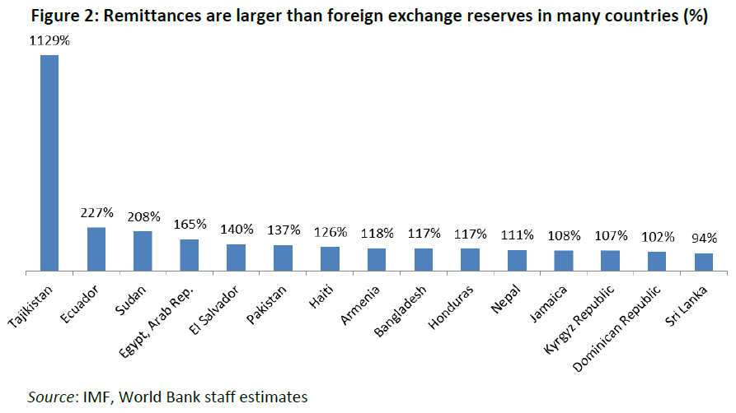
Potential impacts - remittances

Slide 45
Potential impacts - remittances
Indirect effects
→ they result from expenditures by migrant households
→ if households spend remittances on goods and services produced within given economy, than remittances generate positive, multiplier effects.
Adelman and Taylor: for every dollar sent or brought into Mexico, GNP increases by an amount between $2.69 and $3.17, depending on household group
Cumulated macro effects:
South Korea: between 3 and 7% of 1976-1981 GNP growth may be attributed to migrant remittances (directly and indirectly)
Bangladesh: money remitted to Bangladesh in 1983 gave rise to an additional final demand of 351 million USD, which generated almost 600,000 jobs; through expenditures on current consumption, housing, education each migrant created an average of three job.
General comment: impact of remittances strongly depends on structures in which they become embedded.

Slide 46
Potential impacts - remittances
Evolution: Structure → agency: Migration as a survival strategy?
Migration as risk diversification strategy
Remittances as a means towards consumption smoothing
Outcomes of surveys on the local and regional scale:
bulk of remittances are spent on consumption: everyday consumption often absorb 90% or more of remittances
Rempel and Lobdell (1978): 50 remittance-use studies (ILO survey) – conclusion: most of the money remitted is used for increased consumption, education and better housing;
Mexico: over 90% of remittances and about 70% of savings were spent on consumption, primarily on food, clothing, consumer goods and housing
remittances as a source of capital needed to finance basic needs – necessary to survive
remittances are targeted overwhelmingly to housing, purchase of other real property, very little is left for productive investment.

Slide 47
Potential impacts - remittances
Controversies – impact on investment activity?
Should we really expect an investment effect of remittances?
→ Poor public services and infrastructure plus market failures → opportunities’ structure…
A lack of well-functioning factor markets (rural credit market!) → migrants as a kind of financial intermediaries.
Massey (1990): to ‘expect migrants to be proficient at turning savings into production is unrealistic. Migration will have larger effect when local institutions exist to gather savings and make them available for producers’.
And:
Massey and Durand found that always under 50% was spent on production but in many places the effect on production was substantial
Remittances enabled many communities to overcome capital constraints and finance public goods (parks, churches, shools)
Remittances have been critical to the capitalization of migrant owned businesses. E.g. 31% of migrants in Guadalajara used remittances from USA to set up a business; sometimes the share of companies granted by immigrants is higher than 60%

Slide 48
Potential impacts - remittances
Migration and inequality:
A study covering 74 low and middle income countries (Adams and Page): positive correlation between remittances and poverty alleviation → a 10% increase in the share of remittances in country GDP would lead to 1.2 percentage point decrease in the persons living on less than 1 USD per day and also reduce the depth of poverty.
Stark, Taylor and Yitzhaki (1986): migration initially entails costs and risks - pioneer migrants tend to come from households at the upper-middle or top of the income distribution → income sent home will likely widen income inequalities. Over time migrants win access to migrant labour markets, due to networks migration is less and less selective – migration may have an equalizing effect on income distribution → positive impact on equality in the long-term.
Additional effects: internal vs. international mobility; structure of migration.

Slide 49
Potential impacts – social remittances
Social remittances: flows of of ideas, norms impacting socio-economic structures in sending communities (social, class and ethnic hierarchies), traditional care arrangements, family structure, gender relations or particular modes of behaviour (culture of migration, entrepreneurship) (de Haas 2009; Levitt and Lamba-Nieves 2011).
Empirical evidence:
  migration and hierarchy/prestige… consequences for social, class and ethnic hierarchies → e.g. NELM
  impact on traditional care arrangements
  impact on families structure
  impact on gender relations → but rather limited, process of ‘selective asssimilation’ (Parrado and Flippen 2005)
impact on modes of behaviour → e.g. influence on life rhythm and seasonality in Morocco (from traditional harvest seasons to summer holidays of migrants – de Haas 2009)
impact on cultural structures → culture of migration
flow of ideas, norms etc. → e.g. enterpreneurship → see post-2004 migration from the NMS.

Slide 50
Instead of conclusions: Migration instead of development?
Case of the Philippines (de Haas 2009)
Since 1970s governments have encouraged emigration of workers
Active role of the state → Philippine Overseas Employment Administration, the Overseas Workers’ Welfare Administration, the Commission on Fillipino Overseas
One of the biggest labour exporter: 8 million Filippinos staying abroad, 10% of the population
Culture of migration → even 10-12 year-old childred do expect to leave the country
Remittances (2006): $12.8 billion, around 12% of the GDP
Migrants as ‘the countries new heroes’ (bagong bayani)
But:
Little sign of development impacts (compare to Korea, Thailand, Malaysia)
Growing dependence on labour export and remittances
The role and limits of public interventions.
Notes:
50

