Slide 1



WHO Framework Convention on Tobacco Control in Georgia
FCTC 2030 project:

Slide 2
TOBACCO KILLS
Tobacco kills up to half of all long-term users
Globally, tobacco kills more than 7 million people each year
Secondhand smoke is very harmful, especially children
There are more than 1 billion smokers in the world – 80% live in low- and middle-income countries
Up to 1 billion people could die from tobacco-related disease during the 21st Century
There is no safe level of tobacco use - all tobacco products are harmful

Slide 3

TOBACCO HARMS DEVELOPMENT
Environmental
development
Economic
development
Social
development
From: UN Development Programme

Slide 4
SOCIAL DEVELOPMENT
Tobacco causes avoidable death, disease and disability
Tobacco users mostly start (and get addicted) in childhood and adolescence
Tobacco use focused in certain social groups, leading to inequalities
Tobacco is a cause of poverty
Tobacco agriculture – unsafe work and child labor

Slide 5
ENVIRONMENTAL DEVELOPMENT
Tobacco smoke contains thousands of toxic chemicals
Tobacco agriculture and manufacturing requires use of many different pesticides and chemicals
Up to 5% of global deforestation each year is due to tobacco farming:
  One tree is needed for every 300 cigarettes produced – to cure tobacco leaves
4.5 trillion cigarette butts littered each year, many end up in oceans and waterways

Slide 6
ECONOMIC DEVELOPMENT
Globally, the total economic cost of tobacco is estimated to be more than
$1.4 trillion per year = 1.8% of world’s annual GDP (World Bank)
Range of costs including from avoidable healthcare spending, premature deaths, lost productivity and environmental clean-up
People die from tobacco diseases when they are economically productive
Governments are left to pay the costs of treating people who get sick from using tobacco, with unnecessary burdens on health systems
Tobacco retailers often earn very little profit
Revenues of some of the world’s big tobacco companies much more than the entire GDP of some countries

Slide 7
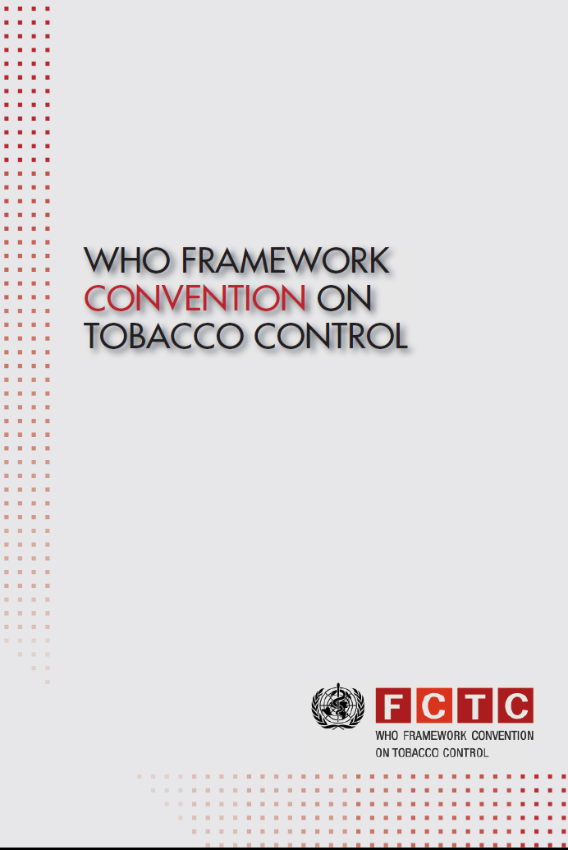

Slide 8
WHO FRAMEWORK CONVENTION ON TOBACCO CONTROL (WHO FCTC)
World’s only health-focused treaty
Objective is to end the global tobacco epidemic
WHO FCTC entered into force in 2005
Georgia ratified treaty in February 2006
FCTC has evidence-based obligations
Governments must protect public health from the vested and commercial interests of the tobacco industry (Article 5.3)

Slide 9
WHO FCTC: ARTICLES
General obligations (Article 5)
Measures to reduce the demand for tobacco (Articles 6 to 14)
Measures to reduce the supply of tobacco (Articles 15 to 18)
Liability (Article 19)
International cooperation (Articles 20, 22, 26)
Research, surveillance, reporting and exchange of information (Articles 20, 21, 22)

Slide 10

IMPLEMENTATION OF
WHO FCTC IN GEORGIA
New tobacco control law will significantly strengthen WHO FCTC implementation
More than half of all men in Georgia smoke

Slide 11

Ban on advertising, promotion and sponsorship
Smokefree environments
Effective “picture” health warnings on tobacco packs
Progress made on strengthening tobacco taxes

Slide 12


FCTC 2030 PROJECT

Slide 13
FCTC 2030 PROJECT
Official development assistance (ODA) funded project
Primary funding from the Government of the United Kingdom
Additional funding from the Government of Australia
Objective of the FCTC 2030 project is to accelerate implementation of the WHO FCTC in LMICs

Slide 14
INTENSIVE SUPPORT FOR WHO FCTC IMPLEMENTATION
Intensive support to 15 selected LMIC countries
Global project with at least country selected in each
WHO Region
Georgia selected as a FCTC 2030 country
FCTC Investment Case
FCTC 2030 countries can become regional and global leaders in tobacco control

Slide 15
ARTICLE 5 OBLIGATIONS
FOR PARTIES INCLUDE…
National multisectoral strategy for tobacco control
National multisectoral coordinating mechanism in operation
Make, implement and enforce legislation
Protect public health from the vested and commercial interests of the tobacco industry (Article 5.3)

Slide 16
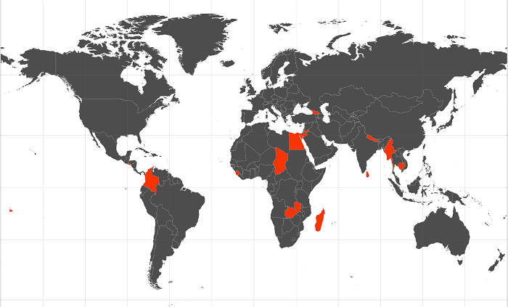
• Cabo Verde
• Cambodia
• Chad
• Colombia
• Egypt
• El Salvador
• Georgia
• Jordan
• Madagascar
• Myanmar
• Nepal
• Samoa
• Sierra Leone
• Sri Lanka
• Zambia
FCTC 2030 project:

Slide 17
FCTC 2030 PROJECT PRIORITIES
Fully implement obligations in Article 5 of the WHO FCTC, as the foundation for effective tobacco control (next slide…)
Fully implement and enforce WHO FCTC time-bound measures:
    smoke-free environments
    effective health warnings on tobacco packaging
    ban on tobacco advertising, promotion and sponsorship
Strengthen tobacco taxation

Slide 18
Congratulations Georgia

