Slide 1

The Richard G. Lugar
Center for Public Health Research
დაავადებათა კონტროლისა და საზოგადოებრივი ჯანმრთელობის ეროვნული ცენტრი
National Center for Disease Control & Public Health
www.ncdc.ge
www.ncdc.ge
Notes:
1

Slide 2
History of Development and Final Formation
Early 90s Nun-Lugar initiative
1997 USA – Georgia Umbrella Agreement signed
2002 USA – Georgia Implementing Agreement signed (DoD / MoD)
2004 Ground breaking of the lab building
2011 Legal establishment of R. Lugar Center
2013 Integration of R. Lugar Center for Public Health Research into the National Center for Disease Control and Public Health (NCDC)
2013-2014 Elaboration and ratification of Joint Transition Agreement (JTA)
2014-2018 Implementation of JTA
From 2018 GoG takes a responsibility for full funding and operation of the Laboratory Network
დაავადებათა კონტროლისა და საზოგადოებრივი ჯანმრთელობის ეროვნული ცენტრი
National Center for Disease Control & Public Health
www.ncdc.ge
www.ncdc.ge
Notes:
2

Slide 3
May, 2013 Integration of Lugar Center into the National Center for Disease Control
June – Transfer the Labs of the NCDC August, 2013 (including the repository of EDPs) to the Lugar Center
August, 2013 Lugar Center Became Fully Operational
დაავადებათა კონტროლისა და საზოგადოებრივი ჯანმრთელობის ეროვნული ცენტრი
National Center for Disease Control & Public Health
www.ncdc.ge
www.ncdc.ge
Notes:
3

Slide 4
MOLHSA
Multisectoral Supervisory Board:
MoLHSA, MoA, MoES, MoIA, MoD, MoE, MoF
NCDC
(High-level Biomedical Research Center –
Major Goal: to become a Regional Center of Excellence)
Lab Part
Richard G. Lugar Center
“One World – One Health”
Non-Lab/Office
Part of NCDC&PH
Immunization Cold Chain Infrastructure
დაავადებათა კონტროლისა და საზოგადოებრივი ჯანმრთელობის ეროვნული ცენტრი
National Center for Disease Control & Public Health
www.ncdc.ge
www.ncdc.ge
Notes:
4

Slide 5
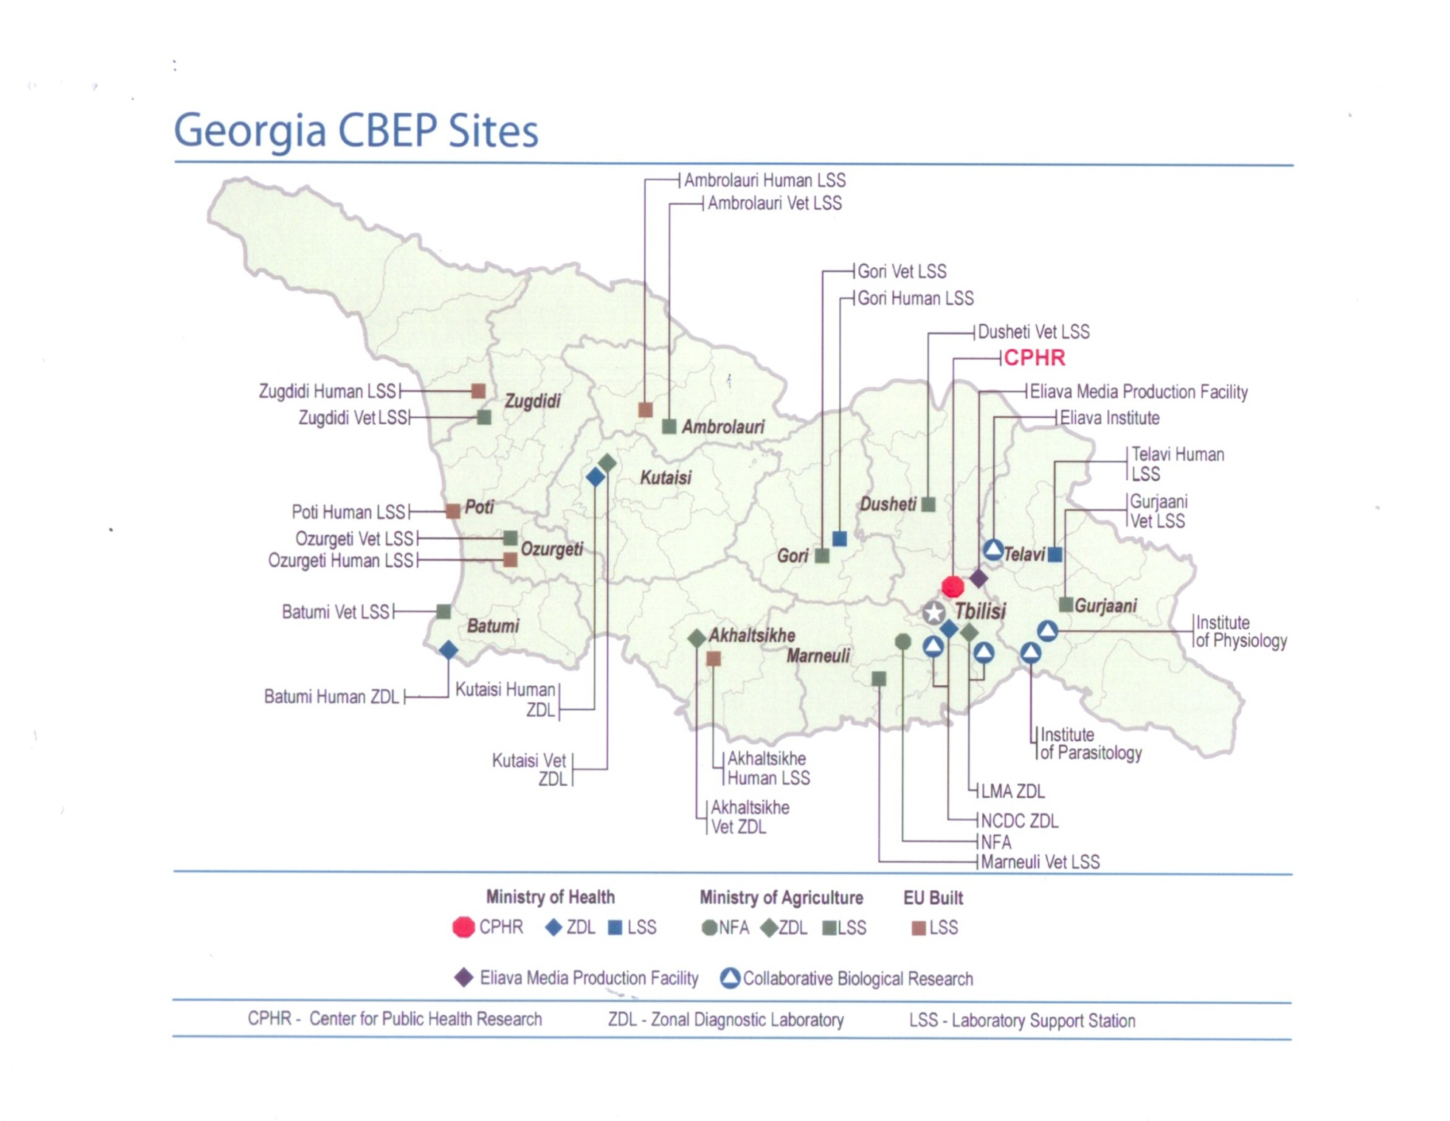
დაავადებათა კონტროლისა და საზოგადოებრივი ჯანმრთელობის ეროვნული ცენტრი
National Center for Disease Control & Public Health
www.ncdc.ge
www.ncdc.ge
Notes:
5

Slide 6
Tiered National Lab Network
Based on One Health Concept
Lugar Center
Human ZDLs
Labs in clinical settings and labs of public & private entities
Human LSSs
დაავადებათა კონტროლისა და საზოგადოებრივი ჯანმრთელობის ეროვნული ცენტრი
National Center for Disease Control & Public Health
www.ncdc.ge
www.ncdc.ge
Notes:
6

Slide 7
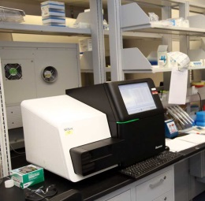

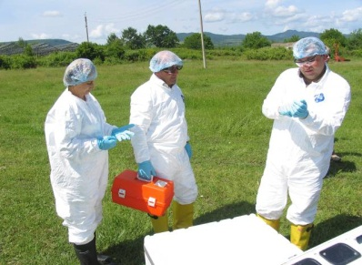
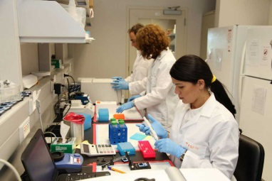
Location – Tbilisi
Size – 8,000m²
Lab space – 2,551m2
Capabilities – BSL-2; BSL-3; vivarium for small animals
დაავადებათა კონტროლისა და საზოგადოებრივი ჯანმრთელობის ეროვნული ცენტრი
National Center for Disease Control & Public Health
www.ncdc.ge
www.ncdc.ge
Notes:
7

Slide 8
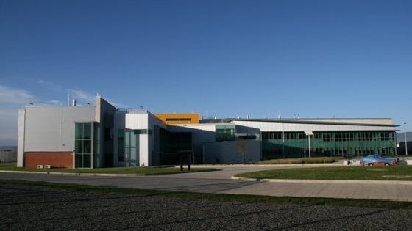
Laboratory Part of NCDC / Lugar Center
Genomic Center
Repository of EDP
Bacteriology
Serology
Molecular Biology
Virology
Parasitological
Cell Cultures
Entomology
Vivarium
CDC/GDD Lab
WRAIR Lab
BSL3 designated area for LMA & MES
2 Zonal Diagnostic Laboratories - ZDLs
7 Local Surveillance Stations - LSSs
დაავადებათა კონტროლისა და საზოგადოებრივი ჯანმრთელობის ეროვნული ცენტრი
National Center for Disease Control & Public Health
www.ncdc.ge
www.ncdc.ge
Notes:
8

Slide 9
3 Labs Accredited by WHO
- Polio
- Influenza
- Measles/Rubella
4 Labs Connected to WHO Lab Network
Rota
Invasive Meningitis
Malaria
Salmonelosis
NCDC / Lugar Center is in a process of applying for the status of WHO Collaborating Center for Emerging Infections
დაავადებათა კონტროლისა და საზოგადოებრივი ჯანმრთელობის ეროვნული ცენტრი
National Center for Disease Control & Public Health
www.ncdc.ge
www.ncdc.ge
Notes:
9

Slide 10
CDC / Atlanta
DTRA
WHO
WRAIR
UNFPA
NIH
UNICEF
WB
NCDC / Lugar Center
USAID
EU
FAO / OIE
GFTAM
GAVI
DSTL - UK
Universities & Research Centers:
University of Florida, University of Maryland,
Emory University, Johns Hopkins University, Arizona University, Bundeswehr Institute of Microbiology, University of Oslo, etc.
დაავადებათა კონტროლისა და საზოგადოებრივი ჯანმრთელობის ეროვნული ცენტრი
National Center for Disease Control & Public Health
www.ncdc.ge
www.ncdc.ge
Notes:
10

Slide 11
Ongoing Scientific Projects
On the basis of Lugar Center
1. Epidemiology of Clostridium difficile-associated disease in Georgia”;
2“Distribution and diversity of Bartonella pathogens among people and animals in Georgia and evaluation of factors associated with the emergence of bartonellosis”;
3. “Molecular Epidemiology of Multidrug Resistant and Extensively Drug Resistant Tuberculosis in country of Georgia”;
4 “Molecular Epidemiology of Toxigenic Escherichia coli in country of Georgia”;
5. “Emerging zoonotic pathogens in Georgian bats”;
6.“Microbiological Monitoring of Uranium-Contaminated Environments”;
7. “Epidemiology and Ecology of Tularemia in Georgia”;
8. “Human Disease Epidemiology and Surveillance of Especially Dangerous Pathogens in Georgia”;
9. “Creation of Sustainable Immunodiagnostics”;
10. “Anthrax Environmental Decontamination Network”;
11. “A Multi-Task investigation on the human immune response to anthrax aimed at developing more efficient vaccines”;
12. ‘’Whole Genome Sequencing of quarantine plant bacterial pathogen Ralstonia Solanacearum Isolated in Republic of Georgia’’;
13. ”Environmental Surveillance in Georgia in 2014 “;
National Center for Disease Control and
Public Health
www.ncdc.ge
Notes:
∞ facilitate necessary legal and institutional changes to ensure that in order to expedite procurement of EDP-related equipment, consumables and reagents for the ULS, these items are exempt from the requirements of the State Procurement Law of Georgia and subsequent normative acts after the procurement and re-supply responsibilities for these items are transferred to the GoG. The list of the exempted equipment, consumables and reagents for the ULS shall be approved by the GoG”.
11

Slide 12
Ongoing Scientific Projects (cont.)
On the basis of Lugar Center
14. “Establishment of a Southwest-Asian network for biosecurity and diagnosis of dangerous infectious diseases”;
15. “NCDC Lugar Center Regional Integration: Kafkas University Partnering for Molecular Epidemiology of B. anthracis and Brucella species in Turkey”;
16.”Seroprevalence of zoonotic pathogens among veterinarians, farmers and animals – comparative analysis in Georgia and Jordan”;
17. „Atypical Y. pestis Strains Isolated from Natural Foci in Georgia from Proteome to Virulence and Gene Expression“;
18. “Epidemiology of febrile illnesses caused by Dengue viruses and other Arboviruses in Georgia”;
19.”Influenza Study of Backyard Animals in Georgia";
21. “Sero-survey for Orthropoxvirus in the Akhmeta Region”;
22. “Surveillance of Avian Influenza Virus and Characterization of Viral Quasi-Species in Georgia”;
23. “Raising Awareness about Barcoding of Sand Flies in Georgia and Caucasus”;
24“Characterization of mechanisms of adaptive phage-host co-evolution using next generation sequencing and phenotypic profiling”;
25. “Collaboration to Enhance MDR-TB Surveillance using the XpertTM MTB/RIF Assay and Color Test in Diverse Settings”.
National Center for Disease Control and
Public Health
www.ncdc.ge
Notes:
∞ facilitate necessary legal and institutional changes to ensure that in order to expedite procurement of EDP-related equipment, consumables and reagents for the ULS, these items are exempt from the requirements of the State Procurement Law of Georgia and subsequent normative acts after the procurement and re-supply responsibilities for these items are transferred to the GoG. The list of the exempted equipment, consumables and reagents for the ULS shall be approved by the GoG”.
12

Slide 13
Upcoming Scientific Projects for 2015
1.”Genotype-phenotype characterization and toxin study of archival and newly isolated Georgian Clostridium botulinum strains”;
2. “Developing Laboratory Diagnostic and Research Capabilities to Address Antimicrobial Resistance in Georgia and the South Caucasus";
3."Carbapenem-resistant Enterobacteriaceae (CRE) in Armenia and Georgia";
4.”Characterization of NCDC Strain Repository by Next Generation Sequencing“;
5.”Molecular Virology Studies in Georgia”;
6.”Enhancing capacity for case detection and diagnosis of febrile zoonotic-related cutaneous lesions in Georgia”;
7.”Analysis of Previously Identified Rickettsia positive Georgian Ticks by Multi-Sequence Typing;
8.‘’Integrating bacteriophage and membrane separation knowledge bases to ensure microbiological safety of water supply’’;
9.’’Phage mediated antibiotic resistance gene transfer in marine, freshwater and extreme environments“;
10.“Validation of FPA as a TADR Confirmatory Diagnostic for Human Brucellosis in Georgia“;
11.“Regional Study of the Ecology of Anthrax Foci in Georgia and Azerbaijan”;
12”Environmental Surveillance in Georgia in 2014“;
13.” Proof-of-principle antimicrobial resistance routine diagnostics surveillance study Georgia (PoP-study)”.
National Center for Disease Control and
Public Health
www.ncdc.ge
Notes:
∞ facilitate necessary legal and institutional changes to ensure that in order to expedite procurement of EDP-related equipment, consumables and reagents for the ULS, these items are exempt from the requirements of the State Procurement Law of Georgia and subsequent normative acts after the procurement and re-supply responsibilities for these items are transferred to the GoG. The list of the exempted equipment, consumables and reagents for the ULS shall be approved by the GoG”.
13

Slide 14

National Center for Disease Control & Public Health
www.ncdc.ge

