Slide 1
DRG cost weights and pricing
Triin Habicht
15.05.2018

Slide 2
Core components of DRG
1
2
3

Slide 3
DRG relative cost weights
1
A DRG relative cost weight measures the expected cost of a certain DRG, relative to the expected cost of the average case across all cases
Average Cost of “DRG X”
DRG “X” Relative Weight =
Overall Average Cost of Case

Slide 4
Example: DRG cost weights and tariffs
1
A DRG with a relative cost weight of 1,0 reflects the average case
If average cost of case (base rate) is 1 000 lari then:
DRG A with a cost weight 0,45 has a monetary value 0,45*1 000=450lari
DRG B with a cost weight 2,32 has a monetary value 2,32*1 000=2320lari
Tariff of DRG X =
DRG X relative cost weight * DRG base rate

Slide 5
Cost weight calculation is more than simple math…
1
Factors to take into account:
  low and high cost cases
  DRGs with small number of cases, e.g. 30 cases in one DRG
  DRGs without any case during particular period
  anomalies, e.g. cost weight for complicated DRG is lower than non-complicated
  health policy priorities, e.g. (dis)incentivizing certain clinical practice

Slide 6
Options to develop DRG cost weights?
1
Existing tariffs
  Pragmatic and some countries use that approach (e.g. Estonia, Thailand)
  Serves as a proxy for cost information as best available information about providers’ absolute and relative costs
Other country’s DRG weights
  Widely used if no alternatives
  Reference country’s cost structure might be different (e.g. exclude salary cost)
Separate cost accounting pilot in selected hospitals
  Requires development of costing methodology, data collection system and to find collaborative hospitals who have wide scope of services with high volume
  Time and resource intensive

Slide 7
Options to validate DRG cost weights: check homogeneity of data
1
Coefficient of variation (CV) shows the extent of variability in relation to the mean
If CV>0.5, then this DRG group has rather heterogeneous data
Standard Deviation of DRGX
CV of DRGX =
Average of DRGX

Slide 8
Options to increase homogeneity: data trimming (Estonian example)
1
Before 2018
Two phases trimming before calculating DRG cost weights
  First phase -> outlier cases in each DRG group with cost outside 3 standard deviation (STD) are excluded
  Second phase -> outlier cases with costs outside 2 STD are excluded
Since 2019
One phase trimming before calculating DRG cost weights
  Outlier cases with cost < 5th or >90th percentile are excluded

Slide 9
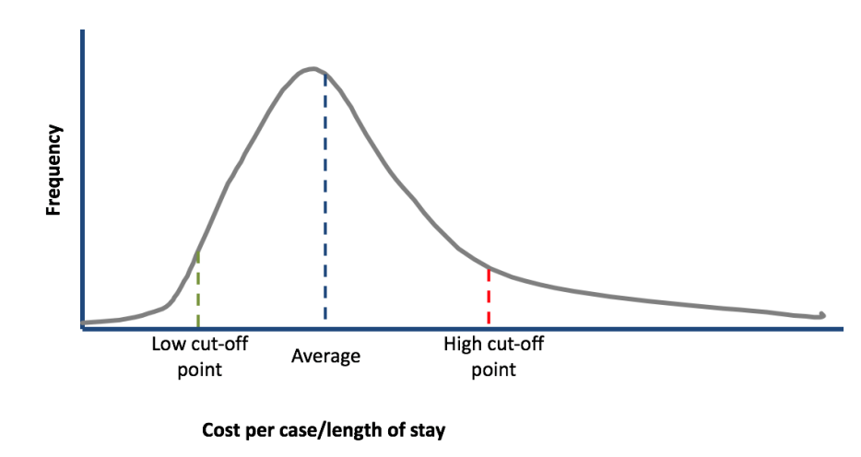
Trimming
1

Slide 10
Trimming example: DRG 070B “Otitis media & uri, age 0-17, w/o cc” - 1
1
Initial data
Mean | 545
Median | 507
STD | 365
Minimum | 56
Maximum | 5 755
Sum | 2 089 942
Count | 3 834
CV | 0,67
1st_trimming
Mean | 509
Median | 503
STD | 222
Minimum | 56
Maximum | 1 625
Sum | 1 915 679
Count | 3 765
CV | 0,44
2nd_trimming
Mean | 500
Median | 499
STD | 204
Minimum | 70
Maximum | 938
Sum | 1 854 365
Count | 3 712
CV | 0,41

Slide 11
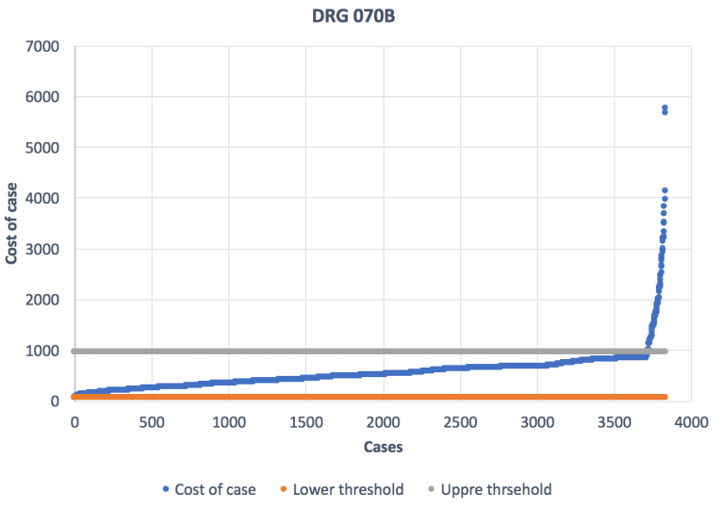
Trimming example: DRG 070B “Otitis media & uri, age 0-17, w/o cc” - 2
1

Slide 12
Case-mix index (CMI)
1
CMI is a measure of one hospital’s overall output of cases (volume and type of cases) compared to the average for all hospitals
Σ (relative weight of DRG X *
number of cases in DRG X)
CMI =
Number of cases

Slide 13
DRG base rate
2
DRG base rate reflects the monetary value of average case
Total budget or expenditures
DRG base rate =
(Sum of equivalent cases across all DRGs * CMI )

Slide 14
DRG adjustments
3
Potential adjustment criteria
  Teaching status
  Geographical location
  Clinical aspects (e.g. specialization, 24/7 preparedness)
Adjustments could be applied to the DRG base rate and/or excluding some costs out of the DRG system

Slide 15
DRG adjustments - outliers
3
High and low cost/LOS cases
Clinical criteria
  Clinical speciality (e.g. psychiatric care, rehabilitation, nursing care)
  Specific treatments (e.g. ICU, chemotherapy, artificial ventilation)
  Referral status (e.g. referred cases)
  …

