Slide 1



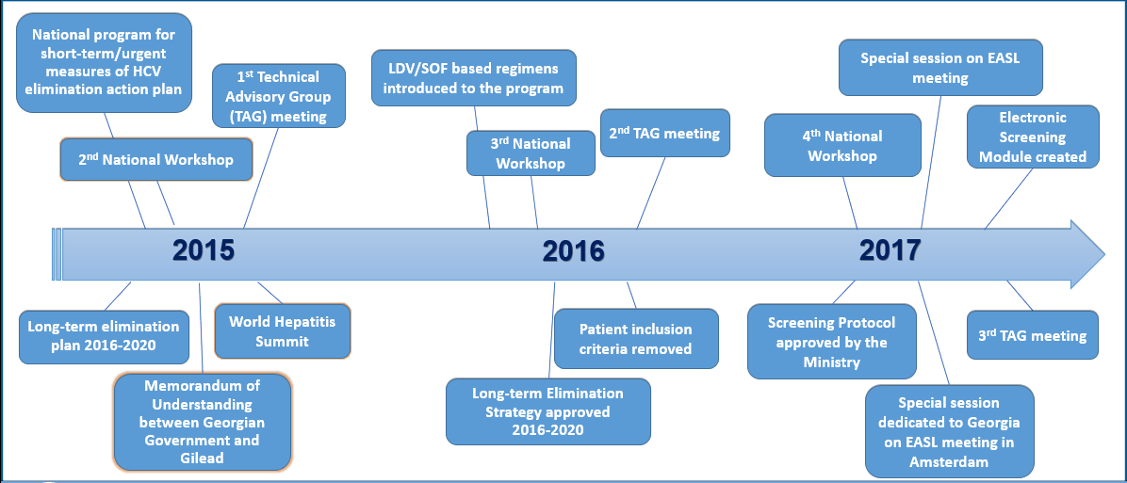
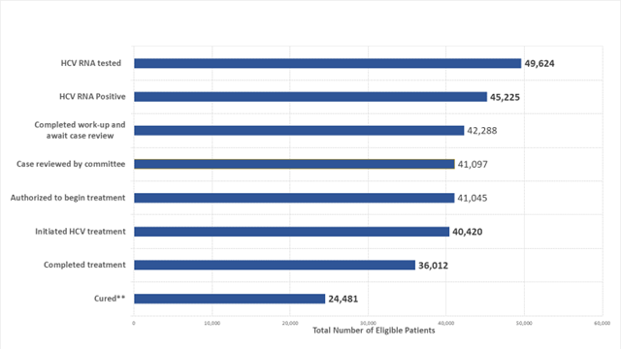
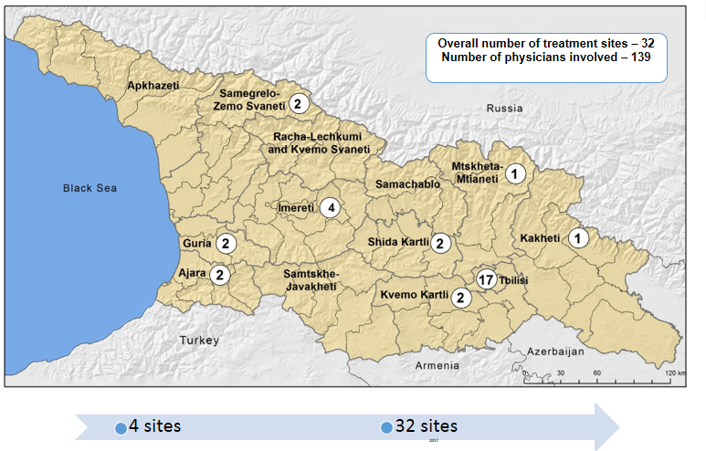
PROGRESS TOWARD HEPATITIS C VIRUS ELIMINATION THROUGH PROVISION OF CARE AND TREATMENT SERVICES, GEORGIA, 2015-2017
D.SERGEENKO¹, A. GAMKRELIDZE², T. TSERTSVADZE³, G. KAMKAMIDZE⁴, D. METREVELI⁵, L. SHARVADZE⁶, M. TSERETELI⁷, A. ASLANIKASHVILI⁸, E. ADAMIA⁹, L. GVINJILIA¹⁰, M. NASRULLAH¹¹, T. KUCHULORIA¹², F. AVERHOFF¹³
1Ministry of Labor, Health and Social Affairs of Georgia; Minister; 2National Center for Disease Control and Public Health; Director General; National Center for Disease Control and Public Health; 3Infection Diseases, Aids, and Clinical Immunology Research Center; Director; 4Tbilisi State Medical University; Health Research Union 5Medical Center Mrcheveli; Head of Department 6Hepatology Clinic Hepa; Hepatology Clinic Hepa; 7National Center for Disease Control and Public Health; Head of Department Hiv/Aids, Hepatitis, Sti & Tb; 8National Center for Disease Control and Public Health; Ncdc; 9Ministry of Labour, Health and Social Affairs; State Programs Department; 10Cdc Foundation; Cdc Foundation; 11Centers for Disease Control and Prevention; Division of Viral Hepatitis, National Center for Hiv/Aids, Viral Hepatitis, Std and Tb Prevention; 12Cdc South Caucasus Office; Georgia Hepatitis C Elimination Program; 13Centers for Disease Control and Prevention; Division of Viral Hepatitis National Center for Hiv/Aids, Viral Hepatitis, Std, and Tb Prevention;
Introduction
The country of Georgia has high burden of hepatitis C virus (HCV) infection. The nationwide seroprevalence survey conducted in 2015, indicated 5.4% of adults (approximately 150,000 persons) with active HCV infection (RNA positive).
Results
Conclusions
In the first 30 months of the HCV Elimination Program, Georgia has scaled up the screening and treatment services achieving impressive cure rates.
These activities represent a key step towards reaching the established national HCV elimination goals.
The Georgia HCV Elimination Program has made substantial progress since its launch in April 2015; the country has demonstrated the ability to scale up HCV care and treatment services rapidly.
Enhancing HCV testing and linkage to care and treatment services are critical to reaching the 2020 HCV elimination goal.
Lessons learned from the Georgia elimination program can inform programs in other countries striving to eliminate HCV as a public health threat.
From April 28, 2015 through October 31, 2017, more than 1.4 million HCV, screening sessions were performed and 45,225 HCV infected (RNA positive) individuals were registered for the treatment program.
Among those who registered, 40,420 (89.4%) individuals initiated treatment, approximately 27% of the estimated 150,000 persons living with HCV in the country.
Of those who initiated treatment, 36,012 (81%) completed treatment.
Among individuals with available data on sustained virologic response (SVR) i.e., cure (n=32,835), the overall SVR was 98.2%.
AIM
In April 2015, the Georgian government, in collaboration with CDC, Gilead Sciences and other partners embarked on a national program to eliminate HCV by 2020, defined as decreasing prevalence of active infection by 90%; a key strategy is scaling up HCV treatment by ensuring access to free of charge treatment for all infected persons.
Road towards HCV Elimination
Acknowledgements
Georgia HCV Elimination Program is conducted under the leadership from the Georgia Ministry of Labour, Health, and Social Affairs (MoLHSA) with strong stake-holder support including partnership and technical assistance from US CDC and commitment from Gilead Sciences to donate direct-acting antiviral HCV medications
Method
Data from all screening and treatment sites are collected and analyzed by the Georgia National Center for Disease Control and Public Health and Ministry officials.
All data from treatment providers are entered into a web-based database.
A unified electronic screening registry captures data from all national and local HCV screening programs throughout Georgia.
Data from the screening and treatment programs are linked by a unique identification number.
these data were analyzed to describe the national cascade of care.
References
1. Nasrullah M, Sergeenko D, Gvinjilia L, et al. The Role of Screening and Treatment in National Progress Toward Hepatitis C Elimination — Georgia, 2015–2016. MMWR Morb Mortal Wkly Rep 2017;66:773–776. DOI: http://dx.doi.org/10.15585/mmwr.mm6629a2
Geographic distribution of HCV treatment provider sites
Georgia Hepatitis C Elimination Program Care Cascade
April 28, 2015 – October 31, 2017
** of 32,835 patients eligible for SVR assessment, 24,930–were tested, 24,481 (98.2%) achieved SVR, 7.905 (24% ) missing data
CONTACT INFORMATION
Sofo Belkania, MoLHSA; Email: sbelkania@moh.gov.ge; Tel: +995599 223232.

