Slide 1

Georgia FCTC2030 Project
NCDC
27 February, 2018
National Center for Disease Control & Public Health
www.ncdc.ge

Slide 2
FCTC 2030 PROJECT
Official development assistance (ODA) funded project
Funded by Government of the United Kingdom
Key elements of project:
Intensive support to 15 selected WHO FCTC Parties that are LMICs
More general support to a wider number of LMIC Parties to support WHO FCTC implementation
WHO FCTC Secretariat
WHO Regional Offices
WHO Country Offices
UNDP
National Center for Disease Control & Public Health
www.ncdc.ge

Slide 3


















United Nations Sustainable Development Summit
25 - 27 Sep 2015, New York
GOAL #3: Ensure healthy Lives and promote well-being
for all at all ages
SDG 3.4: By 2030, reduce by one third premature mortality from non-communicable diseases through prevention and treatment and promote mental health and well-being
SDG3.a: Strengthen the Implementation of WHO FCTC in all countries, as appropriate
National Center for Disease Control & Public Health
www.ncdc.ge

Slide 4
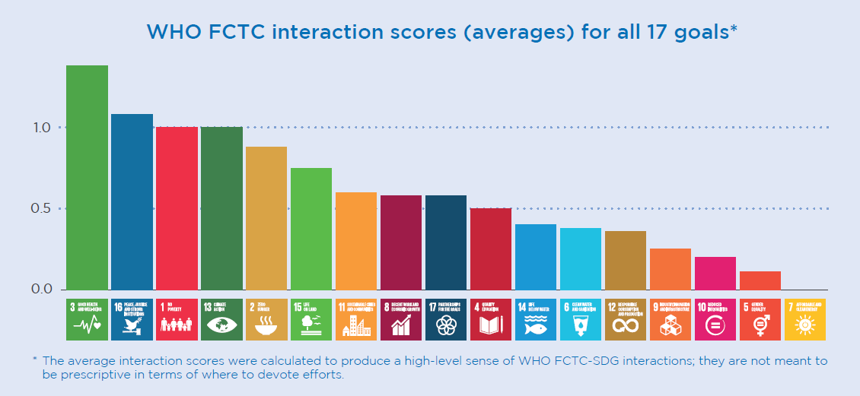
FCTC2030 Project A development focussed project, encouraging countries to use WHO FCTC implementation to promote development and achievement of SDGs:
National Center for Disease Control & Public Health
www.ncdc.ge

Slide 5
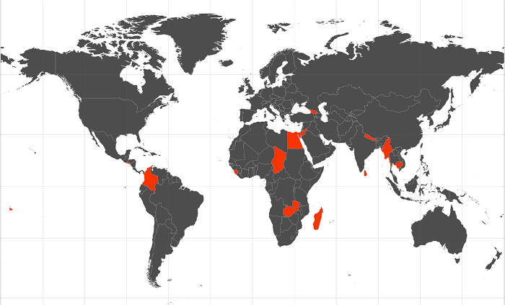
Intensive support for FCTC implementation for 15 LMIC Parties
Georgia – The only Party selected from the European Region
Criteria of selection: the motivation to advance tobacco control and demonstration of some significant achievements in this regard
National Center for Disease Control & Public Health
www.ncdc.ge

Slide 6
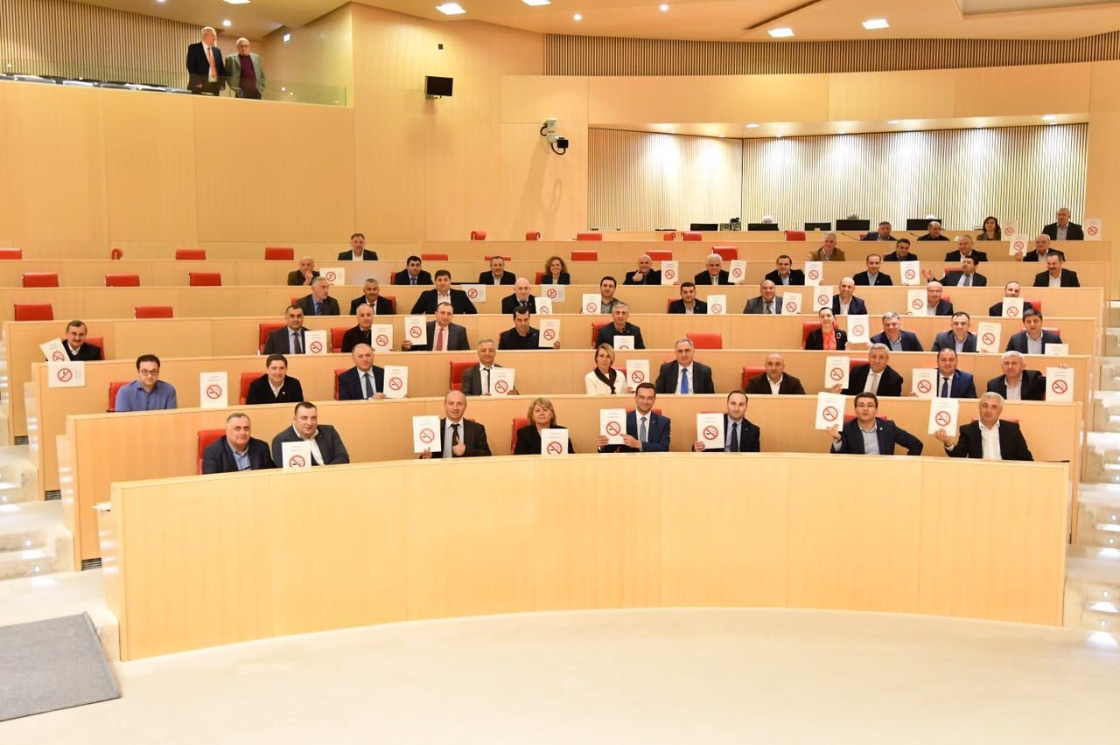
2017
A set of new generation tobacco control laws was adopted
National Center for Disease Control & Public Health
www.ncdc.ge

Slide 7
National Strategic Priorities for WHO FCTC Implementation
Implementation of FCTC Article 5 obligations
Strengthening implementation of timebound articles of the WHO FCTC
Total ban of smoking in all enclosed public/work places and specific outdoor areas designated for youth and hazardous materials
Total ban of tobacco advertisement, sponsorship and promotion
At least 65% of pictorial health warnings on the surface of tobacco packages
Strengthening tobacco control law enforcement/administration
Strengthening of tobacco taxation
National Center for Disease Control & Public Health
www.ncdc.ge

Slide 8
Georgia FCTC2030 Project
IMPACT:
Reduced prevalence of tobacco use in the longer term in Georgia.
OUTCOME:
Strengthened implementation of the WHO Framework Convention on Tobacco Control in Georgia.
National Center for Disease Control & Public Health
www.ncdc.ge

Slide 9
Georgia FCTC2030 Project Strategy
National Tobacco Control strategy and development planning (Art. 5.1)
Outputs:
National Tobacco Control Strategy and Action plan (NTCS&AP) updated in full agreement with WHO FCTC and is implemented (milestones on time)
State tobacco control program (STCP) is adopted and funding is sustained
Inclusion of WHO FCTC in United Nations Partnership for Sustainable Development (UNPSD) where appropriate
National Center for Disease Control & Public Health
www.ncdc.ge

Slide 10
Georgia FCTC2030 Project Strategy
National multisectoral coordination for FCTC implementation (Art. 5.2a)
Outputs:
NTCC is headed by Prime Minister or other Minister and is functional in terms of making timely and adequate high level decisions in relation to tobacco control issues
HPPC is active and functional to develop timely and adequate recommendations
National Center for Disease Control & Public Health
www.ncdc.ge

Slide 11
Georgia FCTC2030 Project Strategy
Legislation and policy environment (Art. 5.2b)
Outputs:
Compliance building and enforcement of tobacco control laws
Capacity of parliamentarians and enforcement agencies to advance FCTC implementation built
Illicit trade protocol submitted for ratification
National Center for Disease Control & Public Health
www.ncdc.ge

Slide 12
Georgia FCTC2030 Project Strategy
Protection from tobacco industry interference (Art. 5.3)
Outputs:
Normative act regulating relationship of tobacco industry with public servants and structures (NACT5.3) is done in full agreement with FCTC article 5.3 Guideline
Report regarding NACT5.3 is regularly done and problems addressed
Strengthening of tobacco taxation(Art. 6)
Outputs:
Tobacco taxes for all tobacco products strengthened in line with WHO FCTC Article 6 guidelines and relevant EU directive
National Center for Disease Control & Public Health
www.ncdc.ge

Slide 13
Georgia FCTC2030 Project Strategy
Smoke-free policies (Art. 8)
Outputs:
Implement new comprehensive smoke free law by 1 May 2018
Achieve high rates of compliance with new law
Prepare policy foundation for moving forward the tobacco smoke free policy (including addressing existing gaps regarding ban of smoking in casinos, cigar bars, private taxis and cars etc.)
National Center for Disease Control & Public Health
www.ncdc.ge

Slide 14
Georgia FCTC2030 Project Strategy
Regulation of the contents and disclosures of tobacco products (Art. 9 and 10)
Outputs:
implement new law on the regulation of tobacco-product contents and disclosures by 1 May 2018
Prepare policy options on restricting use of some additives (including flavouring such a menthol) in tobacco products
Packaging and labeling (Art. 11)
Outputs:
Implement new law on tobacco packaging and labeling by 1 September 2018
Prepare policy foundation for moving forward to packaging of tobacco products to enter into force in January 2023
National Center for Disease Control & Public Health
www.ncdc.ge

Slide 15
Georgia FCTC2030 Project Strategy
Education, communication, training and public awareness (Art. 12a)
Outputs:
Communications strategy developed and campaigns implemented to raise awareness of risks of tobacco use and to build compliance with tobacco control law
Education, communication, training and public awareness (Art. 12b)
Outputs:
Civil society network build to support WHO FCTC implementation (in accordance with Art. 4.7)
National Center for Disease Control & Public Health
www.ncdc.ge

Slide 16
Georgia FCTC2030 Project Strategy
Tobacco advertising, promotion and sponsorship (Art. 13)
Outputs:
Implement new law to ban tobacco advertising, promotion and sponsorship (TAPS) including TAPS on internet and display ban at points of sale
Cessation (Art. 14)
Outputs:
Tobacco cessation program developed and implemented, with integration into primary healthcare system
National Center for Disease Control & Public Health
www.ncdc.ge

Slide 17
Georgia FCTC2030 Project Strategy
Sales to and by minors (Art. 16)
Outputs:
Strengthen compliance with existing law on age of sale of tobacco
Consider further development of regulations regarding sale of tobacco to minors
Alternative livelihoods (Art. 17)
Outputs:
Tobacco farmers encouraged to shift to growing alternative crops
Advocate to stop subsidizing of tobacco growing and manufacture from state budget and transfer those resources to growing of alternative cultures
National Center for Disease Control & Public Health
www.ncdc.ge

Slide 18
Georgia FCTC2030 Project Strategy
Research, surveillance and the exchange of information (Art.20)
Outputs:
Surveillance of tobacco use by adults and youth strengthened
Research to inform and promote WHO FCTC implementation supported
Cooperation (Art. 22)
Outputs:
Experience and evidence on FCTC implementation exchanged
National Center for Disease Control & Public Health
www.ncdc.ge

Slide 19
FCTC 2030 Project Support to achieve the strategic outputs
Support is led by national strategic priorities
Support will be focussed on Georgia FCTC2030 Project strategy and work plan
Support for human resource at country level
Support to assist with implementation of Article 5 (UNDP)
Encourage support from other organisations, as appropriate
FCTC Needs Assessments and Investment Cases
World Conference on Tobacco or Health in March 2018
National Center for Disease Control & Public Health
www.ncdc.ge

Slide 20

Let’s continue together a nationwide public movement towards Smoke-free Georgia
National Center for Disease Control & Public Health
www.ncdc.ge

