Slide 1

Labour and Employment policy in Georgia
Ministry of Labour, Health and Social Affairs of Georgia
Elza Jgerenaia –Head of the Labour and Employment Policy Department
April 19, Tbilisi

Slide 2
Content:
OSH Law and other legislation/Labour Inspectorate
Amendments to Labour legislation
Social Dialogue/TSPC
Active Labour Market Policy

Slide 3
OSH Law –
Labour Inspectorate
Commitments taken by the EU-Georgia Association Agreement – transposition of EU directives – Annex XXX;
Draft Law on Occupational Safety was adopted on March 21, 2018 based on Council Directive 89/391/EEC of 12 June 1989 on the introduction of measures to encourage improvements in the safety and health of workers at work;
At the initial stage the Law will cover high risky hard, harmful and hazardous activities;
Three-level sanctions system:
  Warning;
  Financial Sanction;
  Suspension of Working Process.
Future Activities related to establishment of full-fledged labour inspectorate:
Increasing number of labour inspectors and purchasing relevant equipment
Elaboration of Strategy of Labour Inspection;
Elaboration of Ethic code of Labour Inspector;
Conducting trainings and other activities aiming at raising the qualification of the staff;
Deepening international cooperation;
The authority to inspect child labor cases in the companies;
Establishment of a web-page aiming at disseminating all the information concerning the institute, the process, etc.
State Program on Labour Conditions Inspection 2018 and Rule of State Supervisions/Labor Inspection of Prevention of and Responding on Forced Labor and Labor Exploitation are being implemented by the Labour Conditions Inspecting Department;
In frames of State Program on Labour Conditions Inspection 2018 labour right are also being inspected.

Slide 4
Statistics
Inspections have covered all sectors in Georgia including all regions
In the framework of 2015-2017 State programs:
  2015 - 118 objects of 78 companies have been inspected;
  2016 - 187 objects of 96 companies have been inspected;
  2017 - 280 objects of 166 companies have been inspected;
In the framework of joint decree around 20 objects have been inspected.
In terms of forced labour and labour exploitation:
  In 2016- 99 companies have been inspected (8 unscheduled);
  In 2017- 107 companies have been inspected (6 unscheduled);
Overall, around 6460 recommendations have been issued by the labor inspectors.
  Inspectors investigated around 35 occupational accidents

Slide 5
Amendments to Labour Legislation
Council Directive 2000/78/EC of 27 November 2000 establishing a general framework for equal treatment in employment and occupation;
Council Directive 2000/43/EC of 29 June 2000 implementing the principle of equal treatment between persons irrespective of racial or ethnic origin;
Council directive 2004/113/ECof 13 December 2004 implementing the principle of equal treatment between men and women in the access to and supply of goods and services
The legislative package (currently in the process of discussion at the Parliament) consists of drafts of amendments to the following organic laws and laws of Georgia:
    Organic Law of Georgia “Georgian Labor Code”;
    Law of Georgia on the “Elimination of All Forms of Discrimination”;
    Law of Georgia on “Public Service”;
    Law of Georgia on “Gender Equality”.

Slide 6
Social Dialogue/Tripartite Social Partnership Commission
Strategic plan for 2018-2019 for Tripartite Social Partnership Commission
(TSPC )– Social Partners agreed on topics the commission will be working on next two years.
The last meeting of the TSPC was held on February 10 2017 when TSPC where a roster of mediators was approved. The roster consists of 11 independent, neutral, impartial, qualified mediators and is valid for three years
Piloting social dialogue at the regional level, particularly, in Adjara region;

Slide 7
Active Labour market Policy
Training and retraining – human capacity development according the labour market demand;
Supportive employment – employment support of vulnerable and less competitive groups/wage subsidies;
Job fairs - In different regions of Georgia;
Vocational counseling Consultations and Career Guidance
  Providing professional consultations in every region of Georgia;
  Job couching
The Ministry is currently reviewing the State Strategy on Labour Market Formation and simultaneously working on elaboration of Labour and Employment State and Strategy Implementation Plan 2019-2021

Slide 8


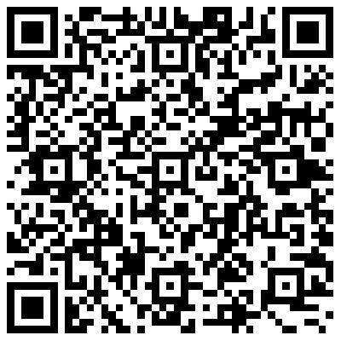
Thank you for your attention!

