Slide 1
Learning & development
Katrin Noormägi
Human Resource Manager
28.05.2018

Slide 2
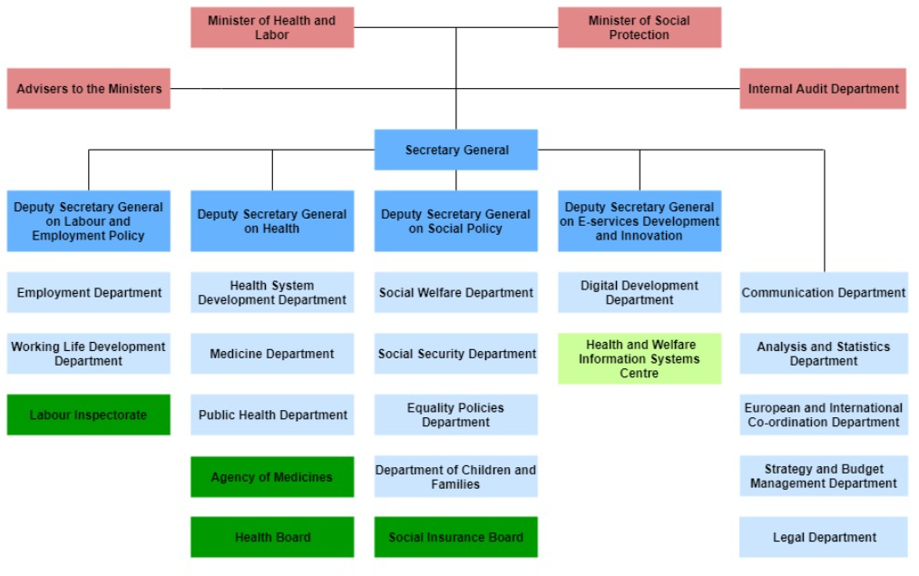

Slide 3
Strategic objectives
to ensure people's economic prosperity and their good work;
to ensure people's social coping and development;
to support the well-being of children and families;
to promote people's mutual care, equal opportunities, and gender equality;
to ensure people's long and high-quality life.

Slide 4
The Ministry and area of governance
Health and Welfare Information System Centre
Estonian National Social Insurance Board
Health Board
Labour Inspectorate
Agency of Medicines
National Institute for Health Development
Astangu Vocational Rehabilitation Centre

Slide 5
Todays topics
training needs assessment
planning/organizing training and development activities
evaluating quality of trainers
what kind of electronical systems we are using

Slide 6
HR policy principles
We hire for skill today – not skill we might have after 6+ months.
We try to align skills and knowhow and make dynamic changes in teams.
There is no better way to learn how to perform than in the game – that is on the work.

Slide 7
Training needs assesment

Slide 8
The traditional development cycle
Workplan, next year objectives
(oct-nov)
Performance review (nov-jan)
Quarterly
monitoring
1 year
Performance review (oct-dec)

Slide 9
Performance review and development needs
Performance review – mandatory at least 1time a year by the Civil Service Act (implemented in 2013, not suitable for fast changing environment)
We don’t collect data that HR doesn’t actually use – have minimized the data that we collect.

Slide 10
Performance review and development needs
Performance review topics to cover:
Results for the last periood – what went well, what didn’t, why – what have we learned?
Evaluation of cooperation – what is good, what needs to change?
New goals and agreements for next periood.
What skills need to be developed?
FOCUS on mutual agreements, development goals, and suggestions for better cooperation.

Slide 11
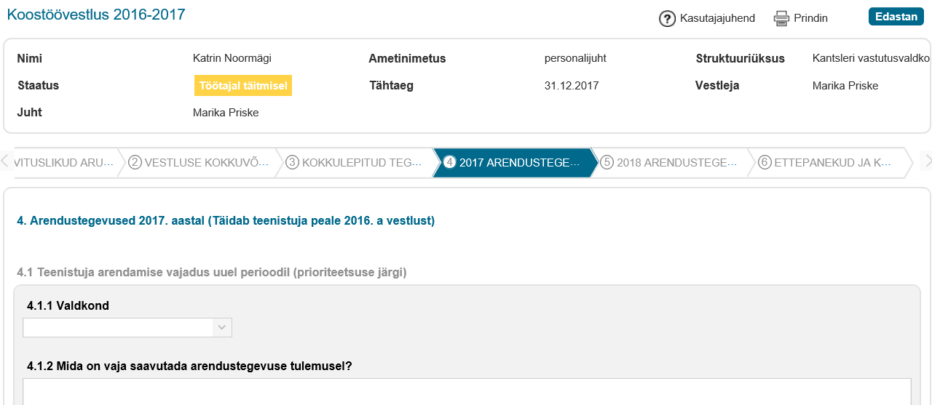

Slide 12
Other ways to get input into development needs
Employee commitment & satisfaction study – we do it every other year
Mainly gives input to evaluating managers

Slide 13
Zero paper principle
Absolutely no paper in personnel administration – first among public service

Slide 14
Planning/organizing training and development activities

Slide 15


Learning and development concept
Horizontal – basic skills to do your job (pouring water, new techniques, into the same old glass)
Vertical - providing personal skills to cope with a rapidly changing environment. Ability to think and act in more complex ways. It’s about how you think, not just what you know.

Slide 16
Planning L&D
We always discuss the L&D needs data from performance review with the manager and the team, also look horizontally over governance area for common themes.
4 ministries have united personnel department – look for common themes for good use of resources and networking.

Slide 17
L&D methods - horizontal
Classroom lecture (both open and inhouse) – for example courses of law.
External conferences, workshops
Job rotation and shadowing etc.

Slide 18
L&D methods - vertical
In-house development programmes
Middle management
Project management
Design thinking
Debate club
Networking
Coaching by line managers (few have training and certificate)
Covision and coaching by external practitioners

Slide 19
Leadership development
Developing middle managers
Talent management - development programs for HIPO employees to middle manager

Slide 20
Leadership development methods combined
Classroom training
Video training
E-learning & groupwork (Coursera)
270 degrees evaluation
Debate club
Masterclasses with top leaders (from public and private sector)
Book club (discussions)
Shadowing
Mentoring
Self assement and career

Slide 21
Topics in leadership training
Setting and communicating goals
Team leadership
Performance management
Empowerment
Leading meetings
Soft skills (motivational interviewing, coaching)
Time management

Slide 22
Statistics
On the average one employee is engaged in some development activity for 32 academic hours per year.

Slide 23
Electronical systems

Slide 24
Electronical systems
Work plan and performance assessment - Planpro since 2012
Personnel administration – Delta (all documentation) and data in SAP, we obtain data using Business Object.
Riigitöötaja iseteenindusportaal ☺ - šelf service port for the civil servants

Slide 25
Thank you!
Katrin Noormägi
Katrin.noormagi@sm.ee

