Slide 1
key domains behind the goals
2.04.2018

Slide 2
Why we do this?
To understand and reach consensus what core areas of development we aim behind the goals
To help the translation of goals into strategic initiatives
To provide tangible linkage from designing the strategy to planning strategy execution
To provide framework of key elements of strategic purchasing and to provide linkage between the elements. Also to help:
  Prioritize development of initiatives
  Sequence the timing of initiatives
  Create ownership over execution

Slide 3
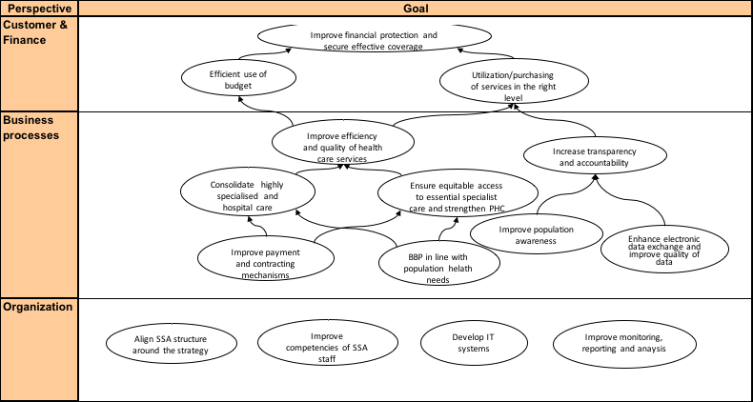
Strategic Purchasing - strategy map

Slide 4
Goal: Improve payment and contracting mechanisms
Developing and implementing payment mechanisms to achieve optimal incentive system for providers (DRG, capitation, global budget, FFS, P4P, ...)
SSA as active health care market price regulator who is developing (transparent principles) and updating tariffs for health care services
Reducing fragmentation inside the SSA by integrating financing of UHC and state programs under one umbrella to increase the SSA’s purchasing power
Developing contracting principles and system (need assessment, planning the volumes, volumes related pricing limits, provider selection criteria, monitoring of contract performance, ...)

Slide 5
Goal: BBP in line with population health needs
Develop and implement explicit procedure to revise the content of the benefit package (services, drugs):
  Taking into account disease burden and health policy priorities
  Assessing clinical efficacy and cost-effectiveness (HTA)
  Assessing budget impact
  Principles to design the user charges policy (to what extent is covered)

Slide 6
Goal: Ensure access to the essential specialist care service in the regions and strengthen PHC
Define the scope of the essential specialist care service and PHC (Note: relates to the referral criteria and patient pathways)
Assessment of provider capacity (adherence to minimum standards; ability to deliver minimum volume) to provide services
Prospective contracting of providers with clear definition of type and volume of purchased care and taking into account referral and hospitalization criteria (Note: consider negotiations with owner group vs contracting single hospitals)’
Regular monitoring and reviewing the contract volumes, regular communication with providers

Slide 7
Goal: Consolidate highly specialised and hospital care
Assessing the health service needs for type, level and volume of care country-wide, regionally (Note: together with essential specialist care and PHC)
Assessment of provider capacity (adherence to minimum standards; ability to deliver minimum volume) to provide services and implementing other elements of selective contracting
Prospective contracting of providers with clear definition of type and volume of purchased care and taking into account referral and hospitalization criteria (Note: consider negotiations with owner group vs contracting single hospitals) ’
Regular monitoring and reviewing the contract volumes, regular feedback and communication with providers

Slide 8
Goal: Improve efficiency and quality of health care services
Developing the providers’ performance (efficiency, quality, safety) monitoring framework and indicators (retrospective)
Developing mechanism for performance monitoring (quality, efficiency) for the claims handling process (in real time, part of claims management systems)
Considering quality issues in contracting process (incentives, penalties, minimum criteria…)
Ensure availability of high quality clinical guidelines/protocols + patient pathways for the priority conditions
Consider developing medical audits system (Note: JLN Handbook for Medical Audits)
Develop explicit referral and hospitalization criteria (PHC->specialist; outpatient>hospital; inpatient>outpatient) and system
Note: data collection, monitoring and feedback to providers is under “Increase transparency and accountability”.

Slide 9
Goal: Improve population awareness
Systematic assessment of communication needs and planning communication
Hotline for operational information
Other channels (citizen portal, SSA web, social media, ...) for information provision
Public campaigns to increase population awareness and to change perception (e.g. PHC as a first contact point in the health system)
Customer service in regional branches to provide “core” information

Slide 10
Goal: Enhance electronic data exchange and improve quality of data
Engage service providers to exchange data electronically, automate data handling
Claims management automation (Note: claims management system’s rethinking and design accordingly)
Develop and introduce applications to integrate beneficiaries into SP functionality
Standardize data exchange and secure quality of data

Slide 11
Goal: Increase transparency and accountability
Fraud detection system
Developing reporting system throughout the SP and beyond
Consolidating performance reporting from service providers, analyses and evaluation
Benchmark of performance, best practice evidence, regular transparent feedback
Disclosing reports regularly, supporting with public events
Introducing governing principles and strengthening SSA being accountable to key stakeholders, SSA reporting on SP and SSA performance

