Slide 1
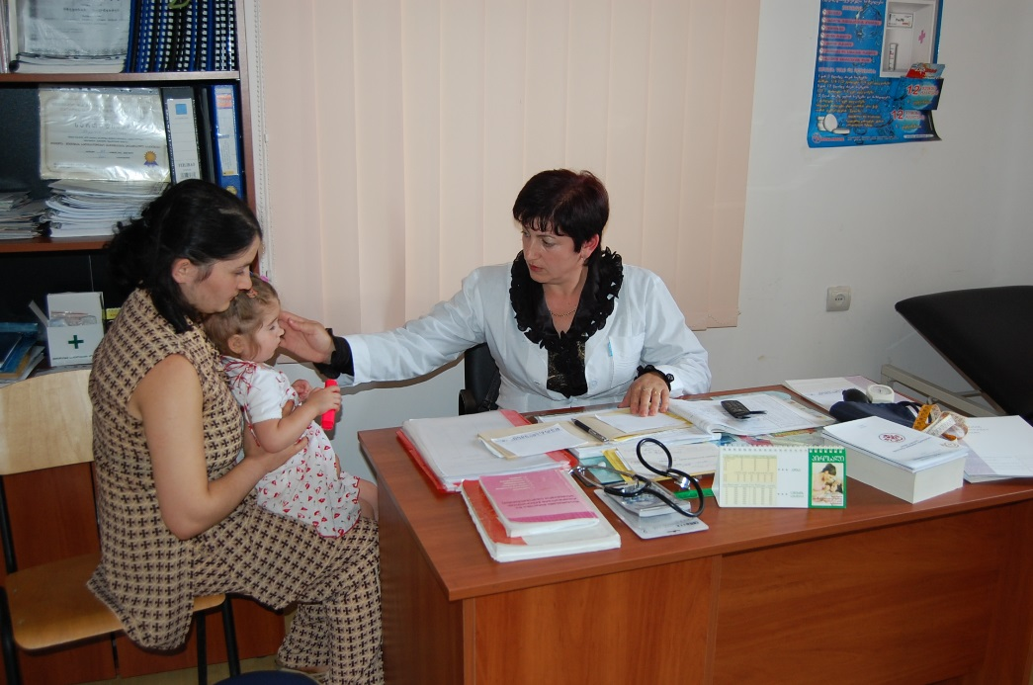



Moving Towards UHC:
Ensuring Coverage and Financial Sustainability
Aparnaa Somanathan
March 07, 2017
Notes:
Good Morning,
Honourable Ministers etc.
Since 2013 the Government of Georgia has undertaken bold and important reforms to expand health care coverage to the entire population. The World Bank, along with other development partners, WHO and USAID have been committed to supporting the Government with the reforms.
It is therefore a pleasure for us to join you today in taking stock of the reforms todate, to put Georgia in perspective and discuss how best to sustain and enhance progress towards the goal of achieving UHC

Slide 2
In the current fiscal context, the UHC program’s coverage and financial protection goals are at risk.

Slide 3
Large improvements in coverage after UHC reforms
Increase in utilization
Improved equity in coverage
Some reduction in share of out-of-pocket payments
Reduced likelihood of impoverishment due to out-of-pocket payments

Slide 4
Government health spending still very low despite recent increases
Country/ Region | Total health expenditure per capita (current US$) | Total health expenditure as a share of GDP (%) | Share of total health expenditures
 |  |  | Government | OOP
Georgia | 374 | 8.5 | 28.2 | 66.0
Armenia | 162 | 4.5 | 43.0 | 53.5
Croatia | 1,050 | 7.8 | 81.9 | 11.2
Estonia | 1,248 | 6.4 | 78.8 | 20.7
Latvia | 921 | 5.9 | 63.2 | 35.1
Lithuania | 1,063 | 6.6 | 67.9 | 31.3
Russian Federation | 893 | 7.1 | 52.2 | 45.8
Slovenia | 2,161 | 9.2 | 71.7 | 12.1
Upper-middle income countries | 494 | 7.0 | 66.6 | 24.9
Europe and Central Asia | 481 | 6.1 | 48.4 | 43.9

Slide 5
Out-of-pocket payments (OOPs) have fallen in Georgia but are still very high
DANGER ZONE
WARNING
SAFE – IF POORER PEOPLE ARE PROTECTED
Source: WHO data for 2014

Slide 6
High out-of-pocket payments undermine financial protection and access
Causes
Limited coverage of outpatient drugs
Complex co-payments policy
This spending pattern results in access barriers and gaps in coverage
Public spending on health has to be sustained and increased over time

Slide 7
Yet, fiscal context not conducive to increases in spending
Earlier rapid economic growth, but has slowed down
Growing demands on public spending, including for UHC
Revenue constraints, especially in short term
→ Fiscal sustainability challenges
Drivers of Fiscal Deficit, Change in Fiscal Balance (% of GDP)
Urgently need to optimize current spending on health or the sustainability of UHC is at risk
Source: MOF and Bank staff calculations

Slide 8
Three key drivers of inefficiency – drug spending, purchasing arrangements and service delivery structure – need to be addressed urgently

Slide 9
A lot is spent on drugs with little value for money
40% of total health spending on pharmaceuticals
OECD average: 17%
Middle income country average: 20-30%
Most of this is paid for out-of-pocket:
Outpatient medicines: the biggest gap in coverage, the main driver of OOPs and financial hardship for households
Little or no public coverage of drugs in primary care
Low cost generics less likely to be available in pharmacies compared to high-cost originator brands
Reimbursement and purchasing of drugs in public sector further contributes to inefficient spending
Hospitals purchase own drugs; large variations in prices imply inefficiency

Slide 10
Purchasing strategies are ineffective at ensuring quality and containing costs
SSA has considerable purchasing power but is not used to its full potential
Selective contracting is not in place
Prior authorization and claims reviews not effective at ensuring quality and controlling costs
Fragmented provider payment mechanisms
different tariff-setting and copayment rules for different types of hospital care creates opportunities to game the system
SSA’s organizational structure is complex resulting in fragmented work practices

Slide 11
Service delivery is biased towards high cost hospital and emergency services
Primary care is fragmented, perceived as low quality and without adequate coverage for outpatient drugs
For patients, hospitals are easy to access, wide scope of care; emergency cases are free of charge and medicines are free.
For hospitals, revenue is gained by hospitalizing patients, categorizing patients as emergency cases and treating private patients.
→ Little incentive to move to a more primary care centered service delivery model

Slide 12
Key reforms are needed to address inefficiencies, some of which are already underway.

Slide 13
Address drivers of high drug spending
For publicly purchased drugs:
Move towards consolidated purchasing
Adopt internal reference pricing
→ Use savings generated to increase UHC coverage of outpatient drugs
Pharmaceutical policies
Promote prescribing of generics
Information campaign improve demand of generics
Quality management

Slide 14
Empower SSA to move towards active purchasing to ensure quality while limiting costs
Strengthen monitoring system and analytical capacity
Optimize administrative procedures
One contract per provider for UHC + vertical programs
→ Move towards selective contracting of providers

Slide 15
Re-orient service delivery towards primary care centered coordinated services
Strengthen provision of primary care services
Expand access to essential drugs in primary care
Improve quality and efficiency of primary care
Integrate rural doctor program into UHC
Address over-reliance on expensive hospital and emergency care services
Case-based payment with global budgets is desirable but should be based on reliable and uptodate estimate of costs
Reduce fragmentation in payment rates
Improve coordination of care
Build in incentives to coordinate care into provider payment mechanisms

Slide 16
Summary
Macro-fiscal context is not conducive to further increases in spending
Persistent budget overruns are not good for credibility of the health sector’s ability to manage its finances
Without additional spending, particularly on outpatient drugs, high OOPs post significant threats to access and financial protection
Need to optimize current spending by:
Addressing inefficiencies in drug spending
Enhance SSA’s strategic purchasing role to get better value for money
Re-orient service delivery towards a primary care centered model

