Slide 1



Abt Associates’ Institutional Review Board (IRB)
201: Advanced Topics Veteran Researchers and Managers Need to Know
2014

Slide 2
Objectives of IRB 201 Training
Increase understanding of common issues (& support) re:
Proposals
Study startup/review
Special populations (e.g., children, prisoners)
Closeout
Publishing
Research Integrity
Data Security Incidents
Notes:
This in-person training assumes you are familiar with the Abt IRB review process, and you have submitted a study protocol at least once.
This in-person training supplements the required online training for staff conducting human subjects research
This training does not cover history of human subjects research, ethical principles, which is covered by the required online CITI Training
Minimum training required for key staff:
Online CITI training (or equivalent)
Refresher needed (every 3 yrs per Abt policy)
Abt IRB tracks—now in Abt LMS
Subcontractors and consultants may also need CITI training depending on depth of role
We’ve organized these advanced topics around project lifecycle from proposal to closeout.
Any other topics you want to see covered today/future?

Slide 3
Pop Quiz/Review
Why is IRB review important?
Where do requirements for protecting human subjects come from?
Who represents your division on the IRB?
Notes:
Requirements come from:
federal/state/local regulations
Guidelines & best practices we learn from
National IRB conference
Other IRBs—consultations, memos, including SRBI
Reviewing grant proposals
Consultants
Literature
Precedent
President’s initiatives to reduce regulatory burden, share data

Slide 4
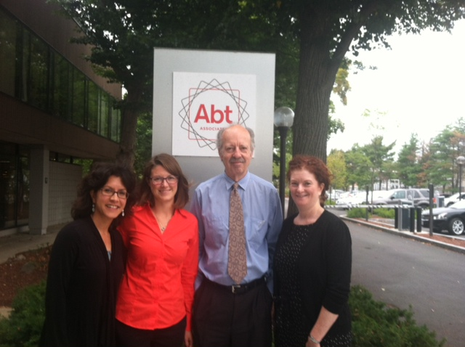

Slide 5
Proposal Support and Tips
Coordinated review with:
Sean Owen, Client Cybersecurity Center (C3)
Joe Contini, Client Technology Center (CTC)
Adapted boilerplate
Common issues with budget/timeline implications
Sensitive data (e.g., HIPAA, FISMA Moderate)
Small biz subs
Multi-IRB review
Data use agreements
Consent process
New!
Notes:
Last year we helped over 50 proposal teams from all 5 divisions.
Send us ASAP w/proposal in subject line; give us a deadline
FISMA Moderate?
Subs: biggest risk—FY15 is the year of the sub. Choose them and their role re: data wisely
We are responsible for them
Double check—everyone know what a DUA is and when needed?

Slide 6
Contract Startup Consultation
To determine type of review needed
To plan for:
Sequence of review by IRB(s), OMB (or deferrals)
Subs and their IRBs/security needs
Consent process/waivers
Data use agreements
Certificate of Confidentiality
Submit Abt IRB Form A or Outlook invite
New!
Notes:
Other start up tips:
Designate 1 person to be liaison with IRB
Use good email organization habits please—1 thread, 1 person
Make a plan to keep data organized
Heads up appreciated
Does everyone know what a DUA and CoC is?

Slide 7
Criteria for Studies IRB Should Screen
RFP/contract specifies IRB review needed
Abt team (subs/SRBI included) will touch sensitive data
Plan to publish
Collecting data from vulnerable populations (e.g.,
Children
Prisoners
Persons living with HIV/AIDs
People with mental/physical disabilities)
Notes:
If you answer yes to any of these 4 criteria, IRB should know about it
1a. Examples of projects that did not meet definition of research:
Interviews with government officials and other stakeholders for a quality assurance/quality improvement initiative
Focus groups with at-risk individuals to get feedback on messages for a communications campaign
Audits of financial information of institutions
1b. Examples of projects that did not involve human subjects:
Meta-analysis of aggregated client data across sites
Interviews with service providers about program (not personal info about themselves) for research project

Slide 8
Publishing
Prevent publishing panic!
Journals often request IRB memo/status
Retroactive approval not possible but…
Retroactive confirmation of exempt status possible
Check with us…
Before submitting D&D grant
Before submitting manuscript

Slide 9
Deadlines and Turnaround
New!
 | Due by | Meeting day | Fdbk to you by
Full board review | Draft :2 wks prior Final: 1 wk prior | 2nd Tues monthly | Within 5 biz days after mting
Expedited review & exemptions | COB Tuesdays | Fridays | Within 5 biz days after mting
Data use agreements | COB Tuesdays | Thursdays | Within 5 biz days after mting
“Emergency” | Early heads up please | If available | As soon as humanly possible
Notes:
As part of our IRM, we have created new meeting schedule with our partners to better coordinate and respond to project needs.
Thanks to the PM Solutions Team, we recently created turnaround time metrics—these are goals but we hope this will set expectations.
If you email us something and don’t hear back, know we will meet and review that which is in our in boxes by these deadlines.

Slide 10
Reminder re: Data Sharing
Anticipate who will request data & identifiers
Ensure consistency across:
Contract
Consent language (legally effective)
OMB Confidentiality section
Privacy Act System of Record Notice (SORN)
Data use agreements
IRB protocol(s) and data security plan
Engage Abt expert in preparing restricted use datasets
Check with us if not sure who can have what data
Notes:
There is a movement in the US government and overseas to increase sharing of data across researchers (as long as does not violate confidentiality). See Today I Learned about this
Clients, students, etc. often request access to data/PII but this is not disclosed in consent.

Slide 11
Special Populations (per US human subjects regulations)
Children:
Parent permission/youth assent process
Many options, but several school regs/policies to check
Consult w/us early, at proposal phase
Social media protocols being developed/tested
Research with prisoners/prisoner data:
Requires review by IRB’s prison expert
If HHS funded, requires certificate from OHRP
Templates for study materials available
Pregnant women

Slide 12
Special Populations, cont.
Risk protocols/safety plans
Required for studies w/participants likely to be at risk of harm (suicidal ideation, child abuse, domestic violence)
Templates available from IRB & SRBI
Other special populations include…
Notes:
Examples: Marriage Eval, Home Fam, BOND, SLIFKA, NVVLS
Not just an Abt policy—risk protocols are a best practice/IRBs/funders require
Average # of incidents is about 1/month; good to be prepared; due to risk protocol, all incidents resulted in positive outcomes
SRBI’s IRB usually consulted during incident

Slide 13
Reminder re: Modifications Require Review Before Implementation
Examples:
Changes to consent language
Substantive changes to data collection instruments
Changes to incentives
Increasing the number of participants
Adding waves of data collection
Making exceptions/changes to inclusion/exclusion criteria
Notes:
Most protocols undergo multiple modifications
Don’t panic if you think your study protocol changed but forgot to get IRB approval—contact IRB.

Slide 14
Reminder re: Closing out Studies
Before end of study (while charge time still available):
Submit Form D to IRB requesting close out
Review data retention & destruction requirements
If certificate of destruction required, make an appt with IRB/IT Security
Avoid “seek and destroy” fire drills
Notes:
Data retention & destruction requirements can be found in:
-contract
-data security plan
-DUAs
-consent
-Abt policy
-ask client

Slide 15
Research Integrity/Misconduct
Per regulations, includes:
Fabrication or falsification of data
Plagiarism
Online CITI training now includes module
For questions, suspected misconduct, contact Teresa Doksum, Research Integrity Officer
See Research Misconduct Policy on AGI
New!
Notes:
A separate but related set of regulations
Regs spell out procedure to handle/respond to allegations
We average 1 allegation/year
Have you seen Boston Globe articles about local hospital researchers fabricating/falsifying data?

Slide 16
Security Incidents
New!
 | FY13 (12/12-3/13) | FY14
Laptop lost/stolen* | 10 | 20
Emailed unencrypted PII | 4 | 28
Unauthorized disclosures | 0 | 6
Paper with PII lost (by sub/grantee) | 0 | 2
Mobile device lost (smart phone, iPad) | 0 | 3
Digital audiorecorder (w/data) lost | 0 | 1
TOTAL | 14 | 60
AVERAGE | 3.5/month | 5/month
*
*Note: all US and newer int'l Abt laptops are encrypted—but don’t put PHI/PII on them—often DUAs specify no portable devices plus we would still need to report loss to client/covered entity)
Notes:
Most frequent type of incident is related to data security. IT Security takes lead on reporting/handling; no IRB paperwork unless we indicate needed.
Reporting has increased w/training and new px to track.
Clients want to know about these too, usually within 24 hours.
None of these were breaches as defined by regs; most were caused by sub/grantee/data provider, not Abt—could be reporting bias?
IT Security team documents how it happened; we use to remediate/prevent via strategies such as:
We will always try to reduce; but remember the denominator—we have 100s of millions of records, 2,700 staff, XXX partners/subs, 45 offices, data travels multiple times in multiple formats.

Slide 17
Strategies to Prevent Security Incidents
New!
Training on data security plan/pxes
Training on Abt’s Moveit DMZ secure web portal
Re-training with clients
Newsletters/checklists/email reminders
DUA specifies secure data transfer method to Abt
Mail room staff trained/briefed on studies
Replacing paper forms w/direct data entry
Notes:
Abt is currently a leader and security is a competitive advantage. But we need your help to continue to think outside the box to prevent/reduce these.

Slide 18
For More Information
Email irb@abtassoc.com
Phone:
Katie Speanburg, IRB 617-520-2499
Teresa Doksum, IRB 617-349-2896
Sean Owen, Client Cybersecurity Center 301-347-5734
AGI (Projects/IRB)
AGI (Projects/IRM)

