Slide 1

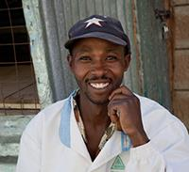
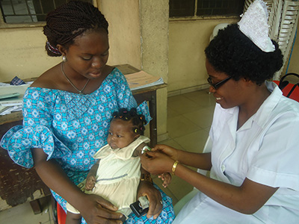
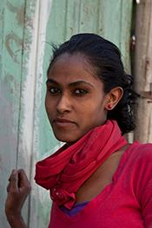
COMPANY CONFIDENTIAL
FY15 Q1 IHD Quarterly Update
August 21, 2014

Slide 2
Agenda
Welcome – Diana Silimperi
Staffing / Business Development / COP Conference / IHD Strategy FY15-16 – Mark McEuen
Project Impacts:
  Dimpa India (Kuhu Maitra)
  PHSP Ethiopia (Ellen Pierce)
  SHOPS Tanzania (James White)
  HFG Tanzania (Travis Snow)
  AIRS Benin (Jane Coleman)
Reputational Capital – Diana Silimperi
EAC Survey Update – Diana Silimperi
Q & A
Closing – Diana Silimperi
COMPANY CONFIDENTIAL

Slide 3

People YTD – 52 New Hires Q1
Total IHD staff: 1,297
Overseas: 1,099 (85%); U.S.-based: 198 (15%)
YTD Strategic Hires
∙ Jeanna Holtz Principal Assoc Health Insurance Specialist
∙ Francis Okello Sr Assoc Asst Research Dir, SHOPS
∙ May Post Principal Assoc FP/RH Strategic Lead
∙ Natasha Sakolsky Principal Assoc PM, Tech Strategist
Strategic Openings and Status
∙ Dir New Business Development – Lowrey Redmond hired
∙ MNCH Strategic Lead (Principal Assoc) – Active recruiting
Key Losses
∙ Itamar Katz Sr Assoc GMS
∙ Colm Fay Associate SHOPS
Other Key Hires
∙ Hilary Andrews Assoc Analyst Proj Coordinator, HFG
∙ Frederic Drigo Assoc Analyst FCA, DRC
Itamar to UNFPA, Colm to Univ of Michigan
COMPANY CONFIDENTIAL

Slide 4
Portfolio Performance: Business Development Summary
Key Wins
  HealthRise $14.5M
  TASC4 IQC $500M ceiling
  Gates Formative Research and Investment Case for PHC in Nigeria $500K
Diversification
  Awarded projects with foundations, e.g., Medtronic, Gates, and submitted proposals to private companies, e.g., Rio Tinto, Astra Zeneca
Collaboration
  11 collaborative bids in process, two of which IHD is leading, and two with Abt JTA
COMPANY CONFIDENTIAL
Notes:
Collaborations:
1. Nigeria DFID modification – IHD leading with collaborating orgs (IPS, IHSD, HIS)
2. Medtronic – IHD lead collaborating with PHE
3. M&E IDIQ – IEG leading with IHD
4. GDD Kenya (CDC) – PHE leading with IHD
5. Youthpower IDIQ – IEG leading with IHD
6. Global Flu – PHE leading with IHD
7. ADVANTAGE IDIQ – IEG leading with IHD
8. Peace IDIQ – IEG leading with IHD
9. & 10. Plus two Abt JTA leading – Indonesia MNCH, Global Health Resource Facility – with IHD
11. And one Abt leading with Abt JTA – Indonesia BANTU
TOTAL: 11 collaborations:
3 IHD leading, including one with Abt JTA
2 Abt JTA leading with IHD
6 others

Slide 5

COP Conference 2014, June 9-12
COMPANY CONFIDENTIAL

Slide 6
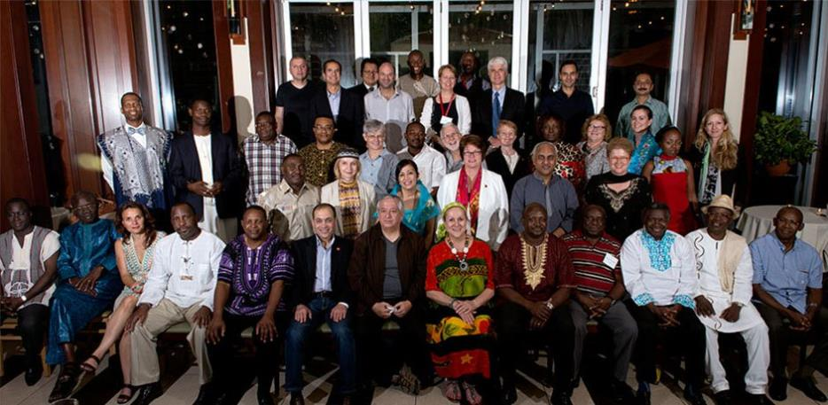
COP Conference 2014
Yearly company reunion and conference to educate, share, celebrate, and showcase One Global Abt
44 COPs, project directors, domestic staff from the US (Bethesda, Cambridge, Atlanta), 8 telecommuters
Focus on: business strategy; client relations; and quality execution, compliance, and accountability
COMPANY CONFIDENTIAL

Slide 7
COP Conference – Highlights
New COP Training – 10 new COPs trained on duties as a COP
Plenary: Changing Client Priorities and Practice – USAID, AusAID, and Gates external speakers followed by Q&A with Abt senior staff
Participatory Technical Sessions – Health Systems Strengthening and Service Delivery; Infectious Diseases; FP; MCH
Reputational Capital / COP Panel Discussion – Meaning of reputational capital and ways to increase Abt’s reputational capital in the field
Innovation Expo – Opportunity to preview tools and approaches developed by Abt to improve and increase efficiency of site office operations.
Cross Division Collaboration – IHD and IEG COPs who are working in the same countries met to discuss how to better work together and communicate across divisions
Innovation and Impact Awards – Innovation Awardee: Dr. Sabry Hamza, Health Systems Strengthening II, Jordan; Impact Awardee: Lisa Nichols, TASC 3 Mali ATN Plus
COMPANY CONFIDENTIAL

Slide 8
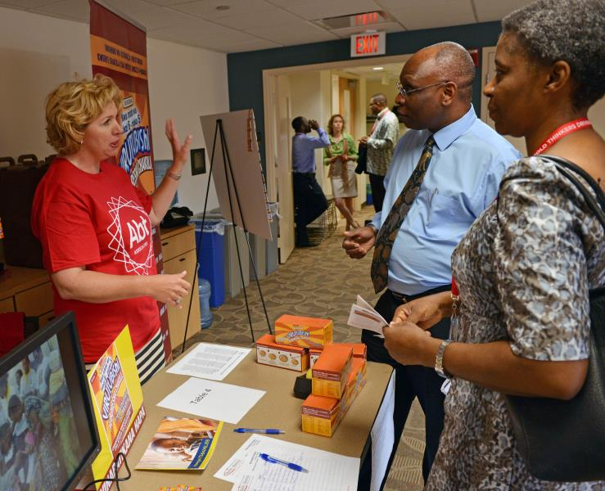
COP Conference – Actions
Significant changes in the market and we have to be proactive:
  Key hires in GBDU who know how to do business with international (non-USG) donors
  Communication: Empower COPs to become brand ambassadors
  Capture: Build capacity among field staff to do capture work; inform them about bids being pursued; connect with other donors, multinationals in country
  Documentation, dissemination, communications, and M&E: always include in proposal budgets
COMPANY CONFIDENTIAL

Slide 9
FY15-16 Strategy Overview
Execute with excellence
Invest in new business strategically
Strengthen new business development processes
Develop robust opportunity pipeline
Strengthen reputational capital
Focus on project/contract management and compliance
Ensure re-bids and global/division priority bids are fully resourced
Focus on reputational capital and thought leadership through technical segments
Refine operating model for efficiency/competitiveness
Test alternative business models, including bidding through Abt JTA
Invest in developing human resources
Improve utilization and coverage of staff
Proactively manage client satisfaction
Ensure quality of technical interventions
Improve in-country collaboration and coordination across projects
Invest wisely in key tech areas and priority countries
Develop strategies to enter promising new markets and diversify
Continue to diversify client base
Implement decision gate/color review process
Introduce country capture lead and quality mentor roles
Improve NBD culture and increase engagement
Develop strategy to better understand clients and competitors
Continue implementing competitive pricing and VfM approaches
Develop/implement/monitor division-specific process improvements
Increase capacity in new business development skills at all levels
Implement strategies to address retention and morale
Strengthen onboarding and orientation for new hires
Improve internal documentation of Rep Cap activities
Document and disseminate to increase visibility
Link reputational capital activities to new business explicitly
Review strategy operations plan regularly to refine/adjust
1
2
3
4
5
6
COMPANY CONFIDENTIAL

Slide 10

Project Impact – Dimpa India
With support from BMGF and Packard Foundation, Abt is implementing the Dimpa Project in urban areas of Bihar and Uttar Pradesh (Phase I: 2013-2016 and Phase II: 2016-2018). The project aims to leverage the private sector to expand contraceptive choices available to eligible couples.
Activities | Increase access to DMPA contraceptive by increasing service delivery points and improving quality of service provision Increase demand for and satisfied use of DMPA through interpersonal media and telephone-based behavior change communication Pilot interventions to increase access to DMPA in rural areas Support advocacy efforts by providing evidence on satisfied use of DMPA
Immediate Results | Dimpa network of 1,654 trained service delivery points in UP and Bihar Update on DMPA-three monthly injectable contraceptive and how to provide expanded basket of contraceptives to clients given to 241 qualified providers Project Technical Advisory Group (TAG) formed and first meeting held in May. TAG consists of senior members of Federation of Obstetric and Gynecologist Societies of India and Family Planning Association of India
Ultimate Impact | Overall, 3,000 new users of DMPA registered in Careline for post-use follow-up service through telephone for increasing continuation rate of DMPA
COMPANY CONFIDENTIAL

Slide 11
Project Impact – PHSP Ethiopia
The USAID-funded Private Health Sector Program in Ethiopia supports the Federal Ministry of Health (MoH) and Regional Health Bureaus in engaging private health care providers in the National TB Program with a public-private partnership approach to expand the Public Private Mix - Directly Observed Treatment Short-course (PPM-DOTS) for TB care.
Activities | Provide technical support to private health facilities for TB testing and treatment expanding on the approach from previous project (clinical training, supportive supervision, clinical mentoring, facilitating partnership with MoH) Second technical staff to MoH to support National TB Program Revise/update national PPM-DOTS Implementation Guidelines
Immediate Results | PPM-DOTS services expanded to 232 private clinic sites (from 20) plus engagement of 225 lower clinics and drug vendors Increased clinical capacity of 1,800 private providers trained in PPM-DOTS 17,838 cases diagnosed and treated (October 2009-June 2014) Project-supported facilities contributed nearly 14% of national TB case detection rate in 2013 (MoH TB Report − 2010-2014) Public-private linkages established for multi-drug resistant TB referrals and better access to anti-TB drugs, test kits, and lab reagents
Ultimate Impact | With private health sector’s role now accepted by MoH in fight against TB, expansion of access to testing and treatment of PPM-DOTS services to more Ethiopians nation-wide will lead to decreased morbidity and mortality from TB
COMPANY CONFIDENTIAL

Slide 12
Project Impact – SHOPS Tanzania
SHOPS is extending the availability of prevention of mother-to-child HIV-transmission (PMTCT) services through private sector nurses and midwives in peri-urban and low-income areas in partnership with the Government of Tanzania (GoT).
Activities | Expand PMTCT B+ provision through private nurses and midwives Strengthen national relationships / local district medical officer dialogue Provide assistance in commodity access Provide ongoing support to Private Nurses and Midwives Association of Tanzania (PRINMAT) HQ in meeting Ministry of Health (MoH) standards
Immediate Results | 70 private nurses and midwives trained in new curriculum 23 facilities rolled-out, 30 awaiting antiretroviral (ARV) procurement PMTCT roundtable established (PPP Forum) MoH national and regional directives provided to all district medical offices 1st month: 36 women received PMTCT [antenatal care (ANC) / labor and delivery (L&D)]; 20 newborns received Nevirapine; dried blood spot (DBS) testing initiated
Ultimate Impact | 53 private nursing/midwifery homes providing full spectrum of PMTCT services [voluntary counseling and testing; DBS; ARVs for PMTCT] Increased number of HIV positive women receiving ARV medication during ANC and L&D in their home community, reducing need for referral, and integrating HIV care into PRINMAT’s package of MCH services Early PMTCT intervention can decrease maternal mortality; reduce vertical HIV-transmission among newborns; reduce loss to follow-up
COMPANY CONFIDENTIAL

Slide 13
Project Impact – HFG Tanzania
The Health Finance & Governance (HFG) Project is designed to strengthen health finance and health governance systems in partner countries, leading to expanded access to health care and better health.
Activities | USAID Healthcare Financing Capacity-Building Workshop held in Dar-es-Salaam, Tanzania, June 9-13
Immediate Results | 30 USAID staff dealing with health systems and disease-specific programs participated, including USAID/Tanzania Mission Director, and staff from 11 bi-lateral Missions, two regional programs of East and West Africa, and Bureau for Global Health
Ultimate Impact | Built the capacity of USAID’s Africa staff in health finance and UHC Immediate requests to replicate workshop in Nigeria, Ghana, and USAID HQ in Washington New advocates for HFG’s and Abt’s HSS technical assistance and capacity building
“I feel as though I have learned more in this week than any training in my professional career.”
COMPANY CONFIDENTIAL

Slide 14

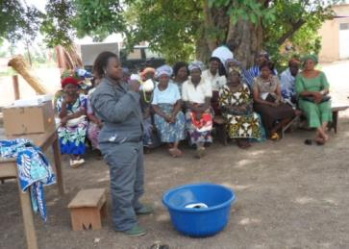
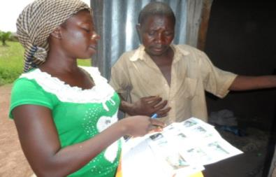
Project Impact – AIRS Benin
Activities | AIRS Carried out IRS Spray Campaigns in Benin
Immediate Results | Sprayed 254,072 structures in Benin
Ultimate Impact | Protected nearly 790,00 people in Benin Protected 25,754 pregnant women in Benin Protected 151,000 children under five in Benin Total protected by AIRS since project inception - > 25 Million People
COMPANY CONFIDENTIAL

Slide 15

Reputational Capital - Summary
Summary of Thought Leadership/Visibility – FY15 Q1Total: 56
(33% increase over FY14 Q1)
Entry Type | Total
Presentation or Poster | 17
Report | 10
Peer-Reviewed Journal Article | 3
Award | 1
Association/Organization/Editorial Board Participation | 1
Guidebook, Manual, or Best Practice | 1
Impact | 1
Media Mention | 9
Other | 13
Summary (total) | 56
COMPANY CONFIDENTIAL
Notes:
Other:
Research Insights
1 Technical Report
Briefs
1 Primer
Contribution to an e-learning course
HFG website post about a Pilot Program

Slide 16
Reputational Capital - Themes
What themes did we write and present about in Q1?
COMPANY CONFIDENTIAL
Notes:
At MIM
Two IRS-focused, Abt-organized symposia on innovations and data-driven decision-making
One IRS presentation in a World Health Organization-organized symposia
Multiple poster sessions highlighting malaria work under AIRS, HS20/20, HFG, and ZISSP
Cocktail hour attended by clients, which included slide show, presentation and fact sheets on Abt’s malaria projects
At ASTMH
IRS-focused symposia on innovation
Shared findings from research on the impact of scaled-up malaria control activities on hospital admissions, resources, and costs, carried out under Health Systems 20/20 and the Health Finance and Governance Project.

Slide 17
Reputational Capital - Journal Articles
Three peer-reviewed journal articles published during Q1
Ben Johns, Wendy Wong, and John Palen. “Assessing the costs and effects of anti-retroviral therapy task-shifting from physicians to other health professionals in Ethiopia.” Journal of Acquired Immune Deficiency Syndromes
Doug Johnson and Xi Cheng. “The role of private health providers in HIV testing: analysis of data from 18 countries.” International Journal for Equity in Health
Ted Hammett and Son Phan. “Pharmacies as providers of expanded health services for people who inject drugs: a review of laws, policies, and barriers in six countries.” BMC Health Services Research
COMPANY CONFIDENTIAL

Slide 18
Reputational Capital – Conferences
Population Association of America, Boston, May1-3: 4 abstracts submitted, 3 accepted
International Health Economics Association/ECHE Congress, July 12-16, Dublin: 4 abstracts submitted, 4 accepted
20th International AIDS Conference, July 20-25, Melbourne: 18 abstracts submitted, 9 accepted + 1 satellite session and 1 AbtJTA event
3rd Global Symposium on Health Systems Research (HSR), September 30-October 3, Cape Town: 23 abstracts submitted, 12 accepted + 1 satellite session
45th Union World Conference on Lung Health, October 28-November 1, Barcelona: 6 abstracts submitted, 3 accepted
American Society for Tropical Medicine and Hygiene (ASTMH), November 2-6, New Orleans: 7 abstracts submitted + 1 symposia accepted, other notices sent late August
American Public Health Association (APHA), November 15-19, New Orleans: 15 abstracts submitted, 6 accepted, 5 waitlisted
COMPANY CONFIDENTIAL

Slide 19
IHD Awards – Abt Annual Meeting
Daniel Bell Award for Outstanding Social Science Research – Slavea Chankova, Alison Comfort, and Randall Juras for innovative use of an experiment to advance the practice of family planning in SHOPS Madagascar
Local Country National Administrative Excellence Award – Helder Tembe for outstanding financial and administrative work with the Mozambique Clinical HIV/AIDS System Strengthening Project
Clark Abt Prize for Outstanding Social Impact – Dereje Dengela, Bradford Lucas, and Allan Were for the amazing impact the AIRS program has achieved in reducing malaria morbidity and mortality in sub-Saharan Africa
COMPANY CONFIDENTIAL

Slide 20
EAC Survey – IHD Action Plan
Key issues identified from EAC and IHD surveys:
  Professional development and job opportunities within Abt
  Performance review process
  Morale and face time
Sampling of actions taken:
  Professional development: TWG dissemination of free training opportunities; work group to develop functional career track including tiered PMs; working with HR re level changes; monthly IHD eltr has job postings + announcements sent out; AGI site with info; HR pursuing academy model and career rotations
  Performance review process: Collected, collated, and shared feedback with HR
  Morale: Increased frequency of one-to-one blocks of time with Diana and Lunches with Leadership; Social Committee reinvigorated; World Cup popcorn viewings; Diana strolls to chat; call for artwork to decorate hallways
COMPANY CONFIDENTIAL

Slide 21
In Summary
Rapidly changing client environment with reform, new initiatives, centralization, and strong focus on results – requires intensified intelligence and triangulation of information
Forecasting increasingly difficult with sudden budget cuts in spite of prior commitments as well as new buy-ins (COP 14 funds – PEPFAR shift to Care and Support) – necessitates improved methods
Volatile labor market with aggressive recruitment, poaching – focusing on employee satisfaction and professional development – HR is priority objective in IHD two-year strategic plan
Key accomplishment – IHD two-year strategy and new business strengthening plan; operationalization of decision gates, color reviews, and quality mentors
Successful COP meeting – Back to Basics
Strengthening cross division and subsidiary collaboration in new business and country-level coordination
Fragile states – obtained board support to further develop and operationalize fragile state strategy including risk mitigation framework
Abt GB – significant advancement in Abt GB strategy with focus on client/DFID relationship strengthening and strategic partnerships
COMPANY CONFIDENTIAL

Slide 22
See You in September!
IHD Global Staff Meeting
Sept 17, 9:00 -10:00am
COMPANY CONFIDENTIAL

