Slide 1
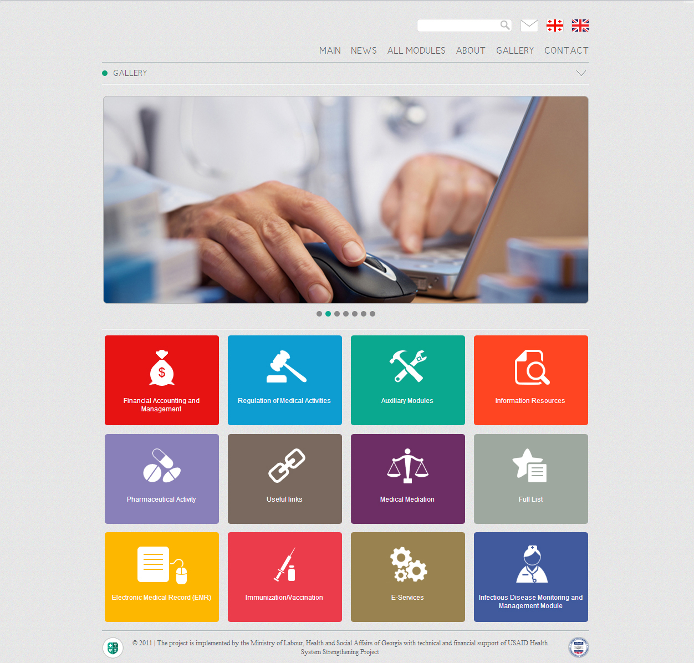


Health Management Information System (HMIS)
http://ehealth.moh.gov.ge/Hmis
USAID Health System Strengthening Project (HSSP)
December
2012

Slide 2
Health Management Information System
Main Characteristics
Privacy and security
Standards-based
Real-time connectivity
Financial and medical data
Statistics and analysis
Evidence-based Decisions
Standardization and transparency
Improved efficiency, reduction of cost

Slide 3

Main Components of Georgia e-Health System
Regulation of Medical Activities
Pharmaceutical Activities
E-Services
Pharmacy and Healthcare Information Portal
ImmunoPack
User Management Module
Accounting and Financial Management
Medical Classifications
Healthcare Dashboard

Slide 4


Functional Architecture of the HMIS System
Access to information & services
Administration/ management tools
Basic registers

Slide 5
The HMIS Stakeholders
MoLHSA
SSA
National Center for Disease Control and Public Health
State Regulation Agency for Medical Activities
Medical Mediation Service
Revenue Service
State Treasury - Ministry of Finance
Healthcare providers
Rural Doctors
Insurance Companies
General Population

Slide 6
Beneficiary Registration Module
Prevents duplications
Simplifies administration
Optimizes resources
Produces more accurate reports
Enables accurate calculation of payments

Slide 7
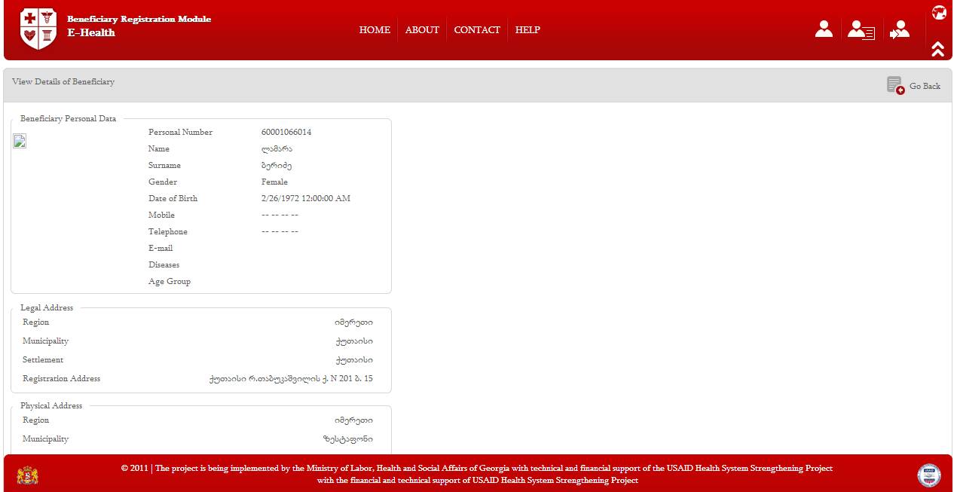
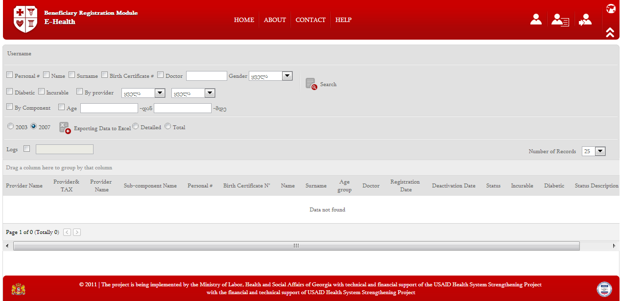
Beneficiary Registration Module Screenshots

Slide 8
Case Registration Module
Real-time registration of cases based on common standards. Information available to the involved parties
Prevention of duplications and fraud
Flexible tool for medical case inspection and analysis

Slide 9
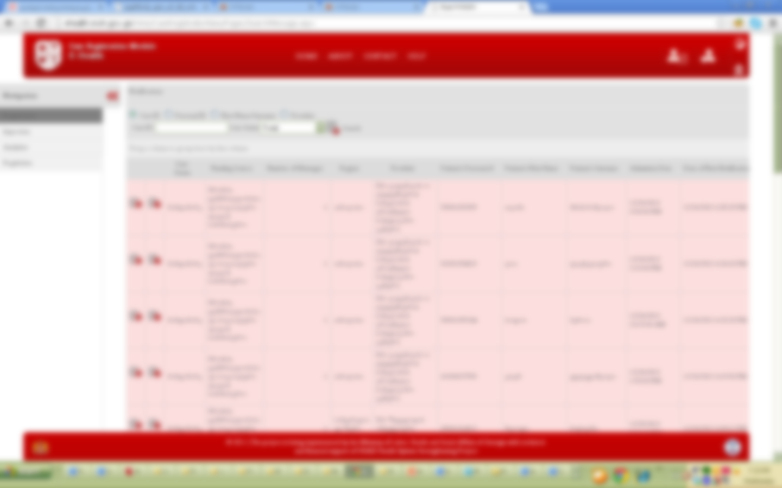
Case Registration Module Screenshots

Slide 10

Regulation of Medical Activities
Central register of personnel and facilities
Reliable information about active and passive certificates
Activities and certified personnel
Transparency on suspension/ revocation of license
Improved disaster preparedness
Accreditation
Certification
Regulation
of Medical
Activities
Reports
Licensing
Permits

Slide 11
E-Reporting Module
E-Reporting Module for Insurance Companies and Healthcare Facilities
Standards for registration and exchange
Validation with databases of internal and external agencies
Transparency of financial information
Prevention of fraud, and reduction of administrative waste
Improved decision making

Slide 12
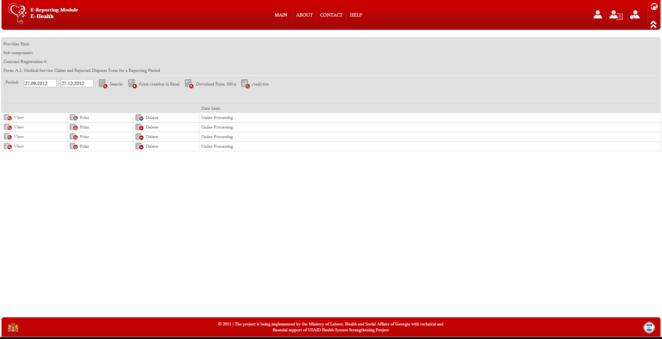
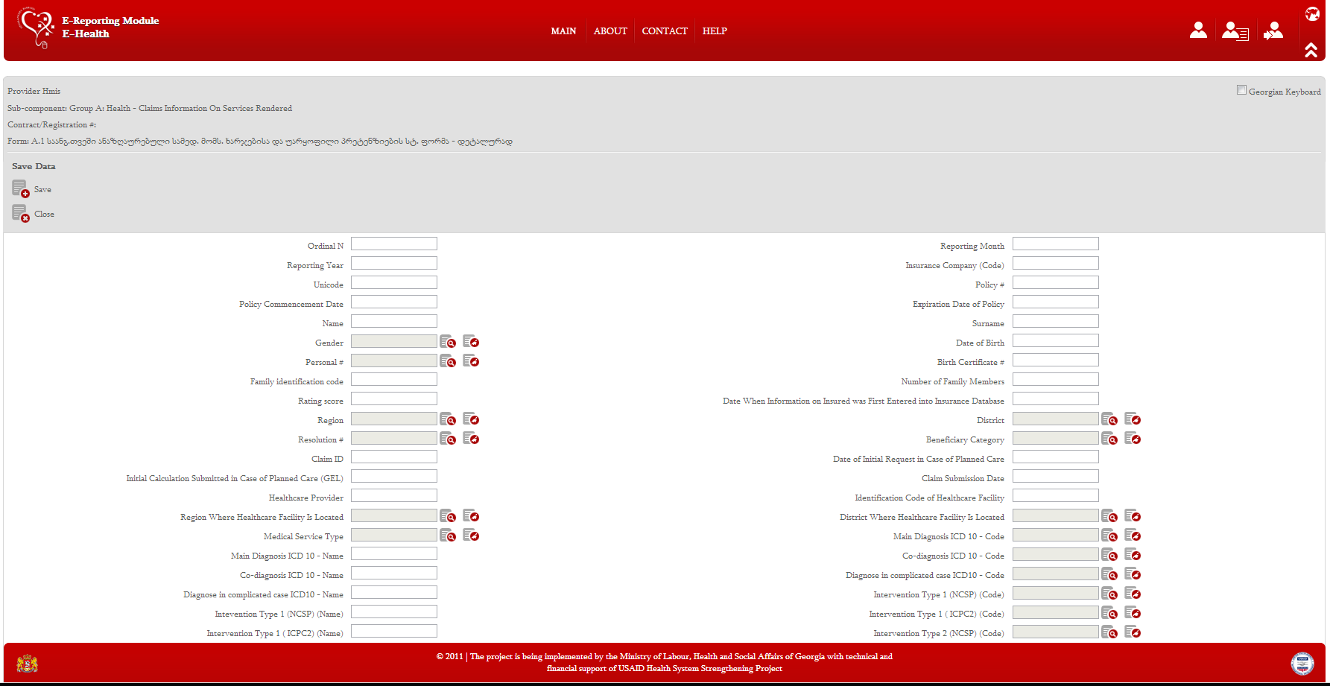
E-Reporting Module Screenshots

Slide 13
ImmunoPack
Registration and monitoring of target population
Simplified administration - including the monitoring of patients’ migration and immunization histories
Monitoring of vaccine use
Reliable statistical and epidemiological analysis

Slide 14
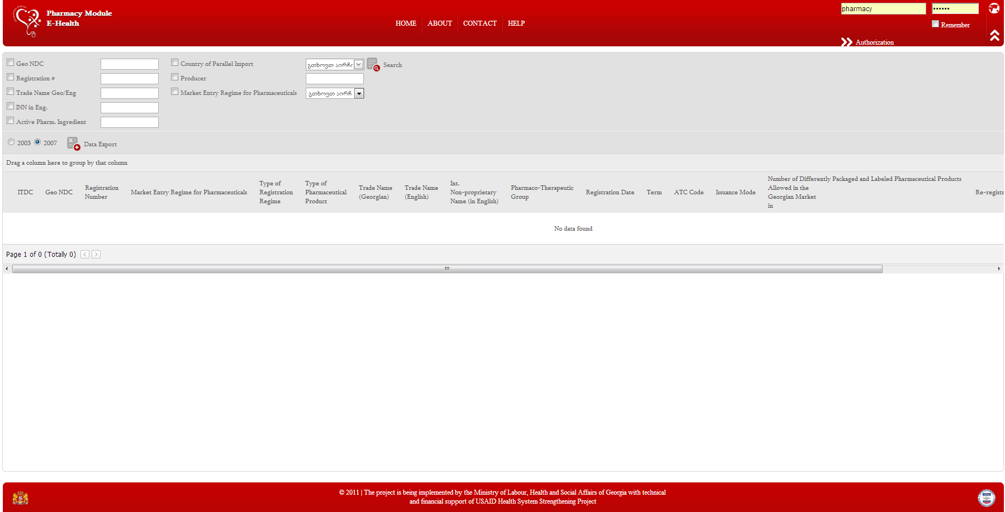
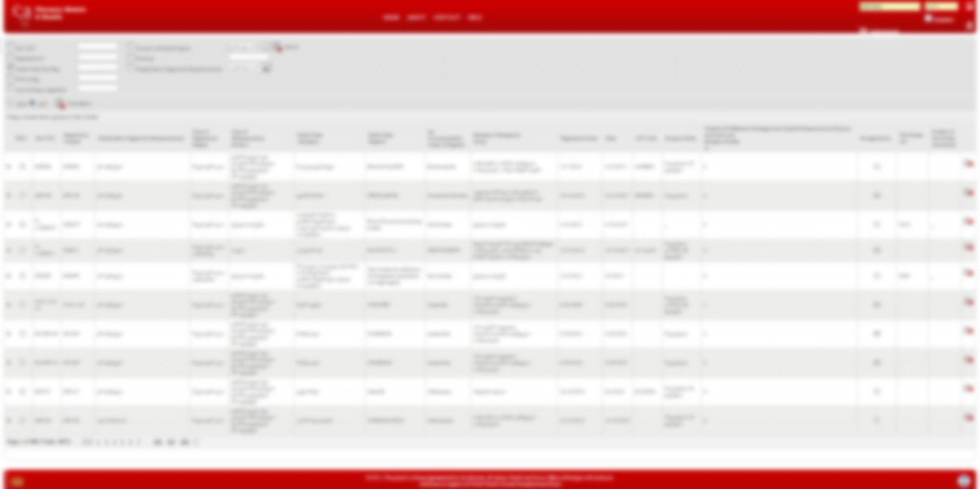
Pharmaceutical Component-Drug Registry
Single source of info on products permitted in Georgia
Connection with Customs Department
Improved drug safety and surveillance, using a unique drug code
Better reports
Clinical decision support, based on drug annotations and different medical/scientific information

Slide 15
Pharmacy and Healthcare Information Portal
View pharmacies and products; medical service providers, their services and staff
Real-time access to free bed capacity
Display of drug stocks, prices and geographic distribution
Price transparency
Citizens in control!

Slide 16
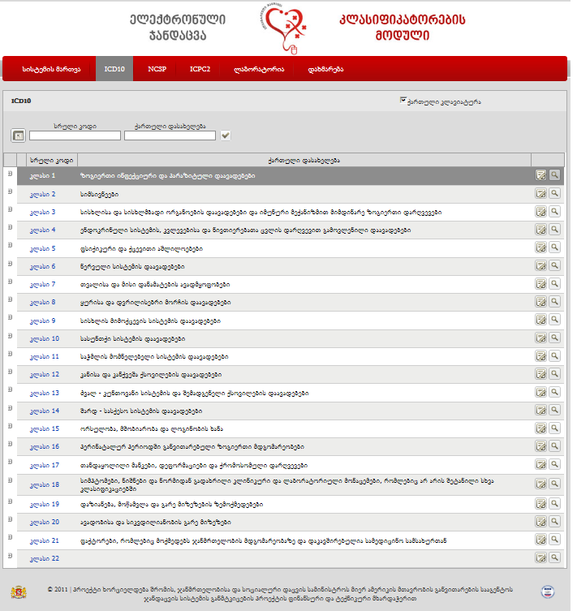
Medical Classifications
Source of classifications approved in Georgia (ICD10, NCSP, ICPC2, laboratory), constantly updated
Efficient management of classifications from a central location
Improved inter-operability and information exchange through the use of common standards

Slide 17
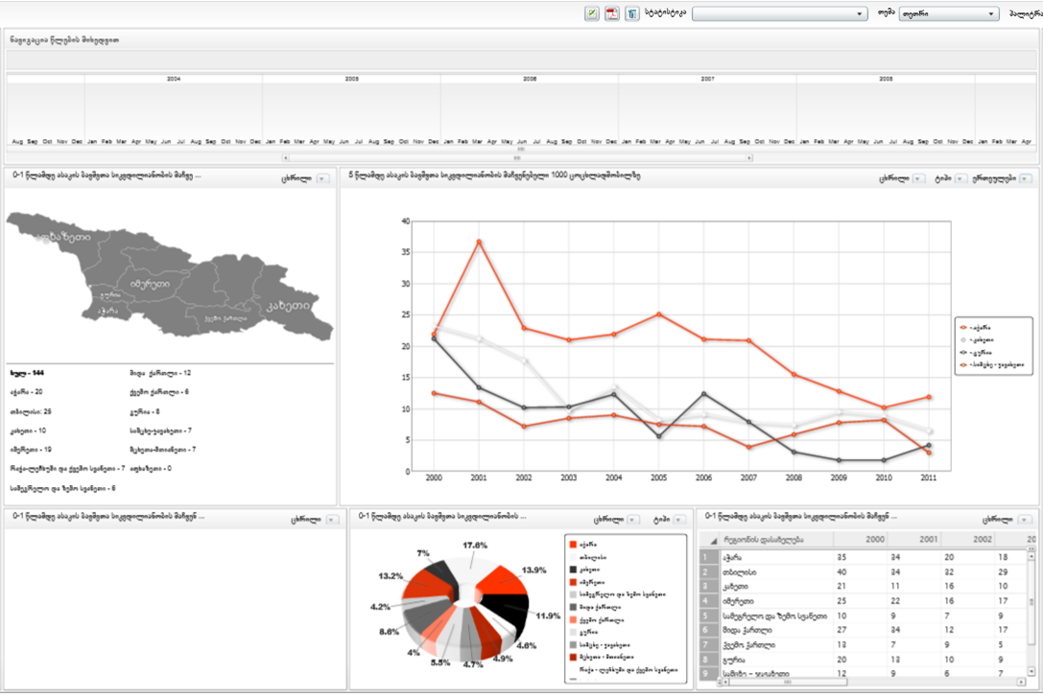
Healthcare Dashboard
Support for policy making through user-friendly graphical access to data
Allows comparison of different indicators, analysis from different angles (time interval, geographic distribution, etc.)

Slide 18
User Management Module
 | Ministry of Labour, Health and Social Affairs | Insurance Company | Provider
Centrally manage users & permissions | ☑
Single sign-on | ☑ | ☑ | ☑
Manage users for facilities independently | ☑ | ☑ | ☑
Integration with external systems | ☑ | ☑ | ☑
Security and data protection | ☑ | ☑ | ☑

Slide 19
New Modules are Coming with New Ideas…

Slide 20
Health Management Information System (HMIS) Website
http://ehealth.moh.gov.ge/
User Manuals and Video Tutorials in English language can be found in Help menu of each module.

