Slide 1



E-Health Health Management Information System (HMIS)
USAID Health System Strengthening Project

Slide 2
Health Management Information System - Mission
Health Management Information System – Characteristics
Information Privacy and Security
Common standard for data accounting and registration, ensuring international comparability
Operational effectiveness and minimization of administration resources
Real-time monitoring of financial or healthcare related data
Accurate statistics and analysis
Knowledge management and knowledge –based clinical decision making, using knowledge resources
Improving the Efficiency and Control of State and private healthcare programs
Policy and management decision making based on accurate data
Improved standardization and transparency of processes, including the service quality

Slide 3

Main Components of Health Management Information System
Regulation of Medical Activities
Pharmaceutical Activity
Pharmacy and Healthcare Facility Information Module
Medical Mediation Module
Immunization/Vaccination
User Management Module
Financial Accounting and Management
Medical Classification Module
Analytic Module

Slide 4

Regulation of Medical Activities Component
Benefits of Component Modules
Licensing and Permitting Module for Healthcare Facilities and Certification and Accreditation Module for Medical Staff
Report
Keeping electronic register and access to public information
Complete histories of healthcare facilities taking into account of legal succession (relative to Licensing, Permits, Accreditation)
Information on distribution of medical staff in a healthcare facility
Information on medical staff training, their certificates and experience
Automatic provision of information on suspension/deprivation of a right to medical activity
Certification
Regulation
of Medical
Activities
Accreditation
Licensing
Permits

Slide 5
Pharmaceutical Activity Component
Component Modules
Benefits of Pharmacy Module
Pharmacy Module
Registration of all registered and functioning pharmacies
Finding exact locations of pharmacies
Identification of pharmacies according to activity types
Registration of results of inspection of pharmacies and pharmaceuticals
Data standardization and prevention of duplicated entries
Pharmaceutical Products Module
Electronic Drug Registration in eCTD (Common Technical Document) Format
E-prescribing Module
E-Services

Slide 6
Pharmaceutical Activity Component-II
Benefits of Pharmaceutical Products Module
Benefits of Electronic Drug Registration in eCTD (Common Technical Document) Format
A complete list of pharmaceuticals allowed in Georgia
Opportunity for real-time exchange of information on import/export of drugs with the Revenue Service
Ability of medical staff to make informed decisions based on drug annotations and different medical/scientific information
Citizens security – ensure finding of pharmaceuticals in the distribution network with unique drug code
Data standardization and prevention of duplicated entries
Simplification of drug registration process and standardization of normative and technical dossier and process of expertise
Compliance of the registration process with international standards and technical possibility to connect reliable regulators to analogous registration interface
Registration of high-quality drugs
Optimization of timely, financial and technical resources
Data systematization and simplified data search; large amount of data archiving

Slide 7
Pharmaceutical Activity Component- III
E-Prescribing Module
Benefits of the Module
Centrally mobilized data, opportunity to gather reliable statistics and make an analysis
Ensuring cost-effective care, making and/or correcting informed decisions
Controlling limit for drugs covered under government-funded and private health insurance plans
Eradication of fraud and duplication of care
Renewal of prescription for patients with chronic diseases without visiting doctors
Optimization of timely, financial and technical resources based on electronic reporting
Software that will ensure access to scientific medical resources while rendering medical services

Slide 8
Pharmaceutical Activity Component - IV
E-Services Module
Benefits of the Module
Simplified electronic feedback exchanged between the Ministry of Labour, Health and Social Affairs (MoLHSA )and other stakeholders
Getting electronic permits and documents
Reduction of costs related to paper documents
Receiving/exchanging fast and reliable data online

Slide 9
Pharmacy and Healthcare Facility Information Module
Benefits of the Module
Accessible and affordable medical care
Accessible and affordable pharmaceuticals
Favorably selected clinics and pharmacies
Price transparency
Saved administrative resources

Slide 10
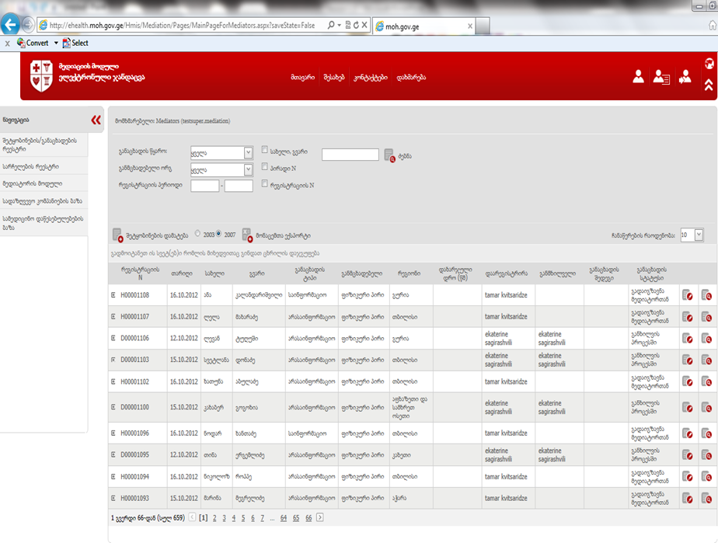
Medical Mediation Module
Benefits of the Module
Real-time registration of applications using common standards
Electronic administration and management of applications
Simple, timely and flexible reaction system
Statistical observation and analysis
Flexible mechanisms for application revision
Simple mechanisms for departmental feedback

Slide 11
Immunization/Vaccination Component
Benefits of the Module
Registration of the whole population and migration monitoring
Centralized data and simplified administration (based on reports submitted in hard copies)
Opportunity to make reliable statistical and epidemiological analysis

Slide 12
User Management Module
Benefits of the Module
 | Ministry of Labour, Health and Social Affairs | Insurance Company | Provider
Tool to manage users and their access levels | ☑
A complete list of users for all information modules | ☑ | ☑ | ☑
Mandatory single authorization (single sign -on) to access to modules | ☑ | ☑ | ☑
Opportunity to manage users and access levels for appropriate facilities independently | ☑ | ☑ | ☑
Possibility of integration of external information systems with the user and access level management module | ☑ | ☑ | ☑

Slide 13
Financial Accounting and Management Component
Case registration Module
Beneficiary Registration Module - General Out-patient Care
Beneficiary Registration Module – Rural Doctors
Beneficiary Registration Module - Dialysis
Beneficiary Registration Module – Psychiatric Care
Beneficiary Registration Module – Antenatal Care
Healthcare Programs Financial Management Module
E-Reporting Module for Insurance Companies
E-Reporting Module for Healthcare Facilities

Slide 14
Case registration Module
Benefits of the Module
Real-time case registration using common standards
Automatically entered/ synchronized personal data and insurance status of the patient (migration of data from the NAPR database)
Providing parties involved in medical cases with timely electronic information
Automatic identification of healthcare facilities and medical personnel
Prevention of simultaneous registration of individuals in different healthcare facilities
Case inspection and analysis

Slide 15
Beneficiary Registration Module
Sub-Components of the Module
General Out-patient Care
Dialysis
Rural Doctors
Psychiatric Care
Antenatal Care

Slide 16
Beneficiary Registration Module
Benefits of the Module
Provision of lists of beneficiaries to all healthcare facilities and rural doctors countrywide
Data registration using common standards; Medical record keeping (out-patient card)
Registration of one individual in only one healthcare facility that eradicates duplication
Identification of civil, insurance and other statuses of individuals in different registers
Financial transparency
Simplified administration and reduced costs; Effective utilization of government funds
Flexible mechanism for reimbursement calculation under government-funded out-patient program
Prediction of the amount of funds to be transferred to insurance companies
Opportunity to analyze information from different angles

Slide 17
Healthcare Program Financial Management Module
Benefits of the Module
Electronic registration and management of contracts signed by healthcare facilities under government-funded healthcare programs
Controlling and analysis of estimations submitted by healthcare facilities under government-funded healthcare programs
Automatic procedures for payment made to healthcare facilities under government-funded healthcare programs
Real-time data exchange with the State Treasury
Complete analysis of financial resource flow within government-funded healthcare programs
Flexible tool for management of budget units, financial limits and relevant changes

Slide 18
E-Reporting Module
E-Reporting Module for Insurance Companies and for Healthcare Facilities
Benefits of the Module
Common standards for data registration and exchange (common registration forms and invoices)
Minimum probability of errors related to data
Identification of data entered into the system and its synchronization with different systems (NAPR, register of the Regulation Agency, register of insurance companies and also register of beneficiaries of government-funded health insurance programs, etc.)
Automatic exchange of data with Electronic Medical Record (EMR)
Effective utilization of funds – save human and administrative resources
Financial transparency
Opportunity to analyze information from different angles

Slide 19
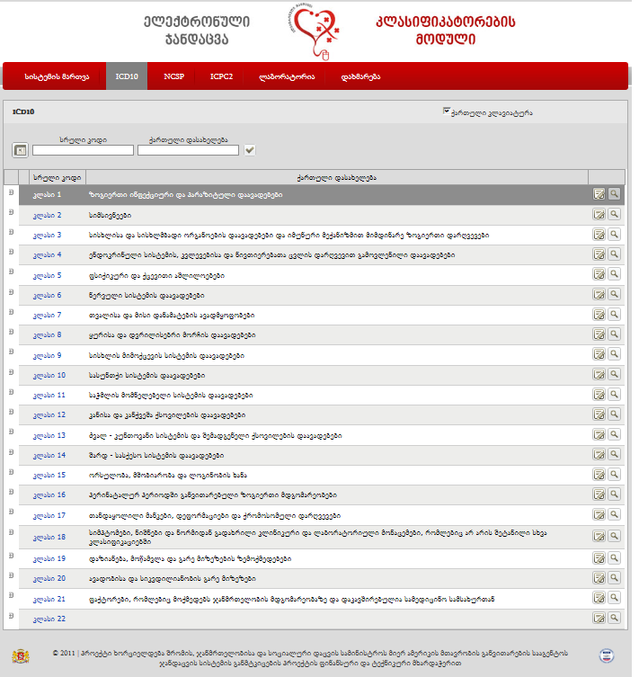
Medical Classification Module
Benefits of the Module
Database of medical classifications approved in Georgia (ICD10, NCSP, ICPC2, laboratory classification)
Constantly updated information on classifications and their interrelationship
for classification content management/improvement
Electronic portal and services to ensure communication with external systems

Slide 20
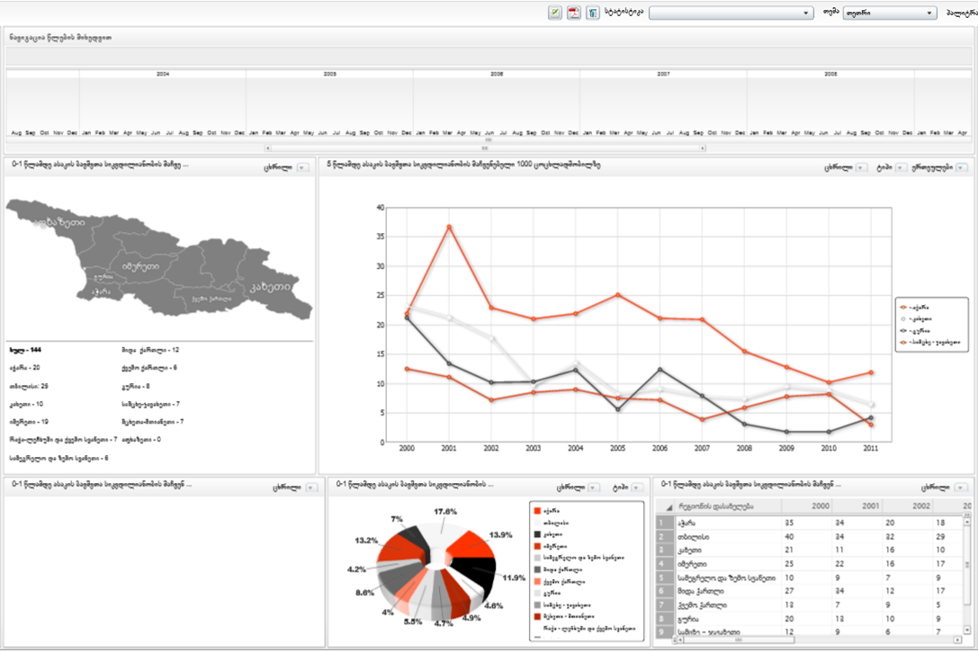
Analytic Module
Benefits of the Module
Opportunity to generate analytical diagrams and graphics based on collected data
Comparison, monitoring and analysis of information flows according to different indicators
Graphics generated based on data received from internal and external modules through electronic channels
Opportunity to analyze collected data according to years, quarters, months, etc.
Opportunity to analyze collected data according to geographic features (region, district, settlement)

Slide 21
Health Management Information System Website
http://ehealth.moh.gov.ge/
User Guides and Manuals in English language can be found in “Help” section of each module.
Thank you for your attention!

