Slide 1
USAID Health System Strengthening Project
Health Management Information System

Slide 2
What is Health Management Information System (HMIS)?
A nationwide web-based electronic data management system (29 modules)
8 538 active users (used 99 % of health services providers in Georgia )
Total of 4 079 732 citizens managed thru HMIS
Second mostly visited and used system among governmental electronic systems - ~ 50,000 visits per week (www.ehealth.moh.gov.ge)
External linkages with: SDA, Public Registry, State Treasury, Customs Department, insurance and healthcare industries, pharmaceutical sector
Notes:
Point 2: excluding dental clinics and labs
Point 4: only after the Revenue Service
SDA: Service Development Agency of the Ministry of Justice

Slide 3
HMIS Structure
Notes:
Universal Health Care program (fully operational)
Other state funded (so called “vertical) programs (being implemented)
Public health programs (being implemented)
Adjara government health programs (to be implemented by the end 2014)
Tbilisi City Hall health programs (to be implemented by the end 2014)

Slide 4
ALL medical services under UHC
ePrescription (UHC)
1 019 216 CASES
(317 354 in-patient)
292,195,351.9 GEL
is paid thru HMIS Finance and Billing module
FINANCES
SERVICES/CASES
HMIS
MANAGES
Regulation of medical personnel and facilities, pharmacies and medicines
Vulnerable groups:
pensioners, veterans,, IDPs, children with disabilities, citizens under the poverty line, etc
REGULATION
BENEFITS
Notes:
* Manages health benefits of various vulnerable groups – benefits are individually managed, including covered services and limits

Slide 5
HMIS has strengthened governance capacity:
Increased efficiency and transparency of public spending, including elimination of fraud
Empowered citizens to make informed decisions
Facilitated government arbitration between citizens, providers, and insurers - Up to 14 500 citizen claims processed
Improved effectiveness of public health interventions, e.g. vaccination
Notes:
Point 2 : Citizens can access information portal and learn about their health benefits under UHC, search for a medical service provider nearest to their place of residence, etc
Point 4: HMIS Immunization Module helps eliminate barriers to service provision. ID based system allows receiving vaccination services anywhere, regardless a place of residence and/or in-country migration, as past vaccination history follows a patient; past vaccination history largely determines future vaccination tactics, therefore when past data was not available service providers could refuse to render a receive. Moreover, the module helps improve statistics due to more accurate reporting. The end result – improved vaccination coverage

Slide 6
Improved regulation of the health market through enabling the government monitoring of health market
based on real-time data:
Instant identification of pharmaceutical product registration status at import – prevents importation of unregistered products; no delays - saved time and costs for importers
Transparent management of health facilities, pharmacies and medical professionals – including revocation of their licenses/permits and legal litigation
Notes:
Active pharmacies : 4165
Active licensed health facilities: 1539
Active certified physicians: 38 441

Slide 7
Improved monitoring of public health indicators, timeliness and quality of service delivery
enabled real-time monitoring of disease patterns
Tracks some of the quality of care indicators: up to 5234 patients were re-hospitalized (~ 0,05 %)
Allows government to mobilize medical resources quickly in a given area by tracking available critical capacities across country
Monitoring of prescription practices: 494 prescriptions/mo in average
Notes:
Point 3: Ministry/ambulance/citizens can check availability resources, such as: free Intensive Care Unite beds, free mechanical ventilators, child incubators, blood products and etc
Point 4: Prescriptions are issued by family doctors as a part of UHC program drug benefit. Total of 34 family doctors

Slide 8





BEFORE
AFTER
No data standardization
100 % of data standardized and validated
High proportion of inaccurate data, hence statistics
Automatic generation of statistical and performance indicators
Max of 2 days - From provider report submission to provision of payment, only 0,006 % of rejected reports
Reporting and payment delays
Delayed service provision: person and resource identification problem
Instant ID number based identification; Ambulance tracks available resources online

Slide 9

ehealth.moh.gov.ge
Contact information:
Mr. Alexander Turdziladze, COP – aturdziladze@hssp.org.ge / (995) 93 226 226
Ms. Ketevan Tatoshvili, DCOP – ktatoshvili@hssp.org.ge / (995) 77 731 560

Slide 10
enabled real-time monitoring of disease patterns
Tracks some of the quality of care indicators: up to 5234 patients were re-hospitalized (~ 0,05 %)
Allows government to mobilize medical resources quickly in a given area by tracking available critical capacities across country
Monitoring of prescription practices: 494 prescriptions/mo in average

Slide 11
Overview of Recent Health System Reforms in Georgia
Expansion of State funded insurance to >1.5M beneficiaries
Government regains powers to administer health programs
2006
2008
2009
2012
2013
First State funded health insurance program introduced for target groups
Privatization of hospitals, service delivery shifted to insurance companies
UHC program launched, covering ~2M uninsured population
Today, HMIS is the main instrument to implement the UHC program

Slide 12
Context and history
Notes:
Flexible and respinding to needs

Slide 13
Project achievemnt

Slide 14
Overview
Coverage: target groups da vin daemata

Slide 15
Pensioners -

Slide 16
HMIS - ePrescpriton policy overview
HMIS role - classificators
Potential
Notes:
Supported policy decision making thru surveys
Prescription – side effects
HMIS – impact in UHC
USAID HSSP catalizing changes of heath reforms

Slide 17
Strengthening professional associations’ capacity introduce best practices and strengthening medical ethics in service delivery - development of the Code of Doctor’s Professional Conduct
14 medical associations became signatories of the MoU endorsing implementation of the code in their respective organizations

Slide 18
Health Service Provider Capacity Development:
Training courses: HR management, quality and infection control
# of ppl trained:
Health Insurer’s Capacity Development:
Training courses: claims administration, underwriting and product development
# of ppl trained:

Slide 19
Strengthened the Georgian Insurance Association to provide support to then state funded health insurance program beneficiaries
Institutionalized training courses at GIA :
Mediation – institutionalize aris
Notes:
Sustainable darcha
IPEC –

Slide 20
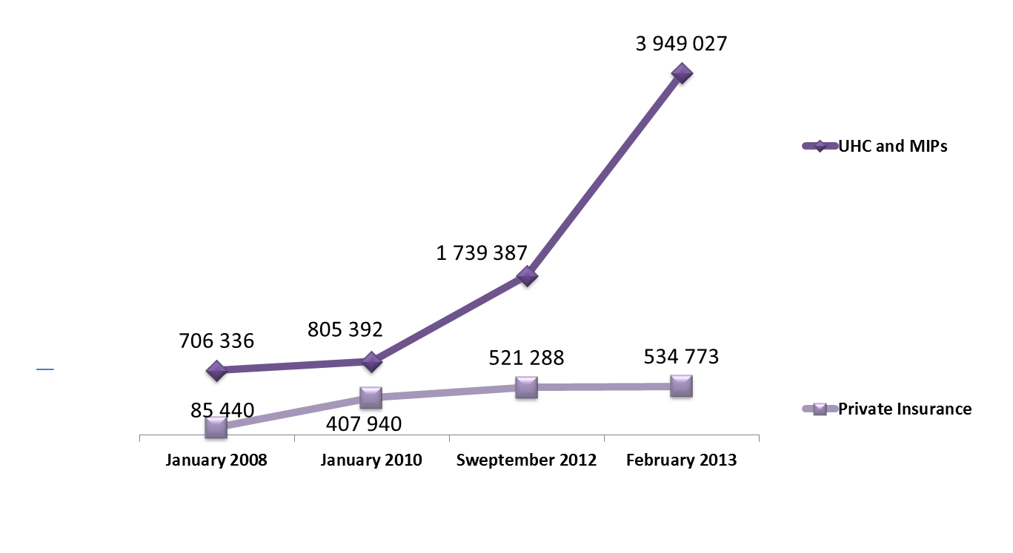
Universal Enjoinment of Health Rights in line with EU and Global Health Vision
4,4 million
Number of Beneficiaries
2.3 million
0.8 million

Slide 21
UHC Basic Package
PHC (GP, specialists, evidence-based diagnostics - INR, Chest X-Ray, etc.
Urgent outpatient services –15,000 GEL limit - 100%
Urgent in-patient services –15,000 GEL limit - 100%
Elective Surgical Care – 15,000 GEL – 70-100%
Oncology Care – 12,000 GEL – 80-100%
Maternity Services – 500 Normal Delivery, 800 GEL C-section
Notes:
Currently the UHC programme covers an expanded primary health care package (with focus on evidence based interventiosn to reduce the disease burden due to communicable and non-communicable diseases), emergency medical care both at ambulatory and hospital levels, elective surgery, oncology treatment and maternity services.
Universal Health Programme like MIPs does not cover procedures related to treatment abroad, plastic surgery, spa- and resort therapies, non-surgical extended duration therapeutic services, self-treatment, conditions related to participation in criminal acts or illegal use of drugs (except for critical care cases), high-cost procedures and interventions that have proven lower-cost alternatives (i.e. PET/CT, defibrillator-pacemaker, drug eluting stents, eye surgery with excimer laser), organ transplantation, exo- and orthopedic endo-prosthesis (except in the case of trauma), reproductive health disorders and infertility, dental care and services that are covered by other State Programmes (vertical programmes) such as Immunization, HIV, TB and Diabetes treatment, Dialysis, Organ Transplantation (GEL 20,000 limit), lifetime immunosuppression medications, etc.

Slide 22
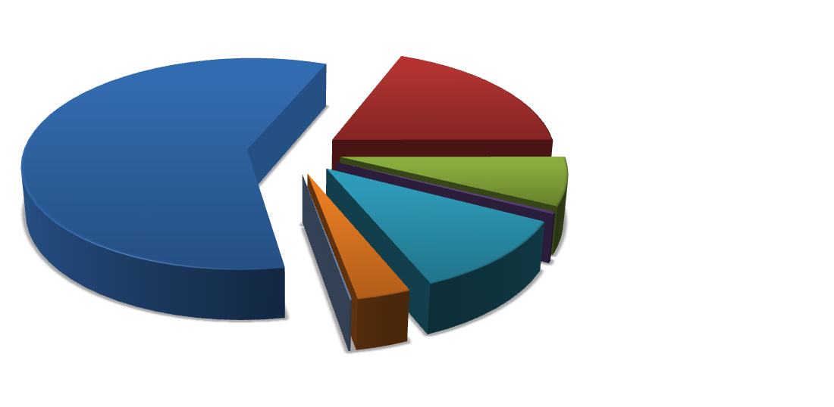
> 400,000 Beneficiaries of Universal Health Care
May 2014
EMERGENCY HOSPITAL CARE
81,495
EMERGENCY AMBULATORY CARE
229,480
ELECTIVE SURGERY
27,030
CARDIOSURGERY
1,107
DELIVERIES
31,867
CHEMO-, IMMUNOTHERAPY AND RADIOLOGY
12,308
Notes:
As of May 5, 2014 2.3 million people without health insurance prior to February 2013 were registered at primary healthcare centers. Since the launch of the UHC a total of 383 707 cases were supported including: emergency out-patient – 229,480; emergency in-patient – 81,495; planned in-patient – 27,030; cardiac surgery - 1107; chemotherapy, hormonal and radiation therapy -12,308 and deliveries – 31, 867.

