Slide 1



Health Management Information System Vaccine Stock Management Module
ehealth.moh.gov.ge
USAID Health System Strengthening Project (HSSP)
November
2013

Slide 2
Our Product:
What is HMIS about?
Privacy and security
Standards-based
Real-time connectivity
Financial and medical data
Statistics and analysis
Enables evidence-based decision making
Ensures standardization and transparency of business processes
Improves efficiency, reduces costs

Slide 3
Rationale for Building the VSMM
Data quality and standardization issues
Limited data for informed decision-making
Limited administrative resources – need for optimization
Lack of centralized database and essential electronic services
Notes:
Limited statistical and data analysis capabilities ???
Delayed exchange of information between parties ???

Slide 4



Basic Components of the VSMM
Registration of warehouse (central, sub-level)
Registration of incoming goods
Registration of requisitions (orders)
Registration of dispatches
Product catalogue
Product returns and write-offs
Reports and invoices
Notes:
Briefly about the VSMM:
Part of a general warehouse and stock management module designed for NCDCPH
Centralized user management (data security also)
User manuals
Data export in Excel
Registration of incoming goods – room, shelf, refrigerator…products are assigned a unique number

Slide 5
Some Functional Capabilities of the VSMM
Real-time monitoring of stocks at central and sub-stock level
Tracking by lot numbers and expiration dates
Assessment of stock by expiration date
?????
Notes:
Automatic generation and transfer of invoices to the Revenue Service of Georgia ????
3. So that dispatch can be in an “earliest-expiry first-out (EEFO)” manner

Slide 6
Vaccine/Diluent Information Registered in the VSMM
Type of vaccine
Vaccine presentation/Packaging/dosage and volume
Quantity received/dispatched (doses)
Vaccine manufacturer
Batch or lot number or numbers
Expiry date for each batch
Status of Vaccine Vial Monitor
Freeze indicator
Notes:
2. Including the number in the package, registered in units and in doses

Slide 7
VSMM Integration with the Immunization Management Module
Accurate calculation of safety and max stock levels, based on consumption history and need in the catchment area
Vaccine wastage calculation
Real-time information on vaccines at the stock for the moment of immunization
????

Slide 8
Summary of VSMM Benefits
1
Information on minimum, maximum and safe stocks at different levels
Monitoring vaccines and other products according to specific warehouses
2
Centralized management of regional/district warehouses
3
4
?????
Notes:
1. Link to immunization module and target contingent

Slide 9
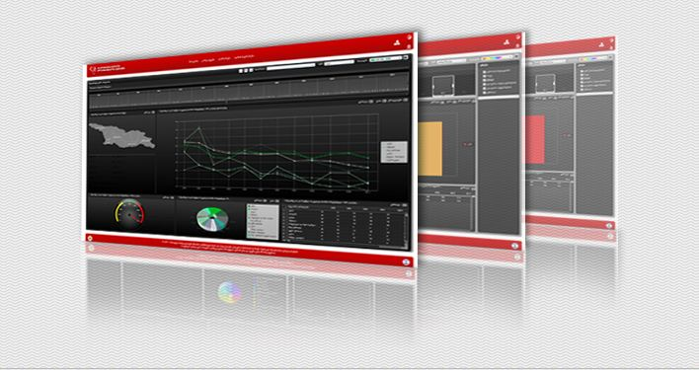
ehealth.moh.gov.ge
Contact information:
Mr. Alexander Turdziladze, COP – aturdziladze@hssp.org.ge / (995) 93 226 226
Ms. Ketevan Tatoshvili, DCOP – ktatoshvili@hssp.org.ge / (995) 77 731 560
Notes:
For more information please visit the this link ehealth.moh.gov.ge
Under documents section you will find the brief description of all modules
Also, every module is equipped with user manuals and some of them with video tutorials as well, in Georgian and English languages

