Slide 1


Slide 2



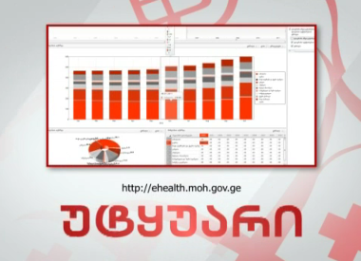

The Government of Georgia aims to create large-scale Healthcare Management Information System that will allow the population of Georgia, the Government and healthcare stakeholders to access information simply, effectively, promptly and respond respectively

Slide 3


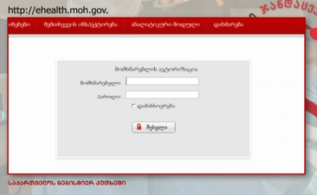
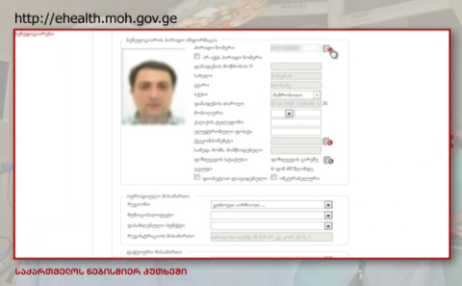
The Healthcare Management Information System will connect
Insurance companies, healthcare providers, pharmaceutical companies and regulatory bodies to each other to exchange important information, improve information quality and reduce fee for service

Slide 4
The system will:
increase transparency in healthcare financing
improve government control over government-subsidized healthcare programs
help to standardize business processes and improve service quality
promote common standards for information registration and enable comparison between it and international data
ensure effective tools for decision-making and policy development
ensure effective utilization of government funds

Slide 5



It will be a patient-oriented system connecting patients to healthcare providers
Citizens of Georgia will have continuous and simple access to the common database to receive information on their health status and drugs on one window principle that will improve their healthchare quality

Slide 6

Information Flows
Government bodies
DEA
Information Exchange Agency
Insurance Companies
Pharmacies
Analysis
Pharmaceutical Companies
Hospitals
HMIS
Clinics
Other sources
STANDARDS:
WEB SERVICES
HL7
DICOM
LOINC

Slide 7
EMR
  Electronic Medical Records
  Centralized Data Storage
Database of Medical Cases
Program Beneficiary Databases
Billing
  Reporting
  Responsibility Management
  Payment Orders, etc.
Billing
Database of Medical Cases
EMR
Information Portal for Pharmacies and Healthcare Facilities
System Components
Pharmacy
  Drug Database
  Pharmacy Registry
  E-Prescribing
  National Drug Code (NDC)
  Electronic Common Technical Document (ECTD)
  E-Services, etc.
Regulation
Information Portal for Pharmacies and Healthcare Facilities
  Regulation
  Certification, Licensing/Permits
  E-Services
  Program Beneficiary Databases
Pharmacy
Auxiliary Modules
  Auxiliary modules
  Classifications
  Module Management System, etc.

Slide 8

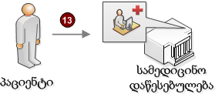

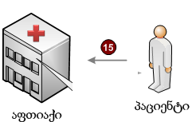






Civil Registry
Database of Insured People
Regulation Database
Classifications
Drug Database
Pharmacy Database
Pharmacy Information Portal
Information Portal for Healthcare Facilities
Information Exchange
E-Health
EMRs
Healthcare Facility
Case Registration Database
Patient
Beneficiary Databases
E-Prescription
Pharmacy
Patient
Reporting Database
Information Exchange
Healthcare Facilities
Insurance Companies
Pharmacies
E-Health Databases
Visiting the information portal, in the pharmacy; identifying patients, pharmacies, prescriptions, dispensing drugs
Doctor’s visit
Identifying patients and staff, filling out EMR, case registration, giving e-prescription
Information exchange/use, analysis

Slide 9





Electronic Medical Records (EMR)
Government-funded Programs
Management and Analysis
(Public health)
System Administration
EMR:
Key demographic data
Diagnosis
Provided care
Drugs
Clinical data
Lab tests
Instrumental examinations
Blood group, allergy, etc.
Citizen
Hospital
Insurance Company
Instrumental Examinations
Drugs
PHC
Lab Tests

Slide 10






Information Portal for Pharmacies and Healthcare Facilities
Information on Healthcare Facilities:
Location
Services
Profile
Resources (beds)
Medical staff
Price
Other…
Information on Pharmacies:
Location
Drugs in the network
Price
other ====
Registry of Healthcare Facilities
Pharmacy Registry
Information Portal for Healthcare Facilities
Pharmacy Information Portal
Patient
E-Prescribing Registry
Insurance companies
MoLHSA
SSA
NCDC

Slide 11






E-Prescription
Healthcare Facility
E-prescribing system
Patient
Pharmacy Information Portal
Pharmacies
Patient
Database of Insurance Companies
Regulation Database
Database of Policy Holders
Civil Registry
Doctor’s visit
See e-prescription
Filling out EMR
Identifying the individual’s status
E-prescription
Identifying insurance status
Drugs in the network
Find the nearest pharmacy
Identifying staff
Visiting the pharmacy/buying drugs
Manageing drug component covered by the insurance policy (limit, co-payment, etc.)

Slide 12

Thank you for attention!

