Slide 1




Health Management Information System (HMIS) Georgia
ehealth.moh.gov.ge
USAID Health System Strengthening Project (USAID HSSP)
January
2014

Slide 2
About USAID HSSP
Who Are We:
USAID funded Health System Strengthening Project Georgia(HSSP)
Our Mission:
Increase access of Georgia citizens to affordable and quality health care services, through strengthening governmental and private sectors
Our Team:
26 employees, including a team of 12 software developers
Major
Product:
Health Management Information System (HMIS)

Slide 3
HSSP HMIS Products:
What is HMIS about?
Enable evidence-based decision making
Privacy and security
Standards-based
Real-time connectivity and monitoring
Financial and medical data
Statistics and analysis
Inform and empower citizens
Ensure standardization and transparency of business processes
Improve efficiency, reduce costs

Slide 4



Major Components of the HMIS
Vital registration
Regulation of Medical Activities
Beneficiary Registration Module
Case Registration Module
E-Reporting Module
Guarantee Administration Module
Accounting and Financial Management
Health Finance and Billing Module
Medical Classifications
Pharmacy Module
Pharmaceutical Products Module
E-Prescribing Module
Information Portal
Regulation of Medical Activities
Regulation of Medical Activities
Immunization Management
Stock and Warehouse Management
Infectious Disease Monitoring and Management Module
Vital Registration Module
Medical Mediation Module
Dashboard
User Management Module

Slide 5
Data Generated by the HMIS
Health System Inputs
Policy & financing decisions
Health System Outputs
Service availability
Service quality
Health Status
Morbidity
Health System Outcomes
Service utilization
Clinical & financial data
Health workforce
Health infrastructure
Mortality
(vital statistics)
Pharmacies/
pharmaceuticals
Coverage and access

Slide 6
Regulation of Medical Activities
1
Central registers of medical professionals and facilities (including pharmacies)
2
Complete histories (licenses, permits, accreditation), including the legal succession
Information on trainings of medical professionals, suspension/revocation of rights to medical activities
3

Slide 7
Beneficiary Registration Module
Prevents duplications of registration by assigning individuals to a single healthcare facility
1
2
Complete registers of beneficiaries of various state-funded programs (dialysis, psychiatric care program, rural doctors’ program)
3
Accurate calculation of payments

Slide 8
Case Registration Module
1
Identification of insurance status and control of limits
2
Dynamic connection with E-Reporting and Finance and Billing Modules
3
Complete case history using the notification system; readmission monitoring
4
Case inspection and analysis, validation of reimbursable cases

Slide 9
Infectious Disease Monitoring and Management Module
1
Complete electronic records of TB patients, including lab tests and treatment regimens
2
Disease and treatment monitoring; notification systems
3
Accurate analysis and statistics

Slide 10
Immunization Management
1
ID-based complete electronic records
2
Monitoring of patient migration
Management of vaccine stock and monitoring of spending
3
4
Reliable statistical and epidemiological analysis and coverage indicators

Slide 11
Stock Management Module
Information on minimum, maximum and safe stocks at different levels, tracking by lot numbers and expiration dates
1
2
Accurate and timely planning and response to replenish stock
3
Centralized management of regional/district warehouses
4
Automated write-off of the vaccines based on utilization; vaccine wastage calculation

Slide 12
Vital Registration Module
1
Centralized database of birth and death cases
2
Tracking of patients treatment history and accurate information on reasons of death
3
Inclusive demographic analysis and proper decision making

Slide 13
E-Reporting Module
1
Standard reporting system for insurance companies and healthcare facilities
2
Accurate payment calculations based on accurate data on services rendered
Optimized administration process -prevents fraud and reduces the administrative waste
3

Slide 14
Health Financing Module
1
Improves efficiency of contracts management with healthcare facilities
2
Real-time data exchange with the State Treasury – direct provision of payments to health service providers
3
Control of payment limits

Slide 15
E-Prescribing Module
1
Centrally stored and accessed patient prescription histories
2
Identification and control of drug benefit limits
3
Population access to their prescription histories
4
Clinical decision support - doctors making informed and evidence-based decisions

Slide 16
Pharmaceutical Products Module
1
Common register of pharmaceuticals permitted in Georgia
2
Electronic connection with the Customs Department of the Revenue Service
3
In future integration of evidence-based pharmacological and clinical data

Slide 17
Medical Mediation Module
1
Centralized management and administration of cases/applications
2
Rapid settlement of medical disputes
3
Comprehensive analysis of disputes/cases taking into consideration their historical changes

Slide 18
Medical Classifications
Constantly updated and easily accessible source of medical classifications (ICD10, NCSP, ICPC2, laboratory classification)
1
2
Unified format for statistical analysis, financial or medical reporting

Slide 19
Dashboard
User-friendly tools for comparing, monitoring and analyzing different indicators and statistics
1
2
Instant display of input data on various graphs, map and time navigator

Slide 20
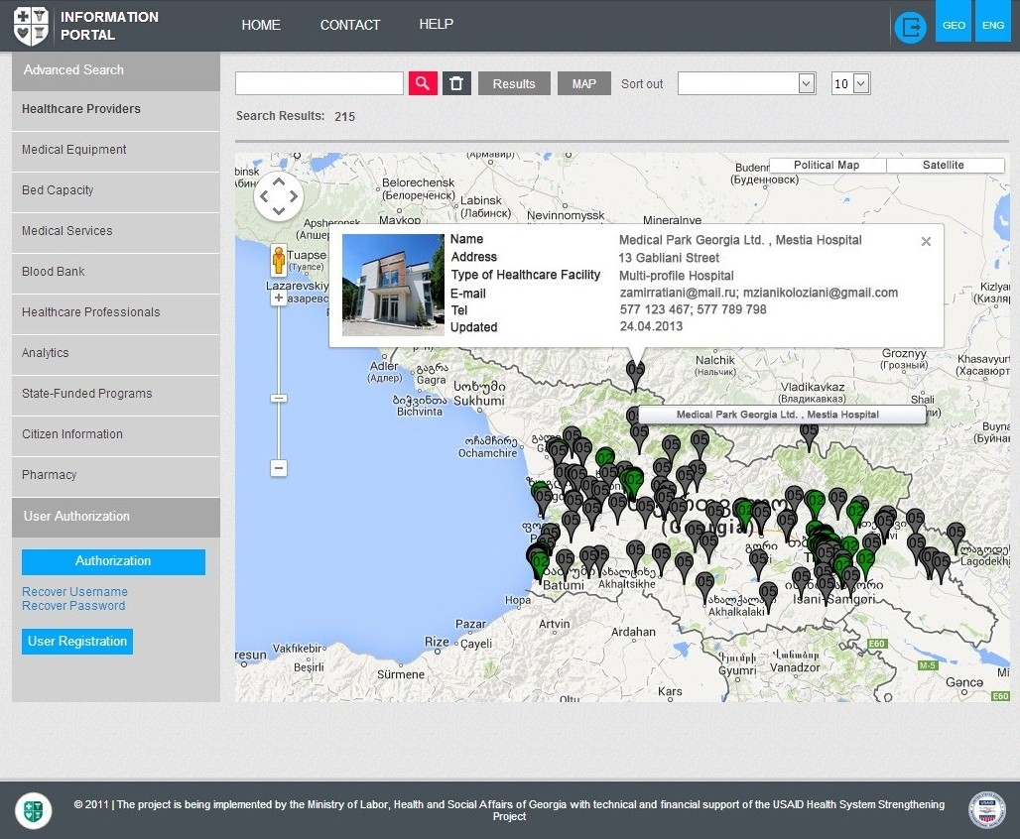
Information Portal
Common database of facilities, medical services, staff and geographic distribution
Personal pages of facilities
Information on medical service & drug prices
Data mapping and improved emergency preparedness
Impact: Empowers patients to make informed decisions about their health; improves country preparedness to emergencies

Slide 21
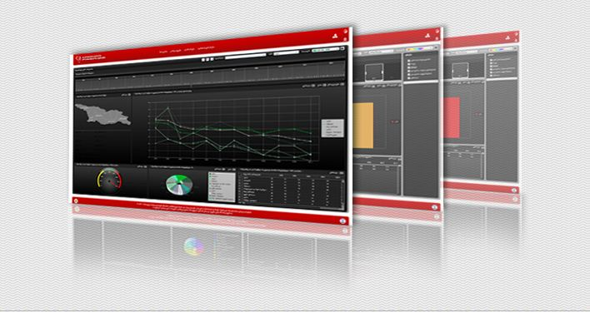
ehealth.moh.gov.ge
Contact information:
Mr. Alexander Turdziladze, COP – aturdziladze@hssp.org.ge / (995) 93 226 226
Ms. Ketevan Tatoshvili, DCOP – ktatoshvili@hssp.org.ge / (995) 77 731 560

