Slide 1


Vision of the Ministry of Labour, Health and Social Affairs
“Healthy Georgia,
Connected to You”

Slide 2
Difficult Times for Healthcare
Providers
Quality of care and
patient safety
Regulatory compliance
(HIPAA)
Reduced reimbursements
Application integration
Staffing issues
Insurance
Pharma
Industry Pains
Patent expiration
Drug development pipeline
Payer pressure
Sales force effectiveness
Cost pressure
Regulatory
compliance
Plan consolidation
Product innovation
Rising costs
Staffing issues
Disconnectedness
Quality

Slide 3

Georgian HMIS Vision
Demonstration of Vision

Slide 4
Geo HMIS
Started 2011
  Three phases
  Four components
Interagency governance
Private sector participation
Utilize lessons learned from around
the world
Developed on international standards

Slide 5
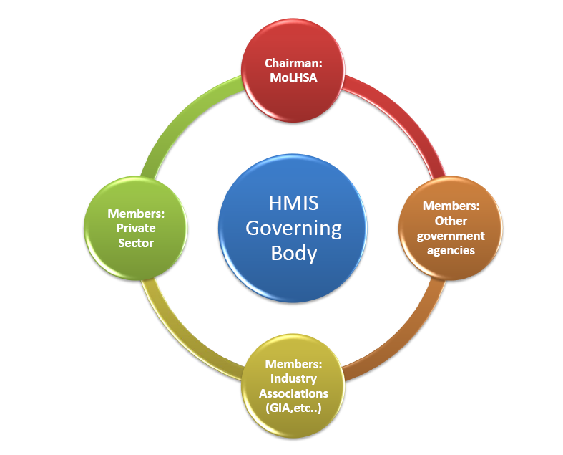
Geo HMIS Governance

Slide 6
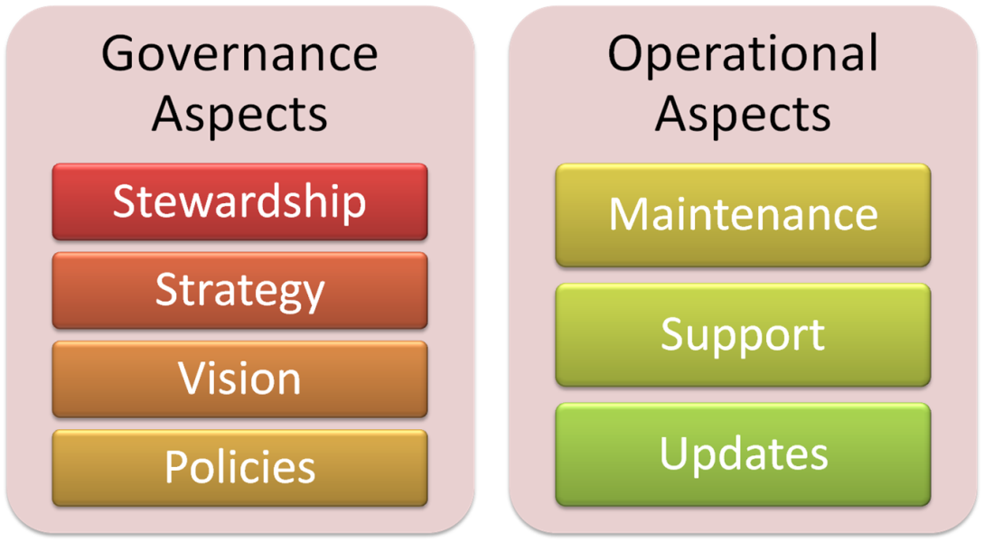
Good Governance
Leads to Efficient Operations

Slide 7

Geo HMIS Main Components:
Parallel Development
Reports
Billing
Geo HMIS
EMR
Prescriptions

Slide 8



Geo HMIS
Public Health Surveillance
EMR Clinical
Patient Data
Eligibility, Financial Billing and Payments
Pharmaceutical Logistic Information
Georgian Healthcare Statistics
Insurance Benefits and Utilization
Approved Drugs
Healthcare Services Pricing including Prosthetics, High Cost single use items
Drug Inventory Tracking

Slide 9
Geo HMIS System Architecture
Presentation Layer
Service
Layer
Data Layer
Conversation workflow
DAO
Relational DB storage
MySQl Oracle SQL Server
Channels
Web services
HTTP, EJB
Queue, Mail
Fax, Printer
Mobile, SMS
Direct call
Stubs
Functional Rule -based Services
AOP Facade
ORM
File storage
Text XML
LDAP storage
Aspect Controller (Security, Tracing, Logs, Workflow, Business Rules, etc)
Infrastructure Components

Slide 10
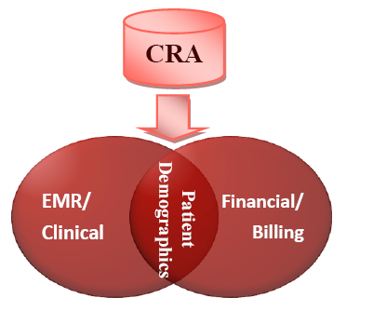
Build on Existing Georgian Information Systems
Civil Registry
Existing billing system
SIMS
Vaccination system
TB/AIDS
DETRA (surveillance)
Notes:
Leverage existing systems

Slide 11
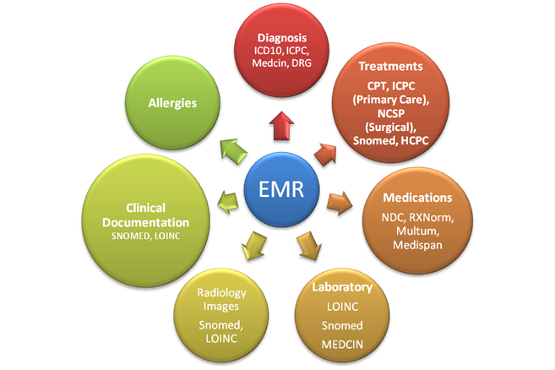
Geo HMIS International Standards and Architecture

Slide 12

Reporting, Analysis and Dashboards

Slide 13
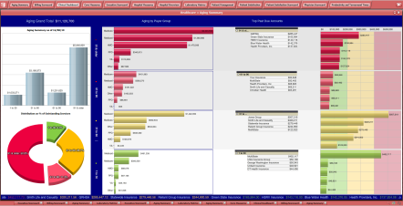
Dashboards
Standards
Reports
Data Exchange Agency
State Agencies
Georgian Healthcare Data Repository
(Clinical, Financial)
Insurance Companies
Pharmacies
Web Services, HL7 Interfaces
Information Systems
Pharmaceutical Companies
Healthcare Providers (Hospitals, Clinics, Physicians)
National EMR
Other Data Sources
National FIS

Slide 14



Geo HMIS Implementation Phases
Providers
Insurance
MoLHSA,
MOF
Reach
CRA
Billing
EMR
Prescriptions
Reports
Capability

Slide 15
Geo HMIS Implementation Phases
1 | 1 | 1 | 3
1 | 2 | 3 | 3
1 | 1 | 3 | 2
1 | 1 | 3 | 3
Providers
Insurance
MoLHSA,
MOF
Reach
CRA
Billing
EMR
Prescriptions
Reports
Capability

Slide 16
In Conclusion
Planning for success
Using best practices from around the world
Three phases – Four components - Parallel development
Opportunity to lead and jump ahead!

