Slide 1
Georgia - IP review
Dr. Lia Jabidze, EPI manager,
11.09.2020

Slide 2
Current situation and government regulations
In Georgia, as of September 11, 2020, there have been
CONFIRMED CORONAVIRUS CASES - 1917
RECOVERED - 1354
FATAL OUTCOME – 19
UNDER HOSPITAL SUPERVISION - 390
UNDER QUARANTINE – 5884
On March 2020 the Parliament of Georgia has approved the declaration of a nationwide State of Emergency aimed to counter the global coronavirus pandemic.
Quarantine measures include:
- the movement of persons by foot or by the any types of transport is prohibited for the period of emergency from a daily curfew from 09:00 pm to 06:00 am
- prohibited all types of meetings, social gatherings, events etc.,
- schools and universities shifted towards online and distance-learning methods
- the main part of institutions and their employees work online
- the state borders are closed

Slide 3
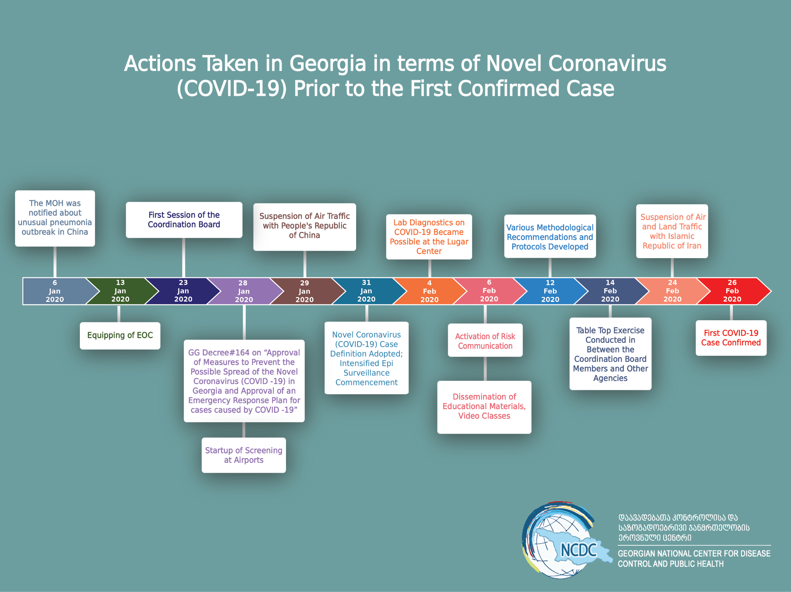

Slide 4
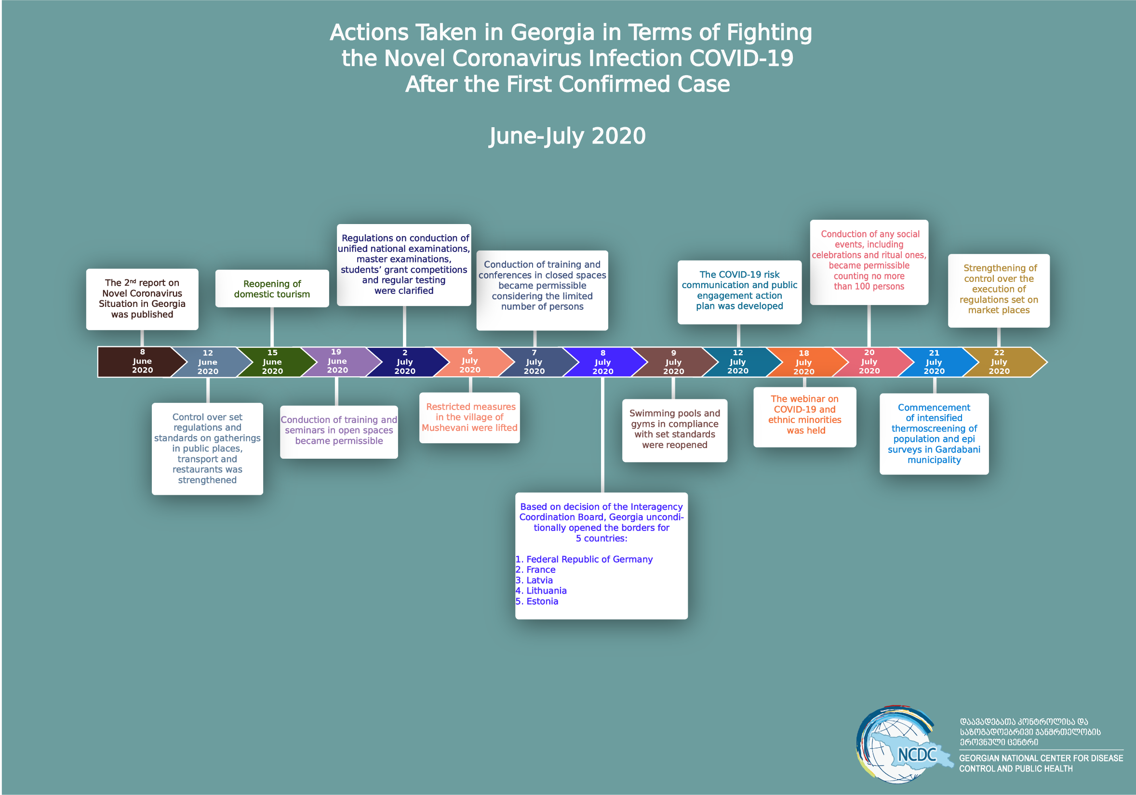

Slide 5
Immunization schedule , 2020
ასაკი / ვაქცინა | 0-12 საათი | 0-5 დღე | 2 თვე | 3 თვე | 4 თვე | 12 თვე | 18 თვე | 5 წელი | 14 წელი
B ჰეპატიტი (ჰეპB /Hep B) | X
ბცჟ (BCG) |  | X
დყ_{ა}ტ+ B ჰეპ +ჰიb+იპვ (ჰექსა/DPaT+HepB+Hib+IPV) |  |  | X | X | X
პნევმო/PCV) |  |  | X |  | X | X
როტა/Rota |  |  | X | X
წითელა, წითურა, ყბაყურა (წწყ/MMR) |  |  |  |  |  | X |  | X
დიფთერია, ყივანახველა, ტეტანუსი, იპვ (დყატპ/DPaT/P)* |  |  |  |  |  |  | X | X
ტეტანუსი-დიფთერია (Td)* |  |  |  |  |  |  |  |  | X
ადამიანის პაპილომავირუსი (აპვ /HPV) | გოგონების ასაკი |  |  | აცრის ჯერადობა |  |  | აცრებს შორის მინიმალური ინტერვალი
 | 10 -11 - 12 წელი |  |  | 2 |  |  | 6 თვე

Slide 6
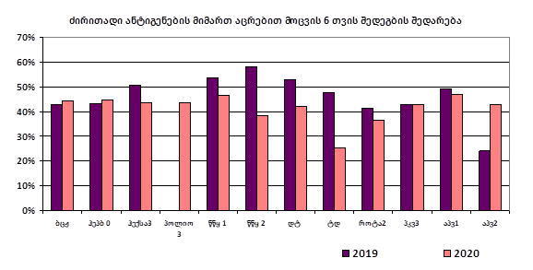
Comparing coverage rates (2019-2020 6 month)

Slide 7
Coverage rates and the forecast

Slide 8
Measures for providing immunization services
Based on the WHO recommendations, the guidance about continuing immunization during the pandemics was prepared approved by the MoH and shared
The physical distance measures and temperature screening are carried out at HF
Guidance how to continue immunization services safely is on place
Health facilities stay open and some of them change working hours
Nevertheless, the coverage rate for all antigens dropped by 7%

Slide 9
Targeted Activities
District and facility level micro plans are in place;
Supportive Supervision Activities (SSA) were conducted in most affected areas
Training course on interpersonal communication is started
Immunization coverage data is analyzed regularly using IMEM and reporting data
Communication activities is carried out
A hotline is in place and the necessary information on vaccination is provided.

Slide 10
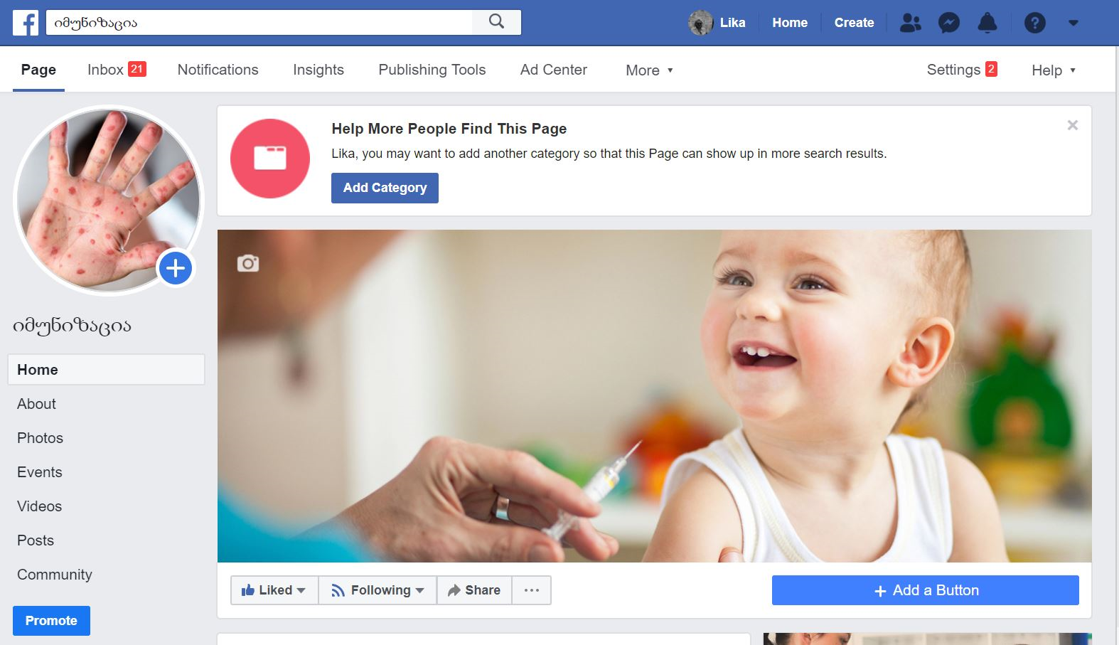

National Center for Disease Control & Public Health
www.ncdc.ge

Slide 11
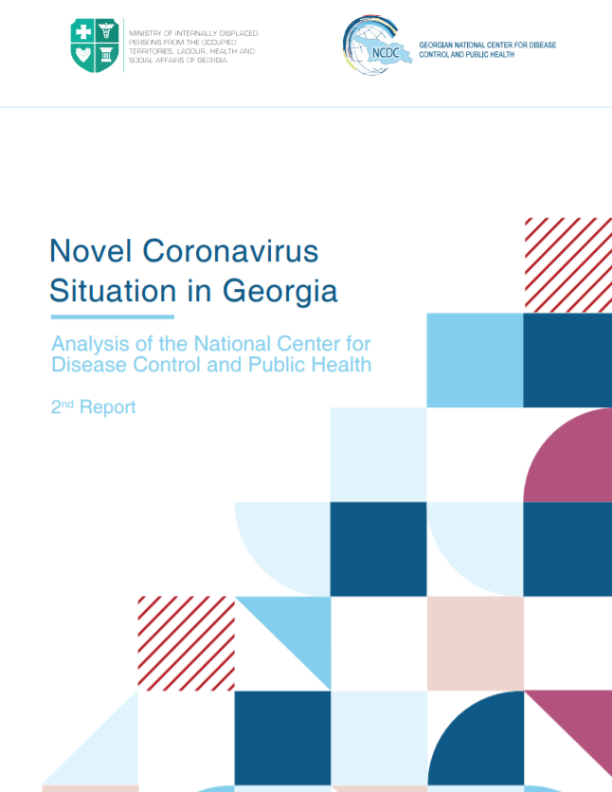
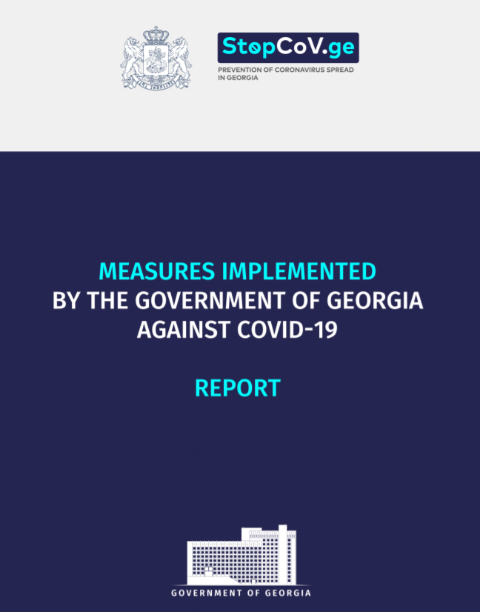
www.stopcov.ge
www.moh.gov.ge
www.ncdc.ge

