Slide 1


Immunizations during the COVID-19
Republic of Moldova

Slide 2
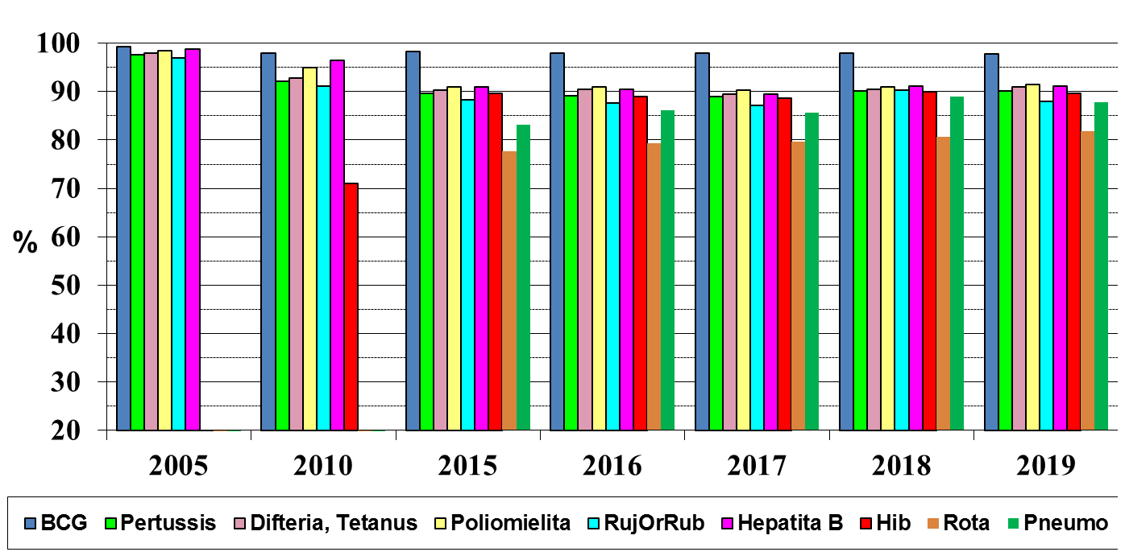
Vaccination coverage of children age 1 year Moldova, 2005; 2010; 2015-2019

Slide 3


Geographical distribution of MMR vaccine coverage at the age of 12 months, 2019

Slide 4
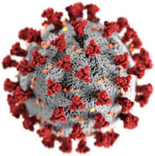
COVID-19

Slide 5
Weekly evolution of new cases and deaths, COVID-19
40.055
Total cases
28.578 (71.3%)
Discharged persons
1.074 (2.7%)
decese
Deaths

Slide 6
Descriptive analysis COVID-19
R (t)
1.03
Incubation period
5 Days
Median Age
46.6 Ani
Urban
67.2%
Females
58.7%
Import
1 % (376 cazuri)
Total (08.03-07.09.2020)
6

Slide 7


Children and pregnant women confirmed COVID-19
2.232 Infected children
309

Slide 8
HCW COVID-19
4.686
Cases of infection among health care workers
Physicians
Nurses
Orderly
Auxiliar
1.239
2.044
844
559

Slide 9
Effective reproduction number depending on the administrative territory,
Reproduction number
Rt = 1.03
Bălți – 1.0
Transnistria – 0.9

Slide 10
Immunization process during COVID-19

Slide 11
Restrictions
In late April immunization process was stoped
Except immunization in maternities and rabies
Were restricted all planned health servicies
Mid of May pllaned health servicies were retaken with strict precautions measures
WHO guidelines was used in ored to allign recomendations

Slide 12
Measures
Mandatory planification by phone
Instruction for vaccination during pandemic
Triage – temperature measurement
Individual protective measures
Only children less than 6 years are except of masks
IN CASE OF ANY SYMPTOMS THE PERSON IS POSTPONED TILL RESOLVES OF THE SYMPTOMS
IF A PERSON HAD COVID-19, IS NOT AN EXCEPTION FOR VACCINATION

Slide 13
EPI ACTIVITIES
Webinars with all HCW performed by EPI team for training of vaccination in COVID-19
Normative and legislative documents
Development of a new NIP for 2021-2025
Assessment of general population perception regarding vaccination during COVID-19
Qualitative study – based on focus group disscusion
10 focus group disscussion
Research on vaccine opinions and perceptions;
Analysis of reasons for refusal of vaccination;
Testing information concepts on promoting immunization.
Implemented a national wide information campaign – mid of August
Plan for COVID-19 implementation

Slide 14

Communication&advocacy campaign
Aggressive campaign
Expirience PR Company & MoH & NAPH & WHO & UNICEF
Development:
Attractive & qualitative & informed based web page https://vaccineaza.md/
Brand new facebook page https://www.facebook.com/vaccineaza.md
8 videographs (Romanian and Russian)
2 videos
1 movie – Road of vaccines
30 infographics
Tons of articles and Radio/TV show
High level advocacy

Slide 15


Web Page
https://vaccineaza.md/
Informed based web page – individual content
Interactive actions – calendar
Description of all vaccine ingredients
Published all vaccine quality certificates which are used in NIP
Preparing documents for approval and being certificated by Vaccine safety net

Slide 16

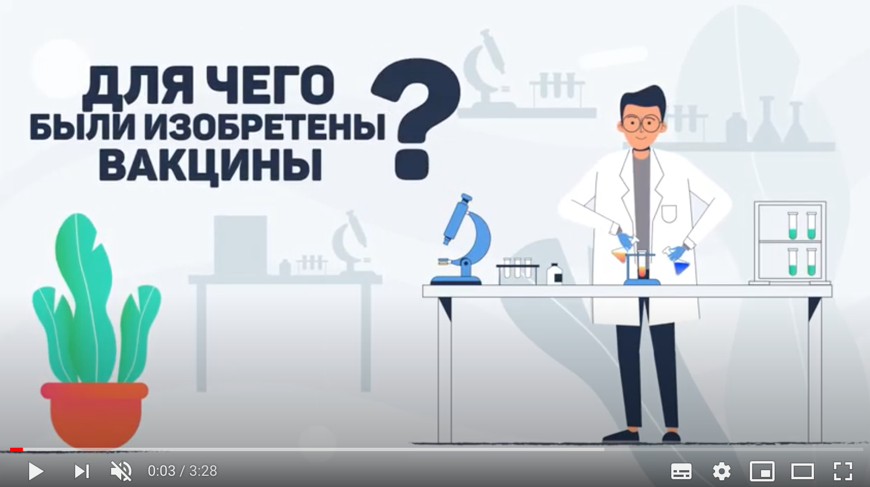


Video
https://www.facebook.com/vaccineaza.md/videos/2687812054772566/

Slide 17
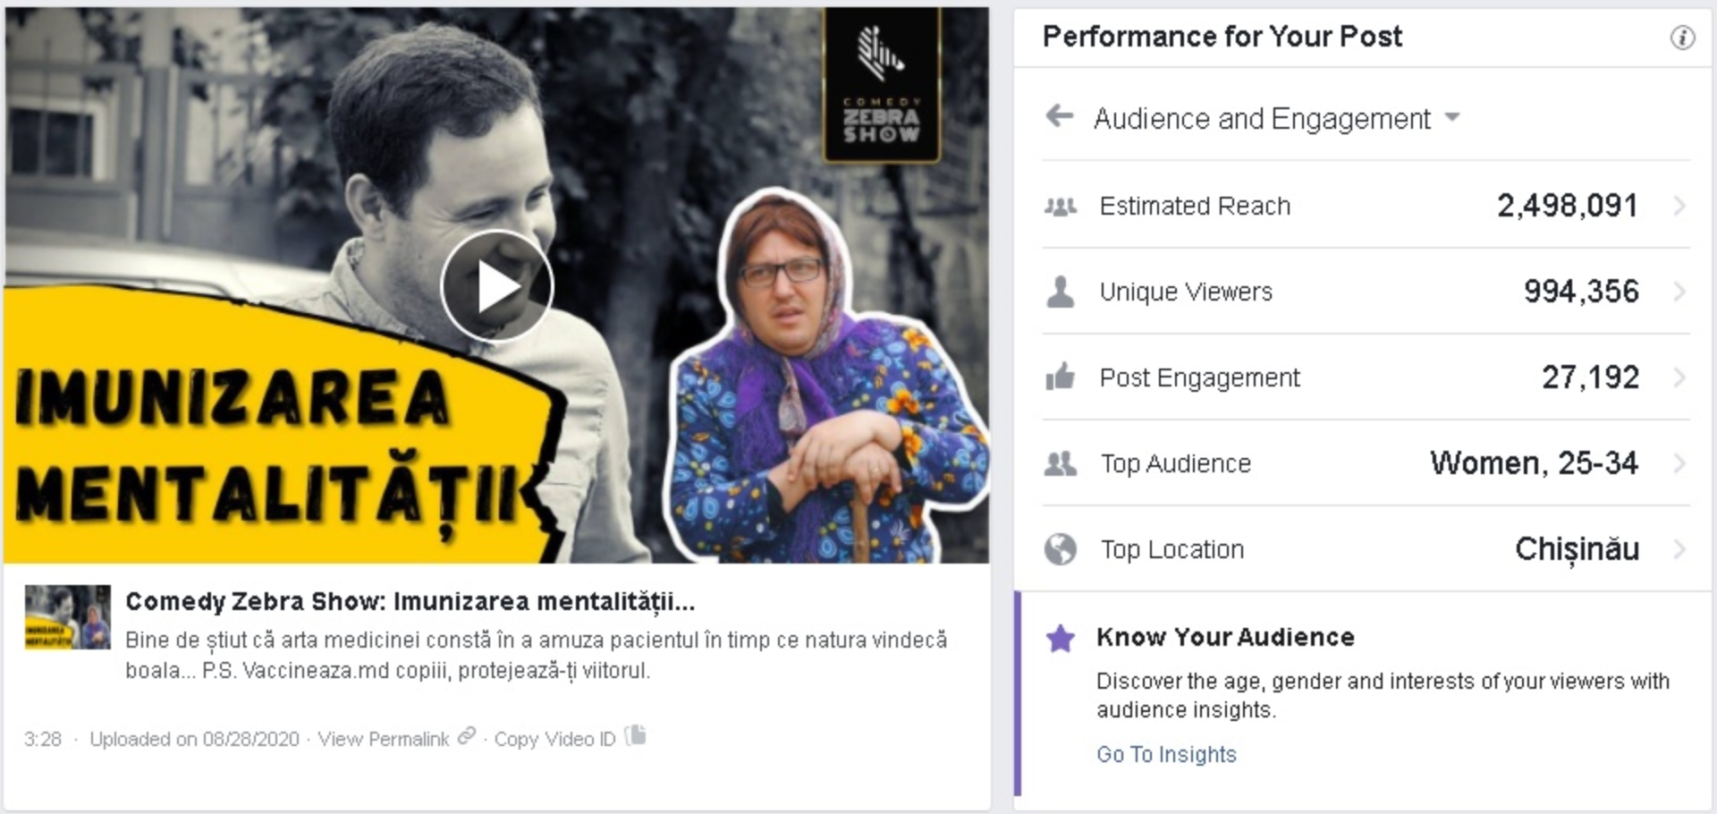
Tv shows

Slide 18
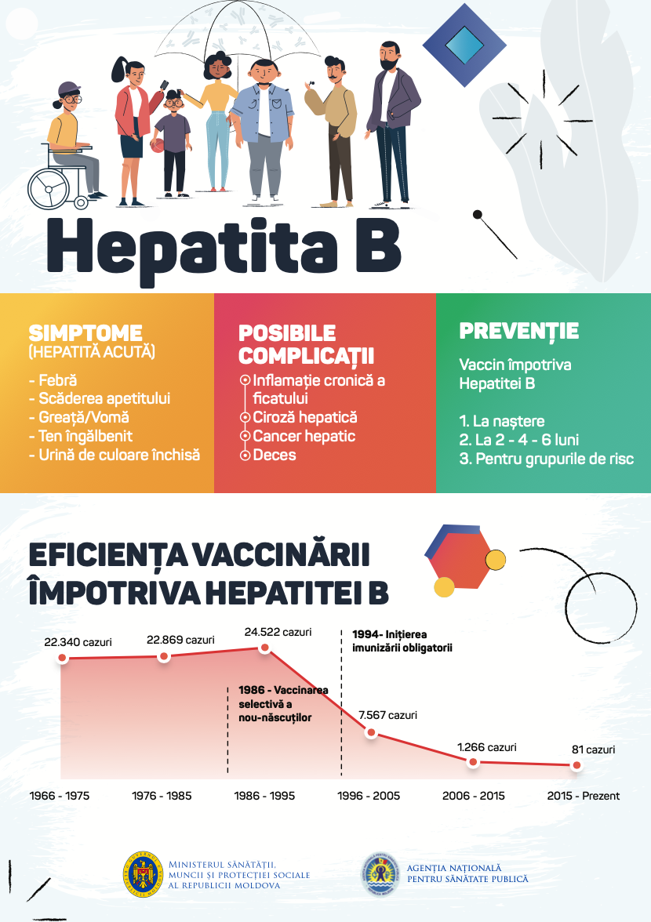
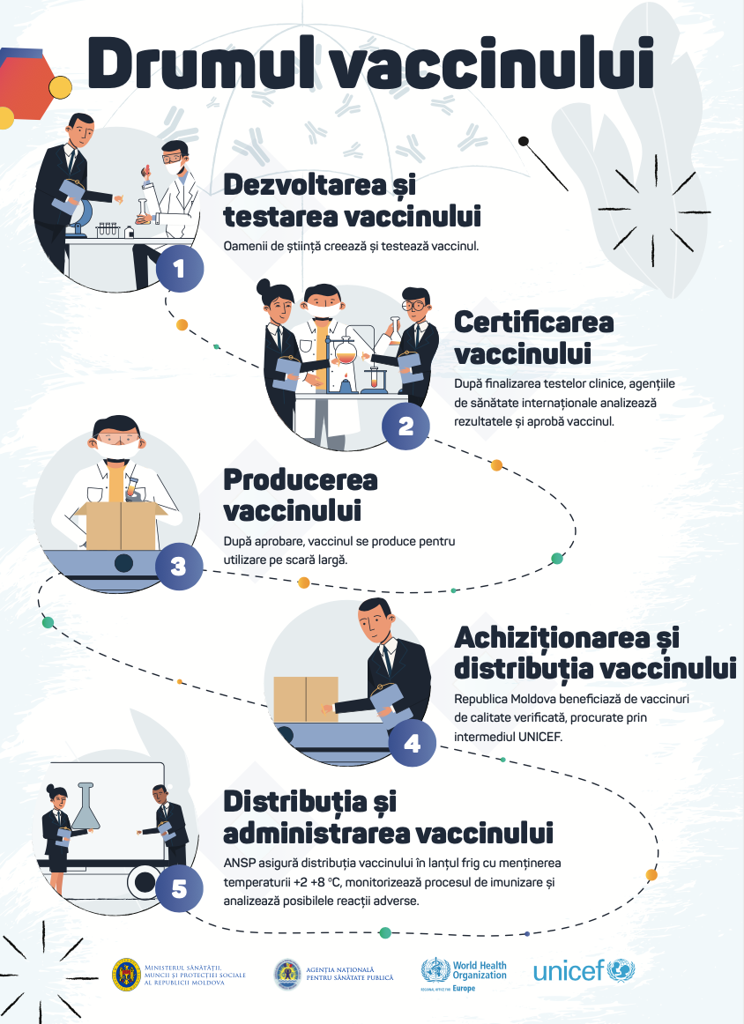
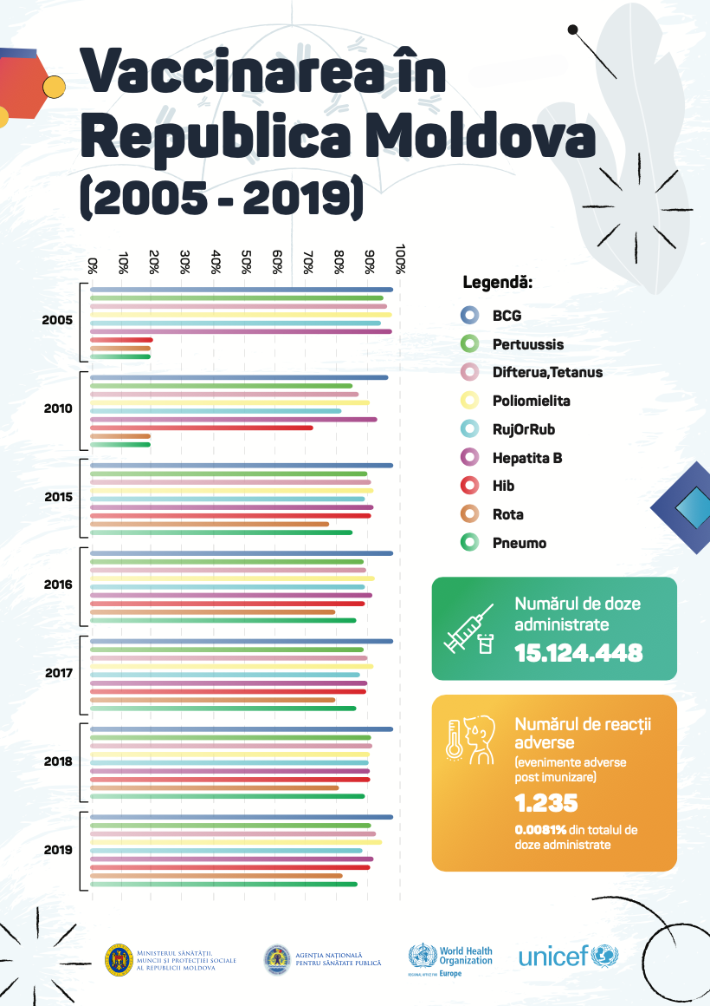
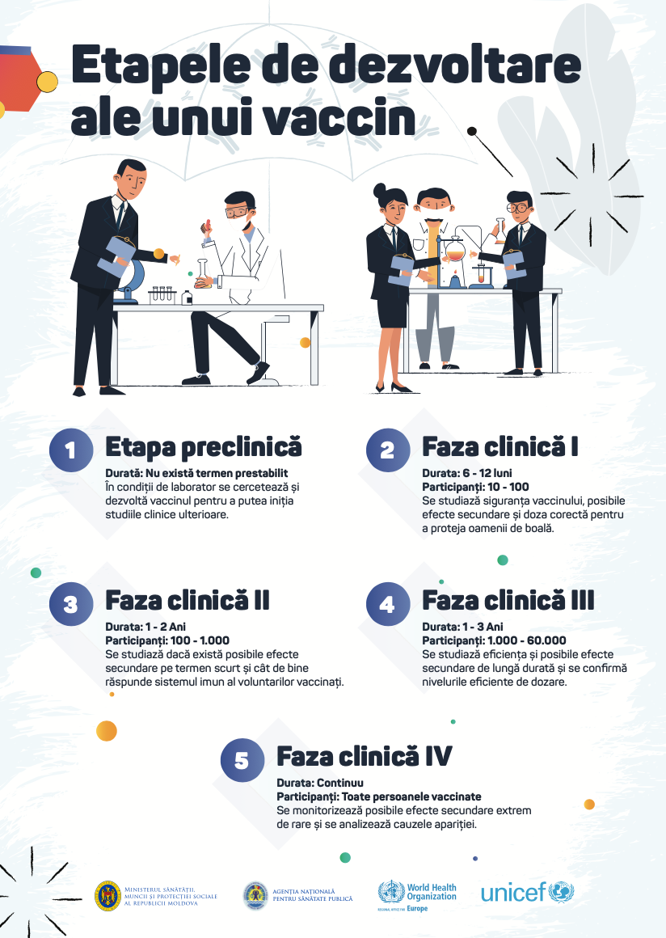
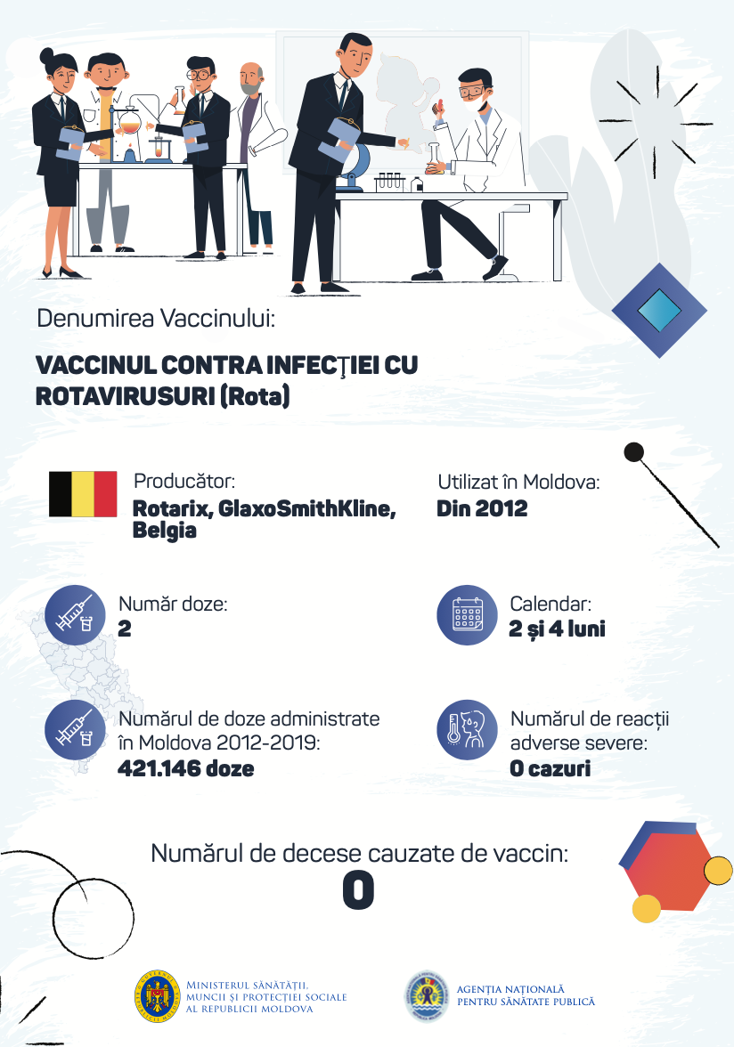
Infographics

Slide 19

Thank you

