Slide 1
COVID-19 in Georgia
Dr Amiran Gamkrelidze, MD, PhD
Director General
NCDC
08.07.2020, Tbilisi

Slide 2
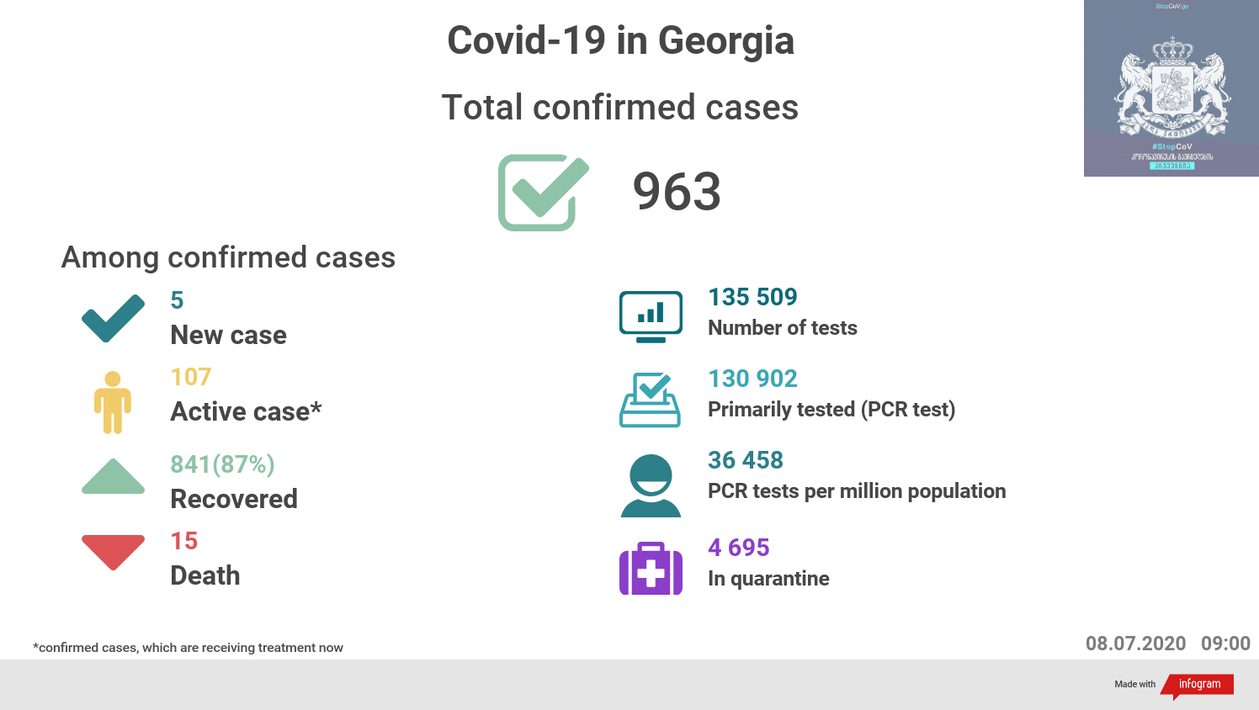

Slide 3
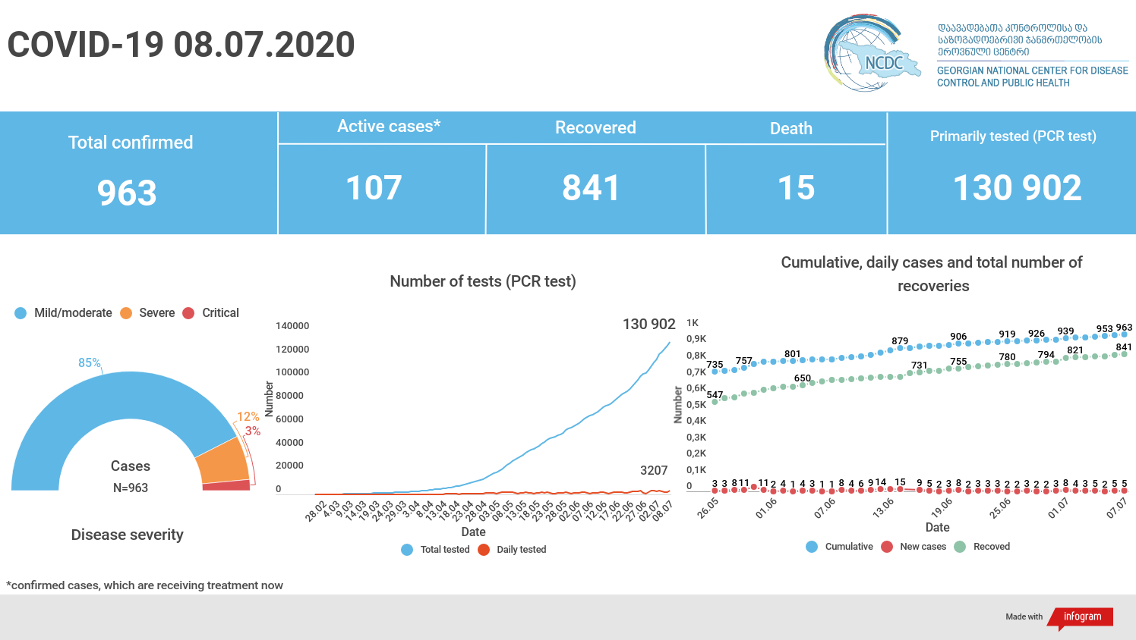

Slide 4

Incidence by countries per 100.000 population
Countries | Incidence per 100.000 population
Georgia | 25.9
Slovakia | 32.3
Greece | 34.4
Hungary | 43.5
Latvia | 60.1
Lithuania | 67.8
Croatia | 79.7
Bulgaria | 87.8
Slovenia | 83.6
Albania | 105.5
Czech Republic | 118.4
Estonia | 150.3
Romania | 153.9
Bosnia and Herzegovina | 171.4
Serbia | 191.3
Azerbaijan | 210.7
Turkey | 246.5
Macedonia | 347.7
Russia | 475.7
Belarus | 677.3
Armenia | 988.2
Incidence of last two weeks 100.000 population | Countries
0.6 | Latvia
0.8 | Hungary
0.9 | Estonia
1.2 | Georgia
1.8 | Lithuania
2.2 | Greece
3.2 | Slovakia
8.7 | Slovenia
18.6 | Czechia
19.8 | Croatia
20 | Turkey
25.2 | Bulgaria
31.2 | Albania
35.9 | Serbia
43 | Bosnia and Herzegovina
47.9 | Belarus
56.35 | Russia
70.18 | Azerbaijan
88.7 | Macedonia
151 | Romania
270.5 | Armenia
National Center for Disease Control & Public Health
www.ncdc.ge

Slide 5
EU countries incidence per 100.000 population
Countries | Incidence per 100.000 population
Georgia | 25.6
Slovakia | 32.3
Greece | 34.4
Hungary | 43.5
Latvia | 60.1
Lithuania | 67.8
Croatia | 79.7
Slovenia | 83.6
Bulgaria | 87.8
Poland | 95.5
Czech | 116.9
Finland | 131
Estonia | 150
Romania | 150.6
Malta | 152.2
Austria | 203.9
Denmark | 221.5
Germany | 235.9
France | 255.8
Netherlands | 295.4
Italy | 399
Portugal | 432.8
Ireland | 516.9
Belgium | 535.1
Spain | 636.6
Sweden | 701.1
Luxemburg | 722.3
Incidence of last two weeks 100.000 population | Countries
0.6 | Latvia
0.8 | Hungary
0.9 | Estonia
1.2 | Gerogia
1.5 | Malta
1.8 | Lithuania
1.96 | Finland
2.2 | Greece
2.9 | Ireland
3.2 | Slovakia
4.1 | Italy
5.2 | Denmark
5.6 | Netherlands
6.4 | Germnay
8.6 | Spain
8.7 | Slovenia
9.5 | France
9.8 | Poland
10 | Austria
11.7 | Belgium
18.6 | Czech
19.8 | Croatia
25.2 | Bulgaria
44.1 | Portugal
64 | Luxemburg
103 | Sweden
151 | Romania
National Center for Disease Control & Public Health
www.ncdc.ge

Slide 6
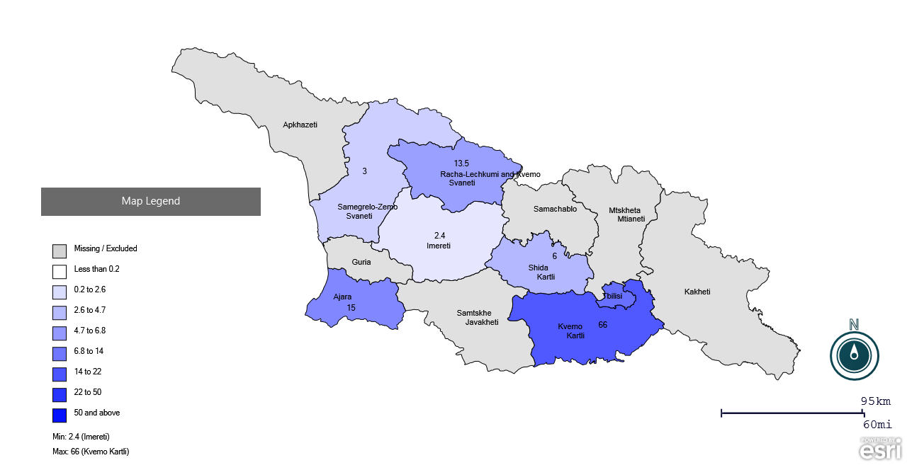
COVID - 19 confirmed cases per 100,000 of population by the place of exposure (n = 800)
National Center for Disease Control & Public Health
www.ncdc.ge

Slide 7
COVID-19 Confirmed vs Recovered on a Daily Basis, 07/07/2020

Slide 8
COVID-19 Confirmed Cases in Georgia, 08/07/2020
Total Quarantine
Lockdown of Bolnisi & Marneuli
State of Emergency Declared
Suspension of Educational process
De-escalation 27/04

Slide 9
No of PCR tests in Georgia, 07/07/2020

Slide 10
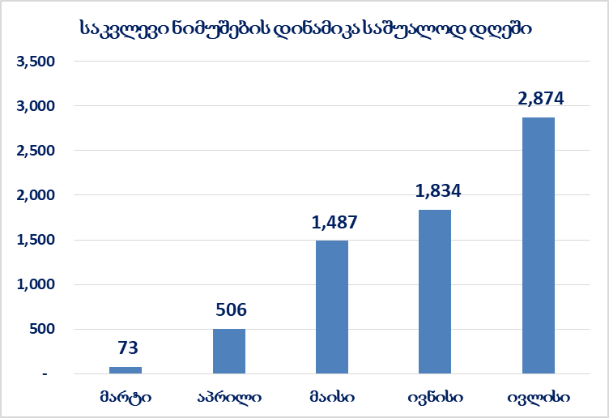
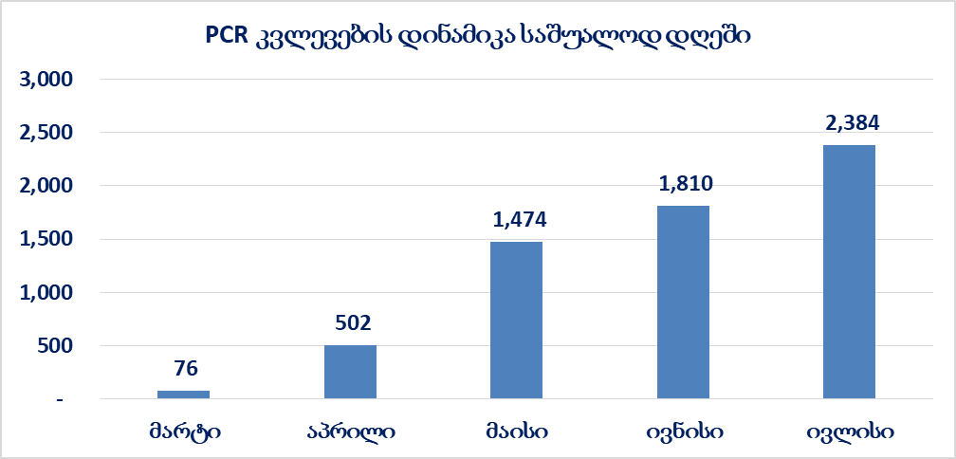
Dynamics of Testing Samples Per Day
Dynamics of PCR Testing Per Day

Slide 11
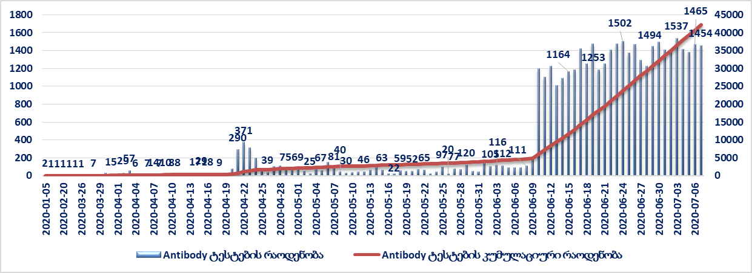
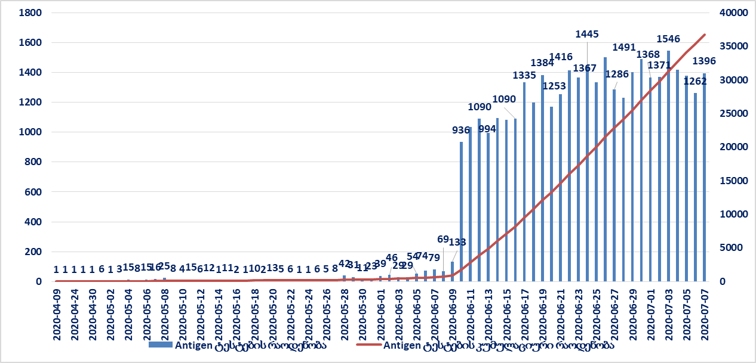
Number of Antibody-based Tests
Number of Antigen-based Tests

Slide 12
EU Countries and Georgia PCR
Country | Total test | Tests 1M pop
Malta | 104,434 | 236,511
Denmark | 1,145,221 | 197,708
Lithuania | 443,391 | 162,927
United Kingdom | 10,651,308 | 156,889
Portugal | 1,205,593 | 118,240
Spain | 5,448,984 | 116,543
Belgium | 1,284,605 | 110,834
Ireland | 467,852 | 94,738
Italy | 5,660,454 | 93,623
Latvia | 158,518 | 84,061
Estonia | 109,338 | 82,423
Switzerland | 636,397 | 73,526
Austria | 654,105 | 72,621
Germany | 5,873,563 | 70,100
Czech Republic | 573,446 | 53,547
Slovenia | 107,736 | 51,822
Sweden | 519,113 | 51,397
Finland | 255,500 | 46,112
Poland | 1,655,664 | 43,747
Romania | 771,482 | 40,108
Slovakia | 218,396 | 40,002
Netherlands | 616,376 | 35,971
Georgia | 132,080 | 35,535
Greece | 340,328 | 32,654
Hungary | 286,083 | 29,615
Bulgaria | 153,576 | 22,106
France | 1,384,633 | 21,212
Croatia | 85,997 | 20,950
National Center for Disease Control & Public Health
www.ncdc.ge

Slide 13
EU Countries and Georgia PCR + Rapid tests
Country | Total test | Tests 1M pop
Malta | 104,434 | 236,511
Denmark | 1,145,221 | 197,708
Lithuania | 443,391 | 162,927
United Kingdom | 10,651,308 | 156,889
Portugal | 1,205,593 | 118,240
Spain | 5,448,984 | 116,543
Belgium | 1,284,605 | 110,834
Ireland | 467,852 | 94,738
Italy | 5,660,454 | 93,623
Italy | 158,518 | 84,061
Latvia | 109,338 | 82,423
Estonia | 636,397 | 73,526
Switzerland | 654,105 | 72,621
Germany | 5,873,563 | 70,100
Georgia | 200,00 | 53,808
Czech Republic | 573,446 | 53,547
Slovenia | 107,736 | 51,822
Sweden | 519,113 | 51,397
Finland | 255,500 | 46,112
Poland | 1,655,664 | 43,747
Romania | 771,482 | 40,108
Slovakia | 218,396 | 40,002
Netherlands | 616,376 | 35,971
Greece | 340,328 | 32,654
Hungary | 286,083 | 29,615
Bulgaria | 153,576 | 22,106
France | 1,384,633 | 21,212
Greece | 85,997 | 20,950
National Center for Disease Control & Public Health
www.ncdc.ge

Slide 14
EU Countries and Georgia PCR
Country | Total Tests | Tests Per 1, 000, 000 population
Malta | 104,434 | 236,511
Denmark | 1,145,221 | 197,708
Lithuania | 443,391 | 162,927
Great Britain | 10,651,308 | 156,889
Portugal | 1,205,593 | 118,240
Spain | 5,448,984 | 116,543
Belgium | 1,284,605 | 110,834
Ireland | 467,852 | 94,738
Italy | 5,660,454 | 93,623
Latvia | 158,518 | 84,061
Estonia | 109,338 | 82,423
Switzerland | 636,397 | 73,526
Austria | 654,105 | 72,621
Germany | 5,873,563 | 70,100
Czech Republic | 573,446 | 53,547
Slovenia | 107,736 | 51,822
Sweden | 519,113 | 51,397
Finland | 255,500 | 46,112
Poland | 1,655,664 | 43,747
Romania | 771,482 | 40,108
Slovakia | 218,396 | 40,002
Netherlands | 616,376 | 35,971
Georgia | 132,080 | 35,535
Greece | 340,328 | 32,654
Hungary | 286,083 | 29,615
Bulgaria | 153,576 | 22,106
France | 1,384,633 | 21,212
Croatia | 85,997 | 20,950
National Center for Disease Control & Public Health
www.ncdc.ge

Slide 15
Tests Per confirmed Cases (Georgia PCR)
Country | Total confirmed cases | Total Tests | Test per Case
US | 3,009,121 | 37,810,612 | 12.57
Brazil | 1,613,351 | 3,330,562 | 2.06
India | 720,346 | 9,969,662 | 13.84
Russia | 687,862 | 21,335,394 | 31.02
Peru | 302,718 | 1,782,846 | 5.89
Chile | 298,557 | 1,198,261 | 4.01
Spain | 297,625 | 5,448,984 | 18.31
United Kingdom | 285,768 | 10,651,308 | 37.27
Mexico | 256,848 | 641,142 | 2.50
Iran | 243,051 | 1,820,000 | 7.49
Italy | 241,819 | 5,660,454 | 23.41
Pakistan | 231,818 | 1,420,623 | 6.13
Saudi Arabia | 213,716 | 1,934,391 | 9.05
Turkey | 206,844 | 3,682,673 | 17.80
Germany | 197,979 | 5,873,563 | 29.67
South Africa | 196,750 | 1,830,161 | 9.30
France | 166,960 | 1,384,633 | 8.29
Bangladesh | 165,618 | 863,307 | 5.21
Columbia | 117,110 | 860,731 | 7.35
Canada | 105,764 | 2,940,925 | 27.81
Qatar | 100,345 | 386,111 | 3.85
China | 83,557 | 90,410,000 | 1082.02
Georgia | 963 | 135,509 | 140
National Center for Disease Control & Public Health
www.ncdc.ge

Slide 16
Tests Per confirmed Cases(Georgia PCR+Rapid Test )
Country | Total confirmed cases | Total Tests | Test per Case
US | 3,009,121 | 37,810,612 | 12.57
Brazil | 1,613,351 | 3,330,562 | 2.06
India | 720,346 | 9,969,662 | 13.84
Russia | 687,862 | 21,335,394 | 31.02
Peru | 302,718 | 1,782,846 | 5.89
Chile | 298,557 | 1,198,261 | 4.01
Spain | 297,625 | 5,448,984 | 18.31
United Kingdom | 285,768 | 10,651,308 | 37.27
Mexico | 256,848 | 641,142 | 2.50
Iran | 243,051 | 1,820,000 | 7.49
Italy | 241,819 | 5,660,454 | 23.41
Pakistan | 231,818 | 1,420,623 | 6.13
Saudi Arabia | 213,716 | 1,934,391 | 9.05
Turkey | 206,844 | 3,682,673 | 17.80
Germany | 197,979 | 5,873,563 | 29.67
South Africa | 196,750 | 1,830,161 | 9.30
France | 166,960 | 1,384,633 | 8.29
Bangladesh | 165,618 | 863,307 | 5.21
Columbia | 117,110 | 860,731 | 7.35
Canada | 105,764 | 2,940,925 | 27.81
Qatar | 100,345 | 386,111 | 3.85
China | 83,557 | 90,410,000 | 1082.02
Georgia | 963 | 215,529 | 223
National Center for Disease Control & Public Health
www.ncdc.ge

Slide 17
Neighbor and Partner Countries (Georgia PCR)
Country | Total Tests | Tests Per Million Population
Israel | 1,107,070 | 120,365
Belarus | 1,074,240 | 113,685
Kazakhstan | 1,620,252 | 86,280
Azerbaijan | 522,773 | 51,554
Armenia | 123,815 | 41,782
Kyrgyzstan | 236,893 | 36,305
Georgia | 132,080 | 35,535
Uzbekistan | 1,121,236 | 33,496
Moldova | 101,180 | 25,083
Ukraine | 722,513 | 16,523
National Center for Disease Control & Public Health
www.ncdc.ge

Slide 18
Neighbor and Partner Countries (Georgia PCR+ rapid tests)
Country | Total Tests | Tests Per 1, 000, 000 population
Israel | 1,107,070 | 120,365
Belarus | 1,074,240 | 113,685
Kazakhstan | 1,620,252 | 86,280
Georgia | 200,00 | 53,808
Azerbaijan | 522,773 | 51,554
Armenia | 123,815 | 41,782
Kyrgyzstan | 236,893 | 36,305
Uzbekistan | 1,121,236 | 33,496
Moldova | 101,180 | 25,083
Ukraine | 722,513 | 16,523
National Center for Disease Control & Public Health
www.ncdc.ge

Slide 19
Tests Per confirmed Cases (Georgia PCR)
Country | Total confirmed cases | Total Tests | Test per Case
US | 3,009,121 | 37,810,612 | 12.57
Brazil | 1,613,351 | 3,330,562 | 2.06
India | 720,346 | 9,969,662 | 13.84
Russia | 687,862 | 21,335,394 | 31.02
Peru | 302,718 | 1,782,846 | 5.89
Chile | 298,557 | 1,198,261 | 4.01
Spain | 297,625 | 5,448,984 | 18.31
United Kingdom | 285,768 | 10,651,308 | 37.27
Mexico | 256,848 | 641,142 | 2.50
Iran | 243,051 | 1,820,000 | 7.49
Italy | 241,819 | 5,660,454 | 23.41
Pakistan | 231,818 | 1,420,623 | 6.13
Saudi Arabia | 213,716 | 1,934,391 | 9.05
Turkey | 206,844 | 3,682,673 | 17.80
Germany | 197,979 | 5,873,563 | 29.67
South Africa | 196,750 | 1,830,161 | 9.30
France | 166,960 | 1,384,633 | 8.29
Bangladesh | 165,618 | 863,307 | 5.21
Columbia | 117,110 | 860,731 | 7.35
Canada | 105,764 | 2,940,925 | 27.81
Qatar | 100,345 | 386,111 | 3.85
China | 83,557 | 90,410,000 | 1082.02
Georgia | 963 | 135,509 | 140
National Center for Disease Control & Public Health
www.ncdc.ge

Slide 20
Tests Per confirmed Cases(Georgia PCR+Rapid Test )
Country | Total confirmed cases | Total Tests | Test per Case
US | 3,009,121 | 37,810,612 | 12.57
Brazil | 1,613,351 | 3,330,562 | 2.06
India | 720,346 | 9,969,662 | 13.84
Russia | 687,862 | 21,335,394 | 31.02
Peru | 302,718 | 1,782,846 | 5.89
Chile | 298,557 | 1,198,261 | 4.01
Spain | 297,625 | 5,448,984 | 18.31
United Kingdom | 285,768 | 10,651,308 | 37.27
Mexico | 256,848 | 641,142 | 2.50
Iran | 243,051 | 1,820,000 | 7.49
Italy | 241,819 | 5,660,454 | 23.41
Pakistan | 231,818 | 1,420,623 | 6.13
Saudi Arabia | 213,716 | 1,934,391 | 9.05
Turkey | 206,844 | 3,682,673 | 17.80
Germany | 197,979 | 5,873,563 | 29.67
South Africa | 196,750 | 1,830,161 | 9.30
France | 166,960 | 1,384,633 | 8.29
Bangladesh | 165,618 | 863,307 | 5.21
Columbia | 117,110 | 860,731 | 7.35
Canada | 105,764 | 2,940,925 | 27.81
Qatar | 100,345 | 386,111 | 3.85
China | 83,557 | 90,410,000 | 1082.02
Georgia | 963 | 215,529 | 223
National Center for Disease Control & Public Health
www.ncdc.ge

Slide 21
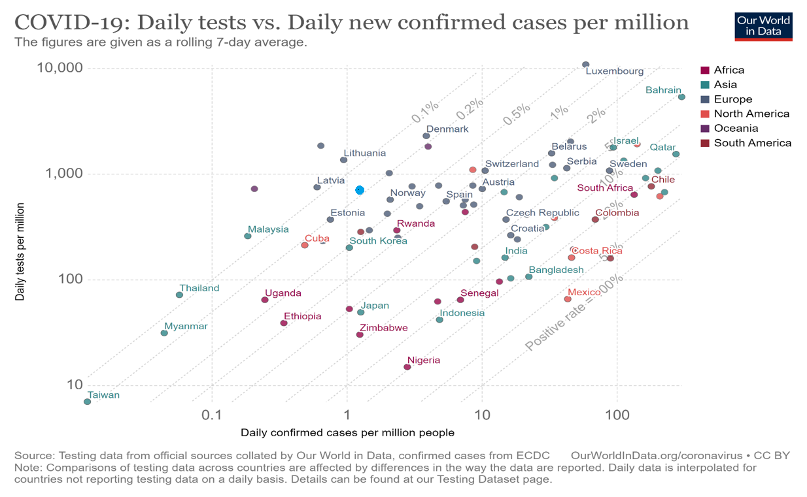
Daily Testing vs Testing per 1, 000, 000 Population
Georgia
National Center for Disease Control & Public Health
www.ncdc.ge

Slide 22
Lab Capacity
Region | PCR Labs/ Quantity | Daily Resources – full overload
Total |  | 6100
Imereti | 3 Labs NCDC Imereti Division State Laboratory of the Ministry of Agriculture (Kutaisi) „Miksta“ Ltd. | 750 300 150 300
Adjara | 3 Labs NCDC Adjara Division Salikh Abashidze Regional Center for Infectious Pathology, AIDS and TB ltd. Tamarisi Family Medicine Center | 750 500 150 100
Samgrelo – Zemo Svaneti | 1 Lab Zugdidi Infectious Disease Hospital ltd. Molecular – Diagnostic Lab ltd. | 300
Rach-Lechkhumi and Kvemo Svaneti | No
Guria | 1 Lab Biomedika – Georgia ltd. | 100
Samtskhe-Javakheti | 1 Lab State Laboratory of the Ministry of Agriculture (Akhaltsikhe) | 100
Mtskheta - Mtianeti | No
National Center for Disease Control & Public Health
www.ncdc.ge

Slide 23
Lab Capacity (Continued)
Region | PCR Labs/ Quantity | დღიური რესურსი -სრული დატვირთვით
Shida Kartli | 1 Lab Giorgi Abramishvili Military Hospital Laboratory under the Ministry of Defense | 100
Kvemo Kartli (Rustavi) | 1 Lab “Oncology Scientific Research Center“ | 500
Kakheti | No
Tbilisi | 15 Labs NCDC / R. Lugar Center Aversi Clinic Ltd. Molecular-Diagnostic Center Ltd. "Megalab“ JSC Neolab Clinic First University Clinic of the Medical University “New Hospitals” Ltd. “Med-Diagnostics” Ltd. Medical Center “Cito" JSC. Viral and Molecular Medicine Laboratory of the Infectious Pathology, AIDS and Clinical Immunology Center Genetics National Laboratory Ltd. State Laboratory of the Ministry of Agriculture (Tbilisi) JSC. Tuberculosis and Pulmonary Disease National Center St. Michael Archangel Clinic WRAIR | 3500 1000 300 200 300 50 200 300 300 500 100 50 100 100
National Center for Disease Control & Public Health
www.ncdc.ge

Slide 24
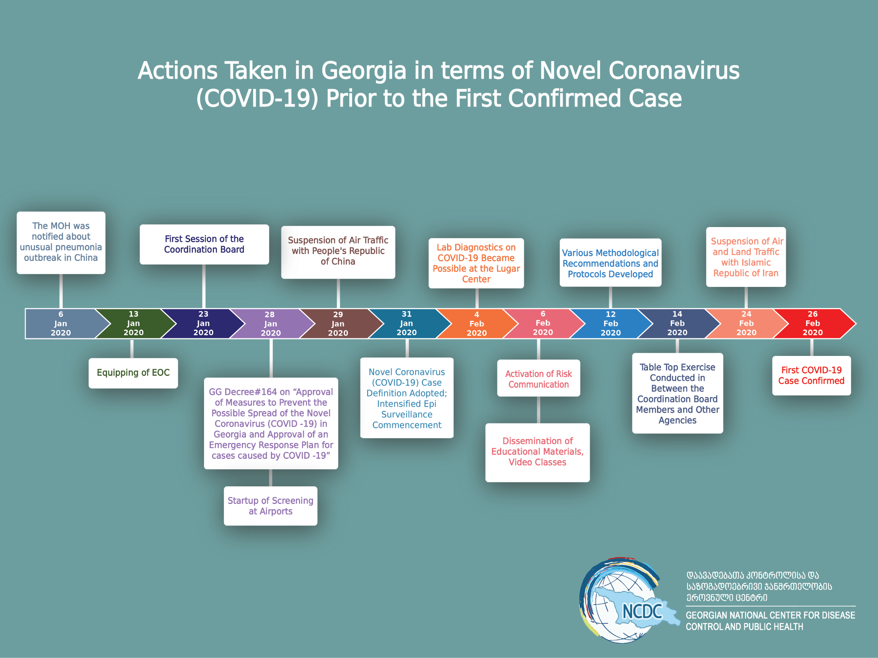

Slide 25
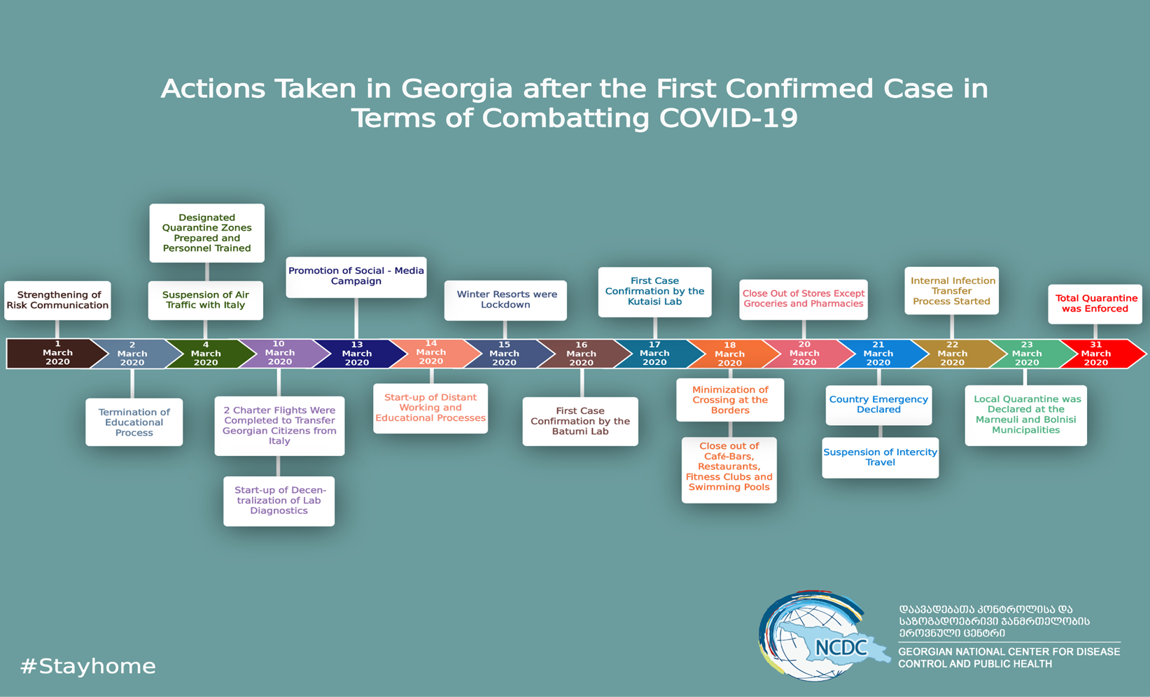

Slide 26
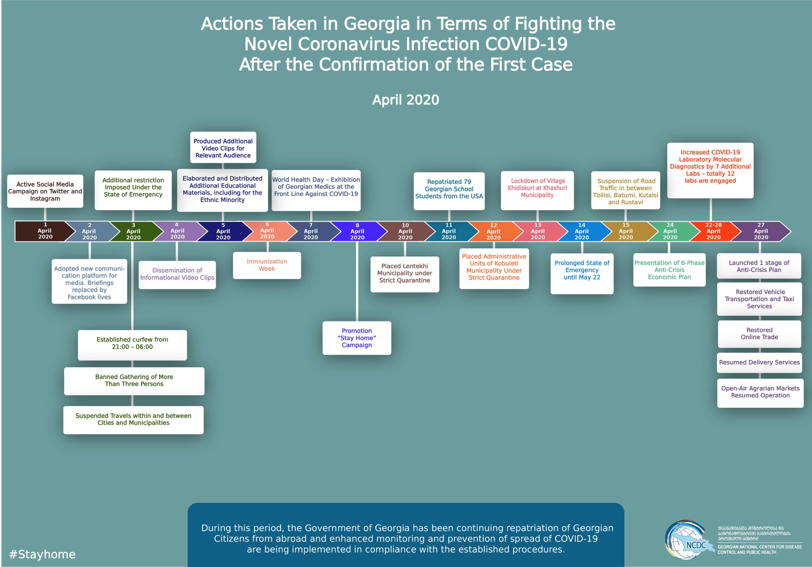

Slide 27
