Slide 1

IT Support for DECENTRALIZATION
Ekaterine Adamia
Head of Health Care Programs Division
March 2018

Slide 2
E-HCV
Screening-providers
Screening Database
HCV-providers
Screening Results
Confirmatory Test Results
Hospitals
Labs
ELIMC Database
NCDC/Reg.Labs
Screening Results
Confirmatory Test Results
Treatment monitoring
Drug Management
SSA
Harm Reduction sites
E Health Financing System
Lugar center
Case Registration
Reporting Module
Billing Module

Slide 3
Patient Pathway
Anti-HCV Screening
Pre-Rx diagnostics HCV Genotyping
12-Weeks SVR
HCV RNA
4 Week HCV RNA
Biochemistry/
Hematology tests
HCV RNA or HCV Core Ag Detection
Screening
Preparation for Treatment
Treatment Monitoring
Outcome
Confirmation of Active Infection
preregistration
Registration/
Committee

Slide 4
Diagnostic before treatment
(standard case)
Anti HCV +
CONFIRMATORY TEST
HCV RNA +
Physician consultation
Alt, Ast, Cbc (FIB4)
HCV GEN, HBsAg, HB Core total, G-GT , ALP, BIL, CR, GL, ALB, INR, TSH (If Interferon) Ultrasound
Physician consultation, Form NIV-100/a
FIB4 - 1.45−3.25
Fibroscan

Slide 5
Treatment monitoring
(12 week regimens – schedule)
Procedures | 2 | 4 | 6 | 8 | 10 | 12 | Follow Up
Drug Control | X | X | X | X | X | X
Physicians Consultation |  | X |  | X |  | X | X
HCV RNA PCR |  | X |  |  |  |  | X
CBC |  | X |  | X* |  | X
ALT |  | X |  | X |  | X
Creatinine |  |  |  |  |  | X
Bil (tot., dir.) |  |  |  |  |  | X
* RBV containing regimens only

Slide 6
Treatment monitoring
(24 week regimens – schedule)
Procedures | 2 | 4 | 6 | 8 | 10 | 12 | 14 | 16 | 18 | 20 | 22 | 24 | Follow Up
Drug Control | X | X | X | X | X | X | X | X | X | X | X | X
Physicians Consultation |  | X |  | X |  | X |  |  |  |  |  | X | X
HCV RNA PCR |  | X |  |  |  |  |  |  |  |  |  |  | X
CBC |  | X |  | X* |  | X |  |  |  |  |  | X
ALT |  | X |  | X |  | X |  | X** |  | X** |  | X
Creatinine |  |  |  |  |  | X |  | X* |  | X* |  | X
Bil (tot., dir.) |  |  |  |  |  | X |  |  |  |  |  | X
* RBV containing regimens only
** RBV free regiments only

Slide 7
Existing situation
Screening Module
Screening results
registration
ELIMC
All diagnostic results
Confirmatory results
registration

Slide 8
Decree changes
Vs
Electronic database changes

Slide 9
Diagnostic before treatment
(Dialysis case)
Anti HCV +
CONFIRMATORY TEST
HCV RNA +
Physician consultation
Alt, Ast, Cbc (FIB4)
HCV GEN, HBsAg, HB Core total, G-GT , ALP, BIL, CR, GL, ALB, INR, TSH (If Interferon) Ultrasound
Physician consultation, Form NIV-100/a
E
X-H
E
P
G1 / G4
FIB4 - 1.45−3.25
HCV GEN
F3, F3-F4, F4
Fibroscan

Slide 10
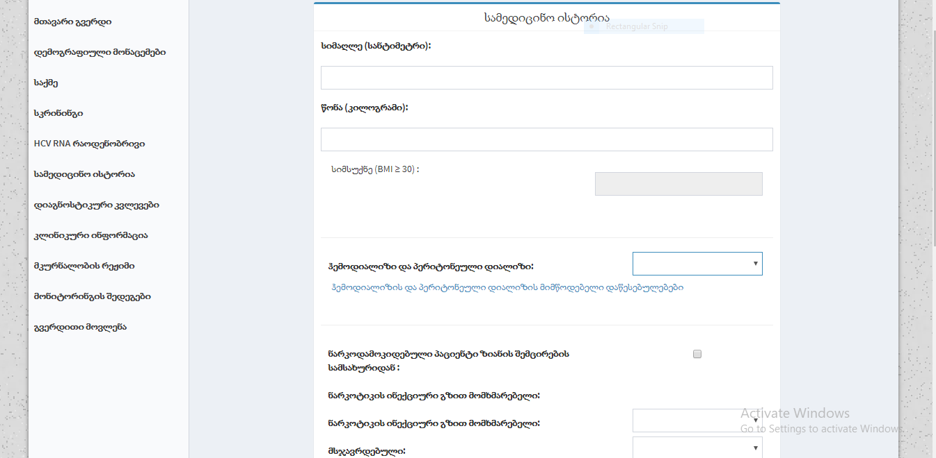
ElimC- Medical History

Slide 11
Diagnostic algorithm
First confirmatory test
Before 1.12.17
HCV RNA PCR Quantitative
After 1.12.17
HCV RNA Genexpert
HCV RNA Quantitative
HCV RNA Qualitative
Core Ag testing

Slide 12
Decentralization
First Steps
existing regulations - all in-patient facilities are conducting HCV screening of hospital patients.
After 10 of march, they will have an obligation to conduct confirmatory testing to all HCV positive patients.

Slide 13
Decentralization
First Steps
The regional laboratories of the NCDC;
The regional units of the NCDC;
Public Health Centers;
Harm reduction sites;
are obliged to conduct confirmatory testing of HCV positive patients;

Slide 14
Blood Samples Transportation
NCDC
Hospitals
NCDC Labs, Public Health Centres
Lugar centre
vertical programs (safe blood, antenatal care etc) providers
Harm reduction sites
HEPC program providers

Slide 15

Information Flow
SCREENING MODULE!
Screening registration
Screening results
+ -
Blood Sample stop tests
Confirmatory test
results

Slide 16
Pilot project “Integrating HCV screening and simplified treatment services in primary healthcare”
Integrated screening, diagnostic and treatment program in PHCs
Total of 4 PHCs will be selected, including one in Tbilisi and three in non-urban regional locations
HCV screening and care services using “One stop shop” approach

Slide 17
Diagnostic before treatment
(PHC case)
Anti HCV +
CONFIRMATORY TEST
HCV RNA +
Physician consultation
Alt, Ast, Cbc (FIB4)
HCV GEN, HBsAg, Anti-HBc total, G-GT , ALP, BIL, CR, GL, ALB, INR, TSH (If Interferon) Ultrasound
Physician consultation, Form NIV-100/a
FIB4 > 1.45
Hcv providers

Slide 18
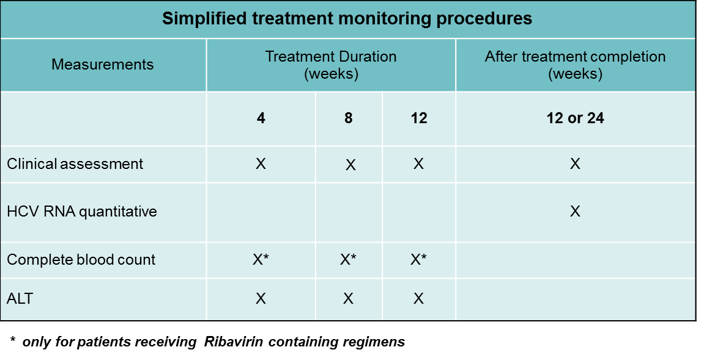
Treatment monitoring
(12 week regimens – schedule)

Slide 19
Pilot project - ,,Simplifing pre-treatment diagnostic tests and treatment monitoring process in the Hepatitic C Elimination Project”
Primary aims:
  Reduce the patient’s unnecessary clinical visits.
  Reduce the patient’s unnecessary visits to HCV Elimination Service Center.
  Remove the unnecessary laboratory investigations.
  Reduce the financial expanses per patient.
  Reduce the budget of the Project.
Secondary aims:
  Simplified algorithm should not influence on the treatment outcome.
  Decrease the lost to follow up rates.
  Make participation in HCV Elimination Project more comfortable.

Slide 20
Diagnostic before treatment
(,,Mrcheveli/Neolabi” case)
Anti HCV +
CONFIRMATORY TEST
HCV RNA +
Physician consultation
Alt, Ast, Cbc (FIB4)
HCV GEN, HBsAg, Anti HBc-total, G-GT , ALP, BIL, CR, GL, ALB, INR, TSH (If Interferon) Ultrasound
Physician consultation, Form NIV-100/a
FIB4 - 1.45−3.25
Fibroscan

Slide 21
Treatment monitoring
(12 week regimens – schedule)
Procedures | 2 | 4 | 6 | 8 | 10 | 12 | Follow Up
Drug Control | X | X | X | X | X | X
Physicians Consultation |  | X |  | X |  | X | X
HCV RNA PCR/HCVcAg |  | X |  |  |  |  | X
CBC |  | X |  | X* |  | X
ALT |  | X |  | X |  | X
Creatinine |  |  |  |  |  | X
Bil (tot.) |  |  |  |  |  | X

Slide 22
Treatment monitoring
(24 week regimens – schedule)
Procedures | 2 | 4 | 6 | 8 | 10 | 12 | 14 | 16 | 18 | 20 | 22 | 24 | Follow Up
Drug Control | X | X | X | X | X | X | X | X | X | X | X | X
Physicians Consultation |  | X |  | X |  | X |  |  |  |  |  | X | X
HCV RNA PCR |  | X |  |  |  |  |  |  |  |  |  |  | X
CBC |  | X |  | X* |  | X |  |  |  |  |  | X
ALT |  | X |  | X |  | X |  | X** |  | X** |  | X
Creatinine |  |  |  |  |  | X |  | X* |  | X* |  | X
Bil (tot., dir.) |  |  |  |  |  | X |  |  |  |  |  | X
* RBV containing regimens only
** RBV free regiments only

Slide 23
FIND project - Study methods
Harm Reduction Sites
Arm 1 - POC
620 beneficiaries who screen HCV+
Blood draw
HCV RNA testing
Results to PWID
Arm 2 - cAg
620 beneficiaries who screen HCV+
Blood draw
Blood sample shipped to Lugar
HCV cAg test
Results to PWID
Arm 3 - SOC
620 beneficiaries who screen HCV+
Current practice

Slide 24
FIND project - Study methods
Harm Reduction Sites
Arm 1 - POC
Screening database
Patient registration
Screening results
Confirmatory test results
Arm 2 - cAg
Screening database
Patient registration
Screening results
blood draw
Report about draw in screening database
Arm 3 - SOC
Coordination with ssa

Slide 25
Main principles/tasks of decentralization
Integrating HCV screening and simplified treatment services in:
Primary healthcare centers (minimum one on each municipalities)
Harm reduction centers (minimum one in Tbilisi, one in Batumi and one in Zugdidi)
Hospitals

Slide 26
Main principles/tasks of decentralization
Simplified Treatment and Diagnostics guidelines/algorithms
Develop reasonable minimum criteria required for facilities to provide services to HCV patients
Initial and Continued Training for PHC, Hospital staff
Develop necessary information systems or modules to support decentralization projects (harm reduction sites, PHC etc.) into Elim-C data base

Slide 27
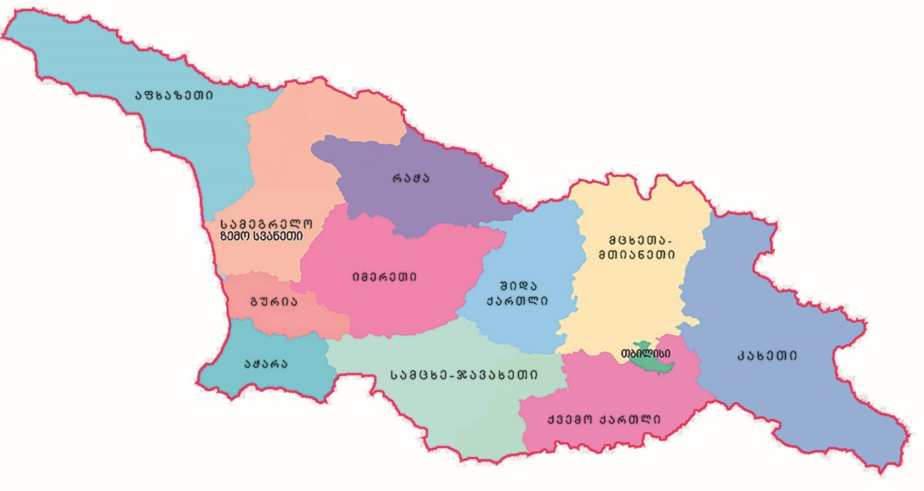
Decentralization Project (Regions)
service-provider
new C - centers

Slide 28
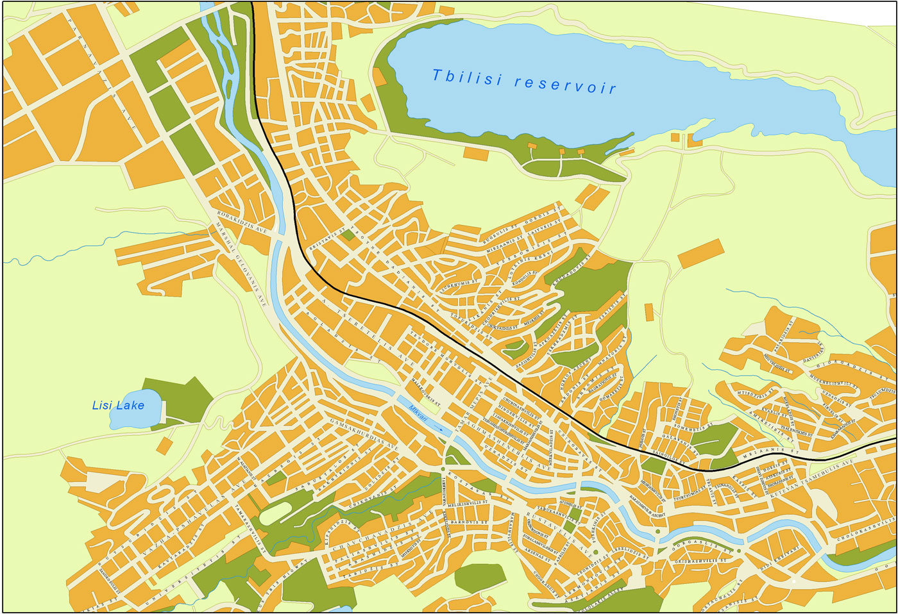
Decentralization Project (Tbilisi)
0
Service provider
0
New C centers

Slide 29




Patient referral system
FIB4>1,45 (?)
FIB4<1,45 (?)

Slide 30
Thank you for your attention!

