Slide 1

Management of HEPC Decentralization
Ekaterine Adamia
Head of Health Care Programs Division
March 2018

Slide 2
Goal
Goal Elimination of HCV by ensuring prevention, diagnostics and treatment of the disease
Targets
90-95-95
By 2020
90% of people living with HCV are diagnosed
95% of those diagnosed are treated
95% of those treated are cured

Slide 4
Challenges
Declined enrollment in the treatment program
Limited provider capacity and a scarcity of treatment centers in some geographic and especially in rural areas
Increase from 4 sites (launch of the program in April 2015) to 31 sites by October, 2017

Slide 5
Service provider

Slide 6
Objectives
Increase geographical accessibility
decentralization of screening, care and treatment services
Increase financial accessibility
simplified diagnostics algorithms
Minimize cost of diagnostic

Slide 7
Diagnostic algorithm First confirmatory test
Before 1.12.17
HCV RNA PCR Quantitative
Cost -110 GEL
Co-payment – 77/33 GEL
After 1.12.17
HCV RNA Genexpert
HCV RNA Quantitative
HCV RNA Qualitative
Core Ag testing
Co-payment – 0 GEL
Cost – 60 Gel

Slide 8
Diagnostic before treatment

Slide 9
Diagnostic for 12 week treatment monitoring

Slide 10
Diagnostic cost for patient Diagnostic for 12 week treatment monitoring

Slide 11
Diagnostic cost Diagnostic for 24 week treatment monitoring

Slide 12
Diagnostic cost for patient Diagnostic for 24 week treatment monitoring

Slide 13
Diagnostic cost
SVR test (HCV RNA + Physician consultation) = 130 GEL
Fully Funded by Government

Slide 14
Decentralization First Steps
existing regulations - all in-patient facilities are conducting HCV screening of hospital patients.
After 10 of march, they will have an obligation to conduct confirmatory testing to all HCV positive patients.

Slide 15
Decentralization First Steps
The regional laboratories of the NCDC;
The regional units of the NCDC;
Public Health Centers;
Harm reduction sites;
are obliged to conduct confirmatory testing of HCV positive patients;

Slide 16
Blood Samples Transportation
NCDC
Hospitals
NCDC Labs, Public Health Centres
Lugar centre
vertical programs (safe blood, antenatal care etc) providers
Harm reduction sites
HEPC program providers

Slide 17

Information Flow
SCREENING MODULE!
Screening registration
Screening results
+ -
Blood Sample stop tests
Confirmatory test
results

Slide 18
Patient Surveillance
From 1 of march 2018, The relevant units of the NCDC and Public Health Centers are obliged to ensure surveillance of HCV positive patients revealed by confirmatory testing and other needed diagnostic tests

Slide 19
Pilot Projects (1)
“Integrating HCV screening and simplified treatment services in primary healthcare” – project of the Infectious Diseases, AIDS and Clinical Immunology Research Center, which aims to eliminate barriers and improve engagement in the entire continuum of HCV care;

Slide 20
Pilot Projects (2)
,,Simplifing pre-treatment diagnostic tests and treatment monitoring process in the Hepatitic C Elimination Project” - Project of Clinics “Mrcheveli” and “NeoLab”

Slide 21
Pilot Projects (3)
FIND’s Head Start Project, which aims to scale up effective diagnosis and linkage to care of PWIDs through harm reduction sites.

Slide 22
Pilot Projects (4)
Integration of HCV, TB and HIV Detection at PHC level
To Develop the sustainable local public-private partnership for effective integration of TB/HIC/HCV screening and early disease detection;
To strengthen PHC through development of integrated TB/HIC/HCV screening model with detailed protocol;
To map the service providers at the regional level and establish effective referral systems to specialized clinics;

Slide 23
Main principles/tasks of decentralization
Integrating HCV screening and simplified treatment services in:
Primary healthcare centers (minimum one on each municipalities)
Harm reduction centers (minimum one in Tbilisi, one in Batumi and one in Zugdidi)
Hospitals

Slide 24
Main principles/tasks of decentralization
Simplified Treatment and Diagnostics guidelines/algorithms
Develop reasonable minimum criteria required for facilities to provide services to HCV patients
Initial and Continued Training for PHC, Hospital staff
Develop necessary information systems or modules to support decentralization projects (harm reduction sites, PHC etc.) into Elim-C data base

Slide 25
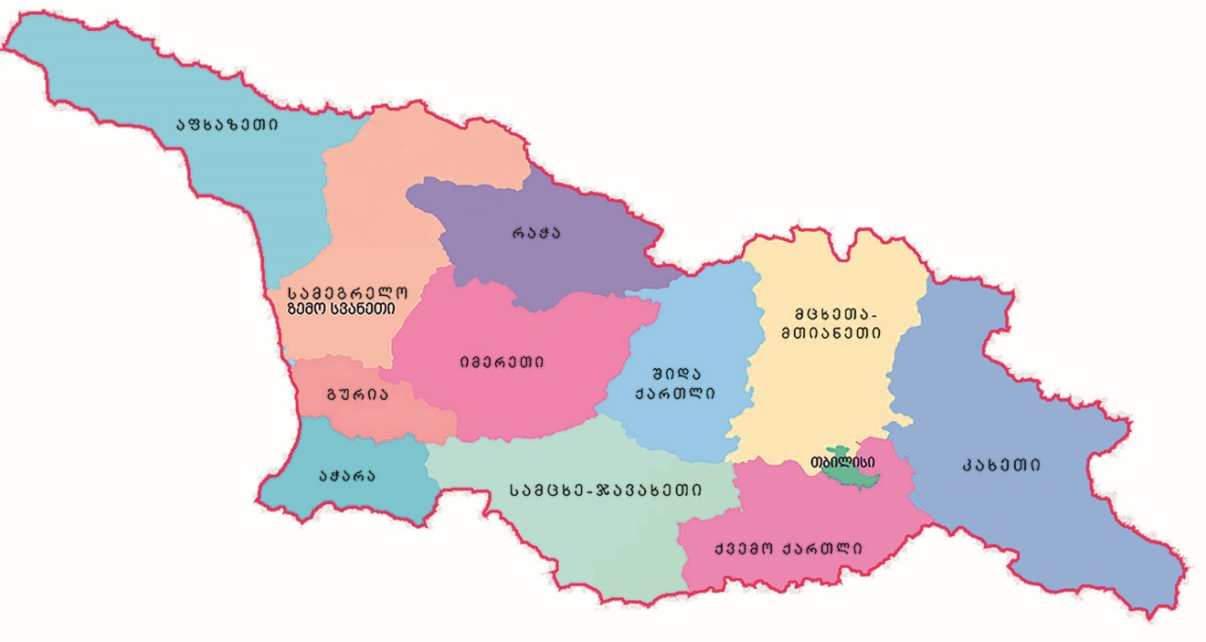
Decentralization Project (Regions)
service-provider
new C - centers

Slide 26
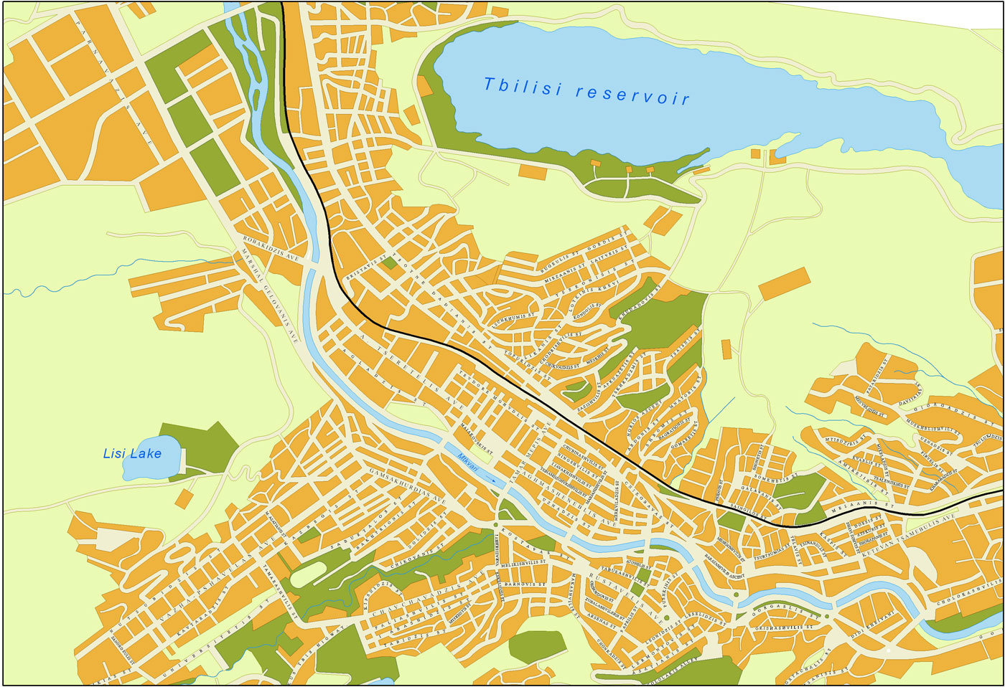
Decentralization Project (Tbilisi)
0
Service provider
0
New C centers

Slide 27




Patient referral system
FIB4>1,45
FIB4<1,45

Slide 28
Thank you for your attention!

