Slide 1


COVID-19 MONITOR
Europe and central Asia
[Unless otherwise specified, data is as of February 27]
03/01/2021

Slide 2
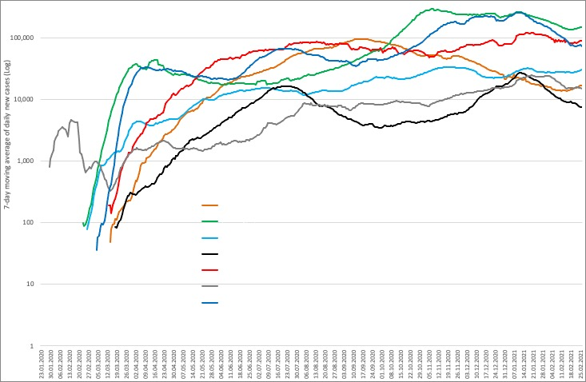
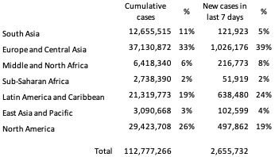
Daily new COVID-19 cases by World Bank regions (all countries)

Slide 3




Regional overview:
COVID-19 cases, mortality, vaccination, and testing in client countries
CASES
DEATHS
VACCINATION
TESTS
Total:
22,846,932 cases
Last week:
+ 745,706 (3%)
Total:
480,953 deaths
Last week:
+ 15,924 (3%)
Total:
30,080,566 doses
Last week:
+ 5,854,869 (24%)
Total:
305,589,423 tests
Last week:
+ 9,314,502 (3%)
Last week: 19th – 27th February 2021

Slide 4
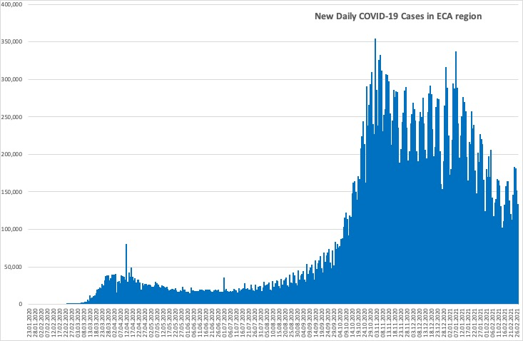
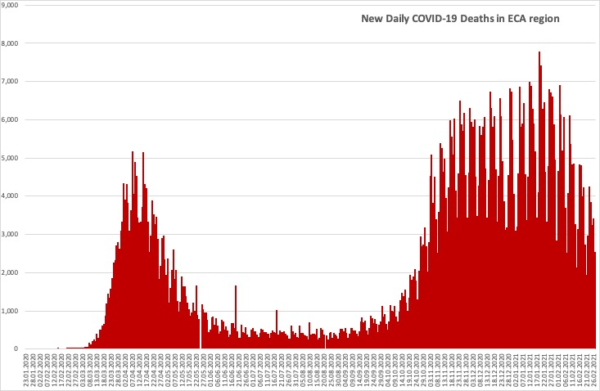
Daily new COVID-19 cases and deaths in ECA region
Countries in the region have passed the second wave, seeing cases and deaths to be falling.

Slide 5
Country-level: cases, mortality and testing
Client countries | Cases per 100,000 | Deaths per 100,000 | Tests per 100,000 | Vaccination per 100,000 | Case Fatality Rate, % | Test Positivity Rate, %
Albania | 3,721 | 62.2 | 15,928 | 355 | 1.7 | 23.1
Armenia | 5,793 | 107.6 | 24,302 | NR | 1.9 | 23.8
Azerbaijan | 2,327 | 32.0 | 25,661 | 646 | 1.4 | 9.1
Belarus | 3,040 | 20.9 | 51,671 | 223 | 0.7 | 5.9
Bosnia and Herzegovina | 3,747 | 145.1 | 18,913 | NR | 3.9 | 19.8
Bulgaria | 3,549 | 146.3 | 23,797 | 3,017 | 4.1 | 14.8
Croatia | 5,935 | 134.8 | 32,605 | 4,752 | 2.3 | 18.2
Cyprus | 3,930 | 26.4 | 215,553 | 8,697 | 0.7 | 1.8
Czech Republic | 11,479 | 188.8 | 73,584 | NR | 1.6 | 15.4
Estonia | 4,846 | 43.9 | 69,153 | 8,355 | 0.9 | 6.8
Finland | 1,030 | 13.4 | 59,388 | 7,989 | 1.3 | 1.7
Georgia | 7,253 | 93.8 | 71,034 | NR | 1.3 | 10.2
Greece | 1,770 | 60.3 | 48,146 | 8,260 | 3.4 | 3.6
Italy | 4,818 | 161.5 | 65,529 | 6,996 | 3.4 | 7.3
Kazakhstan | 1,402 | 16.9 | 39,697 | 119 | 1.2 | 2.8
Kosovo | 3,812 | 88.7 | NR | NR | 2.3 | NR
Kyrgyzstan | 1,349 | 22.9 | 11,535 | NR | 1.7 | 11.7
Latvia | 4,549 | 85.6 | 78,651 | 3,283 | 1.9 | 5.7
Lithuania | 7,249 | 118.8 | 77,074 | 8,691 | 1.6 | 9.4
North Macedonia | 4,934 | 150.5 | 24,850 | NR | 3.1 | 19.7
Moldova | 6,893 | 146.3 | 26,500 | NR | 2.1 | 25.8
Montenegro | 12,108 | 160.6 | 44,576 | 207 | 1.3 | 27.0
Poland | 4,421 | 113.7 | 25,448 | 8,519 | 2.6 | 17.2
Portugal | 7,822 | 158.4 | 79,483 | 8,153 | 2.0 | 9.8
Romania | 4,116 | 104.5 | 30,989 | 7,838 | 2.5 | 13.2
Russia | 2,852 | 57.4 | 75,068 | 2,657 | 2.0 | 3.8
Serbia | 6,555 | 63.6 | 41,897 | 20,579 | 1.0 | 15.5
Slovakia | 5,615 | 129.7 | 37,073 | 7,957 | 2.3 | 15.0
Spain | 6,770 | 146.8 | 81,722 | 7,655 | 2.2 | 8.3
Tajikistan | 146 | 1.0 | NR | NR | 0.7 | NR
Turkey | 3,239 | 34.3 | 39,612 | 10,240 | 1.1 | 8.1
Ukraine | 3,320 | 65.2 | 16,355 | NR | 2.0 | 19.5
Uzbekistan | 240 | 1.9 | 4,143 | 7 | 0.8 | 5.8
Cases per 100,000 population range from 146 in Tajikistan to 12,108 in Montenegro.
Case fatality rates remain below 4.5% in all client countries.
There is significant variation in testing rates per 100,000 population from 4,143 in Uzbekistan to 215,553 in Cyprus.
The test positivity rate ranges from 1.7% in Finland to 27.0% in Montenegro.
The vaccination per 100,000 population ranges from 355 in Albania to 20,579 in Serbia.
* Data on vaccination number for
Azerbaijan is the latest available, specifically as of February 6, 2021
Russia is the latest available, specifically as of February 10, 2021
Belarus is the latest available, specifically as of February 18, 2021
Kazakhstan is the latest available, specifically as of February 24, 2021
Albania, Croatia, and Spain is the latest available, specifically as of February 25, 2021
Cyprus, Montenegro, Poland, Ukraine and Slovakia is the latest available, specifically as of February 26, 2021

Slide 6
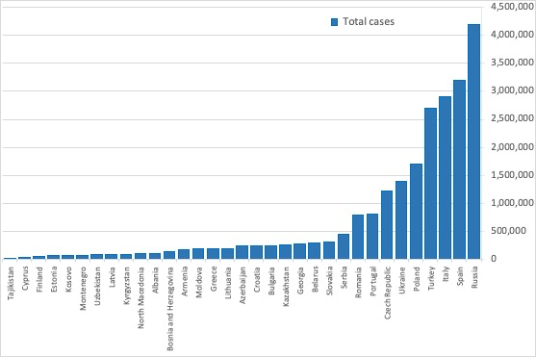
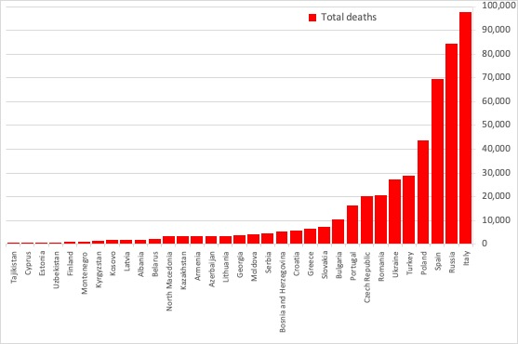
Total cases and deaths in client countries
Countries with the highest number of cases and deaths:
• Cases: Russia (4.187 M), Spain (3.188 M), Italy (2.907 M), Turkey (2.693 M), Poland (1.696 M).
• Deaths: Italy (97,507), Russia (84,330), Spain (69,142), Poland (43,656), Turkey (28,503).
Countries with the lowest number of cases and deaths:
• Cases: Tajikistan (13,308), Cyprus (34,424), Finland (57,052), Estonia (64,399), Kosovo (68,451).
• Deaths: Tajikistan (90), Cyprus (231), Estonia (584), Uzbekistan (622), Finland (742).

Slide 7
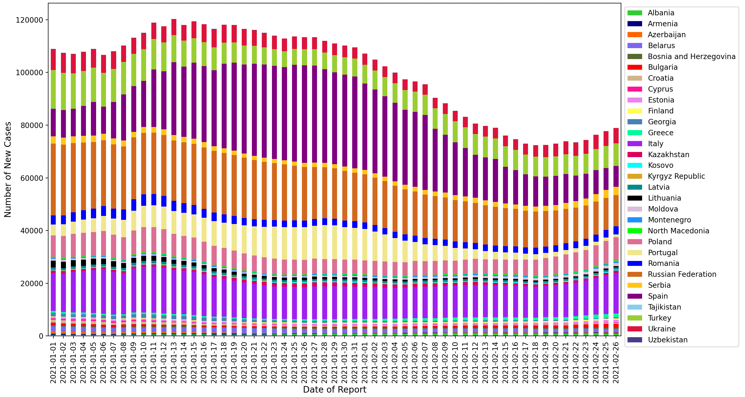
Rolling 7-day average of new cases
​This chart plots the 7-day average of new cases between January 1st and February 26th among client countries.
The contributions of Ukraine, Poland and Italy have been increasing relative to the other countries.
Note: Given the spike in case reporting on Monday, we re-distribute equally across Saturday, Sunday, and Monday in this case.

Slide 8
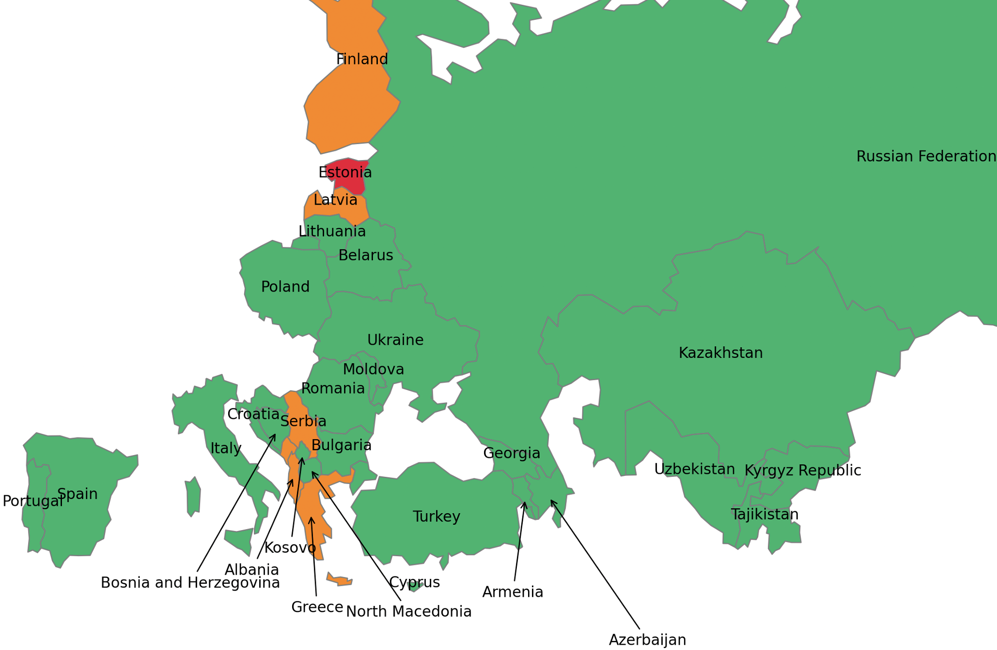
Most recent two-week span: percent increase in total cases
This map shows the % change in the total cases in the current week (February 20th to February 27th) compared to the preceding week (February 13th to February 19th).
Estonia (13%), Albania (7%), and Finland (7%) have recorded the highest percentage increases in total cases.
Color | Percent Increase | Countries
 | 0% - 5% | Kazakhstan, Uzbekistan, Russian Federation, Tajikistan, Kyrgyz Republic, Armenia, Belarus, Ukraine, Poland, Moldova, Romania, Lithuania, Bulgaria, Turkey, Croatia, Portugal, Spain, Italy, Azerbaijan, Georgia, Cyprus, Bosnia and Herzegovina, North Macedonia, Kosovo.
 | 5% - 10% | Latvia, Greece, Albania, Finland, Serbia, Montenegro.
 | > = 10% | Estonia.
Note: Boundaries were cleared by the World Bank Map Design Cartography and Map Clearance Teams.

Slide 9
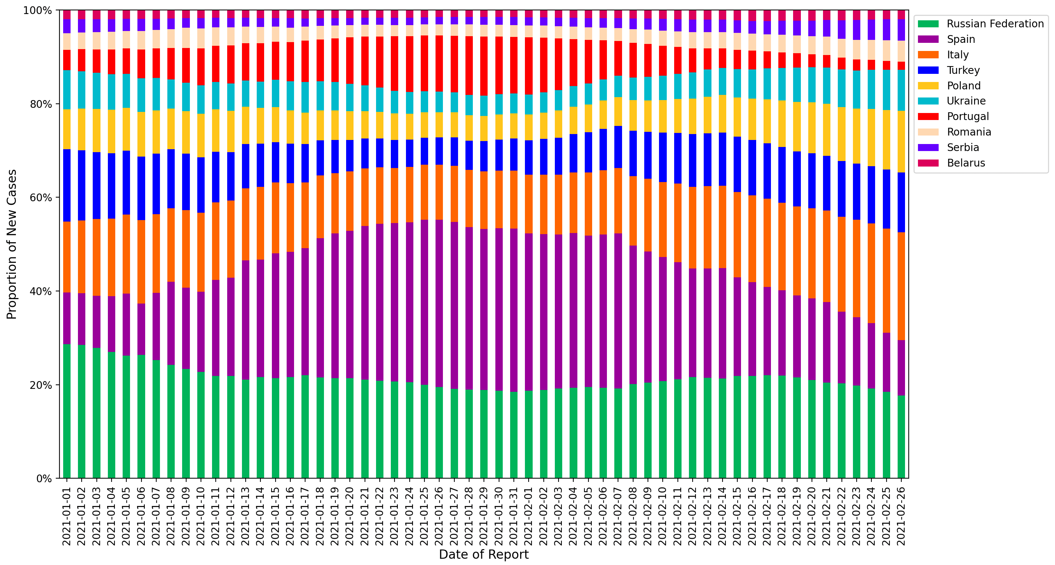
Relative contributions of the 10 client countries with highest case incidence
​This chart plots the proportion of new cases of the total cases in the region between January 1st and February 26th among countries with the highest levels of case incidence.
The 7-day rolling average is computed to adjust for variation in reporting.
The percentage contribution of cases in Ukraine, Romania and Italy is increasing.

Slide 10
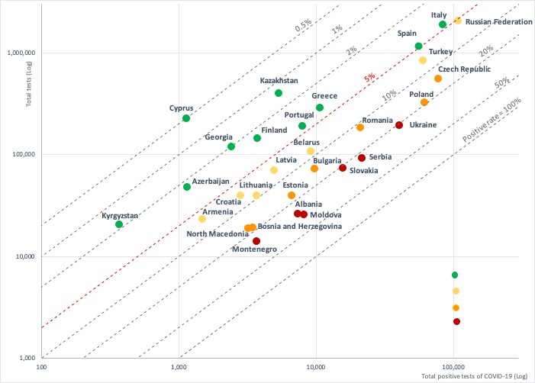

Test positivity rate: total positive COVID-19 tests versus total tests conducted
A test positivity rate of less than 5% is one criterion for informing adjusting of public health and social measures by WHO.
The following countries have testing rates above 5% indicating the need to increase testing and strengthen measures to slow transmission:
Albania, Moldova, Montenegro, Serbia, Slovakia, and Ukraine have positive rates of above 20%;
Bosnia and Herzegovina, Bulgaria, Czech Republic, Estonia, North Macedonia, Poland, and Romania have positive rates of 10-20%;
Armenia, Belarus, Croatia, Italy, Latvia, Lithuania, and Turkey have positive test rates of 5-10%.

Slide 11
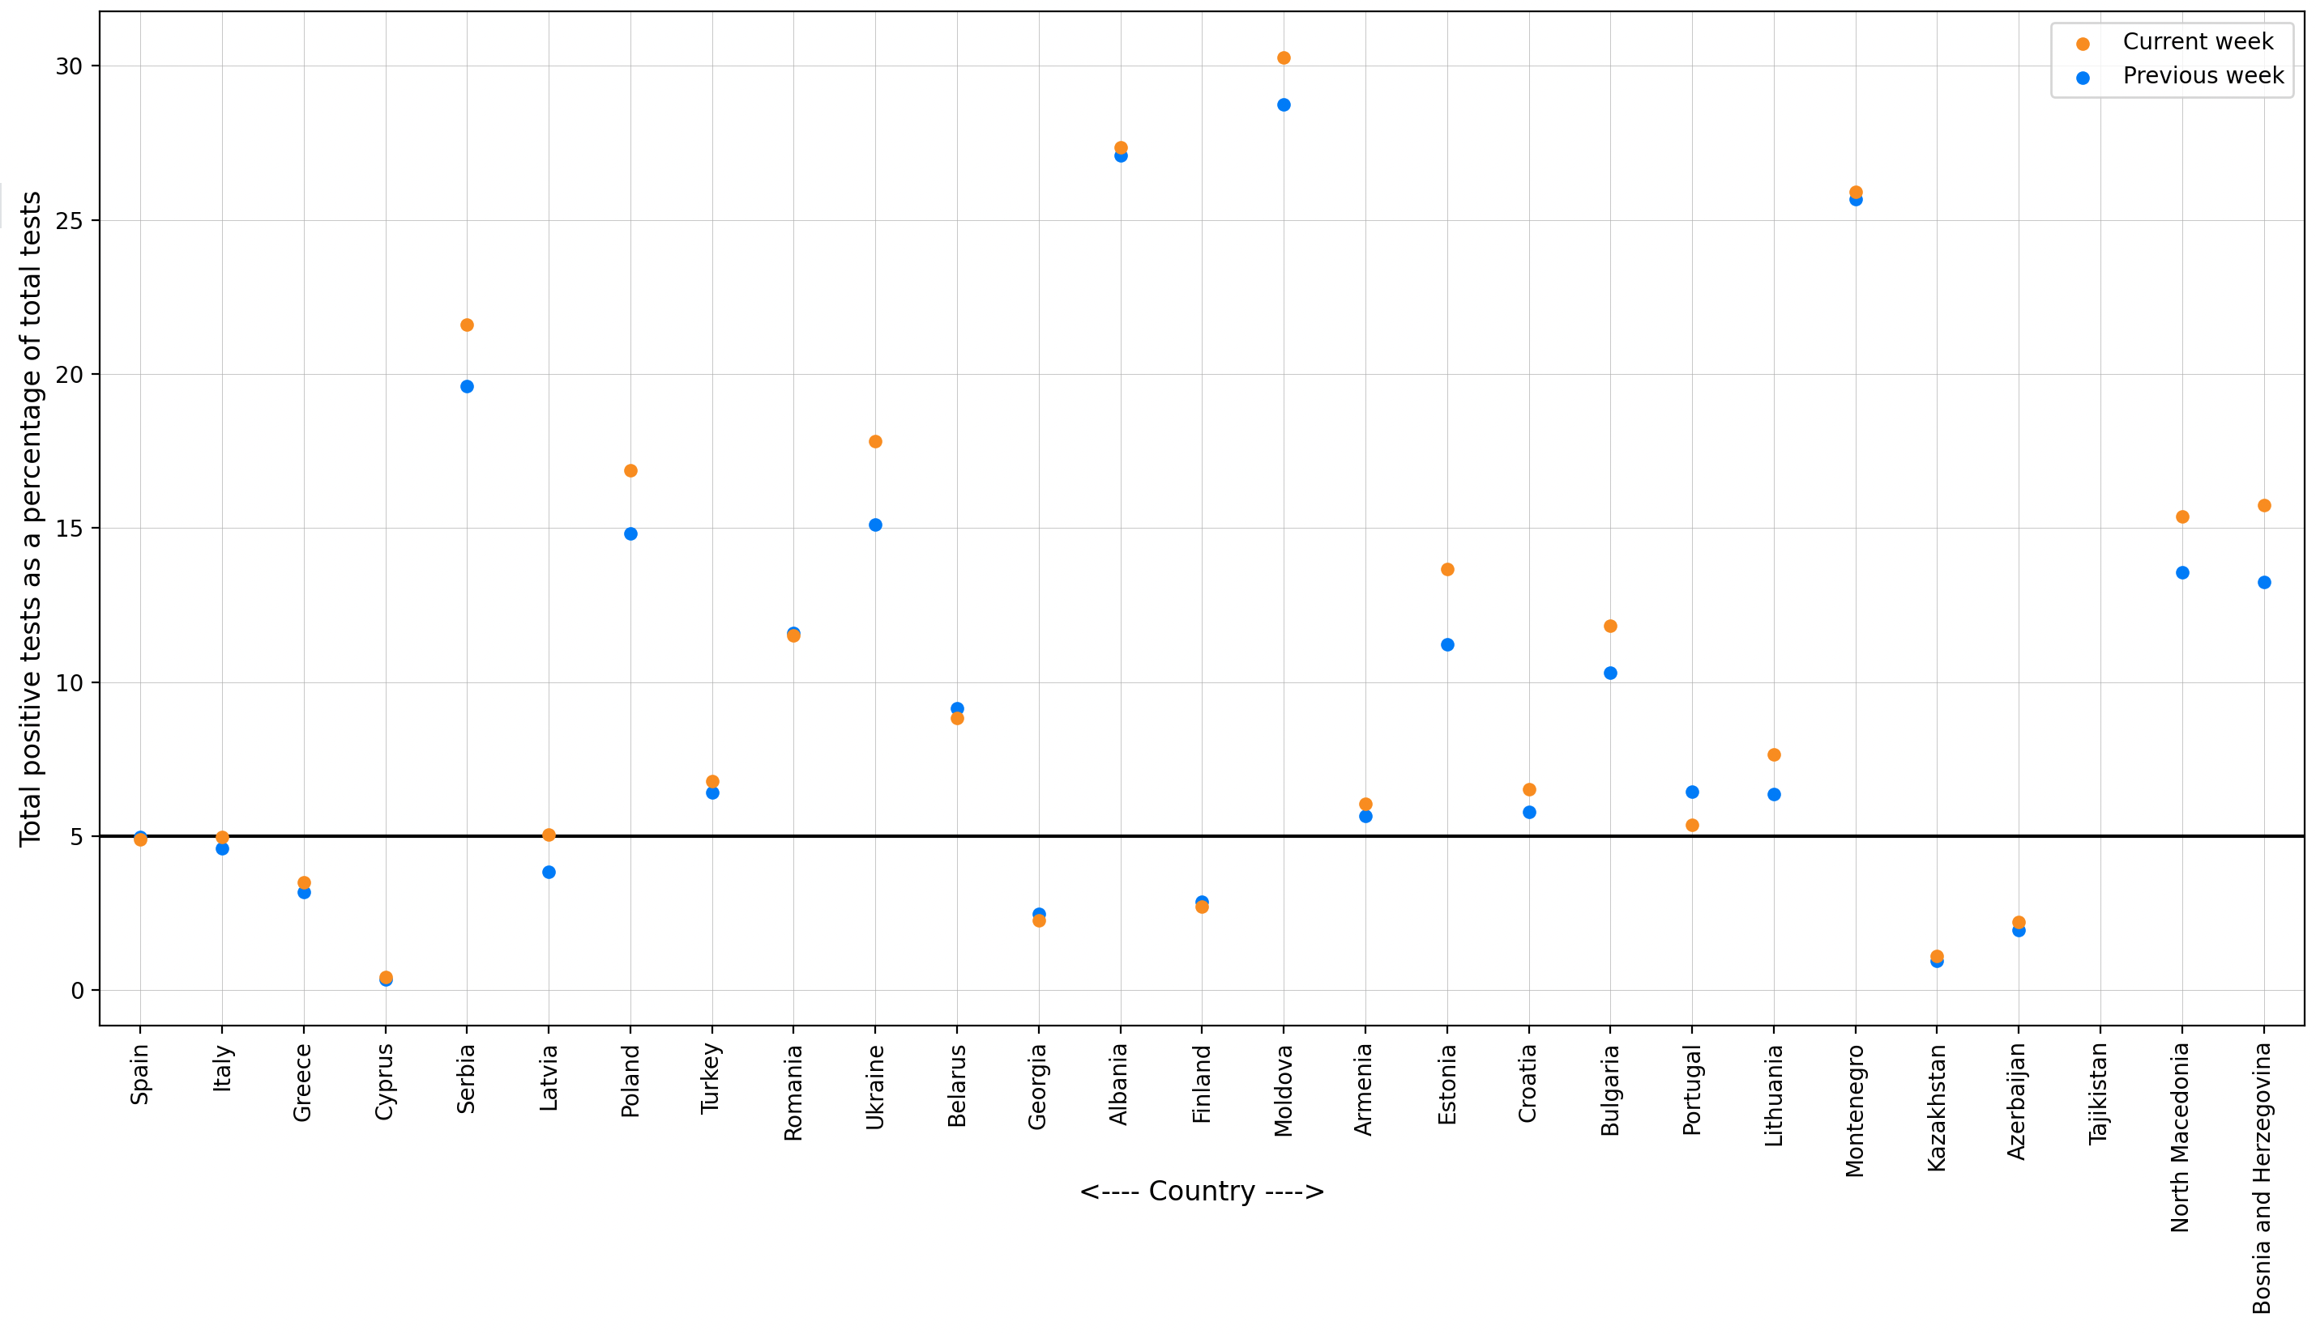
Most recent two-week span: change in test positivity rate
This graph plots the test positivity rate the current week (February 13th to February 19th) compared to the preceding week (February 6th to February 12th).
Over the past week, the test positivity rates in Latavia decreased from below 5% to above 5%.
Albania, Moldova and Montenegro have recorded rates above 25% for three consecutive weeks.

Slide 12
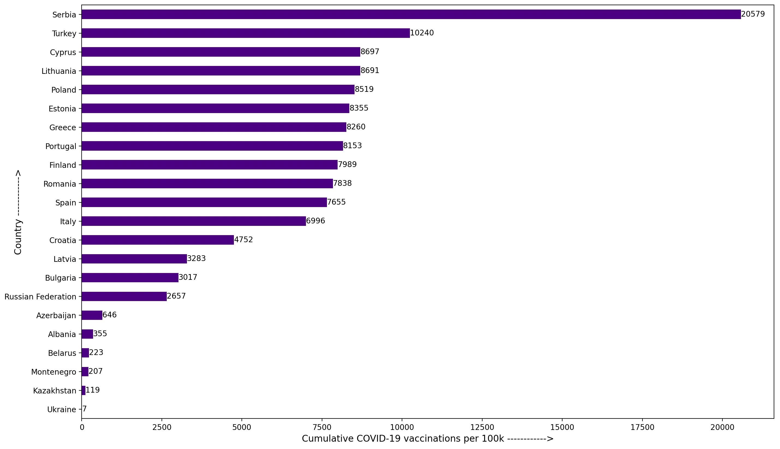
Total COVID-19 vaccines administered per 100,000 population
This chart plots the total vaccines administered per 100,000 population up until February 27th among client countries.
Serbia (20,579), Turkey (10,240) and Cyprus (8,697) have administered the highest number of vaccines per 100,000 population.
Armenia, Bosnia and Herzegovina, Georgia, Kosovo, Kyrgyz Republic, Moldova, Montenegro, Tajikistan and Uzbekistan have no vaccination data available.

Slide 13
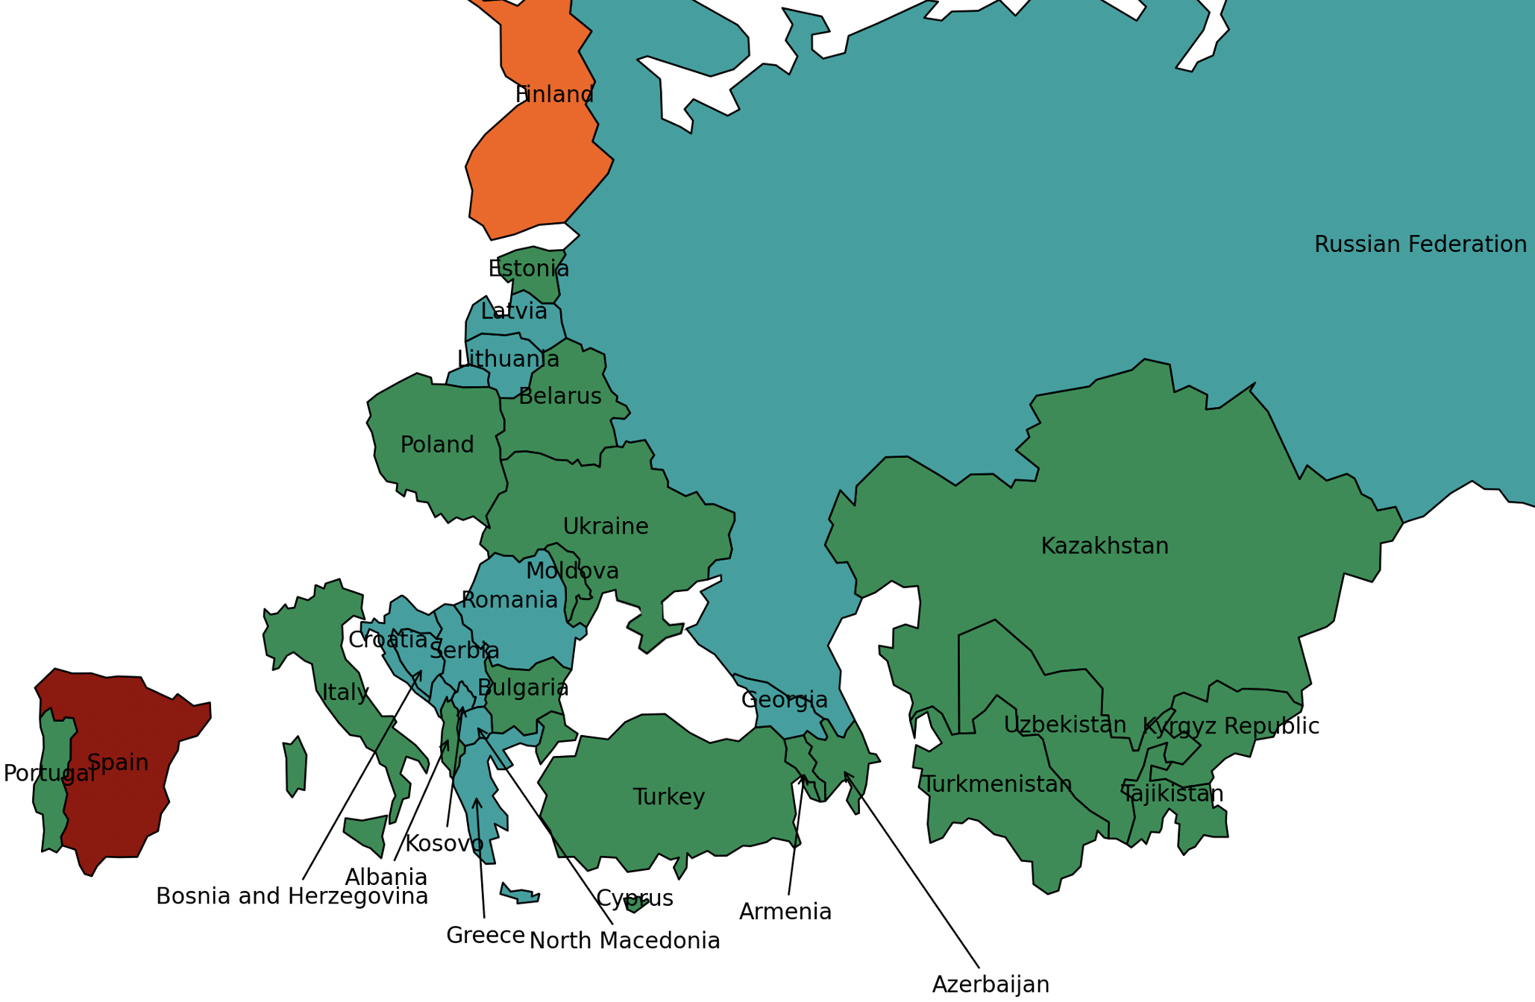
Spread of Coronavirus variants of concern amongst client countries
This map shows the number of Coronavirus variants of concern (B1.1.7, B.1.351, P.1) present in the client countries up until February 19th.
Variants of concern appear to be more infectious than other circulating Coronaviruses.
Coronaviruses from the B.1.1.7 lineage are thought to be roughly 50 percent more infectious as its transmissibility is greater 40% with increase in virulence/mortality.
Variant B.1.351 has a transmissibility greater than 50%, with a potential for immune escape.
P.1, first found in Japan is a close relative of the B.1.351 lineage, and is also potentially associated with reinfections.
Spain (B1.1.7, B.1.351, P.1) has reported the three Coronavirus variants of concern.
Color | Total Variants | Countries
 | 0 | Kazakhstan, Uzbekistan, Tajikistan, Kyrgyz Republic, Turkmenistan, Armenia, Belarus, Ukraine, Poland, Moldova, Estonia, Bulgaria, Turkey, Albania, Portugal, Italy, Azerbaijan, Cyprus.
 | 1 | Russian Federation, Romania, Lithuania, Latvia, Greece, Croatia, Georgia, Bosnia and Herzegovina, North Macedonia, Serbia, Montenegro, Kosovo.
 | 2 | Finland.
 | 3 | Spain.
Note: Boundaries were cleared by the World Bank Map Design Cartography and Map Clearance Teams.

Slide 14
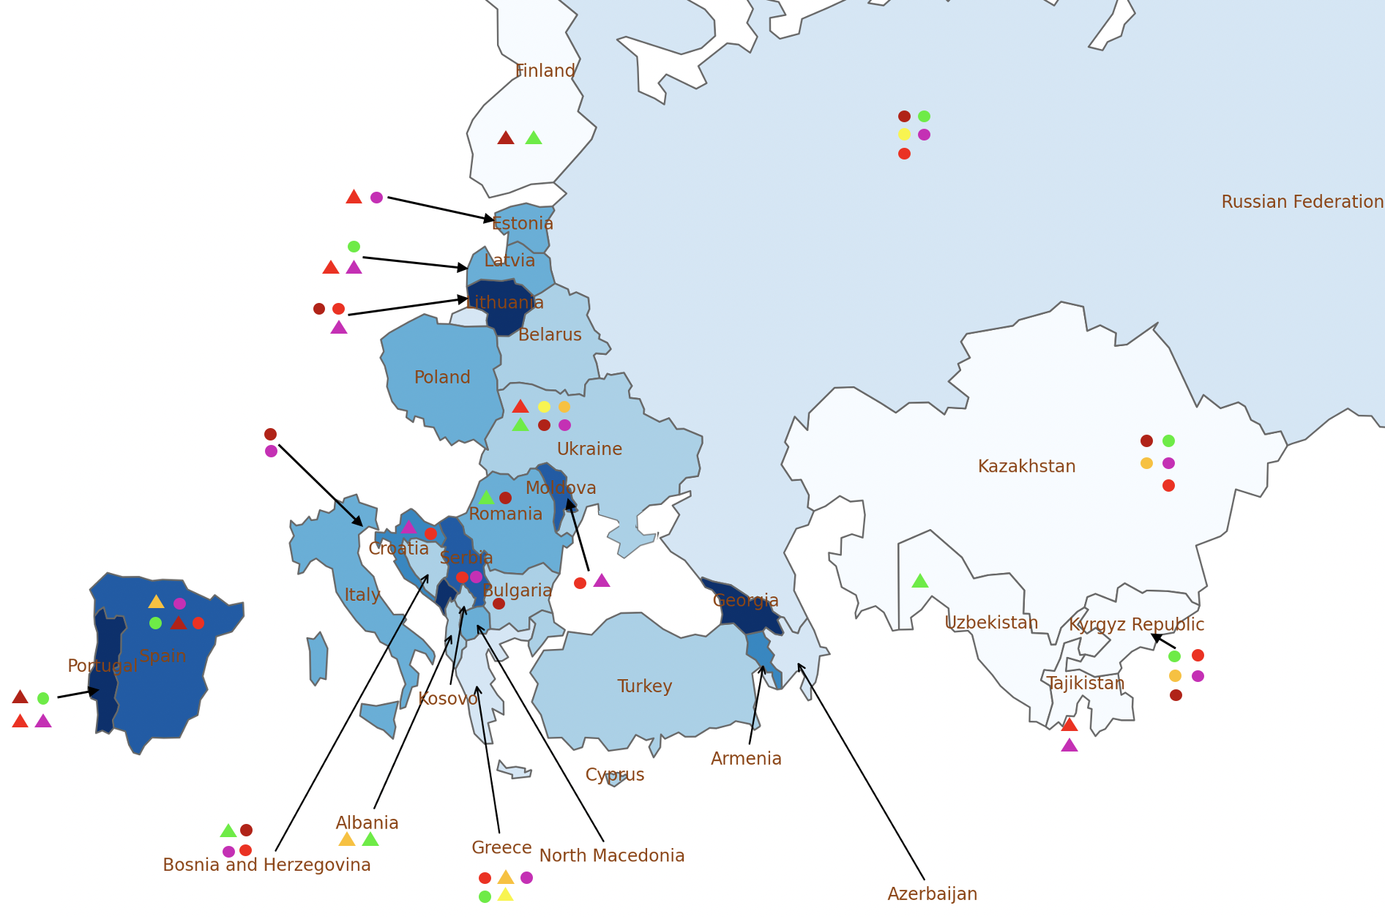
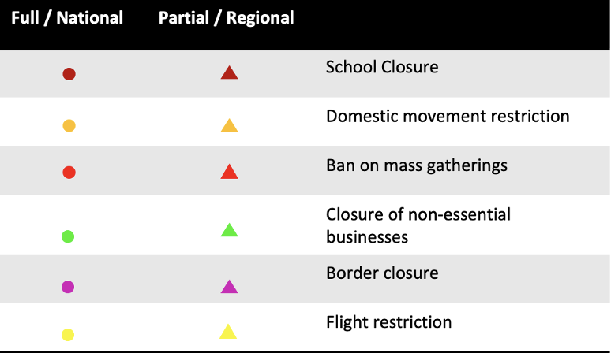
Public health and social measures implemented in the region
Color | Total cases /100,000 | Countries
 | 0 - 1500 | Kazakhstan, Uzbekistan, Tajikistan, Kyrgyz Republic, Finland.
 | 1500 - 3000 | Russian Federation, Greece, Azerbaijan.
 | 3000 - 4000 | Belarus, Ukraine, Bulgaria, Turkey, Albania, Cyprus, Bosnia and Herzegovina, Kosovo.
 | 4000 - 5000 | Poland, Romania, Latvia, Estonia, Italy, North Macedonia.
 | 5000 - 6000 | Armenia, Croatia.
 | 6000 - 7000 | Moldova, Spain, Serbia.
 | 7000+ | Lithuania, Portugal, Georgia, Montenegro.
Croatia is working on bilateral agreements (Covid passports) to facilitate the crossing of its borders for those vaccinated against the novel coronavirus without the need to present a negative PCR test, in order to facilitate easier traffic during the tourist season
Amid the continuous increase of the Coronavirus cases, the Finnish authorities have decided to extend the current entry restrictions for another month
The Chinese government will provide Kyrgyzstan with free COVID-19 vaccines, Chinese Ambassador Du Dewen said during a meeting with Kyrgyz Foreign Minister Ruslan Kazakbaev.
Ukraine has agreed on the supply of 500,000 doses of Indian-made COVISHIELD vaccine against COVID-19.
Note: Boundaries were cleared by the World Bank Map Design Cartography and Map Clearance Teams.

Slide 15
Countries and data sources
Albania | Georgia | Poland
Armenia | Greece | Portugal
Azerbaijan | Italy | Romania
Belarus | Kazakhstan | Russian Federation
Bulgaria | Kosovo | Serbia
Bosnia and Herzegovina | Kyrgyz Republic | Slovak Republic
Croatia | Latvia | Spain
Cyprus | Lithuania | Tajikistan
Czech Republic | Moldova | Turkey
Estonia | Montenegro | Turkmenistan (no cases)
Finland | North Macedonia | Ukraine
 |  | Uzbekistan
The monitor focuses on client countries in Europe and Central Asia with any lending or non-lending operations, and with available data, as in the Table.
Data:
  Cases and deaths: https://ourworldindata.org/coronavirus
  Testing: https://www.worldometers.info/coronavirus/
  Policy responses: https://ourworldindata.org/policy-responses-covid
  Population: provided by task teams or imputed from “our world in data”.
  Variants:
    https://cov-lineages.org/global_report.html
    https://www.nytimes.com/interactive/2021/health/coronavirus-variant-tracker.html

