Slide 1


COVID-19 MONITOR Europe and central Asia
[Unless otherwise specified, data is as of January 15]
01/17/2020

Slide 2
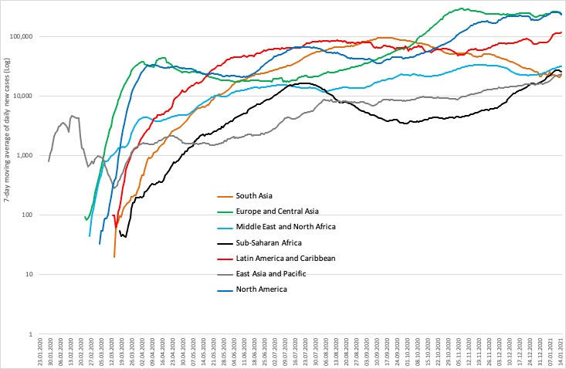
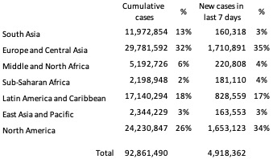
Daily new COVID-19 cases by World Bank regions

Slide 3



Regional overview: COVID-19 cases, mortality, and testing in client countries
CASES
DEATHS
TESTS
Total: 18,436,937 cases
Last week: + 919,702 (5%)
Total: 374,877 deaths
Last week: + 18,651 (5%)
Total: 248,054,811 tests
Last week: + 11,194,322 (5%)
Last week: 8th - 15th January 2021

Slide 4
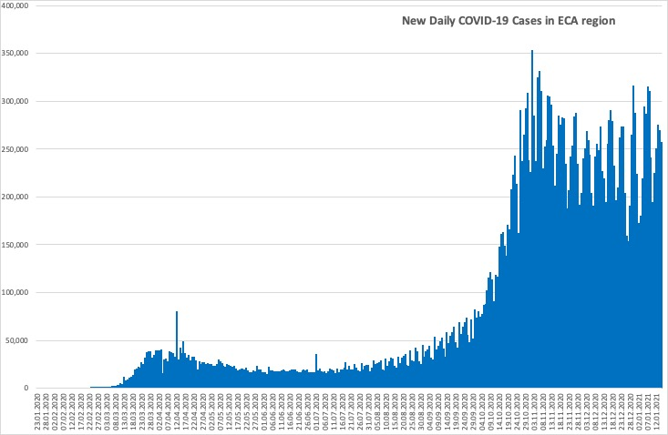
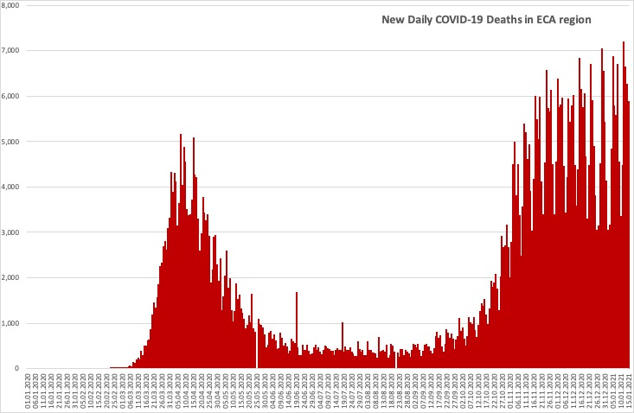
Daily new COVID-19 cases and deaths in ECA region
Countries in the region are seeing a second wave of cases and a second peak in deaths.

Slide 5
Country-level: cases, mortality and testing
Client countries | Cases per 100,000 | Deaths per 100,000 | Tests per 100,000 | Case Fatality Rate, % | Test Positivity Rate, %
Albania | 2,315 | 44.0 | 10,537 | 1.9 | 22.0
Armenia | 5,534 | 100.4 | 20,947 | 1.8 | 26.5
Azerbaijan | 2,234 | 29.4 | 22,797 | 1.3 | 9.8
Belarus | 2,345 | 16.6 | 44,859 | 0.7 | 5.3
Bosnia and Herzegovina | 3,567 | 134.4 | 16,947 | 3.8 | 21.0
Bulgaria | 3,044 | 121.7 | 18,189 | 4.0 | 16.7
Croatia | 5,452 | 110.8 | 27,132 | 2.0 | 20.2
Cyprus | 3,266 | 19.0 | 100,731 | 0.6 | 3.2
Czech Republic | 8,179 | 131.2 | 50,860 | 1.6 | 16.3
Estonia | 2,716 | 23.8 | 53,108 | 0.9 | 5.2
Finland | 720 | 11.2 | 47,639 | 1.5 | 1.5
Georgia | 6,590 | 77.6 | 54,499 | 1.2 | 12.2
Greece | 1,379 | 50.5 | 35,036 | 3.7 | 3.9
Italy | 3,897 | 134.7 | 47,605 | 3.5 | 8.2
Kazakhstan | 1,144 | 15.4 | 31,795 | 1.3 | 2.8
Kosovo | 3,070 | 77.9 | NR | 2.5 | NR
Kyrgyzstan | 1,299 | 21.6 | 9,789 | 1.7 | 13.3
Latvia | 2,866 | 49.6 | 54,643 | 1.7 | 5.3
Lithuania | 6,082 | 87.3 | 66,107 | 1.4 | 9.3
North Macedonia | 4,255 | 129.1 | 20,606 | 3.0 | 20.7
Moldova | 5,678 | 120.4 | 22,041 | 2.1 | 25.8
Montenegro | 8,796 | 119.1 | 33,062 | 1.4 | 26.6
Poland | 3,706 | 85.6 | 20,881 | 2.3 | 17.8
Portugal | 5,142 | 83.1 | 60,796 | 1.6 | 8.5
Romania | 3,545 | 88.1 | 26,542 | 2.5 | 13.4
Russia | 2,373 | 43.3 | 65,531 | 1.8 | 3.7
Serbia | 5,311 | 53.2 | 35,322 | 1.0 | 15.0
Slovakia | 4,047 | 61.6 | 29,403 | 1.5 | 13.9
Spain | 4,782 | 113.2 | 61,093 | 2.4 | 7.8
Tajikistan | 146 | 1.0 | NR | 0.7 | NR
Turkey | 2,854 | 28.5 | 32,550 | 1.0 | 8.8
Ukraine | 2,829 | 51.3 | 14,178 | 1.8 | 19.5
Uzbekistan | 234 | 1.9 | 4,143 | 0.8 | 5.7
•Cases per 100,000 population range from 146 in Tajikistan to 8,796 in Montenegro.
•Case fatality rates remain below 4% in all client countries.
•There is significant variation in testing rates per 100,000 population from 4,143 in Uzbekistan to 100,731 in Cyprus.
• The test positivity rate ranges from 1.5% to 26.6%; with the highest rates in Montenegro (26.6%), Armenia (26.5%), Moldova (25.8%), Albania (22.0%), and Bosnia and Herzegovina (21.0%) suggesting these countries need to improve testing coverage.

Slide 6
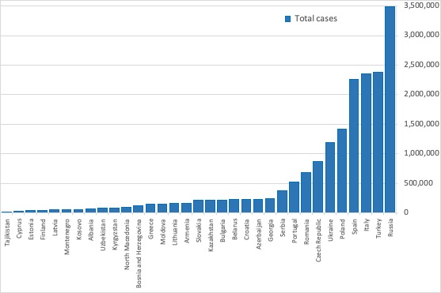
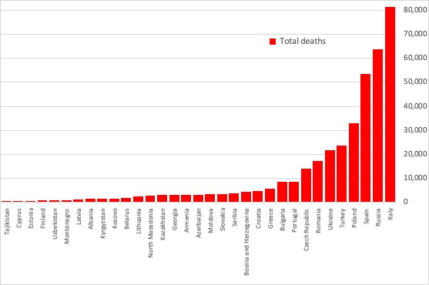
Total cases and deaths in client countries
Countries with the highest number of cases and deaths:
• Cases: Russia (3.483 M), Turkey (2.373 M), Italy (2.352 M), Spain (2.252 M), Poland (1.422 M).
• Deaths: Italy (81,325), Russia (63,558), Spain (53,314), Poland (32,844), Turkey (23,664).
Countries with the lowest number of cases and deaths:
• Cases: Tajikistan (13,308), Cyprus (28,609), Estonia (36,096), Finland (39,911), Latvia (54,066).
• Deaths: Tajikistan (90), Cyprus (166), Estonia (316), Finland (618), Uzbekistan (619).

Slide 7
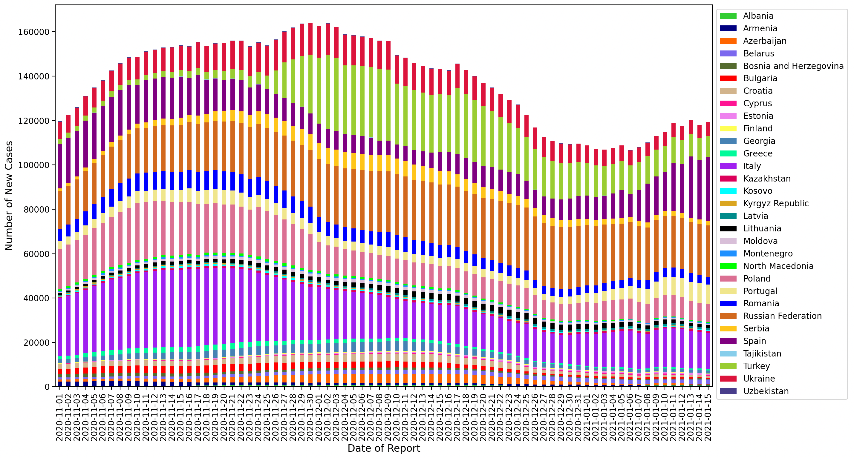
Rolling 7-day average of new cases
​This chart plots the 7-day average of new cases between November 1st and January 15th among client countries.
The contributions of Serbia, Turkey and Lithuania have been decreasing relative to the other countries, while the contributions of Italy, Portugal and Spain has been increasing.
Note: Given the spike in case reporting on Monday, we re-distribute equally across Saturday, Sunday, and Monday in this case.

Slide 8
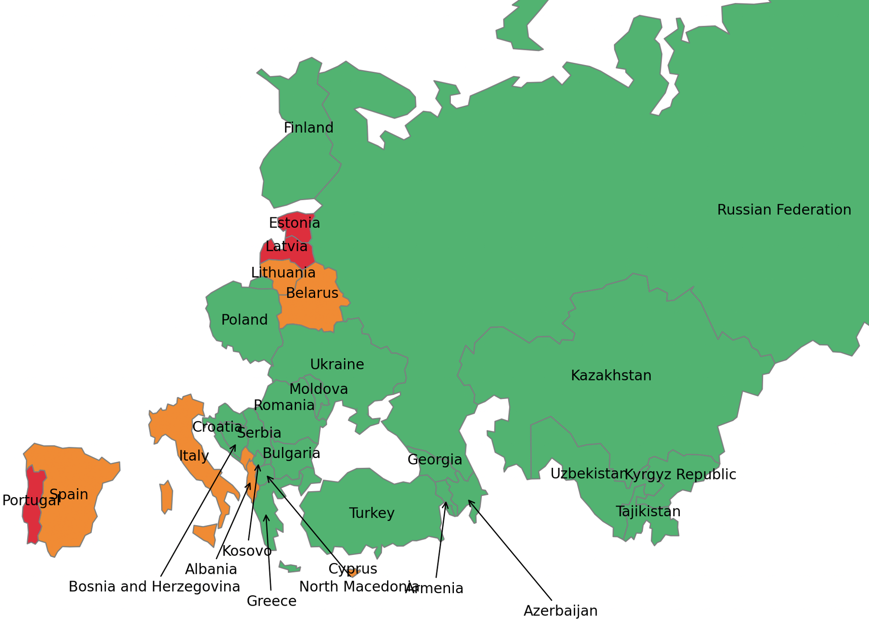
Most recent two-week span: percent increase in total cases
This map shows the % change in the total cases in the current week (January 2nd to January 8th) compared to the preceding week (December 26th to January 1st).
Portugal (13%), Latvia (13%), and Estonia (11%) have recorded the highest percentage increases in total cases.
Color | Percent Increase | Countries
 | 0% - 5% | Kazakhstan, Uzbekistan, Russian Federation, Tajikistan, Kyrgyz Republic, Armenia, Ukraine, Poland, Moldova, Romania, Bulgaria, Greece, Turkey, Croatia, Azerbaijan, Georgia, Finland, Bosnia and Herzegovina, North Macedonia, Serbia, Kosovo.
 | 5% - 10% | Belarus, Lithuania, Albania, Spain, Italy, Cyprus, Montenegro.
 | > = 10% | Latvia, Estonia, Portugal.
Note: Boundaries were cleared by the World Bank Map Design Cartography and Map Clearance Teams.

Slide 9
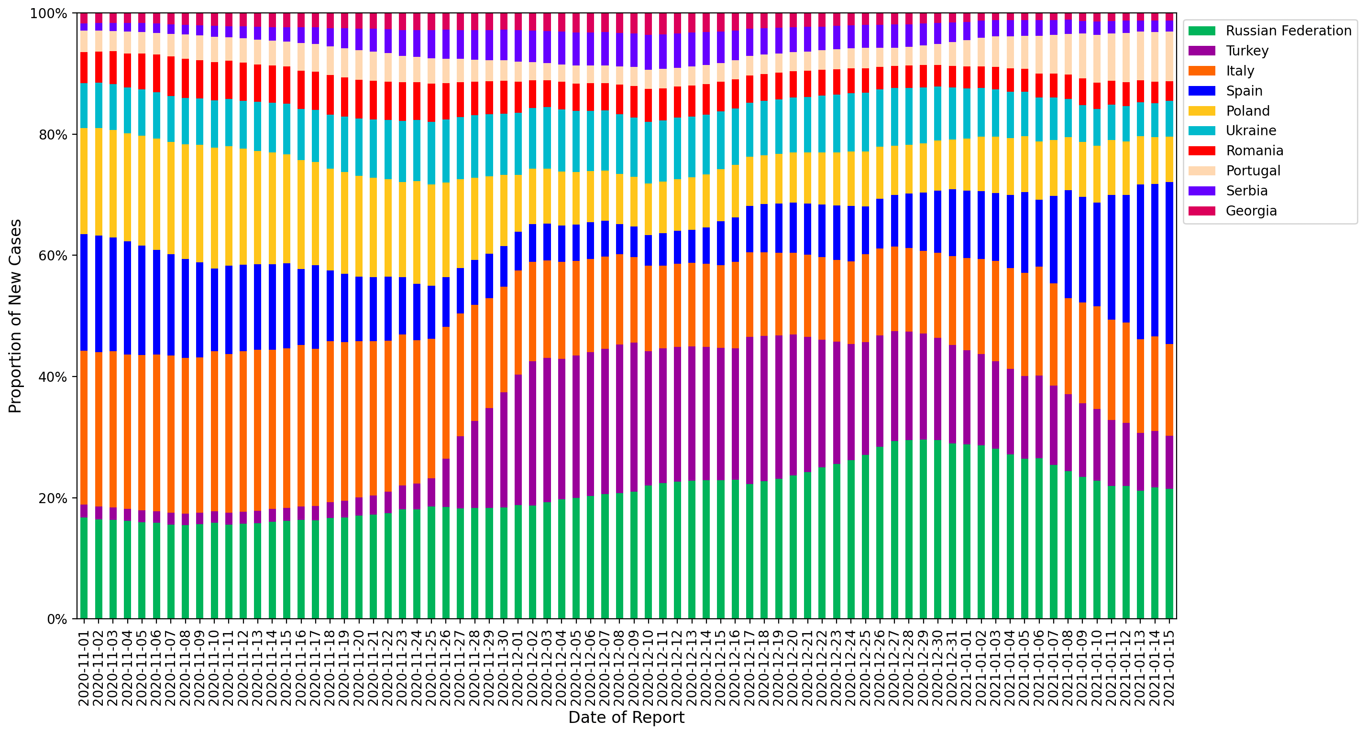
Relative contributions of the 10 client countries with highest case incidence
​This chart plots the proportion of new cases of the total cases in the region between November 1st and January 15th among countries with the highest levels of case incidence.
The 7-day rolling average is computed to adjust for variation in reporting.
The percentage contribution of cases in Spain is increasing at an alarming rate.

Slide 10
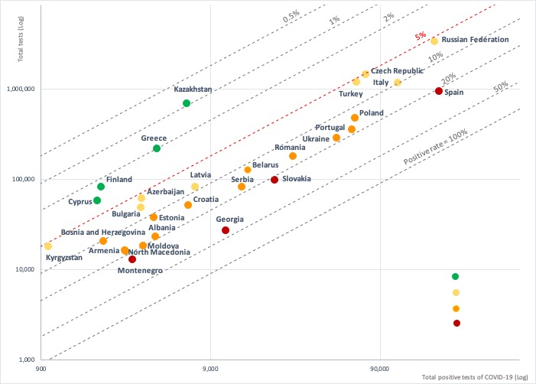

Test positivity rate: total positive COVID-19 tests versus total tests conducted
A test positivity rate of less than 5% is one criterion for informing adjusting of public health and social measures by WHO.
The following countries have testing rates above 5% indicating the need to increase testing and strengthen measures to slow transmission:
Georgia, Montenegro, Slovakia, and Spain have positive rates of above 20%;
Albania, Armenia, Belarus, Bosnia and Herzegovina, Croatia, Estonia, Lithuania, North Macedonia, Moldova, Poland, Portugal, Romania, Serbia, and Ukraine have positive rates of 10-20%;
Azerbaijan, Bulgaria, Czech Republic, Italy, Kyrgyzstan, Latvia, Russia, and Turkey have positive test rates of 5-10%.

Slide 11
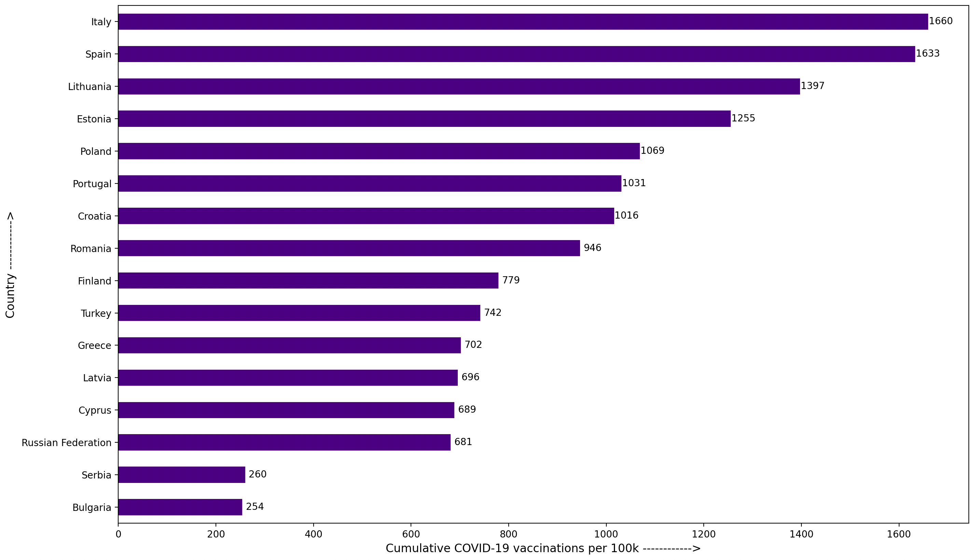
Cumulative total COVID-19 vaccines administered per 100,000 population
This chart plots the total vaccines administered per 100,000 population between till January 15th among client countries.
Italy has administered highest number of vaccines followed by Spain compared to other client countries.

Slide 12
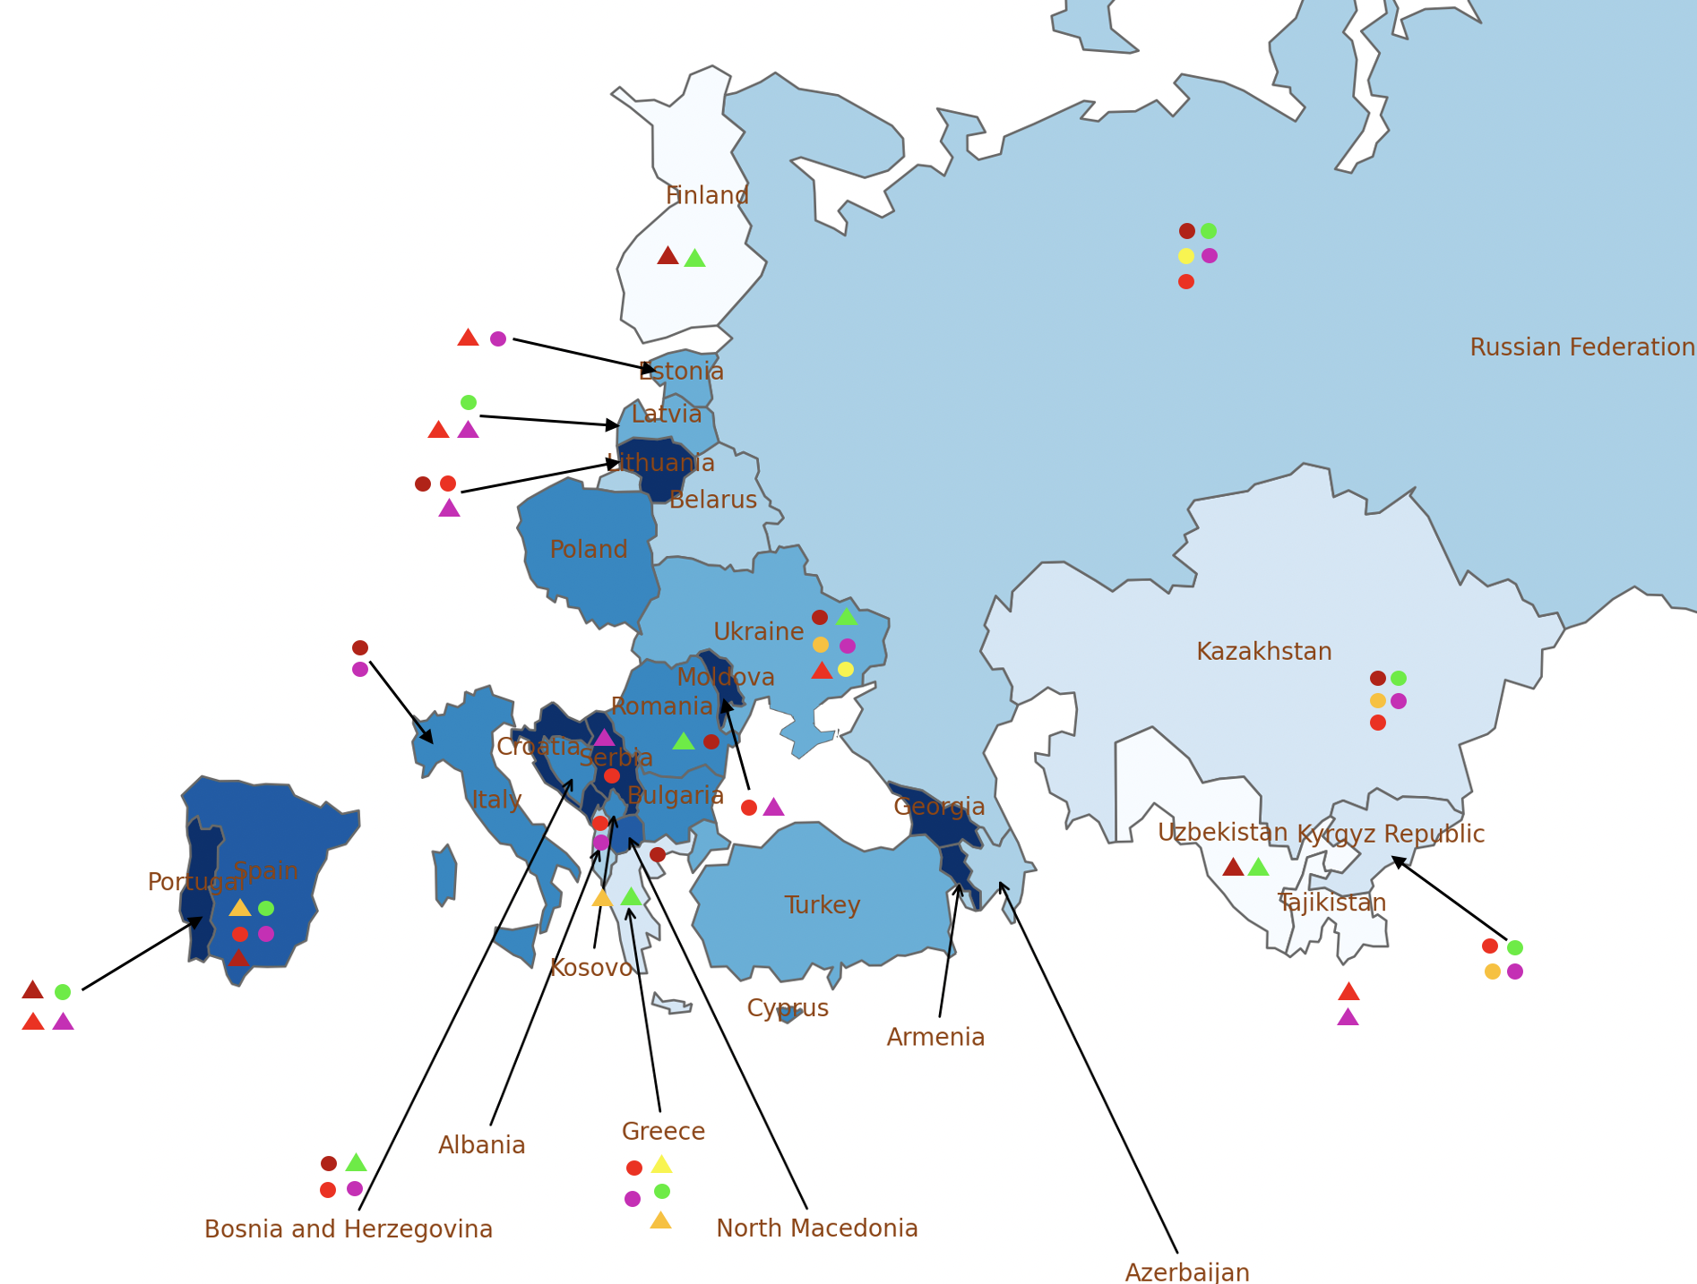
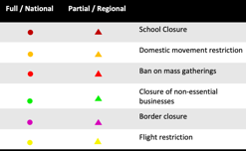
Public health and social measures implemented in the region
Color | Total cases /100,000 | Countries
 | 0 - 1000 | Uzbekistan, Tajikistan, Finland.
 | 1000 - 1500 | Kazakhstan, Kyrgyz Republic, Greece.
 | 1500 - 2500 | Russian Federation, Belarus, Estonia, Albania, Azerbaijan.
 | 2500 - 3000 | Ukraine, Latvia, Estonia, Turkey.
 | 3000 - 4000 | Poland, Romania, Bulgaria, Italy, Cyprus, Bosnia and Herzegovina, Kosovo.
 | 4000 - 5000 | Spain, North Macedonia.
 | 5000+ | Armenia, Moldova, Lithuania, Croatia, Portugal, Georgia, Serbia, Montenegro.
Russian federation and Kazakhstan have maximum restrictions compared to other nations.
Portugal’s public health system close to being overwhelmed as hospitals in the worst-affected areas are running out of intensive care beds.
Tashkent (Uzbekistan) has barred travelers from eight nations from entering the country amid reports about a new coronavirus strain and an increase of COVID-19 cases in those countries.
Greece’s government has extended nationwide lockdown measures indefinitely but says retail stores and malls will reopen Monday with strict entrance limits.
Note: Boundaries were cleared by the World Bank Map Design Cartography and Map Clearance Teams.

Slide 13
Countries and data sources
Albania | Georgia | Poland
Armenia | Greece | Portugal
Azerbaijan | Italy | Romania
Belarus | Kazakhstan | Russian Federation
Bulgaria | Kosovo | Serbia
Bosnia and Herzegovina | Kyrgyz Republic | Slovak Republic
Croatia | Latvia | Spain
Cyprus | Lithuania | Tajikistan
Czech Republic | Moldova | Turkey
Estonia | Montenegro | Turkmenistan (no cases)
Finland | North Macedonia | Ukraine
 |  | Uzbekistan
The monitor focuses on client countries in Europe and Central Asia with any lending or non-lending operations, and with available data, as in the Table.
Data:
Cases and deaths: https://ourworldindata.org/coronavirus
Testing: https://www.worldometers.info/coronavirus/
Policy responses: https://ourworldindata.org/policy-responses-covid
Population: provided by task teams or imputed from “our world in data”.

