Slide 1


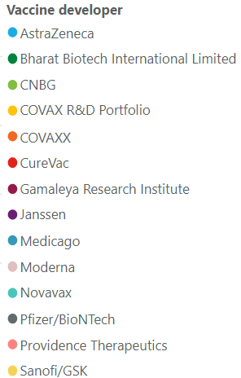
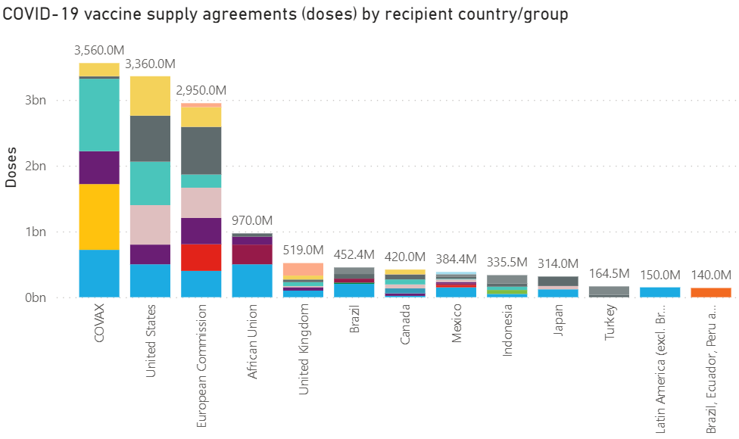
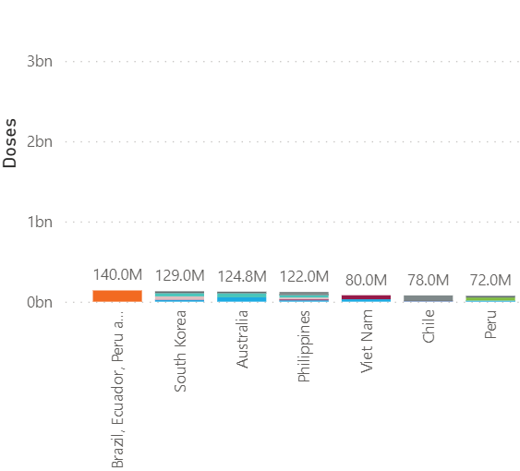
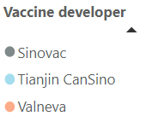
Confidential
As of 26 February 2021
Vaccines Market Intelligence
This flyer summarizes the current market trends for Covid 19 Vaccines globally including country doses procured to date and supplier contracts
Covid-19 Vaccines Global Orders
Media Headlines
Latest global press releases as at 02-26-2021
Below is a consolidation of the main media headlines regarding Covid-19 Vaccine development and distribution.
FDA Panel Votes For Emergency Use Of Johnson & Johnson's COVID-19 Vaccine
Associated Press - 02-26-2021
In a unanimous 22-0, a panel of advisers to the Food and Drug Administration recommended that the COVID-19 vaccine developed by Johnson & Johnson be authorized for emergency use in adults during the pandemic. FDA approval is expected to follow shortly.
Ghana becomes first country to receive COVID-19 vaccine through Covax program
MarketWatch – 02-24-2021
Ghana became the first country in the world to receive COVID-19 shots through Covax, the World Health Organization’s global vaccine-sharing initiative aimed at helping ensure a fairer distribution between rich and poor nations. A flight carrying 600,000 doses of the vaccine developed by drug company AstraZeneca UK:AZN and the University of Oxford, produced by the Serum Institute of India.
Novavax Announces MOU to Supply to COVAX with 1.1 Billion Doses
Dow Jones Institutional News – 02-18-2021
Novavax announced a MOU with Gavi, to provide 1.1 billion cumulative doses of NVX-CoV2373, Novavax' recombinant protein-based COVID-19 vaccine candidate, for the COVAX Facility. The vaccine doses will be manufactured and distributed globally by Novavax and Serum Institute of India.
To Make More Covid-19 Vaccines, Rival Drugmakers Team Up
Dow Jones Newswires – 02-23-2021
Some of the world's biggest drugmakers are joining forces with rivals to help produce Covid-19 vaccines, forging unusual alliances that promise to substantially increase supplies by this summer. Sanofi SA recently agreed to help make a vaccine from Pfizer Inc. Novartis AG also agreed to help Pfizer, while Baxter International Inc. and Endo International PLC have agreed to help Novavax Inc. produce its shot..
IBM Security Report: Attacks on Industries Supporting COVID-19 Response Efforts Double
Dow Jones Institutional News – 02-24-2021
IBM Security released the 2021 X-Force Threat Intelligence Index highlighting how cyberattacks evolved in 2020. IBM Security X-Force observed attackers pivoting their attacks to businesses for which global COVID-19 response efforts heavily relied, such as hospitals, medical and pharmaceutical manufacturers, as well as energy companies powering the COVID-19 supply chain.
EU mulls vaccination passports to resurrect tourism after COVID-19
Reuters – 02-14-2021
European Union leaders will agree on Thursday to work on certificates of vaccination for EU citizens who have had an anti-COVID shot. However, some countries, such as France and Germany, appear more reluctant, as officials there say it could create de facto vaccination obligation and would be discriminatory to those who cannot or will not take a jab.
South Africa leads backlash against big pharma over Covid vaccine access
The Guardian – 02-19-2021
Backed by dozens of developing countries, a proposal to the World Trade Organization, introduced by South Africa and India, argued that bypassing intellectual property rights would allow more of the world’s population to be quickly vaccinated by boosting production.
Note the news articles above are housed within Factiva, a news database and service subscription provided by the WB Library. Accessing them requires a simple one-time registration. Additionally, the full collection of all the relevant news articles from last week can be found here.
Pricing data is drawn from the UNICEF COVID-19 Vaccine Market Dashboard with additional data included where available. This charts below reflect data as at 02-25-2020.

Slide 2
Confidential
As of 26 February 2021
Vaccines Market Intelligence
This flyer summarizes the current market trends for Covid 19 Vaccines globally including country doses procured to date and supplier contracts
Vaccine Regulatory Approvals
Regulatory Approval Headlines
Latest Regulatory approval news as at 02-26-2021
Canada approves AstraZeneca
Politico – 02-26-2021
Canada approved two versions of AstraZeneca’s Covid-19 vaccine; one from AstraZeneca and one from the Serum Institute of India.
FDA Allows More Flexible Storage Conditions for Pfizer
Reuters – 02-23-2021
The FDA is allowing undiluted frozen vials of the Pfizer-BioNTech COVID-19 Vaccine to be transported and stored at conventional temperatures commonly found in pharmaceutical freezers for a period of up to two week.
Brazil approves Pfizer's COVID-19 shot, but has none to use
Reuters– 02-23-2021
Brazil has fully approved the COVID-19 vaccine developed by Pfizer, though a dispute over a supply deal means it has none to start an immunization program with. It is the first coronavirus shot to receive full approval in Brazil.
Sinopharm unit, CanSinoBIO apply in China for COVID-19 vaccines' public use approval
Reuters– 02-24-2021
Sinopharm and CanSino Biologics Inc have applied for public use of their COVID-19 vaccines in China, which if granted would mean China has four locally developed approved vaccines.
Philippines approves Sinovac vaccine but not for all health workers
Reuters – 02-22-2021
The Philippines has approved Sinovac Biotech's COVID-19 vaccine for emergency use, but will not give it to healthcare workers due to its varying levels of efficacy.
Saudi Arabia approves AstraZeneca's Covid-19 vaccine
Reuters – 02-10-2021
Saudi Arabia's food and drug administration has approved the Covid vaccine made by AstraZeneca. It is the country’s second vaccine approval, behind Pfizer.
India's Bharat Biotech pursues COVID-19 vaccine approval in over 40 countries
Reuters – 02-18-2021
Bharat Biotech is in the process of filing regulatory documents for approval of COVAXIN, in more than 40 countries, including Brazil and the UAE. The company has also entered into an agreement with U.S. drug developer Ocugen Inc for the commercialization of COVAXIN in the United States.
Dr.Reddy's seeks Indian emergency use authorization for Russia's Sputnik V vaccine
Reuters – 02-19-2021
Indian drugmaker Dr.Reddy's Laboratories said on Friday it has begun the process of filing for emergency use authorization of Russia's Sputnik V COVID-19 vaccine in India.

Slide 3
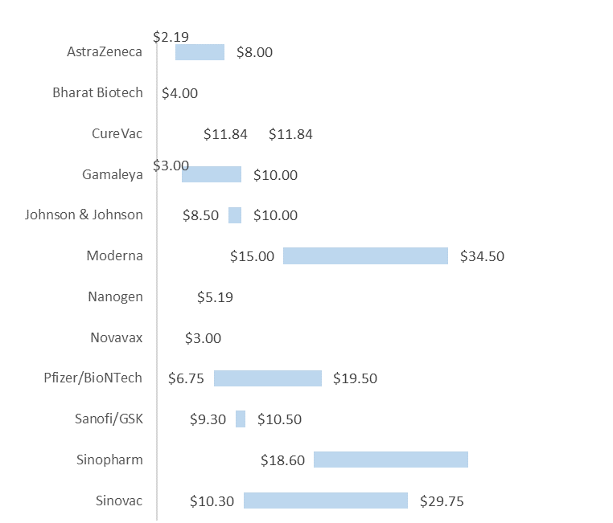
Confidential
As of 26 February 2021
Vaccines Market Intelligence
This flyer summarizes the current market trends for Covid 19 Vaccines globally including country doses procured to date and supplier contracts
Pricing
Pricing data is drawn from the UNICEF COVID-19 Vaccine Market Dashboard with additional data included where available. This data reflects publicly available pricing information as at 02-25-2020.
Price ranges for vaccines
Pricing details by Developer and Purchaser

Slide 4
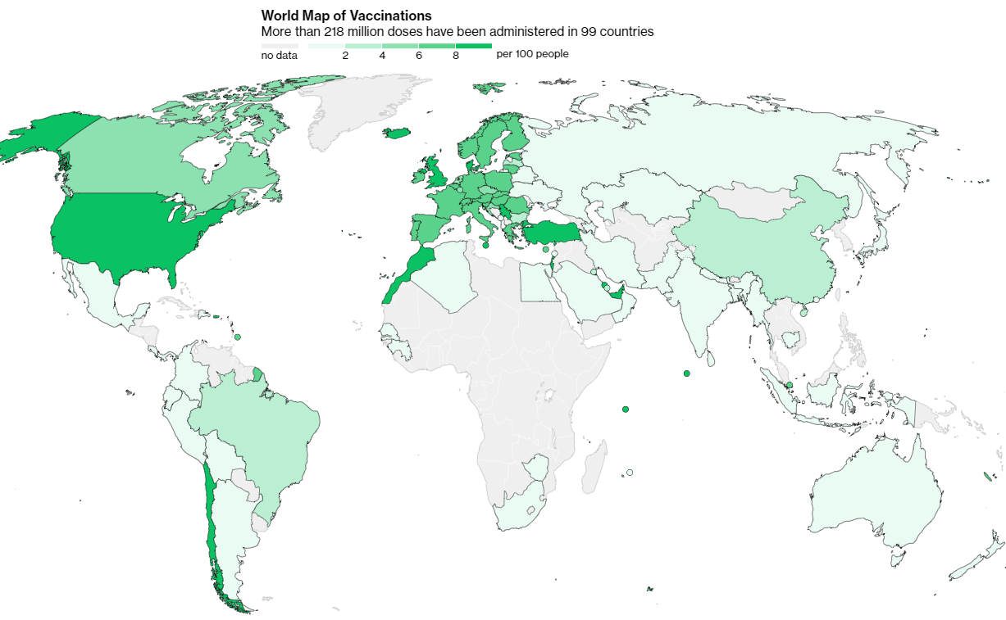
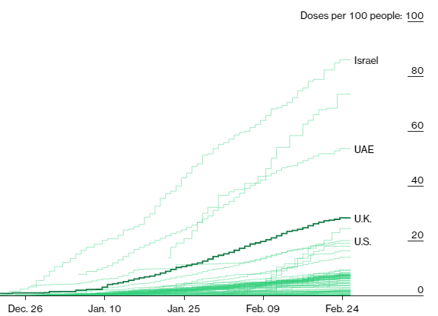
Confidential
As of 26 February 2021
Vaccines Market Intelligence
This flyer summarizes the current market trends for Covid 19 Vaccines globally including country doses procured to date and supplier contracts
Vaccinations
Vaccination data is from the Bloomberg COVID Vaccine Tracker. This data reflects data drawn from government websites, press conferences, public statements and Bloomberg interviews. This charts below reflect data as at 02-25-2020.
More than 218 million doses (Last week: 186 million) have been administered across 99 countries (Last week: 82 countries), according to data collected by Bloomberg. The latest rate was roughly 6.14 million doses a day (Last week: 6.34 million doses a day) .

