Slide 1


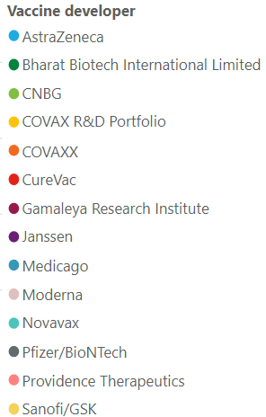
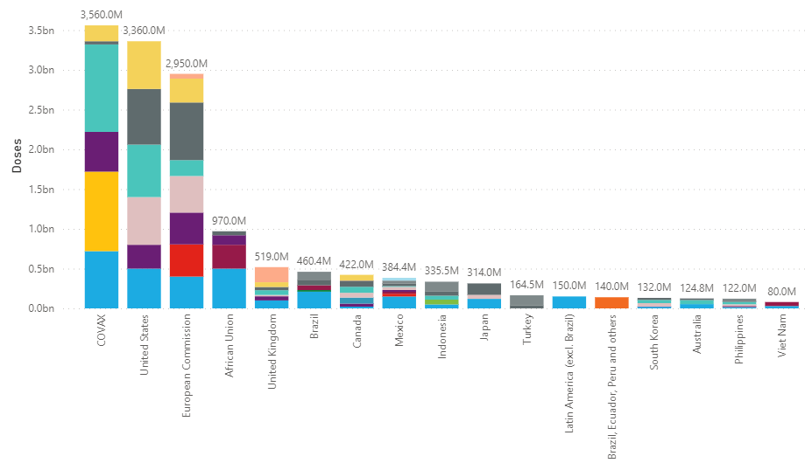
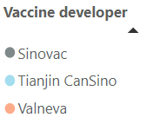
Confidential
As of 4 March 2021
Vaccines Market Intelligence
This flyer summarizes the current market trends for Covid 19 Vaccines globally including country doses procured to date and supplier contracts
Covid-19 Vaccines Global Orders
Media Headlines
Latest global press releases as at 03-04-2021
Below is a consolidation of the main media headlines regarding Covid-19 Vaccine development and distribution.
Covax details rollout of 238 million vaccine doses
Agence France Presse – 03-02-2021
Pakistan, Nigeria and Indonesia will be among the biggest recipients of free Covid-19 vaccines before June -- more than 10 million doses each – from the Covax scheme. Ghana, Ivory Coast, South Korea, India and Colombia have already received their first deliveries of vaccines through Covax. Nigeria, Angola, Cambodia all received their first vaccine doses via Covax this week, with the DR Congo also scheduled for a delivery
Single dose of AstraZeneca or Pfizer COVID-19 vaccine cuts hospitalization risk by more than 80%
MarketWatch – 02-24-2021
A single dose of either the AstraZeneca–Oxford vaccine or the Pfizer–BioNTech COVID-19 shot cuts the risk of hospital admission among older adults by more than 80% percent, Public Health England (PHE) said, citing a preprint study. The new data should also help allay concerns in some European countries, including France, Germany and Italy, which recommended that the vaccine developed by AstraZeneca with the University of Oxford should not be used for people over 65.
Merck Will Help Make J&J's Covid-19 Vaccine
Barrons – 03-02-2021
The White House has arranged a deal by which Merck will chip in to help competitor Johnson & Johnson manufacture doses of its Covid-19 vaccine. Merck will use one of its U.S. facilities for filling vials with the Johnson & Johnson vaccine, a process known as "fit and finish." It will use another to actually manufacture vaccine doses.
Brazil Virus Variant Overwhelms Region
Dow Jones Newswires – 02-23-2021
Brazil's daily death toll from the disease rose to its highest level yet this week, pushing the country's total number of Covid-19 fatalities past a quarter of a million. Neighbor Peru is struggling to curb a second wave of infections. The new variant, known as P.1, is 1.4 to 2.2 times more contagious than versions of the virus previously found in Brazil.
Brazil to buy 20 million COVID-19 vaccines from India's Bharat Biotech
Reuters – 02-25-2021
Brazil's Health Ministry on Thursday signed a contract to purchase 20 million doses of Covaxin, the COVID-19 vaccine made by India's Bharat Biotech, for delivery between March and May. The deal is worth 1.6 billion reais ($290,000). To speed up the buying of vaccines, Brazil published new rules last week dispensing with the bidding process.
mRNA Covid-19 Vaccines Are Fast to Make, but Hard to Scale
Dow Jones Institutional News – 02-24-2021
Pfizer Inc. and partner BioNTech SE did the unimaginable when they developed a Covid-19 vaccine in less than a year. Previously, the quickest vaccine development program was the four years it took to make the mumps vaccine, licensed in 1967. A big reason for the speedy success: a new gene-based technology involving messenger RNA, the molecules that carry genetic instructions. Yet that technology has also complicated manufacturing, forcing companies to redo how shots get made.
Vaccine 'Passports' Raise Logistical, Ethical Concerns
Wall Street Journal – 02-27-2021
Governments world-wide are looking at ways for people to prove they are inoculated against the coronavirus, raising logistical and ethical concerns about whether others will be excluded from daily life..
Note the news articles above are housed within Factiva, a news database and service subscription provided by the WB Library. Accessing them requires a simple one-time registration. Additionally, the full collection of all the relevant news articles from last week can be found here.
Pricing data is drawn from the UNICEF COVID-19 Vaccine Market Dashboard with additional data included where available. This charts below reflect data as at 03-04-2020.

Slide 2
Confidential
As of 4 March 2021
Vaccines Market Intelligence
This flyer summarizes the current market trends for Covid 19 Vaccines globally including country doses procured to date and supplier contracts
Vaccine Regulatory Approvals
Regulatory Approval Headlines
Latest Regulatory approval news as at 03-04-2021
FDA authorizes the first single-dose COVID-19 vaccine
Marketwatch – 03-01-2021
The Food and Drug Administration on Saturday granted emergency authorization to Johnson & Johnson’s COVID-19 vaccine, making it the third vaccine to become available to Americans during the pandemic and the first to only require one dose..
EU regulator not budging on vaccine dosage
Reuters – 03-03-2021
The European Union drug regulator does not see enough evidence yet to recommend changes to the dosage regime for COVID-19 vaccines, despite pressure from EU states after positive data on the level of protection of a single shot.
EU audits Indian vaccine maker as AstraZeneca looks to boost supplies to the bloc
Reuters – 03-01-2021
Europe's drug regulator is auditing the manufacturing site of the Serum Institute of India (SII), a necessary step before AstraZeneca's COVID-19 vaccine made there can be exported to the bloc.
EU, under pressure over vaccine rollouts, considers switch to emergency approvals
Reuters – 03-02-2021
The European Commission said it was considering emergency approvals for COVID-19 vaccines as a faster alternative to more rigorous conditional marketing authorizations which have been used so far.
Bharat Biotech's COVID-19 shot 81% effective, Indian firm's interim data shows
Reuters – 03-03-2021
Bharat Biotech's vaccine showed 81% efficacy in preventing symptomatic COVID-19 in an interim analysis of a late-stage trial in India. The positive result brightens prospects for sales overseas, with the vaccine, India's first successful homemade COVID-19 shot, already attracting interest from more than 40 countries, according to the firm..
Philippines' Duterte signs indemnity bill for COVID-19 vaccine rollout
Reuters – 02-19-2021
Philippines President Rodrigo Duterte on Friday signed into law a bill that gives indemnity to vaccine makers if their COVID-19 shots cause adverse side-effects, days before the country starts its lagging inoculation programme.
Novavax COVID-19 shot could be cleared for U.S. use by May
Reuters – 02-25-2021
Novavax Inc's COVID-19 vaccine could be cleared for use in the United States as soon as May if U.S. regulators authorize it based on data from the company's British trial, which could be completed "in the coming weeks.

Slide 3
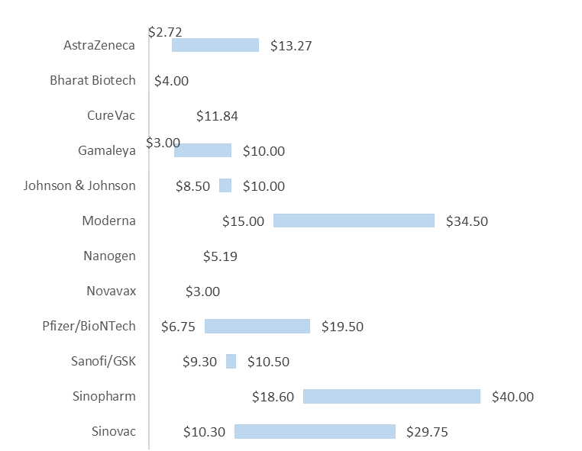
Confidential
As of 4 March 2021
Vaccines Market Intelligence
This flyer summarizes the current market trends for Covid 19 Vaccines globally including country doses procured to date and supplier contracts
Pricing
Pricing data is drawn from the UNICEF COVID-19 Vaccine Market Dashboard with additional data included where available. This data reflects publicly available pricing information as at 03-04-2020.
Price ranges for vaccines
Pricing details by Developer and Purchaser

Slide 4
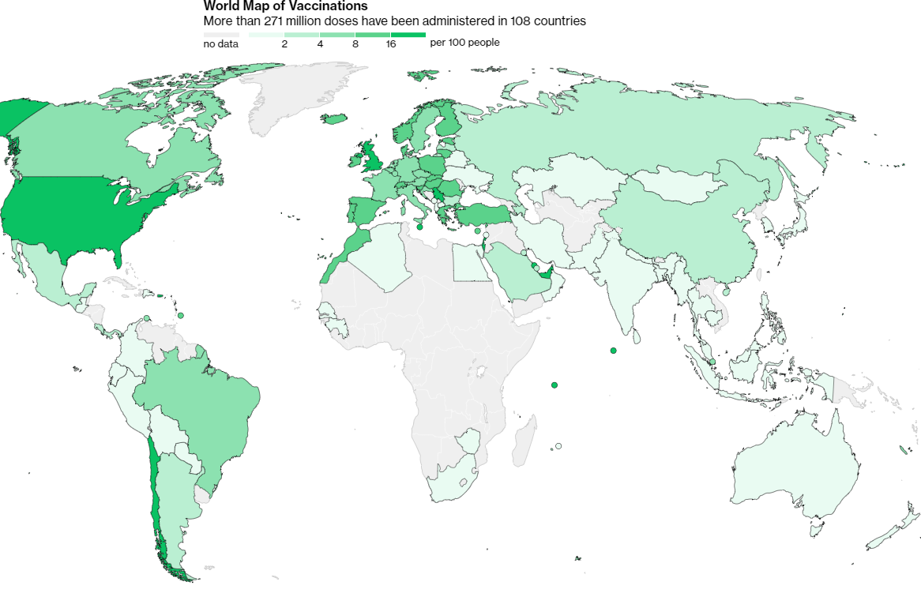
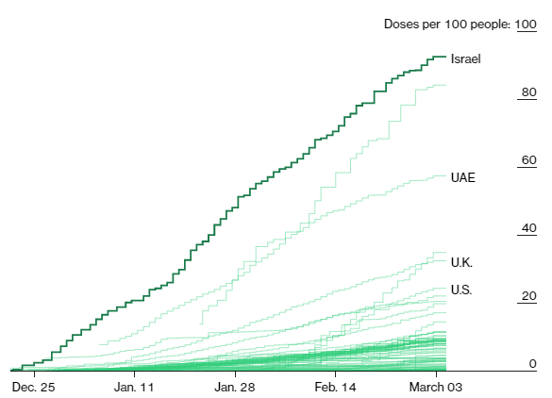
Confidential
As of 4 March 2021
Vaccines Market Intelligence
This flyer summarizes the current market trends for Covid 19 Vaccines globally including country doses procured to date and supplier contracts
Vaccinations
Vaccination data is from the Bloomberg COVID Vaccine Tracker. This data reflects data drawn from government websites, press conferences, public statements and Bloomberg interviews. This charts below reflect data as at 03-04-2020.
More than 271 million doses (Last week: 218 million) have been administered across 108 countries (Last week: 99 countries), according to data collected by Bloomberg. The latest rate was roughly 6.36 million doses a day (Last week: 6.14 million doses a day) .

