Slide 1


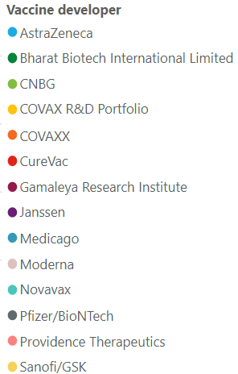
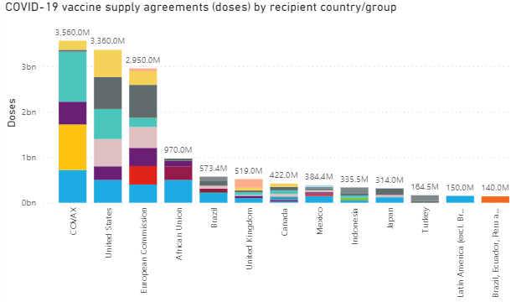
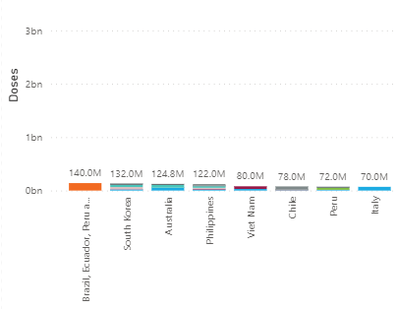
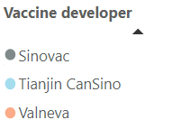
Confidential
As of 11 March 2021
Vaccines Market Intelligence
This flyer summarizes the current market trends for Covid 19 Vaccines globally including country doses procured to date and supplier contracts
Covid-19 Vaccines Global Orders
Media Headlines
Latest global press releases as at 03-11-2021
Below is a consolidation of the main media headlines regarding Covid-19 Vaccine development and distribution.
White House Plans to Seek to Buy 100M More Doses of J&J Vaccine
Barrons Online – 03-10-2021
Since last year, the U.S. government has had a deal with Johnson & Johnson for the delivery of 100 million doses of its vaccine, enough to vaccinate 100 million people. A new agreement would double that figure.
UNICEF chief: $1 billion more needed for COVAX COVID-19 vaccine rollout
Reuters – 03-10-2021
The United Nations' children’s fund urged countries to contribute more money to help poor countries access coronavirus vaccines, saying around $1 billion was needed.
WHO chief: waive Covid vaccine patents to put world on 'war footing
Reuters – 03-05-2021
The normal rules of business that protect the profits of vaccine manufacturers will have to be set aside if that is what it takes to ensure everybody is immunized against the coronavirus, according to the director general of the World Health Organization.
Russia's Sputnik V could be made in European Union after reported deals
Reuters– 03-09-2021
Russia's Sputnik V vaccine against COVID-19 could be produced in western Europe after a deal to make it in Italy was signed by Moscow's RDIF sovereign wealth fund and Swiss-based pharmaceutical company Adienne.
Australia asks EU to review vaccine blocking
The Sydney Morning Herald – 03-06-2021
Australia has asked the European Commission to review a decision to block a shipment of 250,000 AstraZeneca vaccine doses. The decision to block the international shipment is the first time the European Commission has used its powers over whether vaccines manufactured on the continent by Pfizer and AstraZeneca can leave its territory.
EU regulator says no signs AstraZeneca vaccine led to Austria illnesses
Associated Press – 03-10-2021
The European Medicines Agency said there was no evidence so far linking AstraZeneca's COVID-19 vaccine to illnesses in two people who received it in Austria, one of whom died 10 days after being inoculated. The Austrian national health authority suspended the use of a batch of the vaccine after a person who was vaccinated was diagnosed with multiple thrombosis and later died.
Moderna taps Baxter to support fill and finish of 60-90 mln COVID-19 vaccine doses
Reuters – 03-08-2021
Drugmaker Baxter International Inc will help fill in vials and package about 60-90 million doses of Moderna Inc's COVID-19 vaccine in 2021. Baxter has also partnered with Novavax Inc to provide sterile manufacturing services for its COVID-19 vaccine candidate.
Malaysia to buy more Pfizer-BioNTech vaccines
Reuters – 03-08-2021
Malaysia will buy additional doses of Pfizer-BioNTech's COVID-19 vaccine, bringing the total secured to 32 million, enough to cover half of its population. Malaysia is also considering dropping negotiations to procure a single-dose vaccine from U.S. pharmaceutical firm Johnson & Johnson, in favor of a deal with Chinese company CanSino Biologics, which also requires only one dose.
Israel, Austria and Denmark establish vaccine-supply alliance
Reuters – 03-04-2021
Israel, Austria and Denmark said they would set up a joint research and development fund and possibly production facilities for COVID-19 vaccines to ensure they had long-term supplies for booster shots or to contend with virus mutations.
Note the news articles above are housed within Factiva, a news database and service subscription provided by the WB Library. Accessing them requires a simple one-time registration.
Pricing data is drawn from the UNICEF COVID-19 Vaccine Market Dashboard with additional data included where available. This charts below reflect data as at 03-11-2020.

Slide 2
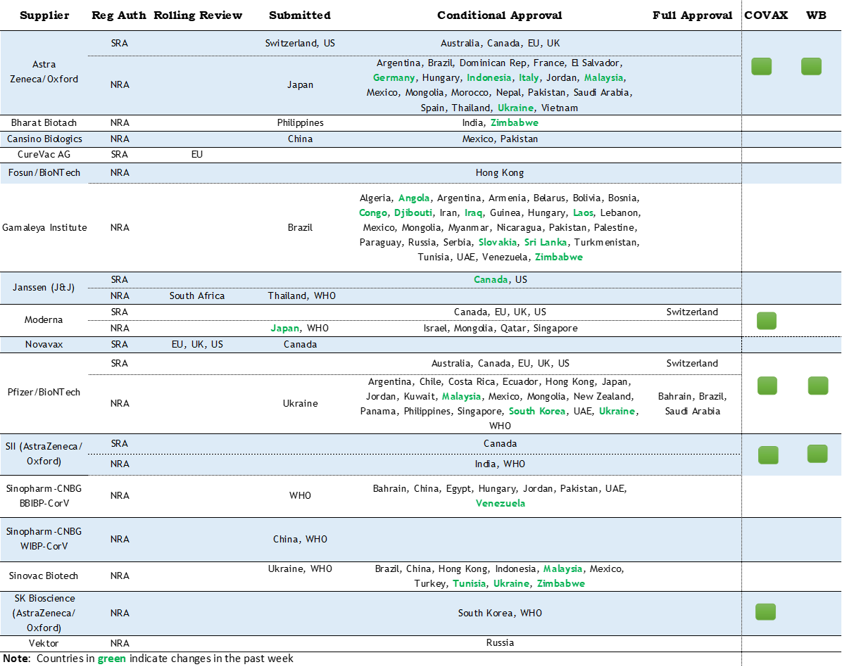
Confidential
As of 11 March 2021
Vaccines Market Intelligence
This flyer summarizes the current market trends for Covid 19 Vaccines globally including country doses procured to date and supplier contracts
Vaccine Regulatory Approvals
Regulatory Approval Headlines
Latest Regulatory approval news as at 03-11-2021
Johnson & Johnson's vaccine is the fourth shot approved for use in Canada
The Globe and Mail – 03-05-2021
Health Canada regulators announced they have authorized the single-dose vaccine from the Janssen Pharmaceutical Companies, owned by Johnson & Johnson. The Johnson & Johnson vaccine has been authorized for people 18 years and older.
EU regulator starts a review of Russia's COVID-19 vaccine
Associated Press – 03-04-2021
The European Medicines Agency has started a rolling review of Russia's Sputnik V coronavirus vaccine, many months after it was first approved for use in Russia and after dozens of countries around the world have authorized it.
Takeda Seeks Japan Green Light for Moderna Vaccine
Dow Jones Institutional News – 03-05-2021
Moderna says Takeda Pharmaceutical, its partner in Japan, has filed for regulatory approval to import and distribute Moderna's Covid-19 vaccine. The companies last year said Takeda plans to import and distribute 50m doses of the vaccine starting in the first half of 2021, pending licensure in Japan.
Indonesia approves AstraZeneca vaccine for emergency use
Reuters – 03-08-2021
Indonesia has approved AstraZeneca's COVID-19 vaccine for emergency use. More than one million doses of the vaccine arrived late on Monday via the COVAX global vaccine-alliance scheme.
Italy approves AstraZeneca’s COVID-19 vaccine for over 65s
MarketWatch – 03-08-2021
Italy has approved the use of AstraZeneca’s COVID-19 vaccine for the over 65s, becoming the latest European country to reverse its stance and give the green light for use of the shot in older people.
Zimbabwe authorizes Sputnik V, Sinovac coronavirus vaccines for emergency use
Reuters – 03-09-2021
The Medicines Control Authority of Zimbabwe has authorized the use of Sinopharm and Sinovac shots from China, Russia's Sputnik V and India's Covaxin.
South Africa regulator says at advanced stage of Pfizer vaccine review
Reuters – 03-04-2021
South Africa's medicines regulator said on Thursday that it was at an advanced stage of reviewing an emergency use application for Pfizer's COVID-19 vaccine.
Namibia becomes the 50th country to authorize Sputnik V
Reuters – 03-04-2021
The Ministry of Health and Social Services of Namibia has registered Sputnik V under the emergency use authorization procedure. Total population of 50 countries where the Russian vaccine is approved for use exceeds 1.3 billion people.

Slide 3
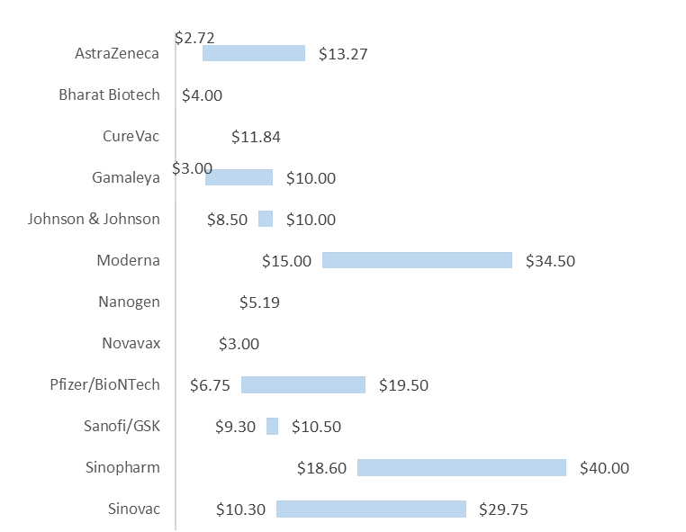
Confidential
As of 11 March 2021
Vaccines Market Intelligence
This flyer summarizes the current market trends for Covid 19 Vaccines globally including country doses procured to date and supplier contracts
Pricing
Pricing data is drawn from the UNICEF COVID-19 Vaccine Market Dashboard with additional data included where available. This data reflects publicly available pricing information as at 03-11-2020.
Price ranges for vaccines
Pricing details by Developer and Purchaser

Slide 4
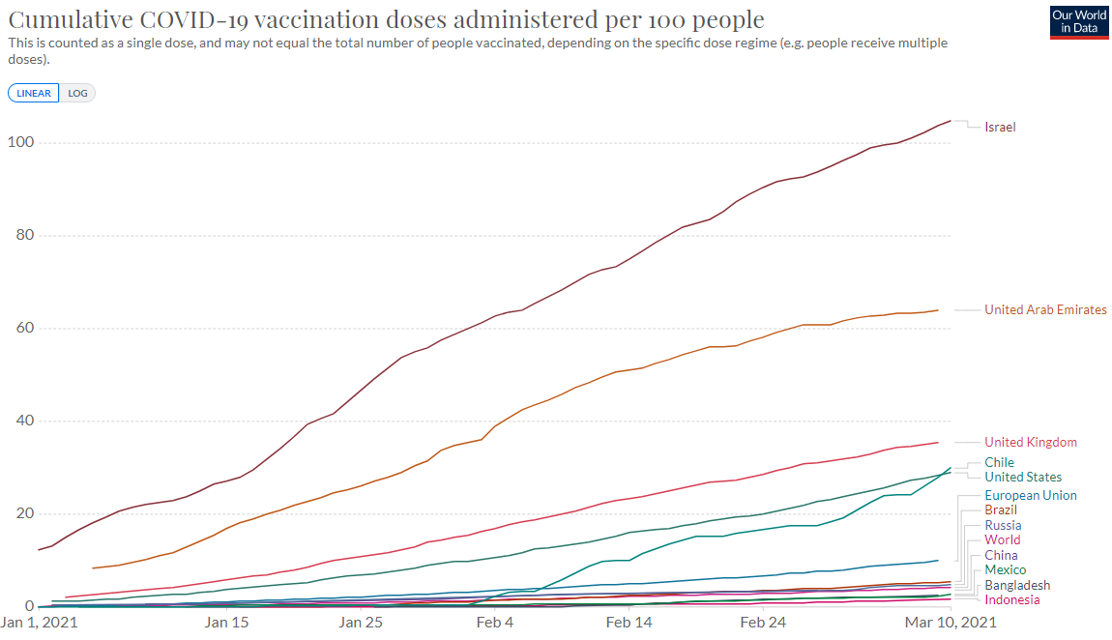
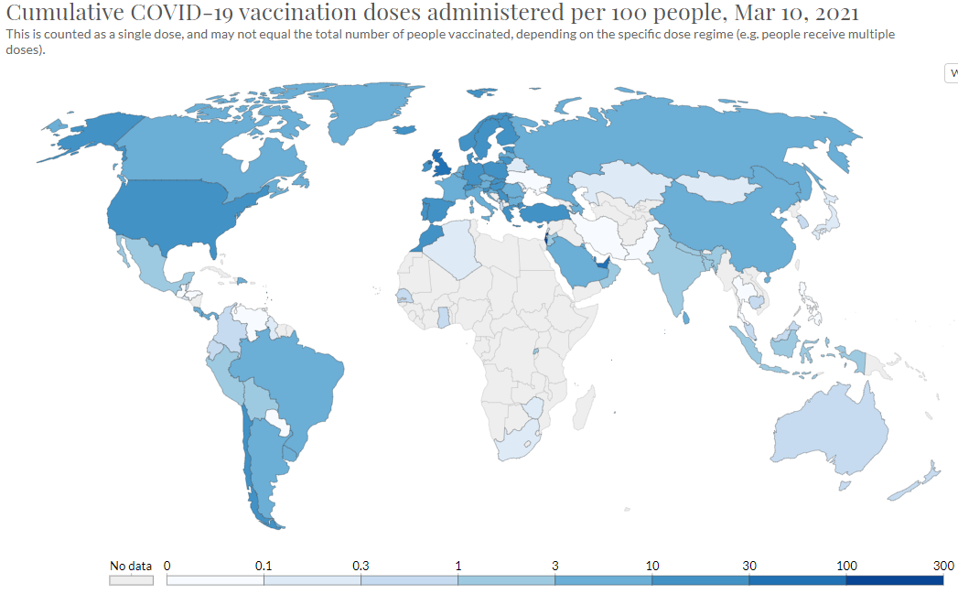
Confidential
As of 11 March 2021
Vaccines Market Intelligence
This flyer summarizes the current market trends for Covid 19 Vaccines globally including country doses procured to date and supplier contracts
Vaccinations
Vaccination data is from the Our World in Data database. This charts below reflect data as at 03-11-2020.
More than 330 million doses (Last week: 271 million) have been administered across 121 countries (Last week: 108 countries), according to data collected by Bloomberg. The latest rate was roughly 8.47 million doses a day (Last week: 6.36 million doses a day) .

