Slide 1


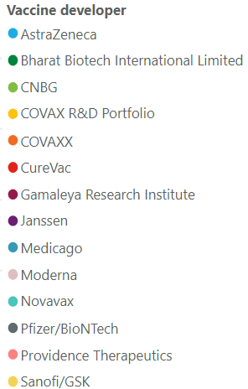
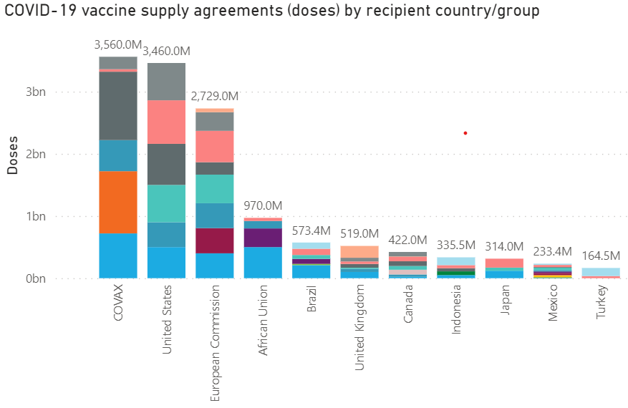
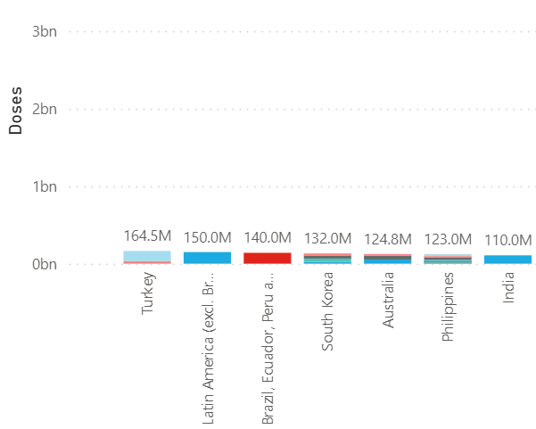
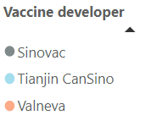
Confidential
As of 18 March 2021
Vaccines Market Intelligence
This flyer summarizes the current market trends for Covid 19 Vaccines globally including country doses procured to date and supplier contracts
Covid-19 Vaccines Global Orders
Media Headlines
Latest global press releases as at 03-18-2021
Below is a consolidation of the main media headlines regarding Covid-19 Vaccine development and distribution.
EU countries to restart use of ‘safe and effective’ AstraZeneca vaccine
Financial Times – 03-18-2021
Germany, France, Italy and Spain said they would resume using the Oxford/AstraZeneca coronavirus vaccine after the EU drugs regulator said there was a “clear scientific conclusion” that the jab was “safe and effective”.
Novavax vaccine 96% effective against original coronavirus, 86% vs British variant in UK trial
Reuters – 03-11-2021
Novavax Inc's COVID-19 vaccine was 96% effective in preventing cases caused by the original version of the coronavirus in a late-stage trial conducted in the United Kingdom. In a smaller trial conducted in South Africa - where volunteers were primarily exposed to another newer, more contagious variant - the vaccine was 55% effective, but still fully prevented severe illness.
EU threatens to halt Covid vaccine exports to UK unless it gets ‘fair share’
Reuters– 03-09-2021
The EU is prepared to take exceptional steps to halt exports of Covid-19 vaccines to Britain and secure doses for its own citizens unless the UK starts shipping shots to the bloc, the European commission president has said.
Australia gives COVID-19 shots to virus-hit Papua New Guinea
Associated Press – 03-16-2021
Australia will send COVID-19 vaccines from its own supply to its near-neighbor Papua New Guinea and will ask AstraZeneca to send more to try to contain a concerning wave of infections.
Hungary publishes Chinese, Russian vaccine contracts amid COVID-19 surge
Reuters – 03-11-2021
Hungary said on Thursday it was paying the equivalent of about $37.50 per dose for Chinese company Sinopharm's COVID-19 vaccine and $9.95 per dose for the Russian Sputnik-V vaccine, adding it was publishing the purchase contracts to push for more transparency.
Conflict grows between US and allies over vaccine supply
Associated Press – 03-12-2021
The Biden administration is stockpiling tens of millions of doses of a COVID-19 vaccine whose authorization in the U.S. remains uncertain, frustrating U.S. allies who say those doses should be used now to save lives overseas. Besides generating ill will, Biden's insistence on an excess supply for America is potentially creating new openings for geopolitical rivals Russia and China.
Quad leaders' pledge of 1 billion doses seen as a move to counter Beijing's influence in region
Reuters – 03-08-2021
The United States, India, Australia and Japan have pledged to deliver a billion doses of Covid-19 vaccine throughout the Indo-Pacific by the end of 2022 in what is widely seen as a bid to counter China's influence in the region. Observers say it will allow the group known as the Quad to stake out a role in a region that has been a major beneficiary of Beijing's so-called vaccine diplomacy.
China donates vaccine doses to UN peacekeepers
Associated Press – 03-15-2021
China is donating 300,000 doses of COVID-19 vaccines to U.N. peacekeepers, with priority given to those serving in Africa.
Africa proves rocky terrain for Russian and Chinese vaccines
Reuters – 03-12-2021
Russia and China are racing to plug the COVID-19 vaccine gap in Africa, hoping to cement their influence on a continent where many countries have yet to administer a single shot. But, so far, vaccine donations from Beijing and Moscow have been small, the commercial deals they offer are costly, and some African governments are wary about a lack of data..
Pricing data is drawn from the UNICEF COVID-19 Vaccine Market Dashboard with additional data included where available. This charts below reflect data as at 03-18-2020.

Slide 2
Confidential
As of 18 March 2021
Vaccines Market Intelligence
This flyer summarizes the current market trends for Covid 19 Vaccines globally including country doses procured to date and supplier contracts
Vaccine Regulatory Approvals
Regulatory Approval Headlines
Latest Regulatory approval news as at 03-18-2021
Johnson & Johnson’s Single-Shot Covid Vaccine Approved by EU
Bloomberg – 03-11-2021
The European Commission granted a conditional marketing authorization after the EU’s drugs regulator recommended approval for all adults earlier Thursday. It’s the fourth shot to be cleared in the region.
WHO grants emergency authorization for J&J COVID vaccine
Associated Press – 03-12-2021
he World Health Organization granted an emergency use listing for the coronavirus vaccine made by Johnson & Johnson, meaning the one-dose shot can now theoretically be used as part of the international COVAX effort.
Canadian panel changes tack, recommends AstraZeneca COVID-19 vaccine in people over 65
Reuters – 03-16-2021
Canada's vaccine advisory panel on Tuesday backed the use of AstraZeneca's COVID-19 vaccine for people aged 65 and older after initially recommending against it, saying that three recent real-world studies showed the shot to be safe and effective for older adults.
U.S. authorization of AstraZeneca vaccine could come in April
Reuters – 03-15-2021
The independent monitors are analyzing data from the 32,000-person U.S. study to determine whether the vaccine is safe and effective. If the results are positive and all goes well, the F.D.A. would review the data and issue the authorization in about a month.
Italy approves AstraZeneca’s COVID-19 vaccine for over 65s
MarketWatch – 03-08-2021
Italy has approved the use of AstraZeneca’s COVID-19 vaccine for the over 65s, becoming the latest European country to reverse its stance and give the green light for use of the shot in older people.
Brazil gives final approval for AstraZeneca vaccine, sees domestic manufacture
Reuters – 03-15-2021
Brazil's health regulator Anvisa said it has given final approval for AstraZeneca COVID-19 vaccine, which will be manufactured domestically by the Fiocruz biomedical institute. Brazil could begin full production of the vaccine by July.
China to Allow More Foreigners In -- If They've Had a Chinese Covid Vaccine
Dow Jones Newswires – 03-16-2021
After a year of barring entry by most foreign citizens, China's government plans to ease restrictions for those who have been inoculated against Covid-19. The hitch for now: Only vaccines made in China will qualify.
South Africa approves Pfizer-BioNTech COVID vaccine
Reuters – 03-16-2021
South Africa’s drugs regulator SAHPRA said that it had approved a “section 21” emergency use application for the COVID-19 vaccine developed by Pfizer and BioNTech.

Slide 3
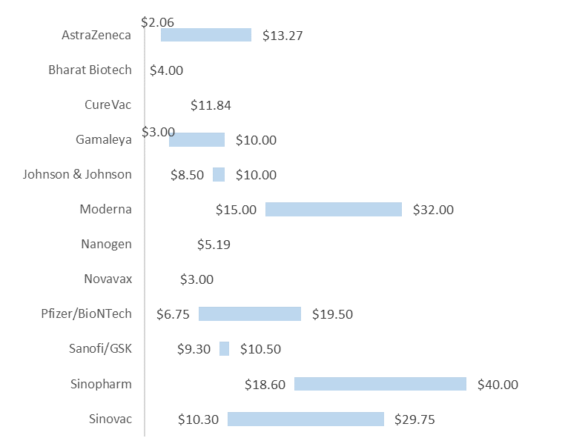
Confidential
As of 18 March 2021
Vaccines Market Intelligence
This flyer summarizes the current market trends for Covid 19 Vaccines globally including country doses procured to date and supplier contracts
Pricing
Pricing data is drawn from the UNICEF COVID-19 Vaccine Market Dashboard with additional data included where available. This data reflects publicly available pricing information as at 03-18-2020.
Price ranges for vaccines
Pricing details by Developer and Purchaser

Slide 4
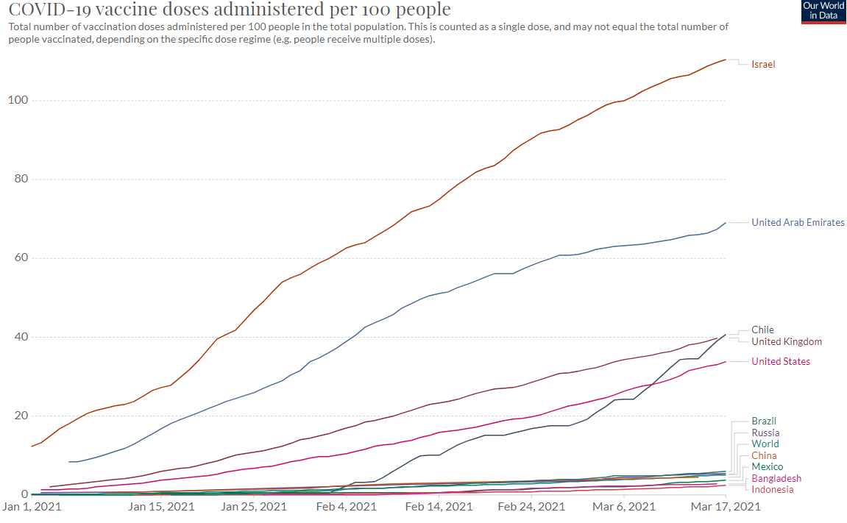
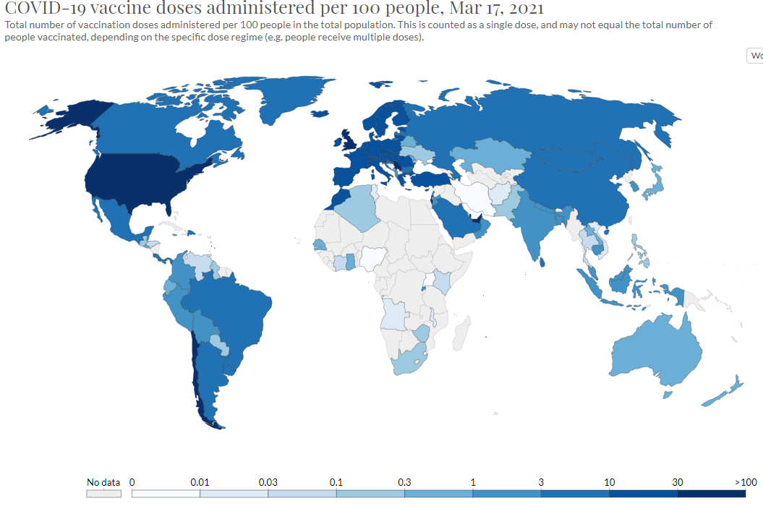
Confidential
As of 18 March 2021
Vaccines Market Intelligence
This flyer summarizes the current market trends for Covid 19 Vaccines globally including country doses procured to date and supplier contracts
Vaccinations
Vaccination data is from the Our World in Data database. This charts below reflect data as at 03-18-2020.
More than 400 million doses (Last week: 330 million) have been administered across 132 countries (Last week: 121 countries), according to data collected by Bloomberg. The latest rate was roughly 9.64 million doses a day (Last week: 8.47 million doses a day) .

