Slide 1


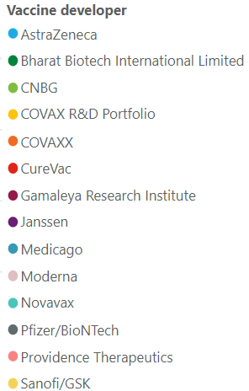
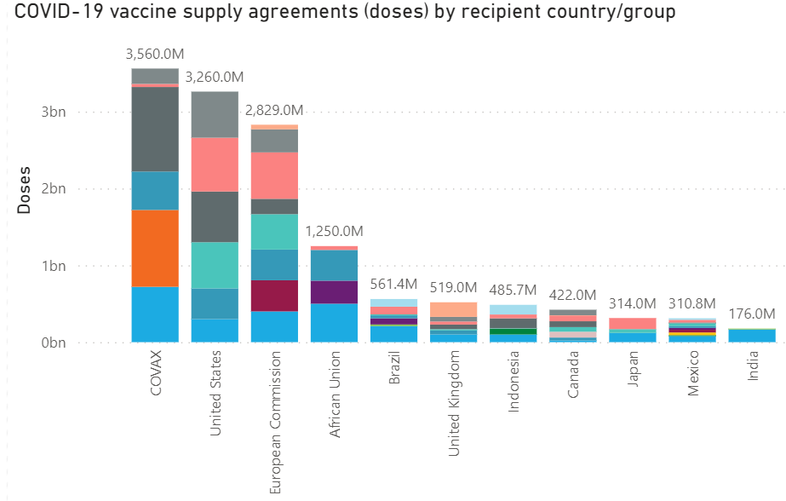
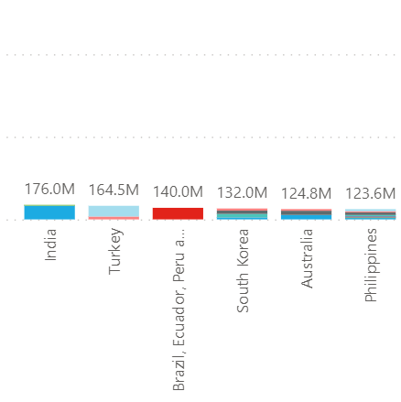
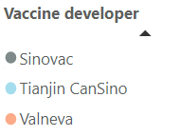
Confidential
As of 01 April 2021
Vaccines Market Intelligence
This flyer summarizes the current market trends for Covid 19 Vaccines globally including country doses procured to date and supplier contracts
Covid-19 Vaccines Global Orders
Media Headlines
Latest global press releases as at 04-01-2021
Below is a consolidation of the main media headlines regarding Covid-19 Vaccine development and distribution.
EU drug watchdog reaffirms no particular clot risk factor linked to AstraZeneca vaccine
Reuters – 03-31-2021
Europe's medicines regulator reiterated its backing of AstraZeneca's COVID-19 vaccine, saying no particular group of age, sex or a previous medical history was especially susceptible to blood clotting after receiving the shot.
Germany to restrict AstraZeneca use in under-60s over clots
Associated Press – 03-30-2021
German health officials agreed to restrict the use of AstraZeneca's coronavirus vaccine in people under 60, amid fresh concern over unusual blood clots reported in a tiny number of those who received the shots. The move follows the recommendations of Germany's independent vaccine expert panel and comes after the country's medical regulator released new data showing a rise in reported cases of an unusual form of blood clot in the head.
J&J, African Union in deal for up to 400 million COVID-19 shots
Reuters – 03-29-2021
J&J unit Janssen Pharmaceutica NV has entered into a deal with the African Vaccine Acquisition Trust (AVAT) to deliver 220 million doses of its single-dose shot. AVAT could order an additional 180 million doses through 2022.
India balances 'vaccine diplomacy' with local demand amid case surge
South China Morning Post – 03-30-2021
As countries anxiously await delayed shipments of Covid-19 vaccines, India has defended its decision to halt exports of Covishield, the Oxford/AstraZeneca vaccine made by the Serum Institute of India (SII), to prioritize local demand amid a sharp rise in cases. Meanwhile, India has placed another order with the SII for a further 100 million Covishield doses, prompting concerns in other countries over how much will be left for them.
Asian countries seek vaccine supplies after India export curbs hit COVAX
Reuters – 03-30-2021
Several Asian countries sought alternative sources for COVID-19 inoculations after export restrictions by manufacturer India left COVAX short of supplies. In Vietnam, for example, officials have asked the private sector to step in after their COVAX supplies were slashed by 40% to 811,200 doses and shipments were pushed back by weeks.
GlaxoSmithKline Will Help Manufacture Novavax's Covid-19 Vaccine for U.K.
Barrons – 03-29-2021
GlaxoSmithKline disclosed the latest in a recent spate of Covid-19 vaccine manufacturing collaborations, saying it would help make up to 60 million doses of Novavax's vaccine for use in the U.K. GSK said it will be providing fill and finish capacity, the last step in the vaccine manufacturing process, at one of its facilities in England.
New vaccines needed globally within a year, say scientists
The Guardian – 03-30-2021
The planet could have a year or less before first-generation Covid-19 vaccines are ineffective and modified formulations are needed, according to a survey of epidemiologists, virologists and infectious disease specialists. Persistent low vaccine coverage in many countries would make it more likely for vaccine-resistant mutations to appear
Despite shortages, Zimbabwe hesitates to take Chinese COVID-19 vaccines
The Globe and Mail – 03-26-2021
The suspicions about the Chinese coronavirus vaccines have added yet another complication to the vaccination challenges in Africa. Zimbabwe was one of the first African countries to receive vaccines for the virus, thanks to a donation from China five weeks ago. Today it has received 600,000 doses of two Chinese vaccines, Sinopharm and Sinovac. Yet it has managed to administer fewer than 59,000 of those doses so far, largely because of a lack of enthusiasm from the Zimbabwean people.
Pricing data is drawn from the UNICEF COVID-19 Vaccine Market Dashboard with additional data included where available. This charts below reflect data as at 04-01-2020.

Slide 2
Confidential
As of 01 April 2021
Vaccines Market Intelligence
This flyer summarizes the current market trends for Covid 19 Vaccines globally including country doses procured to date and supplier contracts
Vaccine Regulatory Approvals
Regulatory Approval Headlines
Latest Regulatory approval news as at 04-01-2021
Pfizer says its COVID-19 vaccine protects younger teens
Reuters – 03-31-2021
Pfizer announced that its COVID-19 vaccine is safe and strongly protective in kids as young as 12, a step toward possibly beginning shots in this age group before they head back to school in the fall. In the vaccine study of 2,260 U.S. volunteers ages 12 to 15, preliminary data showed there were no cases of COVID-19 among fully vaccinated adolescents.
COVID vaccine found highly effective in real-world US study
Associated Press – 03-29-2021
The two vaccines available in the USA — Pfizer and Moderna — were found to be highly effective at 90% after two doses, the Centers for Disease Control and Prevention reported. In testing, the vaccines were about 95% effective in preventing COVID-19.
AstraZeneca confirms strong protection after data update
Daily Mail – 03-21-2021
AstraZeneca insisted that its COVID-19 vaccine provides strong protection even after counting additional illnesses in its U.S. study. AstraZeneca said it had analyzed more data from that study and concluded the vaccine is 76% effective in preventing symptomatic COVID-19, instead of the 79% it had reported earlier in the week.
Brazil's Fiocruz readies study of AstraZeneca vaccine for minors
Reuters – 03-22-2021
Convidecia - the second Chinese-produced vaccine approved in Hungary after the Sinopharm vaccine in February - is a single-dose viral vector jab currently approved for use in China, Pakistan and Mexico.
.
Other Approval news
The following countries have approved Sputnik V vaccine developed by Gamaleya Research Institute for Emergency Use in:
Antigua and Barbuda (RDIF)
Viet Nam (RDIF)
Janssen's COVID-19 vaccine has been approved for use in the following countries:
Colombia (Reuters)
Thailand (Thailand's Minister of Public Health)

Slide 3
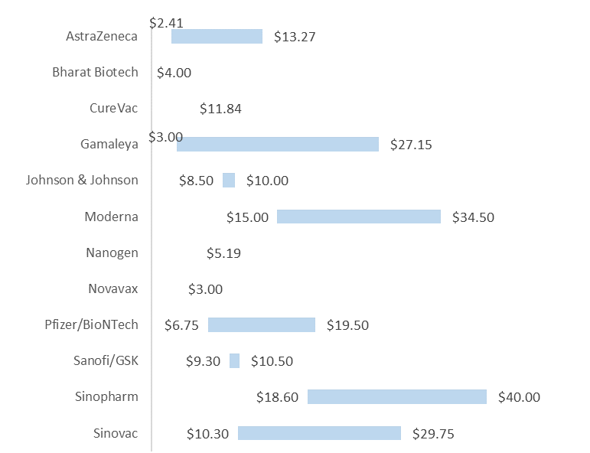
Confidential
As of 01 April 2021
Vaccines Market Intelligence
This flyer summarizes the current market trends for Covid 19 Vaccines globally including country doses procured to date and supplier contracts
Pricing
Pricing data is drawn from the UNICEF COVID-19 Vaccine Market Dashboard with additional data included where available. This data reflects publicly available pricing information as at 04-01-2020.
Price ranges for vaccines
Pricing details by Developer and Purchaser

Slide 4
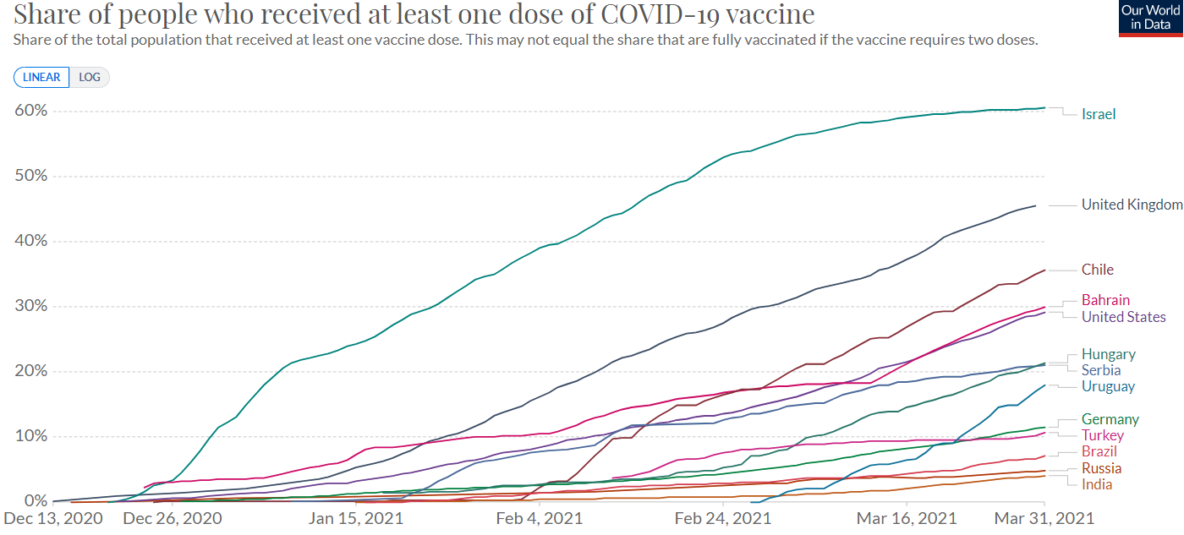
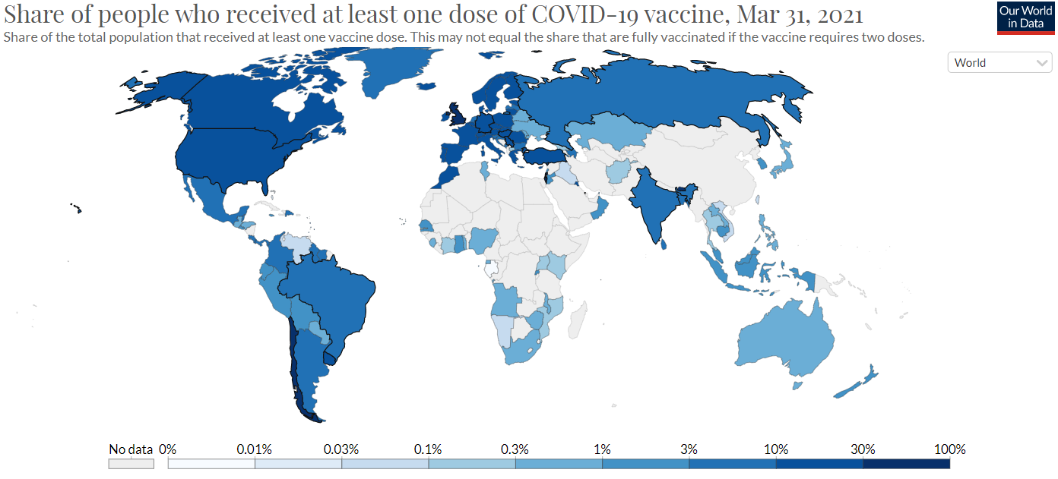
Confidential
As of 01 April 2021
Vaccines Market Intelligence
This flyer summarizes the current market trends for Covid 19 Vaccines globally including country doses procured to date and supplier contracts
Vaccinations
Vaccination data is from the Our World in Data database. This charts below reflect data as at 04-01-2020.
More than 486 million doses (Last week: 400 million) have been administered across 137 countries (Last week: 132 countries), according to data collected by Bloomberg. The latest rate was roughly 11.9million doses a day (Last week: 9.64 million doses a day) .

