Slide 1




Launching a system of Quality
Improvement of Primary Health Care in Georgia
MINISTRY OF INTERNALLY DISPALCED PERSONS FROM THE OCCUPIED TERRITORIES, LABOUR, HEALTH AND SOCIAL AFFARIS OF GEORGIA

Slide 2
Project title: Improvement of Quality system of Primary Healthcare in Georgia
Donor: Czech Development Agency
Implementing Agency: Caritas Czech Republic based on the Cooperation Agreement with the Ministry of Internally displaced Persons from the Occupied Territories, Labour, Health and Social affairs of Georgia
Project duration: July 2017- December 2019
Project Information

Slide 3
Project Aim
To set up a system of quality improvement of primary health care in Georgia
Project Objectives
Develop tools for measuring quality of clinical processes in PHC with the purpose of demonstrating at pilot facilities
Assess quality of health services with IT system developed within the framework of the Project
The second stage of the project assumes to offer Results- based payment model to MoILHSA

Slide 4
Health System Enabling Factors
In February 2013, the Government of Georgia launched the Universal Health Coverage (UHC) Program
  Sustaining the coverage achieved to date and deepening coverage through better financial protection against Out Of Pocket (OOP) costs are the policy priorities for the Government of Georgia
Free visits to family doctors, referral and prescribing systems
A single purchasing agency
Higher public spending on health (WHO 2016)
  GoG funding on Healthcare has been increased dramatically (from 12% in 2001) and reached 37% of THE in 2016
Investments in primary care infrastructure, practice guideline development, disease surveillance mechanisms
Primary Health Care Development Strategy 2016-2023 prepared by the Global Alliance for Health
  The Strategy aims at strengthening family medicine and developing responsive, effective and sustainable primary health care

Slide 5
Challenges
Along with the service accessibility, prices are increasing for medical services and quality does not reach the desired indicator
The infrastructure of quality systems in health-care institutions is based largely on private initiative and is very diverse, at different stages of development
The current external medical audit system is based on reported adverse events rather than systematic examination of clinical priorities – a mechanism for financial control rather than clinical learning
The current attitude of organizations to stronger quality is perceived as unnecessary control that threatens “business”, therefore there is resistance to transparency
Current permits and technical regulations are focused on structure evaluation and have limited scope
Lack of national framework to systematically measure quality of all health services at process and outcome levels

Slide 6





Project pilot health facilities
Curatio
Medcapital
Medicore
Medical Holding 23
National Family Medicine Training Center
Concluded Memorandum of Understanding between Caritas Czech Republic in Georgia and Pilot Medical facilities

Slide 7
What has been done up to date
Developed indicators’ portfolio for assessment the quality of clinical processes: for preventive services, non-communicable chronic diseases as well as organizational – for utilization of PHC services
Developed and updated clinical protocols/algorithms for the management of project priority clinical conditions
Developed respective clinical supervision forms (flow sheets)
5 pilot facilities selected for testing quality assessment tools (based on preliminary developed inclusion criteria). Their participation in the pilot initiative approved by the decree #01-4/ო of the Minister of Internally displaced persons from the occupied territories, Labor, Health and Social affairs of Georgia, on January 9, 2018

Slide 8
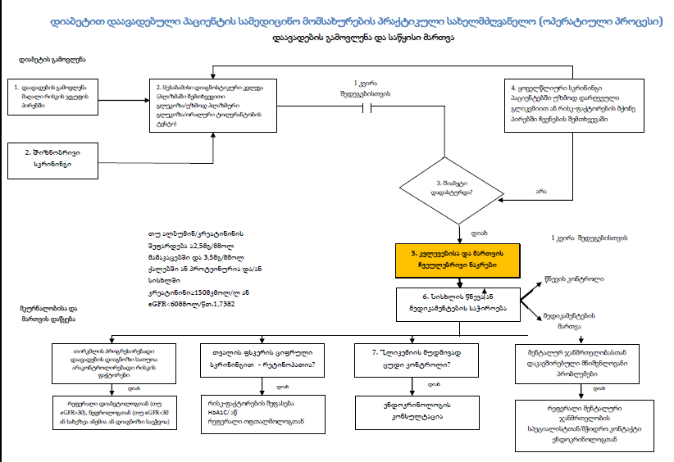
Sample of the Algorithm of Management of Clinical Condition – Diabetes Mellitus

Slide 9
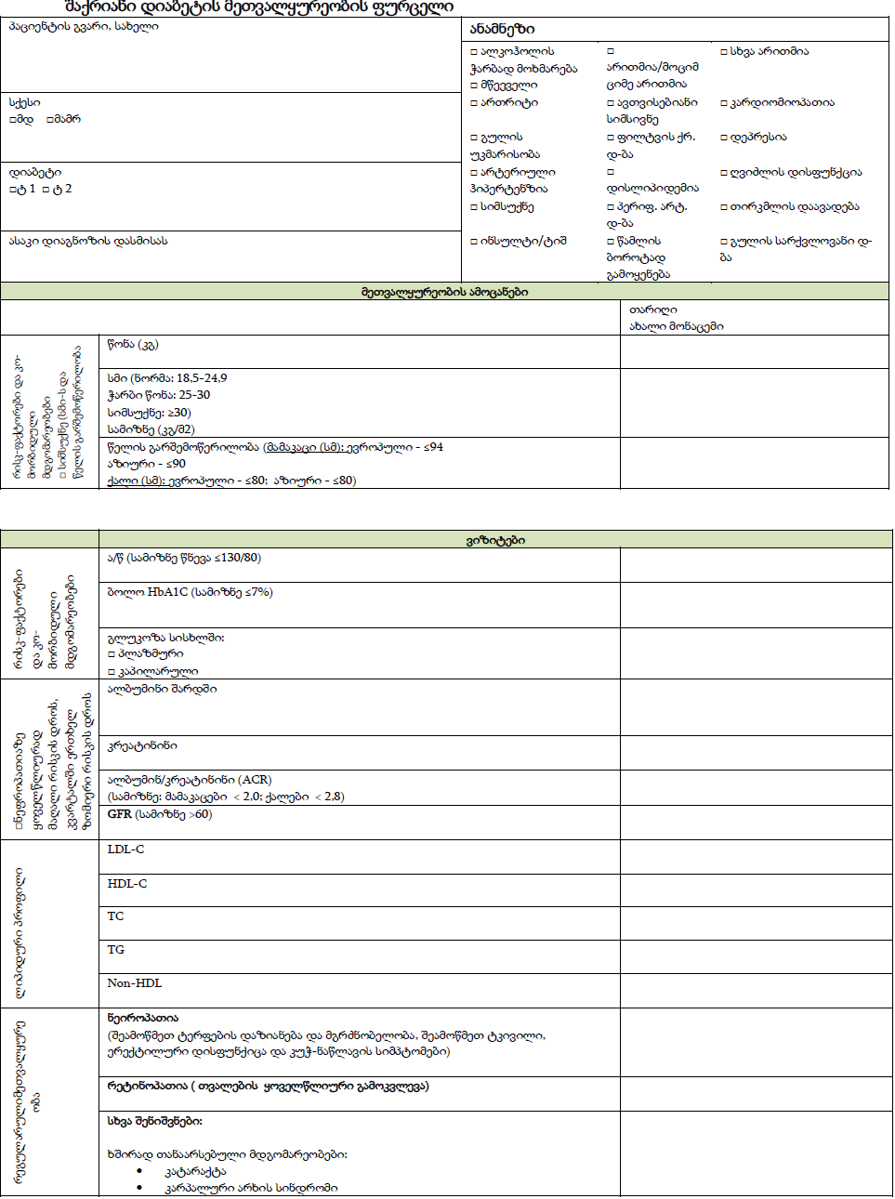
Sample of the Flow-sheet for disease follow-up– Diabetes Mellitus and CAD
დიაგნოსტიკური/კლინიკური მონაცემები თარიღის მიხედვით |  |  |  | ახალი მონაცემი ვიზიტის თარიღი
3-6 თვეში ერთხელ | კლინიკური სტატუსი | გადაუდებელი დახმარება კად-ის გამო (სასწრაფო/ჰოსპიტალური დახმარება ბოლო გეგმიური ვიზიტის შემდეგ) |  | □ არა □ სასწრაფო ვიზიტების რაოდენობა_____________
 |  | სტაბილური სიმპტომები (სტენოკარდია, გულის ფრიალი, ჰაერის უკმარისობა, შეშუპება, თავბრუ) |  | □ სტაბილური □ არასტაბილური □ სტენოკარდია □ გულის ფრიალი □ ჰაერის უკმარისობა □ შეშუპება □ თავბრუ
 | ჰიპერტენზია | არტერიული წნევა (სამიზნე <140/90მმ ვწყ სვ) |  | გაზომვის თარიღი________ მნიშვნელობა_____________
 | ცხოვრების სტილი | სამიზნე სმი 18,5 - 24,9 სიმაღლე: ჩაწერეთ წონა |  | □კგ სმი _______________
 |  | კონსულტირება თამბაქოს მოწევაზე |  | □ დიახ □ არა
 |  | ფიზიკური აქტივობა >30წთ დღეების უმეტესობა, საშუალო ინტენსივობის |  | □ დიახ □ არა □ N/A
 |  | სხვა ქცევითი რისკფაქტორები: □ სტრესი □ კვება □ ალკოჰოლი |  | □ განხილულია □ განხილულია □ განხილულია
 | მედიკამენტები | ანტიაგრეგანტული/ანტიკოაგულაციური თერაპია ____________________________________________ |  | □ დიახ: □ASA □ პლავიქსი □ არა: □უკუჩვენება; □აუტანლობა; □ პაციენტის უარი; □ ფინანსური □ სხვა_________________________
 |  | აგფ-ი ან არბ ________________________________ |  | □ დიახ: ______________________ □ არა: □უკუჩვენება; □აუტანლობა; □ პაციენტის უარი; □ ფინანსური □ სხვა__________________________
 |  | სტატინი___________________________________ |  | □ დიახ: _______________________ □ არა: □უკუჩვენება; □აუტანლობა; □ პაციენტის უარი; □ ფინანსური □ სხვა___________________________
 |  | ბეტა-ბლოკერი_____________________________ |  | □ დიახ: ________________________ □ არა: □უკუჩვენება; □აუტანლობა; □ პაციენტის უარი; □ ფინანსური □ სხვა_______________
 |  | შენიშვნა: |  | □ მკურნალობის გადახედვა □ მკურნალობის კორექტირება
 | დისლიპიდემია | უზმოდ პროფილი | LDL-C | გაზომვის თარიღი________ მნიშვნელობა_____________
 |  |  | HDL-C | გაზომვის თარიღი________ მნიშვნელობა_____________
 |  |  | TC | გაზომვის თარიღი________ მნიშვნელობა_____________
 |  |  | TG | გაზომვის თარიღი________ მნიშვნელობა_____________
 |  |  | Non-HDL | გაზომვის თარიღი________ მნიშვნელობა_____________
წელიწადში ერთხელ | სხვა | თვით მართვის სამიზნეების შეფასება და განხილვა |  | □ განხილულია
 |  | რეფერალი კარდიული რეაბილიტაციის ან სხვა პროგრამაში |  | □ განხილულია

Slide 10
What has been done up to date
5. Delivered intensive clinical and quality improvement trainings for the medical staff of the health facilities
6. To collect necessary data on agreed indicators, encouraged to initiate internal health information systems/Electronic Health Record at pilot PHC facilities (based on Decree №41/ნ of MOILHSA)
7. Assigned Quality Leaders in each medical facility to monitor process of data collection and transfer
Developed PHC Data Collecting and Analytical electronic modules

Slide 11
Project Priority Clinical Conditions
Strong focus on high-impact, cost-effective best practices
Diabetes Mellitus
Coronary Artery Disease
Cervical, Breast and Rectal Cancer
Hypertension
Asthma/COPD
Depression
Well Person Check-up
Child Health

Slide 12
List of indicators proposed by the Project
1) Preventive care indicators
Child Surveillance
Healthy child check up (< 1 year)
Immunization
2. Screening of healthy population – CVD prevention
Assessment of patient’s risk factors
Assessment of 10 year CVD risk
3. Implementation of HIV/Hepatitis C/TB screening integrated protocol
4. Screening of breast, cervical and rectal cancer

Slide 13
List of indicators proposed by the Project
2) Prevention of Early death (at 30-70 years) from non-communicable chronic diseases
5. Coronary artery disease (CAD)
6. Diabetes Mellitus
7. Bronchial Asthma
8. Chronic Obstructive Pulmonary Disease (COPD)
9. Depression

Slide 14
List of indicators proposed by the Project
10. PHC team utilization (essential indicators)
  Average consultations per patient during the year (at PHC level)
  Family Doctor’s visits per 1000 registered patients
  % of the expenses on outpatient medical service (Family Doctor + Specialist)
  % of patients satisfied or very satisfied with the medical service of PHC facilities
Indicators were agreed with MoILHSA and NCDC

Slide 15
Relations with other stakeholders
WHO
  Diabetes management pathway
UNICEF
  Child Surveillance Module, 0-5 children development assessment tool
BMJ
  Continuous Medical Education
Family Medicine Association of Georgia
Georgian Family Doctors Association

Slide 16
Problems within the course of the Project
Project implied the establishment of “Quality Unit” at the Ministry
Electronic software was not part of initial project proposal, which proved to be essential for Project sustainability and scaling up
Changes in Ambulatory part of Universal Healthcare Coverage Program (36th Decree of the GoG: amendment №208 of 25.04.2017, amendment №486, 30.10.2017)
Non-use of Electronic Medical Record by medical facilities

Slide 17
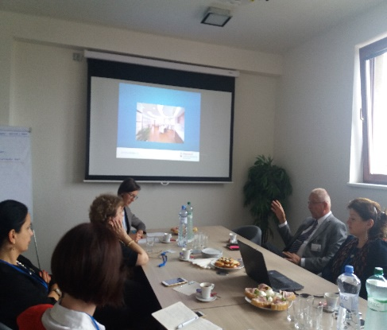
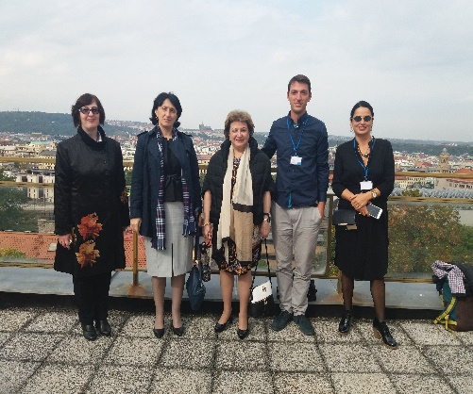


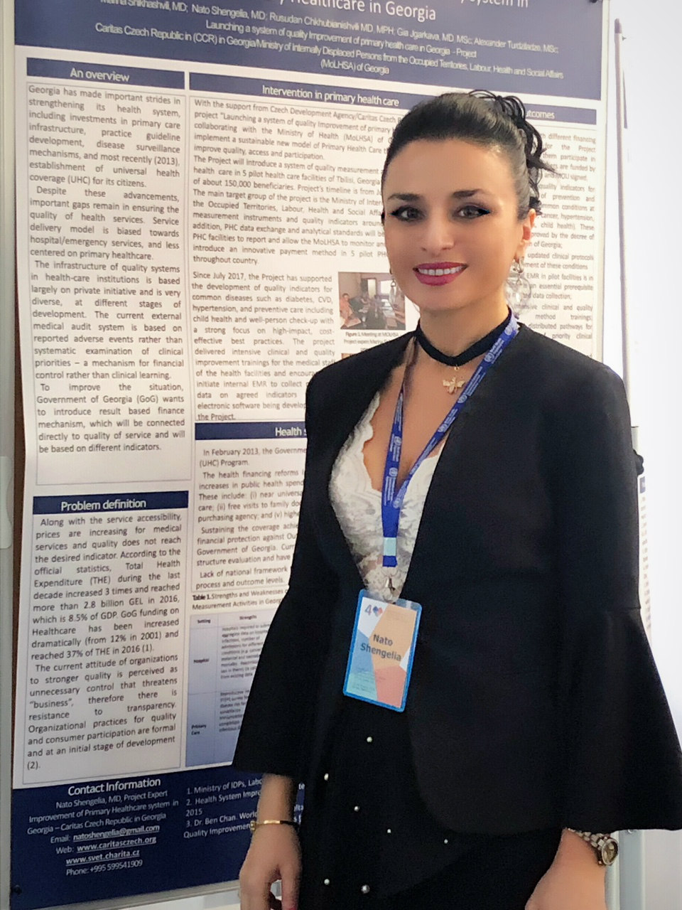
Activities at the International Level
Study trip in the Czech Republic in September 2017
Participation in the Global Conference on Primary Health Care in Astana, October 25-26
Participation in the WHO conference: “Crossroad of policy, research, education and practice in primary health care”, Almaty – Poster presentation, October 22-23

Slide 18




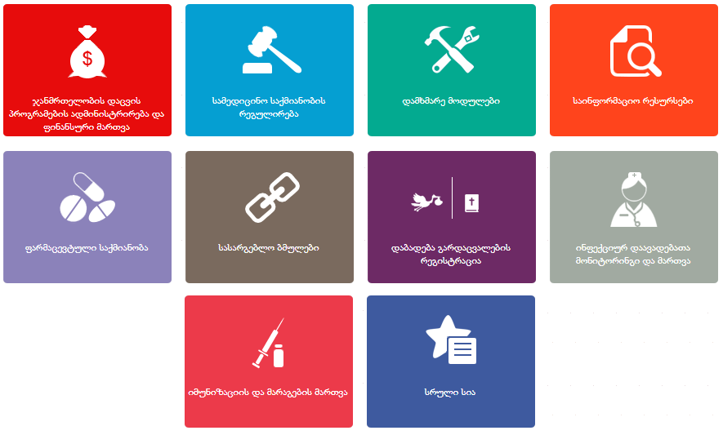



SSA
NCDC
RAMA
Tbilisi
Data Collection &
Analytical System
Adjara
Current Situation
> 30 Modules
Medical Case Registration Module
eReporting module for healthcare providers
Healthcare Programs Financial Module
Beneficiary Registration Module – Outpatient
Beneficiary Registration Module – Dialysis
Beneficiary Registration Module – Psychiatry
Maternal Care
Universal Healthcare – Outpatient
Referral Management Module
Referral Management Module – Tbilisi Mayor
Referral Management Module – Adjara
Autism Case Registration Module
Orthopedic Care – Tbilisi Mayor
Social Programs
Hepatitis C Screening
Hepatitis C Treatment
Referral Committee Management
Healthcare Providers License Management
Healthcare Personnel Licensing
Clinical Classifications Module
User Management Module
Socially Insecure Population
Immunization Management Module
TB Program Management Module
NHIV Management Module
Information Portal
ER Portal
Pharmacy Products
ePrescriptions Module
Pharmacy Products – Tbilisi Mayor Office
Pharma Organization Module
Social Service Agency Child Care Modules
Pharma Products for Chronic Diseases
Birth Registry Module
MoLHSA

Slide 19






SSA
NCDC
RAMA
Data Collection &
Analytical System
Tbilisi
Adjara
PHC Provider
HIS
< Epidemiology >
< Registries >
< Financial >
< Reporting >
< . . . >
< Clinical Process Data >
< Care Process Data >
Web Services
MoLHSA

Slide 20
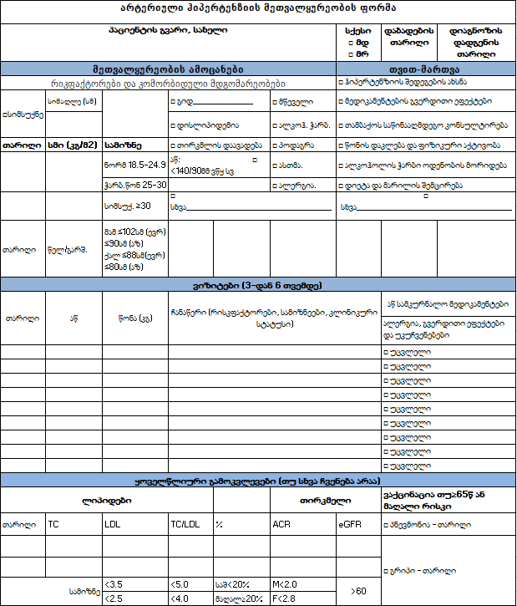
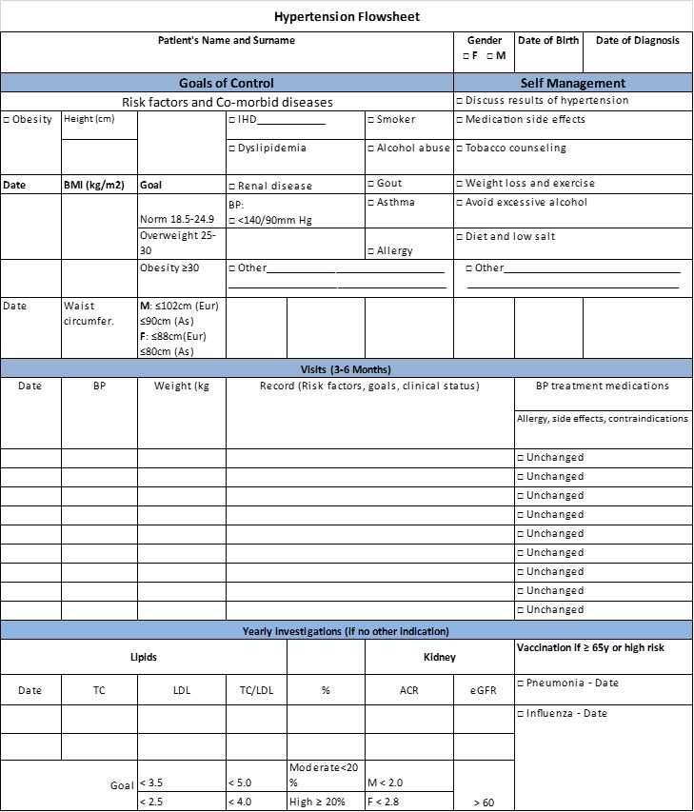


PHC Providers
PHC Professionals
PHC Data Warehouse
Process Flow
Flowsheets

Slide 21
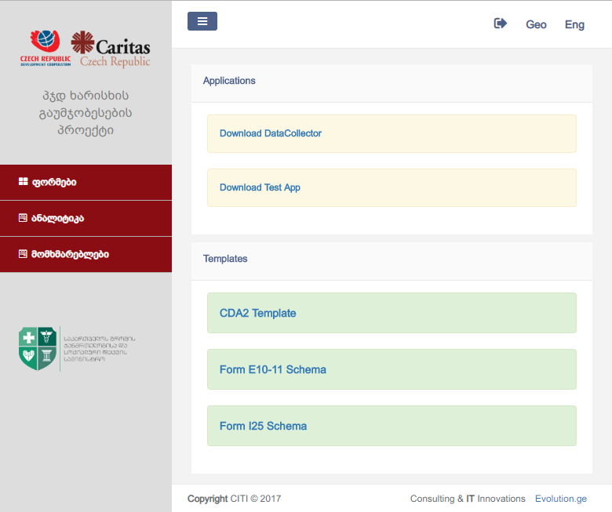


<HL7>
<HL7>
<HL7>
<HL7>
PHC Data Collector

Slide 22







<HL7>
<HL7>
<HL7>
<HL7>
Web Services
Stat.
Forms
0-5 Years
Immunization
PHC Data Warehouse

Slide 23
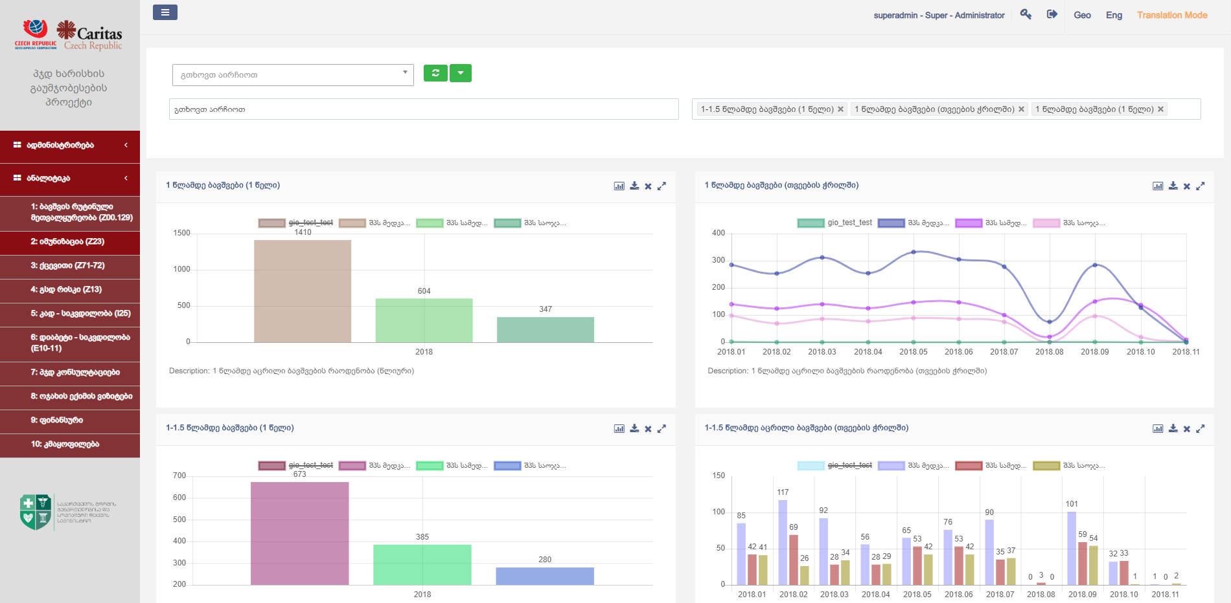
PHC Analytics

Slide 24
PHC Professionals
PHC Provider
Future Development
PHC Data Warehouse

Slide 25
HIS/EMR
  Clinical audit forms – flowsheets (web-forms)
Web-services
PHC Data Collector Module (Win App)
System Components: Provider
Local Network
Web-services

Slide 26
System Components: MoLHSA
Web-services (REST)
PHC Data Warehouse
  Web-services
PHC Database
Analytics
Service Bus
User Management
Common Data
External Modules
  Web-services
Web-services

Slide 27
Clinical Priorities have been selected
Indicators for tracking the quality of clinical processes developed
Clinical Protocols/ algorithms and clinical supervision forms designed
Data Collecting and Analyzing software developed and operational, pulling out and analyzing the clinical data (diabetes and Coronary Artery disease - CAD ) from 5 pilot PHC facilities
Close cooperation with stakeholders (UNICEF, WHO, BMJ) on corresponding indicators
Strong buy-in and support from GoG
Summary

Slide 28

SETTING UP HEALTHCARE QUALITY STANDARDS
IN GEORGIA
Launching a system of improving quality of primary health care in Georgia
Project Scaling Up

Slide 29

PHC – Foundation of Health Care System
Tertiary Care
Secondary Care
Primary Health Care
Levels of health service delivery

Slide 30
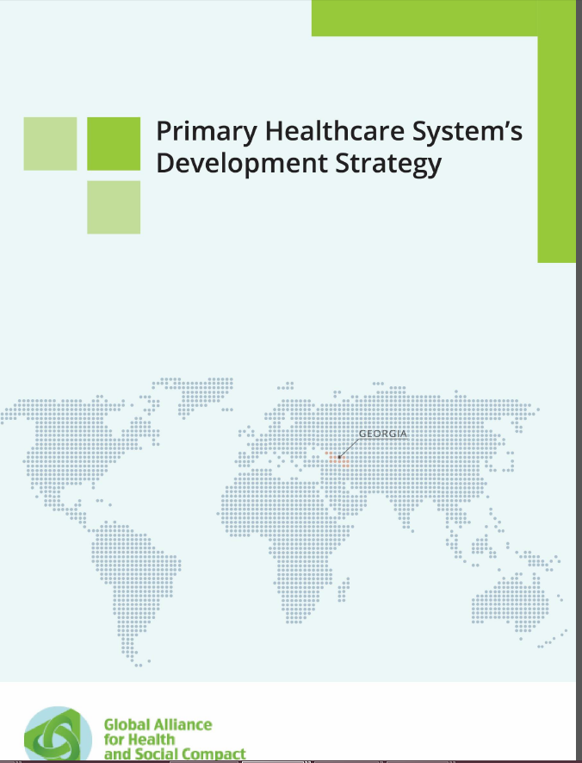
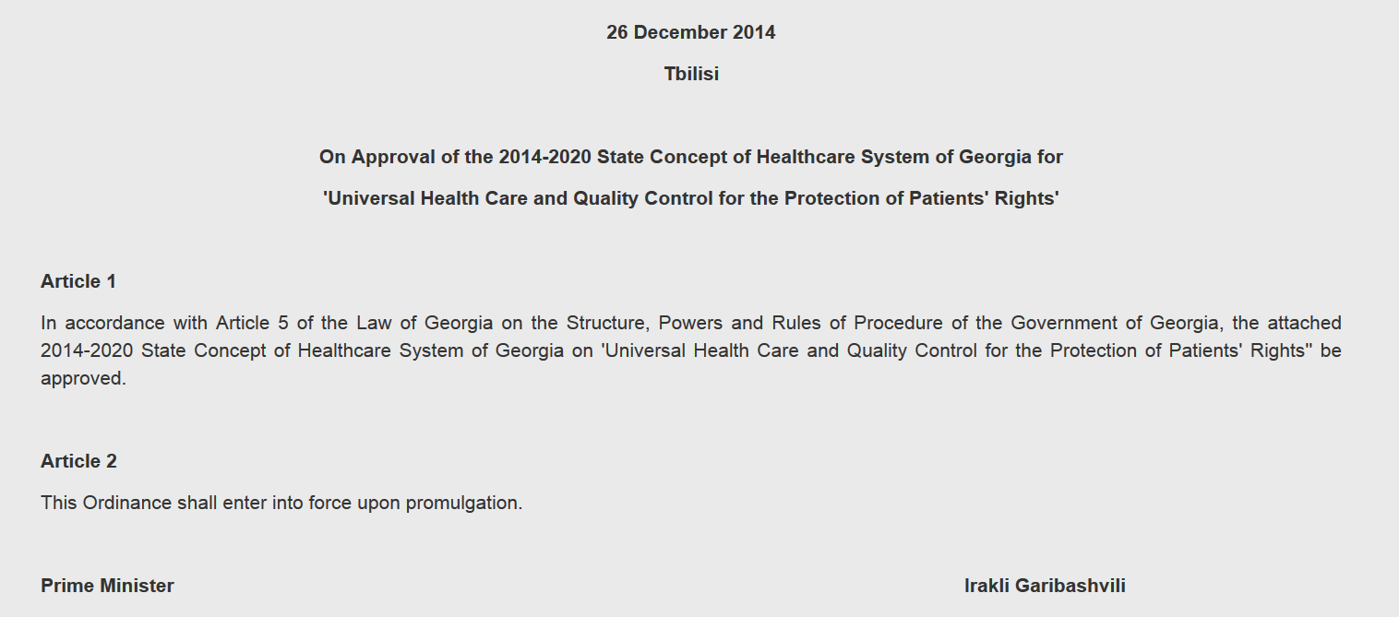
PHC – in center of international health agenda and national health care strategic documents
Georgian Health System State Concept 2014–2020
Primary Health Care Development
Strategy 2016-2023

Slide 31
Launching a system of improving quality of primary health care in Georgia
to
AIM
Create strong and sustainable model of primary health care service delivery through improving the quality and accountability of health services and creating PHC data exchange and analytical standards in Georgia.

Slide 32
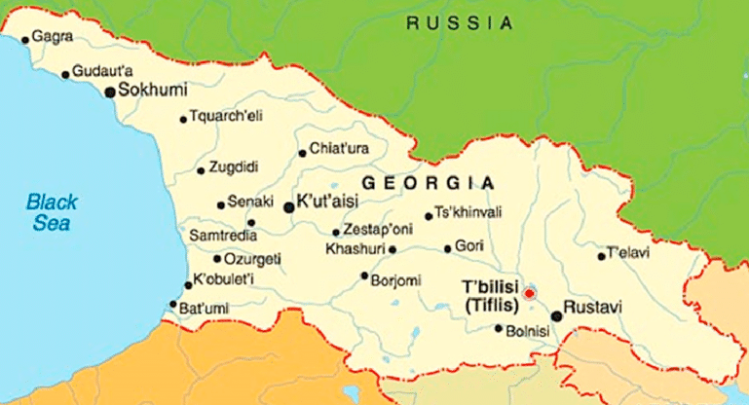
from Pilot
to Scale Up

Slide 33
Project Scaling Up
Support from MoILSHA on project scaling up
Functional HIS/EMR system at potential target PHC facilities
Challenges:
      high cost of HIS/EMR system for purchasing/maintenance
      universal computer literacy of PHC providers
      technical equipping (computer/printer etc).

Slide 34
Selection criteria for target facilities
Well-defined criteria for selection of project target facilities in regions
  Strong motivation and dedication of PHC facility in project enrollment (must)
  Strong management system on place (must)
  Retrained team of General Practitioners (must)
  Operational EMR system on place (highly preferable)/
  some extend of health information system (must)
  High load of patients (large catchment area) (preferable)
  Presence of diverse medical services including child care and immunization (preferable)

Slide 35
Project Scaling Up
Strong analytical system for PHC quality measurement and decision making
Project
MoILHSA

Slide 36
SWOT ANALYSIS
  Declared support of MoLSHA to project concept, scaling up
  Strong project team with solid expertize in field
  Groundwork for project scaling up completed:
    - PHC quality improvement tools developed/tested
    - PHC quality monitoring tools (quality indicators) developed
    - Strong PHC HIS developed with standardized data collection/data analytical modules
  Scaling up not requires additional server capacity of MolSHA IT syst
  Successful partnerships with partner organizations (WHO, UNICEf, NCDC, BMJ etc)
Strength
  Absence of institutional capacity at MoLSHA (quality management unit/department) in charge of PHC quality analysis and control
  Absence of HIS/EMR system among PHC facilities
  High cost of HIS/EMR system for purchasing/maintenance
  Precondition for EMR establishment at PHC facilities - universal computer literacy of the PHC providers, technical equipping of PHC providers (with computer/printer etc).
Weaknesses

Slide 37
SWOT ANALYSIS
  PHC well recognized foundation of the health care, often referred as "essential health care"
  Urgent need for strengthening and standardization of PHC in Georgia
  Alignment of project goals and ojectives with MoLSHA priorities
Opportunities
  Changes in MoLSHA management, which may cause changes in MoLSHA priorities and subsequent changes in commitment to the project support
  Low motivation of PHC facilities to get enrolled in project
  PHC facilities performance data, collected through the project not used for PHC performance measurement, analyses and decision making (pubic reporting, acknowledgement, P4P, Selective Contracting).
  PHC facilities do not analyze the collected data and do not use for performance improvement
Threat

Slide 38
Thank You!
მადლობა!

Slide 39


EARLY CHILD DEVELOPMENT ORIENTED PRIMARY CARE IN GEORGIA
Tbilisi, 24 January 2019
Tamar Ugulava
Notes:
ILO – International Labor Organization
United nations Human Rights Office of the High Commissioner
UNDP – United Nations Development Fund

Slide 40



Children’s right to
survival & development and
to special care and support
Expected result:
Child growth and development monitoring is institutionalized at the Primary Health Care level (in two pilot regions)
Notes:
ILO – International Labor Organization
United nations Human Rights Office of the High Commissioner
UNDP – United Nations Development Fund

Slide 41

Impact
Every child attain age specific development milestones
Outcome
Growth and development is monitored for all young children and all young children have a baseline screening on development delays at milestone age (s) with linkage to services
Risks & Assumptions
Increased number of appropriate growth monitoring and high quality developmental screenings performed in
practice
Children identified at risk for developmental, behavioral or social delays and/or with developmental disabilities are referred to early intervention
Children at risk or with developmental disabilities receive early intervention or other community based services
Parents understand
developmental
milestones/ behaviors
and ways to facilitate
healthy development
UNICEF and Pilot Region’s Government and other stakeholders’ contribution
Outputs
Enabling Environment
Supply
Quality
Demand
Consensus around early child growth and development built
Enabling legal environment for pilot project implementation developed, enforced and implementation closely monitored
Governance of service model adopted
Developmental screening tools and referral pathways enforced
Results of the pilot inform national policy/strategy development and application at national level
Health workers capacity built in quality growth monitoring, developmental screening and parent counselling at all levels
Developmental surveillance system designed and operational, including MIS system to record child growth and development progress
Health workers equipped with respective IT equipment
Growth monitoring, developmental screening and assessment practices integrated in the undergraduate and postgraduate medical education system
Standardized developmental screening tools developed and complied with by health workers
Referral pathways within and outside health sector developed, operational and practice compliance ensured
Children with development delays are timely referred to Early Intervention services
Data recorded in ECD surveillance MIS system meets quality criteria
Baseline and end line results documented and inform national scale -up
Parent counselling and behaviour change communication integrated into the practice
Parent engagement in service delivery institutionalized

Slide 42
PHASE 1:
PREPARATION
PHASE 2:
IMPLEMENTATION
PHASE 3:
EVALUATION, DOCUMENTATION AND SCALE UP PLANNING

Slide 43
PHASE 1: PREPARATION FOR THE PILOT
Developmental surveillance MIS system design
Cascading training
Finalization of the Service delivery model design
Developing training package
1
3
5
7
9
2
4
6
8
Formation of the project oversight structure
Selection of pilot site(s) and facilities
Selecting the Developmental Screening tool
ToT
Consensus building workshop with participation key stakeholders
June, 2017
April, 2019

Slide 44





COMMUNITY LEVEL
DISTRICT LEVEL
REGIONAL LEVEL
Parent completes
screening tool in
waiting room or at home
Screens Negative
Screens Positive
PHC clinical staff scores, reviews screening tool answers
Rayon paediatrician, 2nd level developmental screening
Concerns
Immediate action required
Physician discusses results and concerns with parents
Provides anticipatory guidance
Refers for further assessment
No Concerns
Disability Assessment Unit, Regional level referral point for positive screens
Physician discusses results and concerns
with parents.
Concerns
No Concerns
No Concerns
Concerns
Further Concerns
Physician discusses results with parents
Provides anticipatory guidance
No immediate action required
Rescreen at next well-child visit
Provides anticipatory guidance
Monitor development
Rescreen at next well-child visit
Referral to appropriate early intervention services if child is not yet 3 years old or
Special education program if the child is 3 years or older
Social services
Other services

Slide 45






BIRTH REGISTRY
GROWTH MONITORING AND DEVELOPMENTAL SURVEILLANCE
E-MODULE
REGISTRY SERVING THE STATE SUBSIDIZED PROGRAMS FOR SOCIAL REHABILITATION AND CHILD PROTECTION

Slide 46
0-6 Child Growth and Development Surveillance Electronic Module is part of Georgia’s unified e-health system
Web based e-health system ensures:
Real-time data collection
Possibility of tracking patients
Data exchange internally - among its components (more than 30 components/modules)
High external integration capabilities with: The State Service Development Agency, the National Agency for Property Registration, the Customs Department of the Revenue Service, the State Treasury etc.
All this became possible because of personal identification number given to every citizen of Georgia immediately after the birth.

Slide 47
14 components of Georgia’s e-health system supported by UNICEF
Birth registry
Immunization module
0-6 CHILD GROWTH AND DEVELOPMENT MONITORING
State subsidized programs for social rehabilitation and child protection:
  Rehabilitation and habilitation program
  Early Childhood Development program
  Maternal and child housing program
  Child adoption program
  Reintegration program
  Custodian care program
  Emergency program for families with children in crises
  Social housing program
  Housing program for homeless children
  Home care program of children with severe and profound mental disorders
  Specialized family type service program for children with severe and profound mental disorders.

Slide 48
The surveillance module is thought to fulfill the following objectives
Linking PHC services for mothers and infants with perinatal services to ensure continuity of care
Detecting developmental delays as early as possible and initiating the referral
Detecting environmental risks to child development and initiating the referral
Establishing sustainable communication platforms

Slide 49








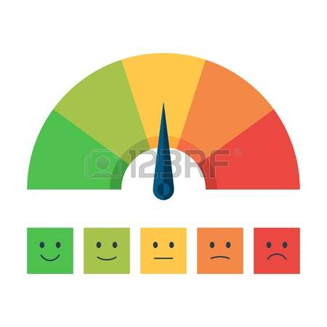



Child Registered at the facility
Patient data transferred automatically from Birth Registry
Patient pre-screening electronic form filled in by nurse or parent
Physician developmental screening e- form
filled in by physician
Parent information and counselling messages
Patient referred to Early Intervention Services
Next appointment planned
Early Intervention Services provided & Results transferred to DSEM
Reminder sent

Slide 50
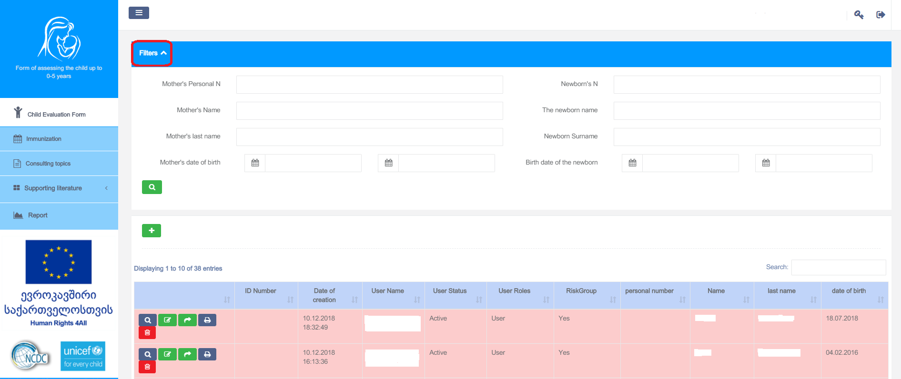
0-6 CHILD GROWTH AND DEVELOPMENT MONITORING

Slide 51
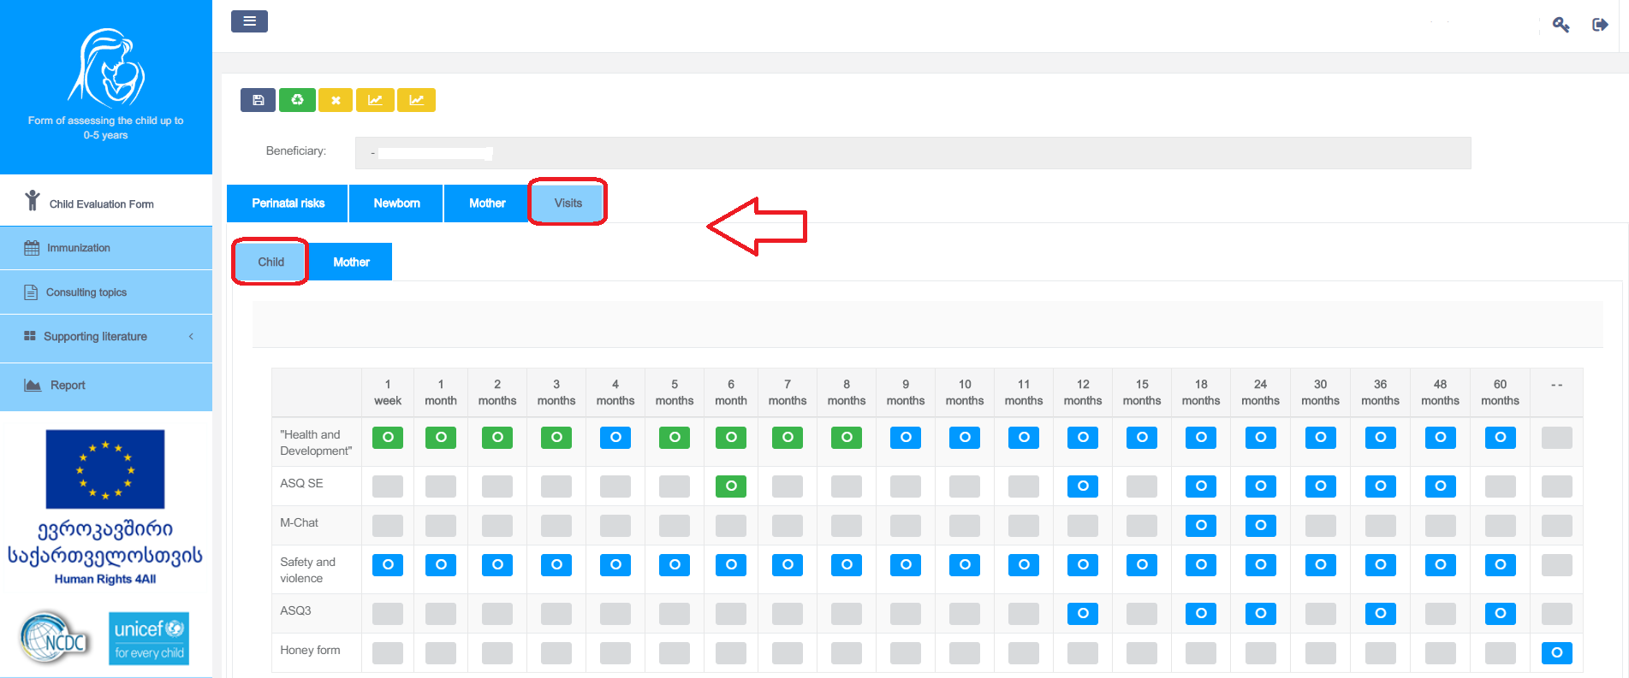

Slide 52
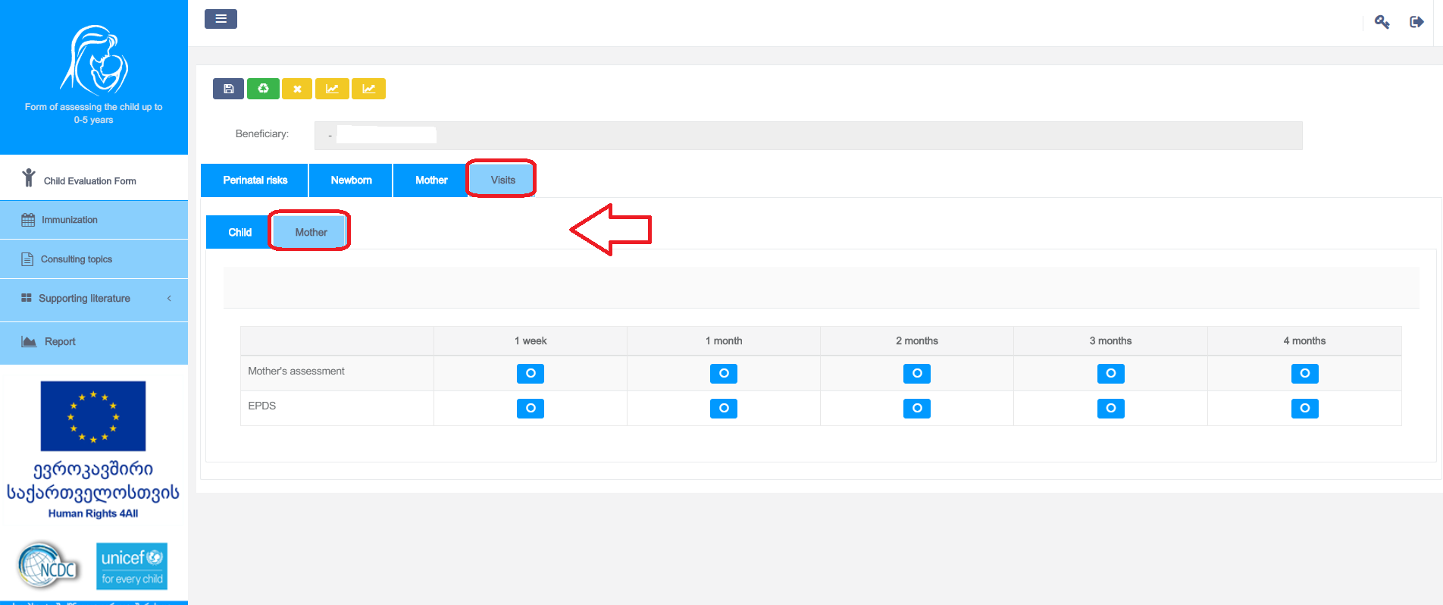

Slide 53




CORE FACE TO FACE TRAINING
RESOURCE MATERIALS
SUPPORTIVE SUPERVISION
ADDITIONAL TRAINING NEEDS
PRACTICE OBSERVATION AND DATA QUALITY AUDIT
REFRESHER TRAININGS
TELECONFERENCING
INDIVIDUAL CAOCHING
GROUP DISCUSSION

Slide 55
PHASE 2: IMPLEMENTATION

Slide 56
Do you see the need for reforming quality system of primary health care services?
How do you see the project sustainability and scale-up?
Are there any changes you would suggest to the project?
Discussion Points

